Slide 1
Smart Devices
Prepared by-
Aryaman
Sharma Ajit
Ambrish Tiwari

Slide 2
Abstract
Automation of the surrounding environment of a modern human being allows increasing his work efficiency and comfort. There has been a significant development in the area of an individual’s routine tasks and those can be automated.
In the present times, we can find most of the people clinging to their mobile phones and smart devices throughout the day. Hence with the help of his companion a mobile phone, some daily household tasks can be accomplished by personifying the use of the mobile phone.
Analyzing the current smart phone market, novice mobile users are opting for Android based phones.

Slide 3
The Automation System has been designed for mobile phones having Android platform to automate an WiFi which controls a number of home appliances like lights, fans, bulbs and many more using on/off relay.
Smart Devices presents the automated approach of controlling the devices in a household that could ease the tasks of using the traditional method of the switch. The most famous and efficient technology for short range wireless communication- WiFi is used here to automate the system.
The Automation System for Android users is a step towards the ease of the tasks by controlling one to many different appliances in any environment.

Slide 4
Objectives:
The central idea of our project is to make our home appliances or devices work smartly i.e. the device can operate on human commands. An individual
can control the devices wirelessely by just using the smartphone.
We are doing this project for connecting every individual with the fast growing technical world. This project is efficient in cost and in operation so that everyone can afford it. This will bring the better leading for future.

Slide 5
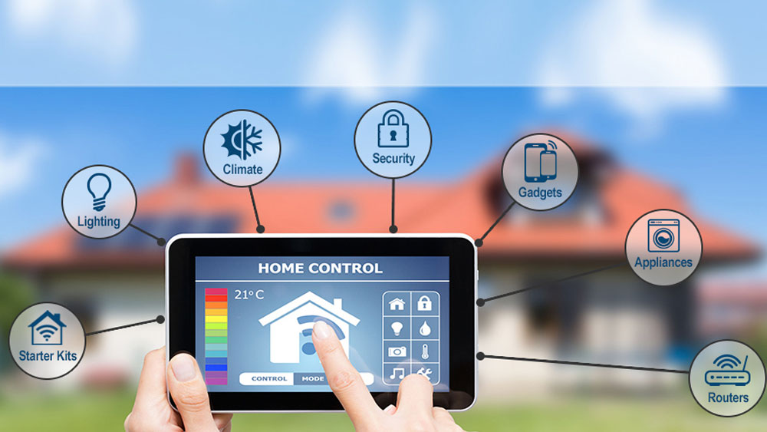
Smart Devices
Automation of house,house work,household activities.
Simplicity
Affordability

Slide 6
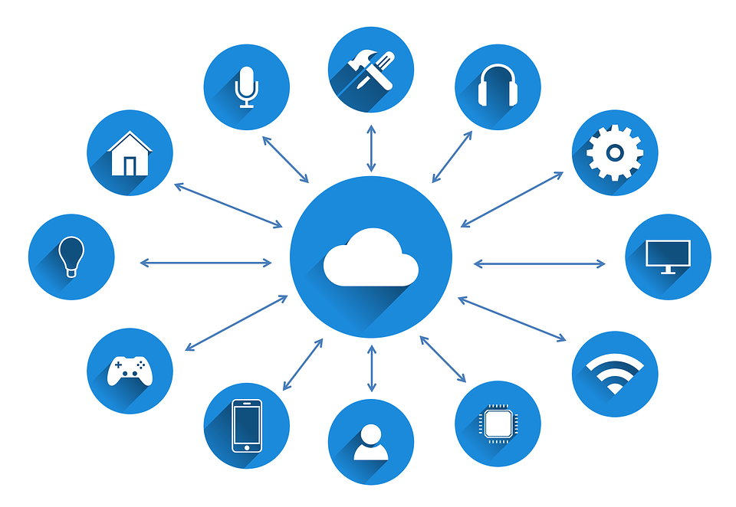
Internet of Things :-
A scenario in which objects,animals or people are provided with unique identifiers and the ability to transfer the data over a network to without requiring human-to-human or human-to-computer interaction.

Slide 7
Components :-
NodeMCU ESP8266
4 Channel Relay Module
Resistor
Transistor
Led Lights

Slide 8
System Functions
To control lighting,heating,ventilation,air conditioning,appliances,communication systems,entertainment and home security devices.
To improve Convenience,Comfort,Energy efficiency and Security

Slide 9
Features
Wireless Connectivity
Expansion Capability
Protocol Compatibility
Application control
Device Management
Savings
Convenience

Slide 10
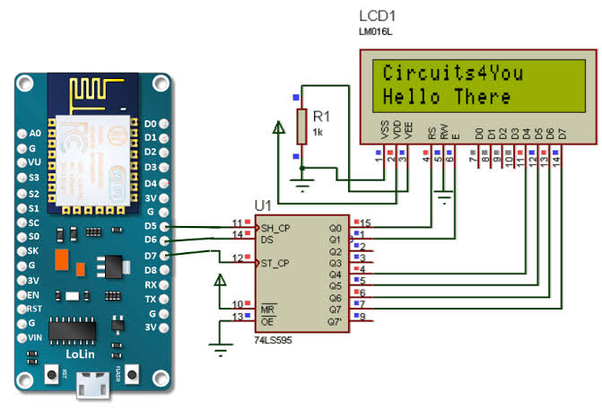
Operation procedure :-
The domain of our project is ‘IoT’. We are going to prepare a prototype of our project by showing the smart work of four devices( for eg a switch board, a led, a bulb, a fan).
Here is the circuit diagram of Nodemcu ESP8266 which is our main component of whole system.

Slide 11
Using these setups we are making all the connections to make our device work.
The operation includes the commands to ‘Google Assistant’ for eg- if we assist our assistant that turn on led then the led will be on or if we assist turn off led then it will be off.
Advantages :-
Economical
Easy to operate and install
Time-complexity
Public safety
Energy conservation

Slide 12
Quality Assurance
“part of quality management focussed on providing confidence that
quality requirements will be fulfilled”
We are using The following Quality Approaches :
Failure Testing
Statistical Control
Total Quality Management

Slide 13
Conclusion :-
Our project is leading towards the new era of technology use and the better leading towards future. The implementation can be further done in our project to make it more advance but as per the current situation of technology using by people is not that much in India so by our project we can increase that using percentage and will give the chance to every individual to taste the modern technology .

Slide 14
Thank You

