Slide 1
SAFETY TIPS IN COMPUTER USE

Slide 2

PRESENTATION OUTLINE
Introduction
Human Engineering/Ergonomics
- Definition
- Objective
- Primary Areas of Ergonomics
Office of Horrors
Correct/Incorrect Position
Exercises
Ideal Office

Slide 3
INTRODUCTION
Importance of Computer
Injuries of Its Use
- Eye Strain
- Stiff Back
- Numbness in Hands and Feet
- Fatigue

Slide 4
HUMAN ENGINEERING/ERGONOMICS
Definition:
It is the study of how people physically interact with their work – fitting the job,
the equipment, and the work environment to the worker.
Objective:
To Work in great safety and comfort with increased productivity.
Primary Areas of Ergonomics :
- Monitor Location
- Keyboard Location
- Seating

Slide 5
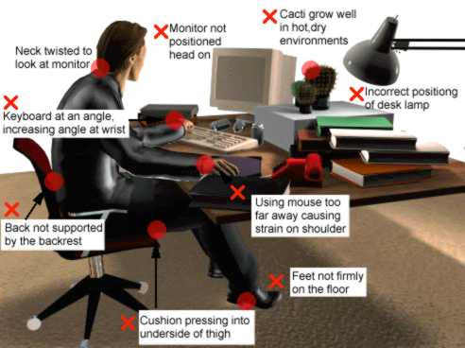
OFFICE OF HORRORS

Slide 6
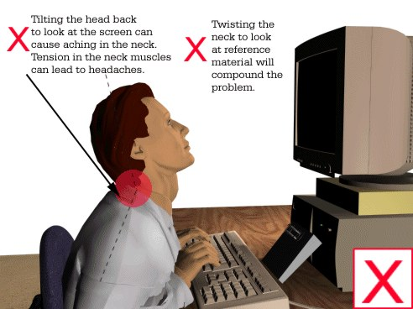
Head and Neck
If the position of head (
forward,
backward
or neutral)

Slide 7
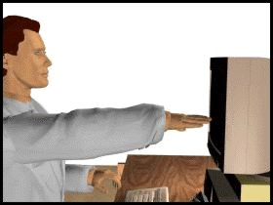
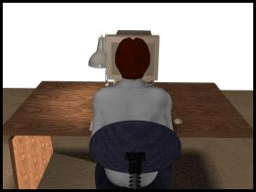
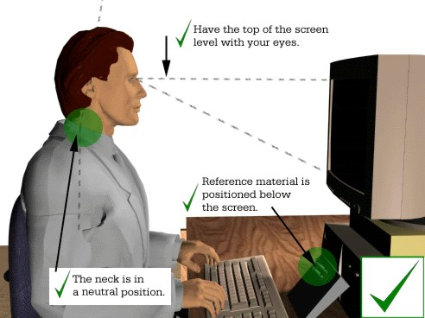
Check the distance of the monitor (22-26”).
Check the side-to-side position of the monitor.

Slide 8
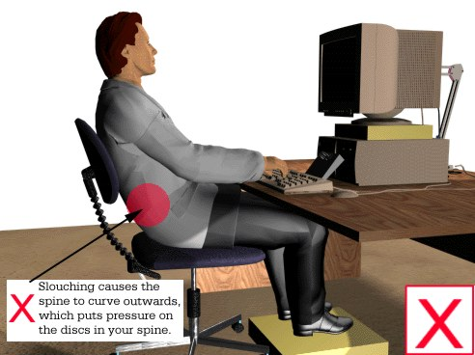
Lower Back
When you sit down the inward curve in your lower back flattens, this places pressure in the spine.

Slide 9
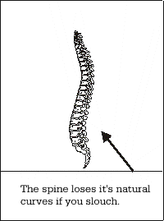
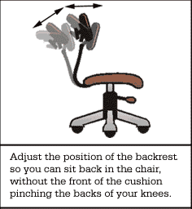
Make an effort to sit correctly.
Adjust the backrest on your chair to give support to
the lower spine.
Make sure that the seat cushion is not too long.
Experiment with your chair to find out what all the
adjustments do.
Make small adjustments to your posture.

Slide 10
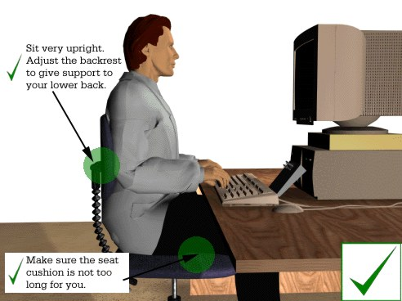
Get a footrest if you need one .
If you need more support in the small of your back, try using a lumbar support.

Slide 11
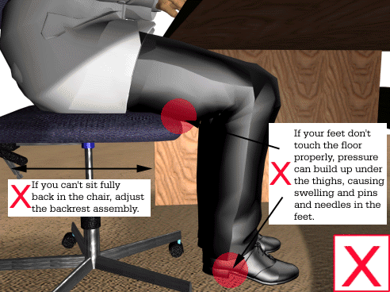
Legs and Knees
Pressure can build up under thighs and behind knees if your chair in not adjusted properly.

Slide 12
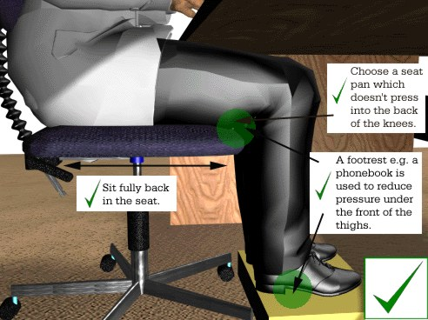
Set your seat height.
If you can feel pressure at the front of the seat cushion, you need a footrest.
If you cannot sit fully back in the seat, you need to adjust the backrest assembly.

Slide 13
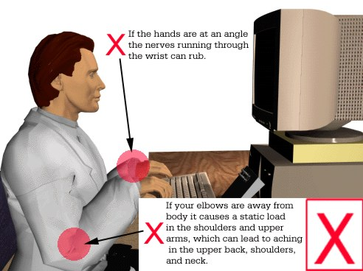
Keyboard
If you hold your elbows away from your body, muscles in your neck, shoulder and upper
arms are under a constant static load.

Slide 14


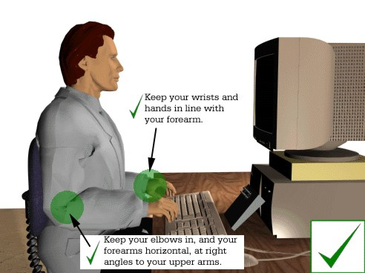
Adjust your chair height.
Position the keyboard so that you can use it with
your hands in line with your forearms.

Slide 15
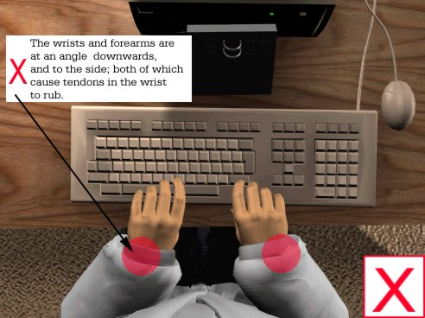
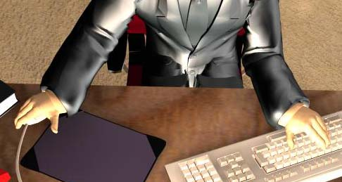
Hands and Wrists
Placing your keyboard at an angle to the edge
of the desk encourages a bad posture.
The tendons and nerves that control the fingers run through the wrists.

Slide 16
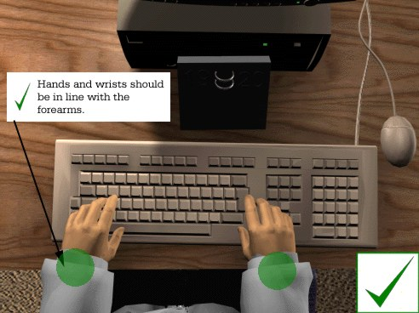
Check your seat height.
Make sure that your hands are in line with your forearms.
Use a light keying action.
Have a space in front of your keyboard.

Slide 17
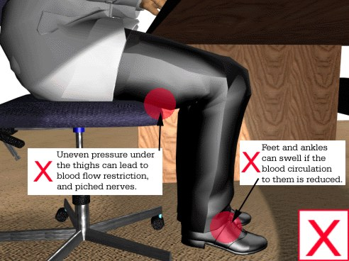
Feet and Ankles
If your seat is too high or too low you, will experience uneven pressure under the thighs
and this can restrict blood flow and pinch nerves.

Slide 18
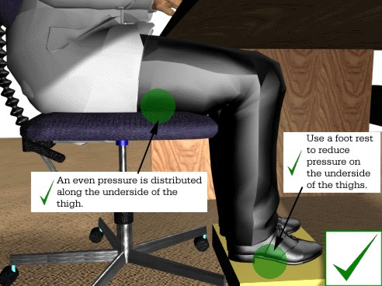
If you can feel pressure under the front of the thighs, get a footrest.

Slide 19
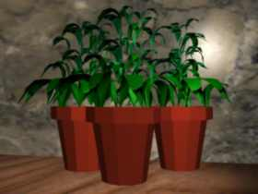
Temperature and Humidity
Discomfort can occur if the indoor climate is too warm, too cool or draughty.
Electrical equipment dries the air.
The quickest way is to open a window.
Adjust room temperature (20 to 24 ºC) and
air humidity (40 to 60 %).
Introduce water-pot plants to your work area.

Slide 20
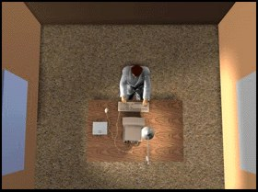
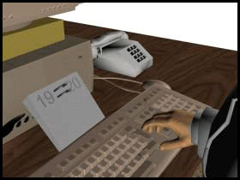
Additional Setup Steps:
Eliminate any reflection on your monitor.
Position any additional equipment in accessible
places.

Slide 21

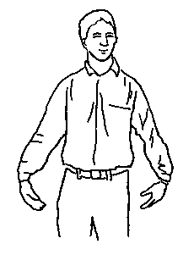

EXERCISES FOR THE OFFICE
One of the biggest injury risk factors is static posture.
Try to spend at least 5 minutes every hour away from your computer.
Remember to ONLY stretch to the point of mild tension.
Try to incorporate the stretches into your daily routine.
This slide provides some illustrations of simple active stretches to perform at the office.
Hand Exercises
Tightly clench your hand into a fist and release, fanning out the fingers. Repeat 3 times
0

Slide 22
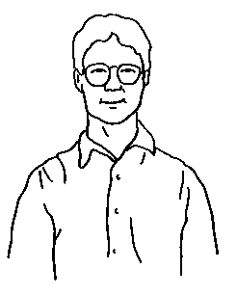
EXERCISES - CONTINUE
Back and Shoulder Exercises
Stand up straight, place your right hand on your left shoulder and move your head back
gently. Do the same thing for the right shoulder

Slide 23
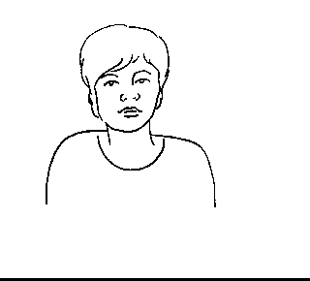
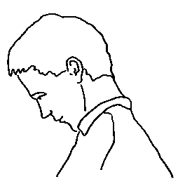
EXERCISES - CONTINUE
Head and Neck Exercises

Slide 24
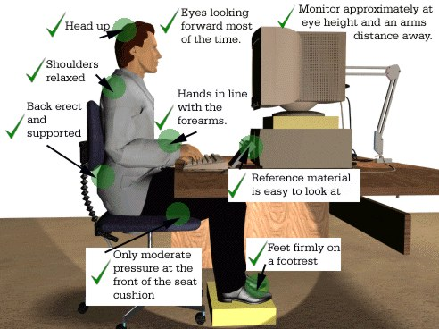
IDEAL OFFICE

Slide 25
Remember !
Remember…
following these ergonomic guidelines can help you
prevent common injuries associated with the use of computers.
Remember…
in most cases, corrective measures are relatively
simple and inexpensive.
Remember…
through the application of getting the ideal office, you
can work in greater safety and comfort with increased productivity.

Slide 26
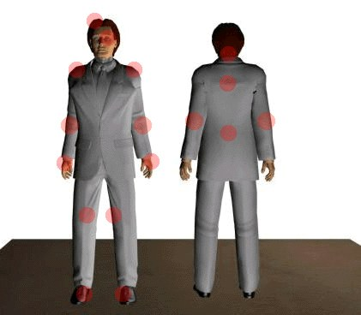
Symptoms

Slide 27
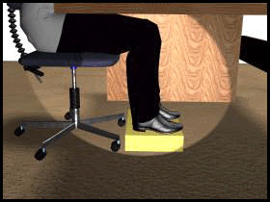
Footrest

