Slide 1
I-TCP, SNOOPING TCP, Mobile TCP,
Susheel Kumar Gupta

Slide 2
About TCP
With the advent of WLANs, a lot of research went into increasing the performance of TCP in wireless and mobile environments, some of its outcome are I-TCP and SNOOP-TCP, Mobile-TCP etc. Let us study I-TCP and Snoop-TCP:

Slide 3
About TCP
Describe the two competing insights that led to development of indirect TCP
The two competing insights are
1) TCP performs poorly together with wireless links
2) TCP within the fixed network cannot be changed

Slide 4
I-TCP
Working:
Indirect TCP or I-TCP segments the connection (figure 1)
no changes to the TCP protocol for hosts connected to the wired Internet, millions of computers use (variants of) this protocol
optimized TCP protocol for mobile hosts
splitting of the TCP connection at, e.g., the foreign agent into 2 TCP connections, no real end-to-end connection any longer
hosts in the fixed part of the net do not notice the characteristics of the wireless part

Slide 5
I-TCP
Packet delivery ( CN to MN)
If CN sends packet, FA acknowledges packet and forwards packet to MN
If MN receives packet,it acknowledges
This acknowledgement only used by CN
Similarly if MN sends packet, FA acknowledges packet and forwards it to CN

Slide 6
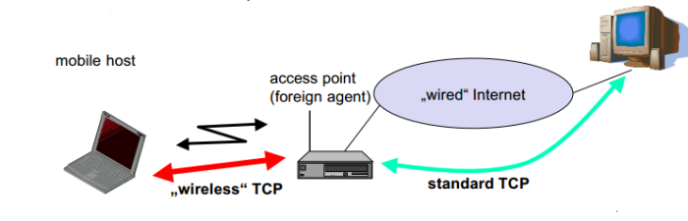

Slide 7
I-TCP
I-TCP requires several actions as soon a handover takes place:
The packets have to be redirected using mobile IP
The access point acts as a proxy bufferering packets for retransmission
After handover, the old proxy forwards data to new proxy
The sockets(current state of TCP) of old proxy also migrate to new foreign agent

Slide 8
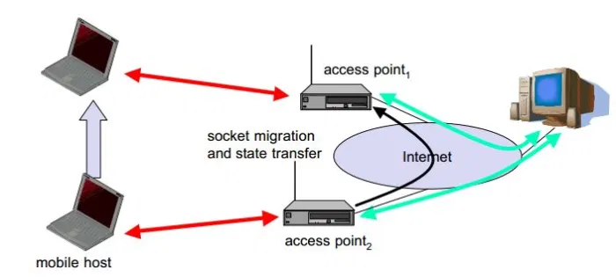

Slide 9
I-TCP Acknowledgements
Here the correspondent node (i.e. Sender) does not notice the wireless link or segmentation of the connection.
The foreign Agent (FA) becomes or acts as a proxy and relays data in both directions.
When the CN sends data, FA sends back a acknowledgement to it.
When the mobile host receives a packet from FA, the mobile host also sends back an acknowledgement
This acknowledgement is a local acknowledgement. It will not be forwarded to the CN.
If a packet is lost in wireless transmission (i.e. no acknowledgement received) then FA will try re-transmitting it again.

Slide 10
I-TCP Advantages
I-TCP does not require any changes in TCP protocol as used by the different hosts in network.
Because of a strict partition between the two connections, transmission error on the wireless link will not propagate to the wired link. Therefore, flow will always be in a sequence.
The delay between the FA and Mobile host is small and if optimized properly, precise time-outs can be used to carry out retransmission of lost packets.
Different solutions can be implemented ad tested between the FA and mobile host without jeopardizing the stability of the internet.
With two partitions, we can use a different transport layer protocol in the second half with the FA acting as a translator.

Slide 11
I-TCP Disdvantages
The end-to-end connection for which TCP has been designed will fail if the Foreign Agent (FA) crashes.
The foreign agent (FA) must be a trusted entity as the TCP connections end at this point.
In practical terms increased handover may latency may be much more problematic. (During handover from old FA to new FA, some delay will occur. During this period, some extra data will come at old FA. This data also needs to be send!!)

Slide 12
Snooping TCP
One of the main feature of I-TCP also goes on to become its major disadvantage i.e. segmentation of TCP.
To overcome it but also to provide enhanced feature a new TCP was designed which worked completely transparent and also left the TCP end-to-end connection intact.
The new idea for making an enhancement is to buffer the data close to the mobile host to perform fast local retransmission in case of packet loss. A good place to carry out this enhancement is at the foreign agent (FA).

Slide 13
Snooping TCP
“Transparent” extension of TCP within the foreign agent
• buffering of packets sent to the mobile host
• lost packets on the wireless link (both directions!) will be retransmitted immediately by the mobile host or foreign agent, respectively (so called “local” retransmission)
• the foreign agent therefore “snoops” the packet flow and recognizes acknowledgements in both directions, it also filters ACKs
• changes of TCP only within the foreign agent

Slide 14
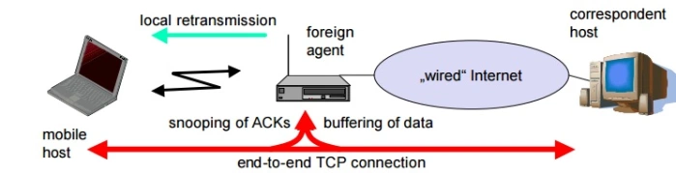

Slide 15
Snooping TCP
Method –( How)
Here, the foreign agent instead of terminating all packet with destination mobile host, it buffers (i.e. temporarily stores all these packets). In addition to this, it also ‘snoops’ each packet flowing in both the directions for reading acknowledgements.
Buffering towards the mobile host is carried out so that a retransmission can be done in case of missing acknowledgements.
The FA buffers every packet until an acknowledgement is received from the mobile host.
If the foreign agent does not receive an acknowledgement within the stipulated time, the packet or the acknowledgement has been lost.
In such a situation, the FA can directly retransmit the packet without waiting for the correspondent host.

Slide 16
Snooping TCP
Transparency:
To maintain transparency i.e. the communication happens only between the correspondent node (CN) and the mobile host, the FA doesn’t send acknowledgement to the correspondent host as in I-TCP.
The acknowledgement is send by the Mobile host itself. The FA keeps on monitoring it.
When the data flows for mobile host to CN, the FA snoops and checks the sequence of acknowledgement number. If a gap is found, FA sends signal to re-transmit.

Slide 17
Snooping TCP
Data transfer to the mobile host
FA buffers data until it receives ACK of the MH, FA detects packet loss via duplicated ACKs or time-out
fast retransmission possible, transparent for the fixed network

Slide 18
Snooping TCP
Data transfer from the mobile host
FA detects packet loss on the wireless link via sequence numbers, FA answers directly with a NACK to the MH
MH can now retransmit data with only a very short delay

Slide 19
Snooping TCP
Integration with MAC layer
MAC layer often has similar mechanisms to those of TCP
thus, the MAC layer can already detect duplicated packets due to retransmissions and discard them

Slide 20
Snooping TCP
Problems
snooping TCP does not isolate the wireless link as good as I-TCP
snooping might be tough if packets are encrypted

Slide 21
Advantages of Snoop-TCP:
The original TCP sematic i.e. end-to-end connection is preserved.
The correspondent node need not be changed as all the new enhancements are made in the FA.
During handover form on cell to another, there is no need to transfer the previous incoming data (as in I-TCP).
In handover, the next foreign Agent (FA) need not use the same enhancements used here i.e. follow Snoop-TCP method.

Slide 22
Dis-Advantages of Snoop-TCP:
If any encryption is applied at both ends, the snooping and buffering process would be a waste of time as no data can be read by FA.
Does not fully isolate wireless link error from the fixed network (e.g. problems like congestion and interference may cause a delay in retransmission).
The Mobile host needs to be modified to handle the NACK signals (No Acknowledgement) for reverse traffic (i.e. from MH to Sender)

Slide 23
Mobile TCP
Tries to avoid the sender window from shrinking or reverting to slow start
TCP is divided into
Wired TCP ( Traditional TCP) – Between Fixed Host & Supervisory Host
Wireless TCP ( Mobile TCP)- Between Supervisory Host & Mobile Host
[1] Many MH are connected to SH through several Base Station(BS)
[2] SH Supervises all packets transmitted to (MH) and ACK sent by MH

Slide 24
IMPORTANT POINTS ABOUT SH
No Caching of data at SH
No Retransmission at SH
No Snooping at SH
No Buffering at SH

Slide 25
Wired TCP – Uses normal unmodified traditional TCP
Wireless TCP –Uses Modified TCP ( M-TCP)
-→ It delivers packet to MH
Point-1 If ACK is not received by FH,SH decides that MH is disconnected ( Meaning it prevents retransmission) and send FH window size to ZERO(0)
Point-2 When SH notices that MH is connected it sets full window size of the sender FH.

Slide 26
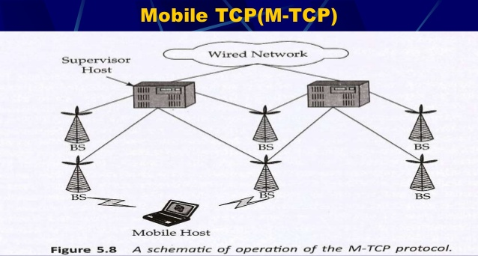

Slide 27
Mobile TCP(M-TCP)
The M-TCP (mobile TCP)1 approach has the same goals as I-TCP and snooping TCP: to prevent the sender window from shrinking if bit errors or disconnection but not congestion cause current problems. M-TCP wants to improve overall throughput, to lower the delay, to maintain end-to-end semantics of TCP, and to provide a more efficient handover. Additionally, M-TCP is especially adapted to the problems arising from lengthy or frequent disconnections (Brown, 1997). M-TCP splits the TCP connection into two parts as I-TCP does. An unmodified TCP is used on the standard host-supervisory host (SH) connection, while an optimized TCP is used on the SH-MH connection. The supervisory host is responsible for exchanging data between both parts similar to the proxy in ITCP (see Figure ).

Slide 28
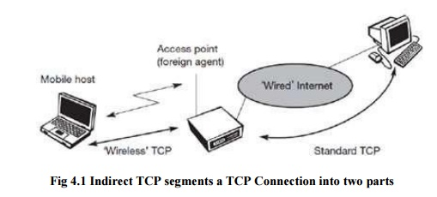

Slide 29
Mobile TCP(M-TCP)
The M-TCP approach assumes a relatively low bit error rate on the wireless link. Therefore, it does not perform caching/retransmission of data via the SH.
If a packet is lost on the wireless link, it has to be retransmitted by the original sender. This maintains the TCP end-to-end semantics. The SH monitors all packets sent to the MH and ACKs returned from the MH. If the SH does not receive an ACK for some time, it assumes that the MH is disconnected.

Slide 30
Mobile TCP(M-TCP)
It then chokes the sender by setting the sender‟s window size to 0. Setting the window size to 0 forces the sender to go into persistent mode, i.e., the state of the sender will not change no matter how long the receiver is disconnected. This means that the sender will not try to retransmit data. As soon as the SH (either the old SH or a new SH) detects connectivity again, it reopens the window of the sender to the old value.
The sender can continue sending at full speed. This mechanism does not require changes to the sender‟s TCP. The wireless side uses an adapted TCP that can recover from packet loss much faster. This modified TCP does not use slow start, thus, M-TCP needs a bandwidth manager to implement fair sharing over the wireless link.

Slide 31
Advantages of M-TCP
The advantages of M-TCP are the following:
It maintains the TCP end-to-end semantics. The SH does not send any ACK itself but forwards the ACKs from the MH.
0 If the MH is disconnected, it avoids useless retransmissions, slow starts or breaking connections by simply shrinking the sender‘s window to 0.Since it does not buffer data in the SH as I-TCP does, it is not necessary to forward buffers to a new SH. Lost packets will be automatically retransmitted to the new SH.

Slide 32
Dis-advantages of M-TCP
The lack of buffers and changing TCP on the wireless part also has some disadvantages:
2 A modified TCP on the wireless link not only requires modifications to the MH protocol software but also new network elements like the bandwidth manager.
1 As the SH does not act as proxy as in I-TCP, packet loss on the wireless link due to bit errors is propagated to the sender.
M-TCP assumes low bit error rates, which is not always a valid
assumption.

Slide 33
