Slide 1
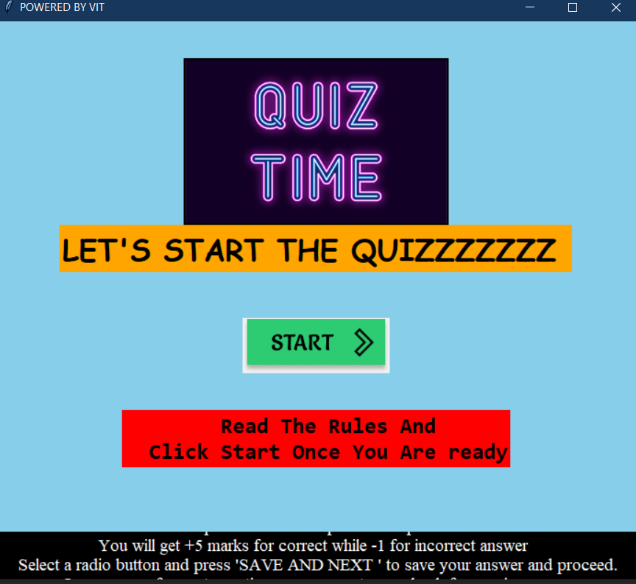
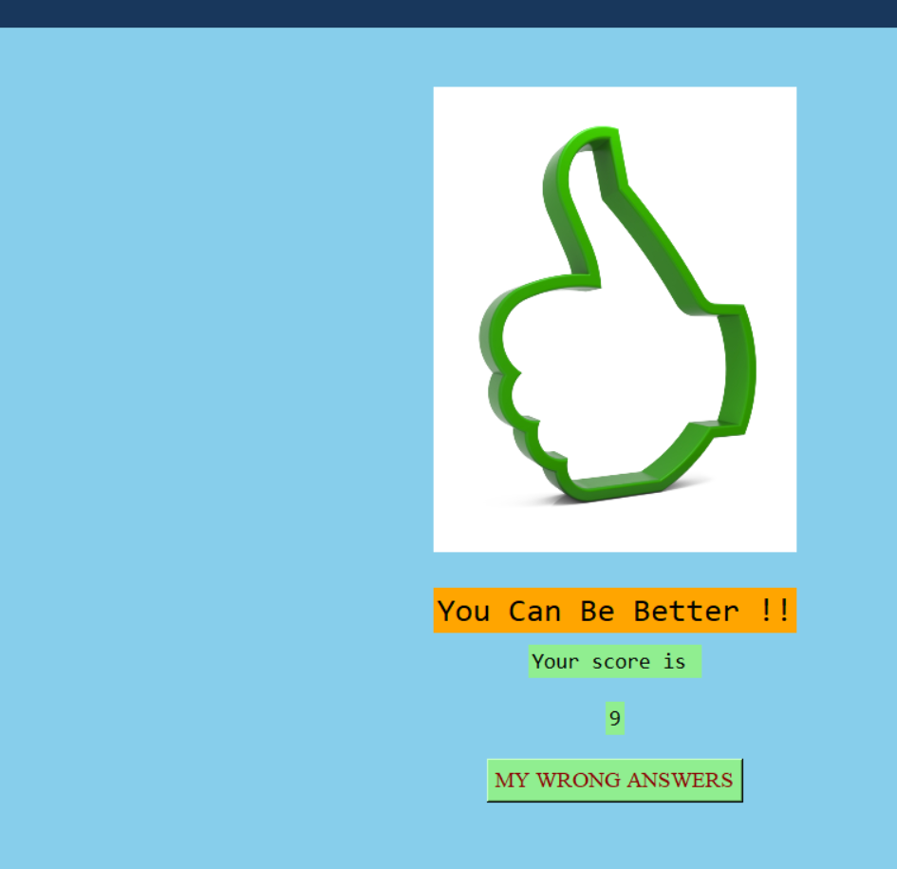
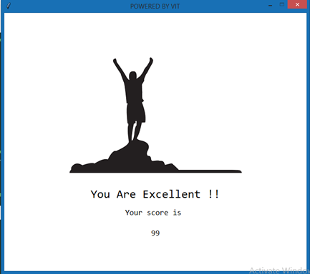

Prof. shaiwali ballal
Ayush kagane
Div:-B roll no:-38

Slide 2
OUTLINE
Introduction
problem statement
Objective of project
Implementation
Module Description
Conclusion and Future Scope
References

Slide 3
Introduction
Intend to create a funny and loving way of learning
App will be consists of multiple domains
Based on users selection MCQ test will be carried out on selected Domain.
To make it feel like exam limited time will be given as well negative marking is applied.

Slide 4
problem statement
How to create an interesting way of learning ?

Slide 5
objectives of Project
Objectives:-
To create an interesting way of learning
To attract people towards general knowledge
Making question papers available for each and every student for free
To give students exam experience

Slide 6
Implementation
Category of the project
Desktop application
Tools / Platform
tkinter , PILLOW (PIL) and python , pycharm
Front end-Backend Software Requirement
1 . Built in methods by “tkinter ” module
2 . Backened logic by python lists , functions , conditional statements, etc.

Slide 7
Module description
Modules
1. tkinter module :-
Used to create GUI i.e.. Graphical User interface and coding part also.
2 . Sample Module :-
Used to create list of questions , options and correct answers for each domain.
3 . Random Module :-
used to create a list of random numbers corresponding to question No.

Slide 8
Conclusion and Future Scope
Conclusion
Asking for users choice of Domain for test
Selection of domain followed by MCQ test with time bounding and negative marking
Showing users score and suggestion

Slide 9
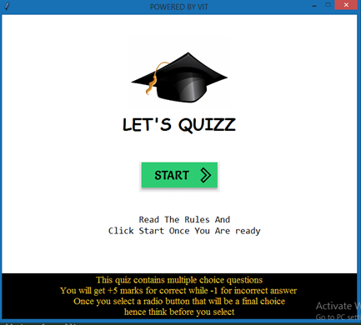
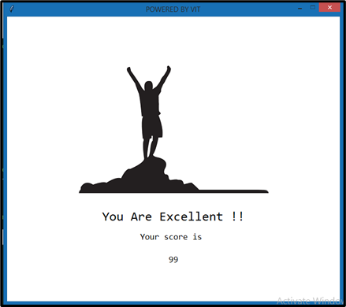

Slide 10
References
A_Practical_Introduction_to_Python_Programming_Heinold (reference 141 onwards)
https://stackoverflow.com/questions/48554463/python-multiple-choice-quiz-scoring-using-tkinter

Slide 11
Thank You

