Slide 1

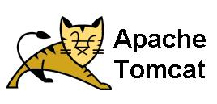
PART-1: JENKINS MASTER AND SLAVE CONFIGURATION PART-2: BUILDING MAVEN PROJET AND DEPLOYING IN TOMCAT USING JENKINS
PROJECT-4
BY:
MOHAMMED AJLALUDDIN

Slide 2
JENKINS: - Jenkins is open-source automation server. It is developed by java language. Jenkins provides hundreds of plugins to support building, deploying and automating any project.
Path of Jenkins: /var/lib/Jenkins
Default port: 8080
Jenkins is used for automate Build and Deployment process. Using Jenkins we can implement CI & CD (Continuous Integration and Continuous Deployment)
CI & CD is used to build and test software project or application continuously making it easier to integrate changes in the project.
JENKINS PIPELINE:-
Jenkins Pipeline is a suite of plugins which supports implementing and integrating continuous delivery pipelines into Jenkins.
A Pipeline is a user-defined model of a CD pipeline. A Pipeline’s code defines your entire build process, which typically includes stages for building an application, testing it and then delivering it.

Slide 3
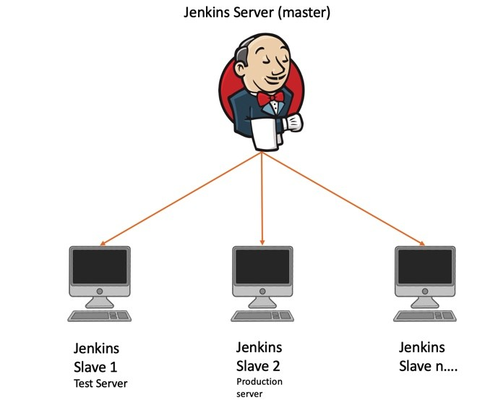
JENKINS MASTER AND SLAVE CONFIGURATION: - The Jenkins master acts to schedule the jobs, assign slaves, and send builds to slaves to execute the jobs. In order to perform testing in different environments, Jenkins uses various Slaves. Multiple slaves servers can be attached to single master server.
JENKINS MASTER AND SLAVE ARCHITECTURE

Slide 4
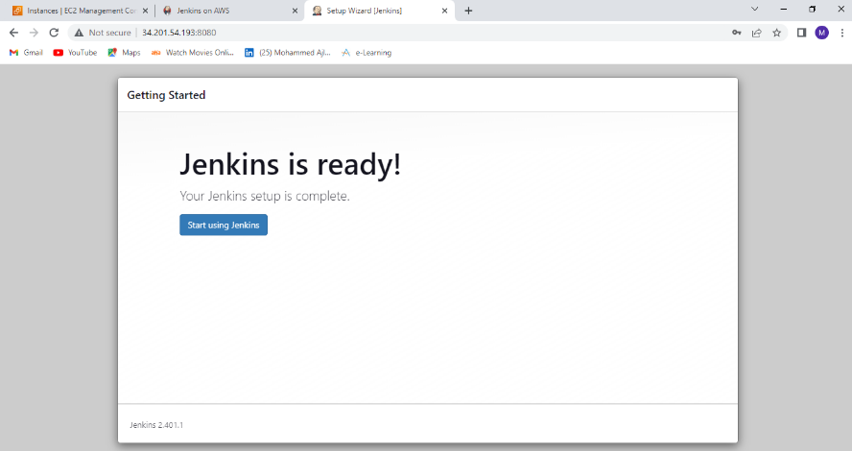
PRE-REQUISTES:-
AWS Account
EC2 Instance
Jenkins Server
Create EC2 Instance for master server (kernal version + t2.medium + 16gb storage) and another EC2 Instance for Slave server(kernal + t2.medium). Connect to the instances.
Install Jenkins in master server by executing Jenkins installations commands and setup Jenkins server.

Slide 5
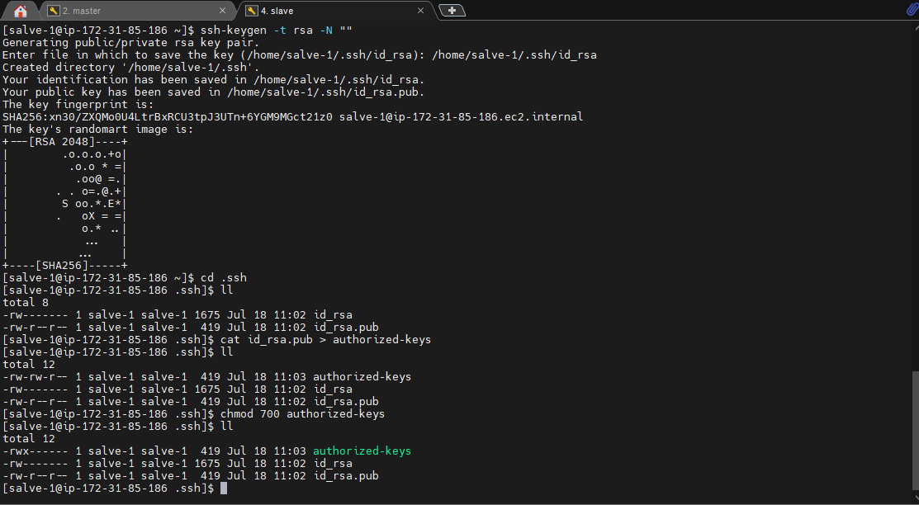
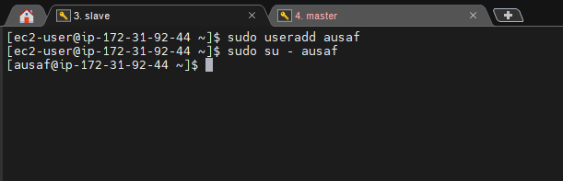
SLAVE NODE CONFIGURATIONS
Create a new user, SSH key and copy the key into Authorized_keys.
PROCEDURE:-
Update the instance .
Install java in machine.
Create a new user and add password to that user.
Switch to the New user (slave3).
Generate a new key in the user.
Copy public key id_rsa.pub in new file with name authorized_keys.
Change the permission authorized_keys file i.e., give all permissions to the user.

Slide 6
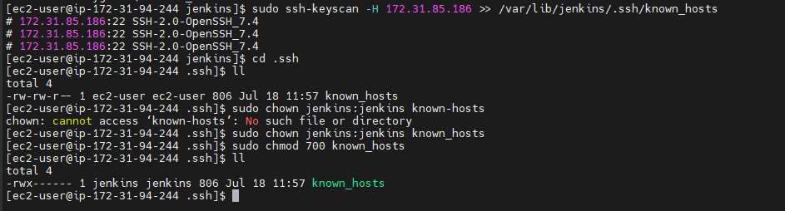
MASTER SERVER CONFIGURATION
Copy the slave node public key to master node’s known_hosts.
PROCEDURE:-
Create a .ssh directory in path /var/lib/Jenkins/.ssh.
Go to the .ssh directory.
Change the permissions of .ssh directory i.e., give all permissions to users, group and others.
copy the public key(id_rsa.pub) of slave node to known_hosts.
Change the ownership known_hosts from ec2-user to Jenkins.
Change the permissions of known_hosts i.e., give all permissions to user only.

Slide 7
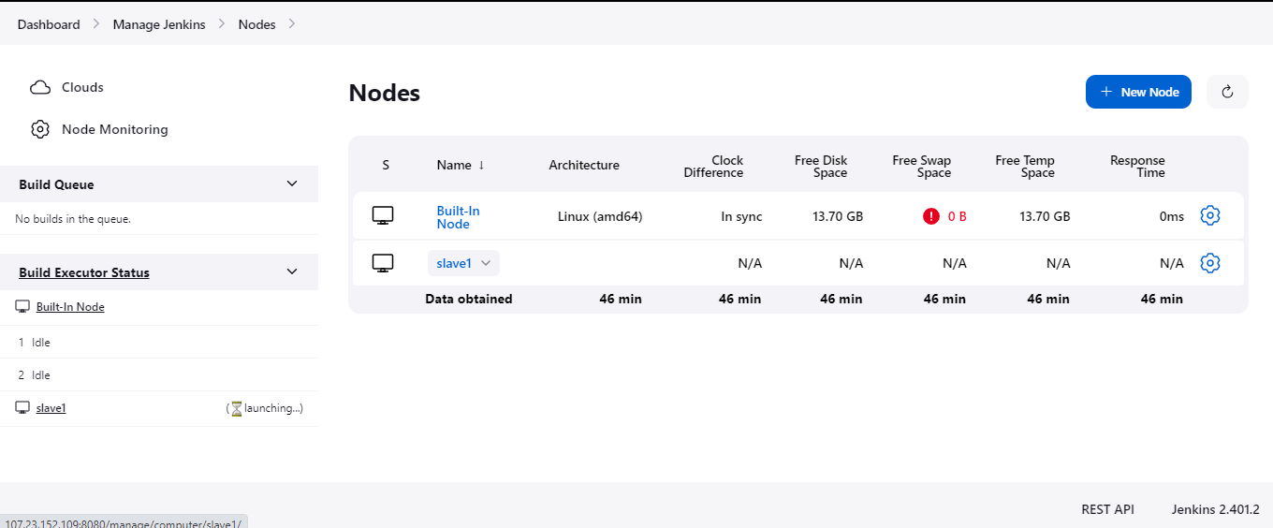
ATTACHING SLAVE NODE TO MASTER SERVER
Attaching slaver server with master server.
PROCEDURE:-
Go to Jenkins server.
Click Manage Jenkins option in Dashboard.
Click on Manage Nodes and Cloud and then click on New Node.
Enter the node name and select permanent agent and click ok.
Enter the Node configuration such description, label name, number of executors, credentials, remote root directory etc.
While adding credentials choose kind as SSH username with private key and provide user name and private key which is generated in slave user.
Click on save option and check in the log weather the slave server is online or offline.

Slide 8
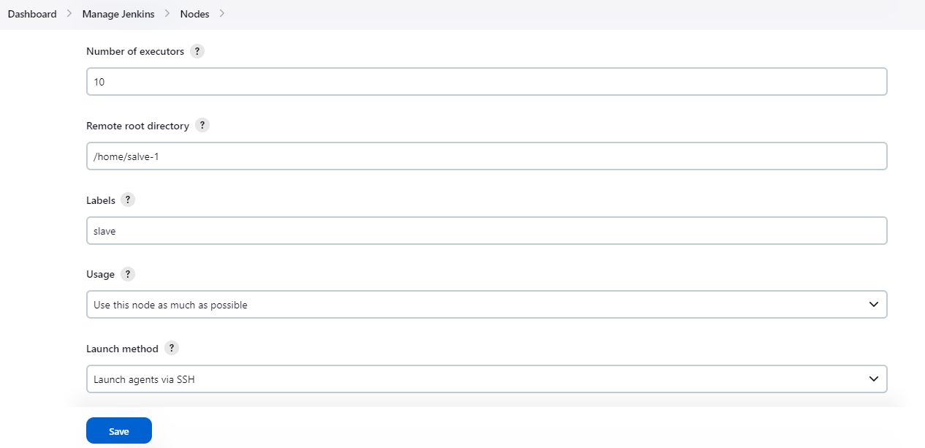
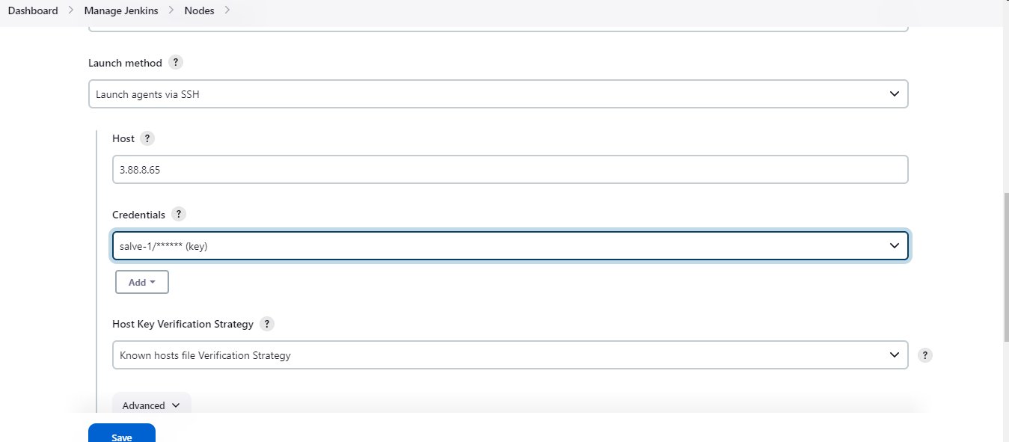
CONFIGURATIONS:

Slide 9
RUNNING A JOB IN SLAVE SERVER
PROCEDURE: -
Login to Jenkins server.
Create a new task by providing name and descriptions.
Select “Restrict where this project can be run” option and provide label Name in “ Label Expression” to select the slave.
Select Git as “Source Code Repository”.
Provide Project repo URL with credentials.
Select Execute Shell in Build Steps and provide execution command to run the project.
Click Apply and Save option.
After providing all project configuration build the project by selecting “Build Now”.

Slide 10
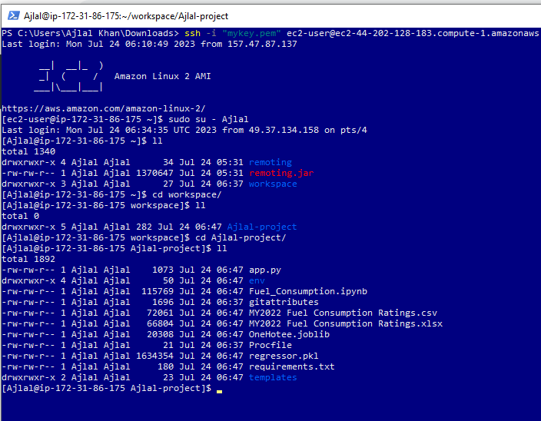
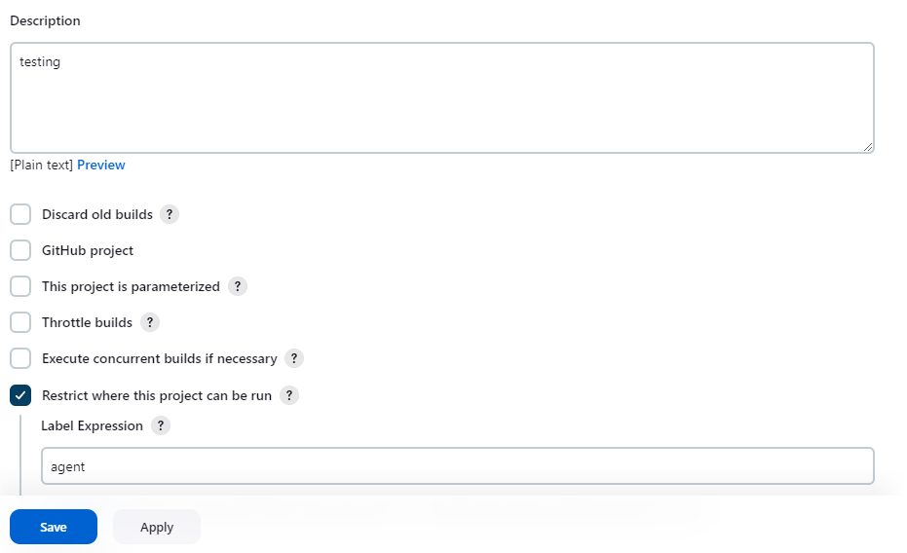
Project Configurations
Slave Server

Slide 11
BUILDING MAVEN PROJECT AND DEPLOYING PROJECT IN TOMCAT USING JENKINS
What is Maven?
Maven is a popular open-source build tool developed by the Apache Group to build, publish, and deploy several projects at once for better project management.
Apache Maven is a software project management comprehension tool. Based on the concept of a project object model (POM), Maven can manage a project's build, test and package.
What is POM file?
POM stands for “Project Object Model “. The pom. xml file contains information of project and configuration information for the maven to build the project such as dependencies, build directory, source directory, test source directory, plugin, goals etc.
What is Apache Tomcat?
Apache Tomcat is a web container. It allows the users to run Servlet and JAVA Server Pages that are based on the web-applications.
Apache Tomcat is used to deploy project (java project). It can be used only for hosting JAVA based code.

Slide 12
Tomcat Installation In Linux:
Launch A EC2 Instance by giving 8080,8081,8090 ports in security group.
Connect to the instance.
Create a new user and switch to the created user.
Install java 1.8* version in instance.
Install tomcat 9 version by using wget command and provide tomcat download url.
Once tomcat is downloaded, Extract the tomcat files by using “tar –xvzf” command.
Go to META-IN directory (cd /tomcat/webapps/manager/META-IN directory).
Edit “context.xml’ file such that comment last four lines.
Go to conf directory (cd /tomcat/conf/ directory).
Add user, password and roles in “tomcat-user.xml” file.
<user username= “Ajlal” password= “ajlal121” roles=”Ajlal,manager,manager-gui,manager-script”/>
Go to bin directory (cd /tomcat/bin)/
Execute “./startup.sh” command to start the tomcat server.
To stop tomcat server execute “./shutdown.sh”.
Note: To start and stop tomcat server from any directory execute following commands.
Command: sudo ln -s /home/ajlal/apache-tomcat-9.0.78/bin/startup.sh /usr/bin/tomcatup
sudo ln -s /home/ajlal/apache-tomcat-9.0.78/bin/shutdown.sh usr/bin/tomcatdown

Slide 13
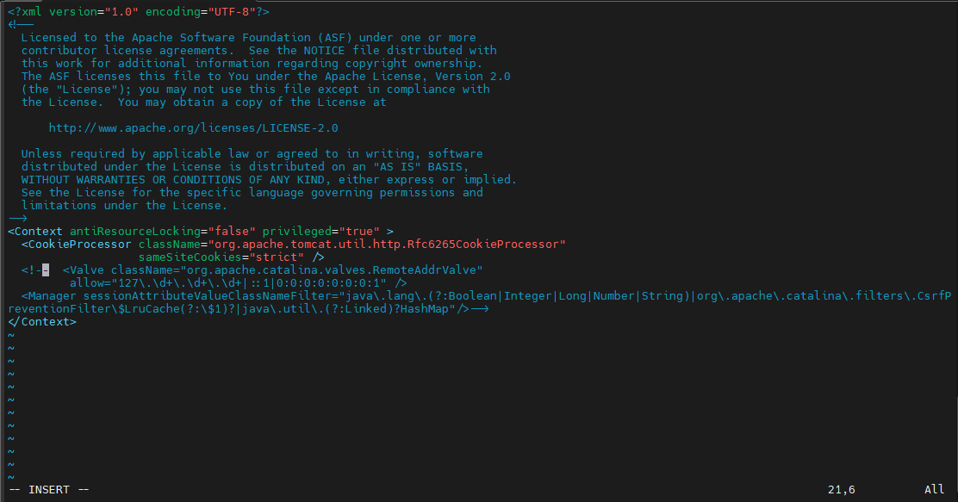
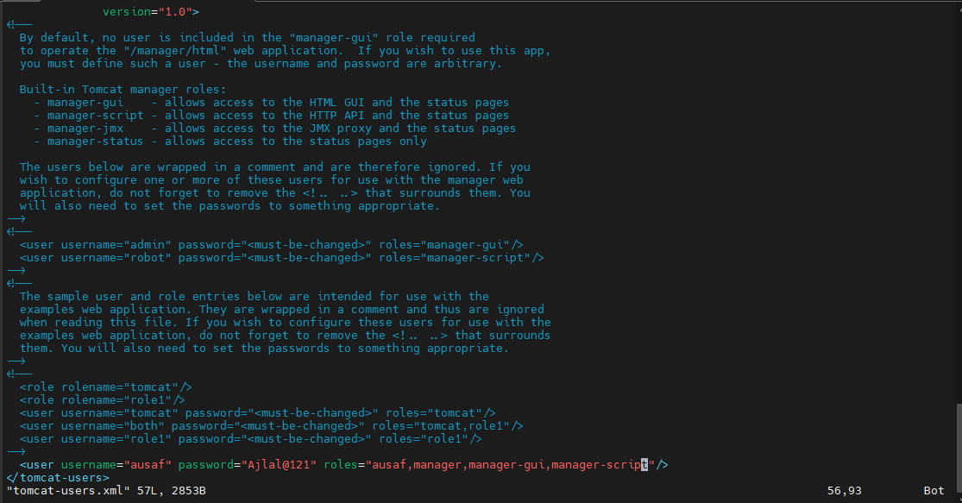
Commenting last four lines
Adding user, password and roles

Slide 14
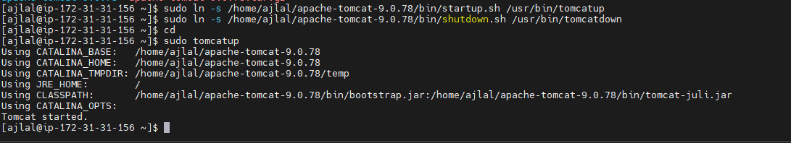
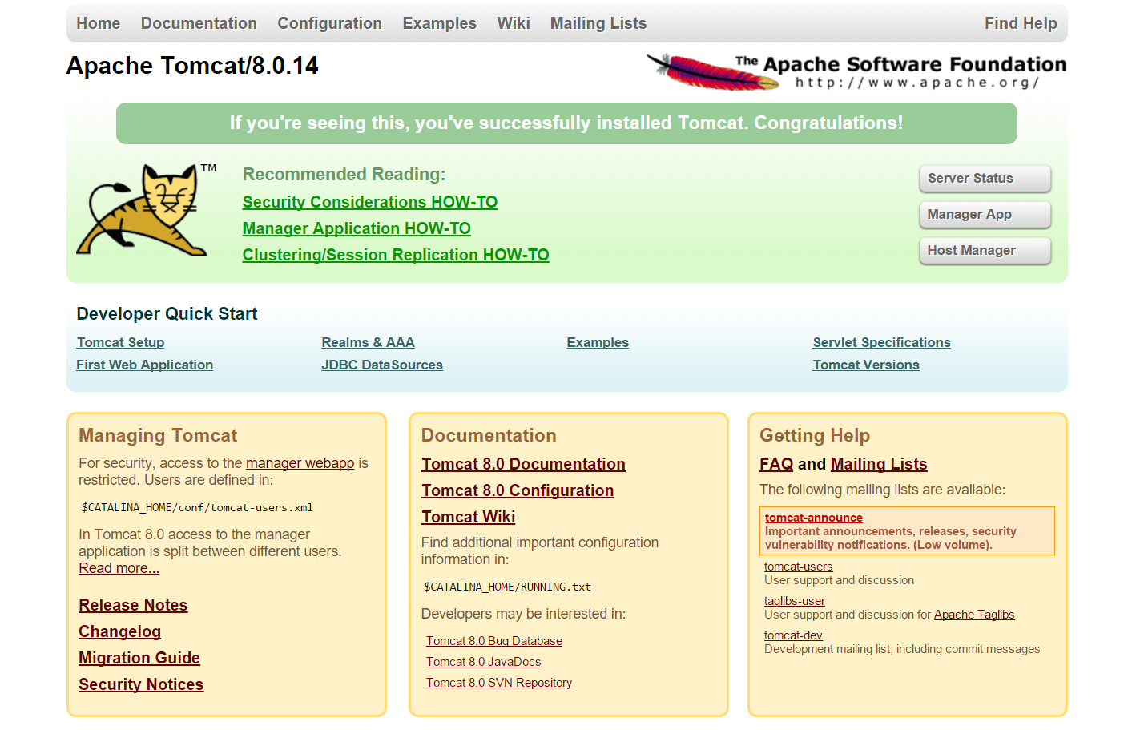
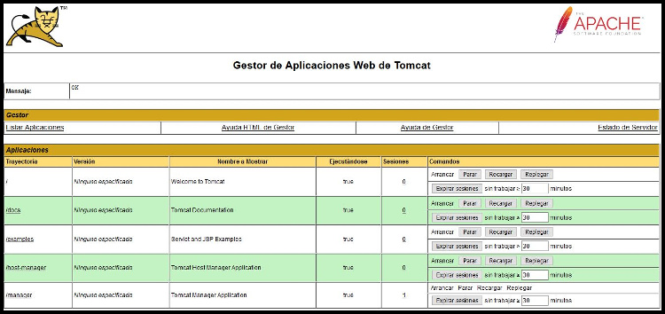
To start and tomcat server from any directory
Tomcat server:

Slide 15
BUILDING AND DEPLOYING MAVEN PROJECT
login into the Jenkins server with an 8080 port and click on manage Jenkins to configure the system with plugins of maven integration & deploy to container and also add the maven installation tool in the system Tool configuration.
Create a job for the Tomcat web application naming tomcat.
Configuring the job in source code management with Git repository, Invoking top-level maven targets in build steps with the goal and post build Actions with Deploy War file to a container.
Apply and Save the configuration to Build the job assigned in Dashboard.
Check the Web application output in the Apache Tomcat server by browsing Instance public Ip with 8080 port.

Slide 16
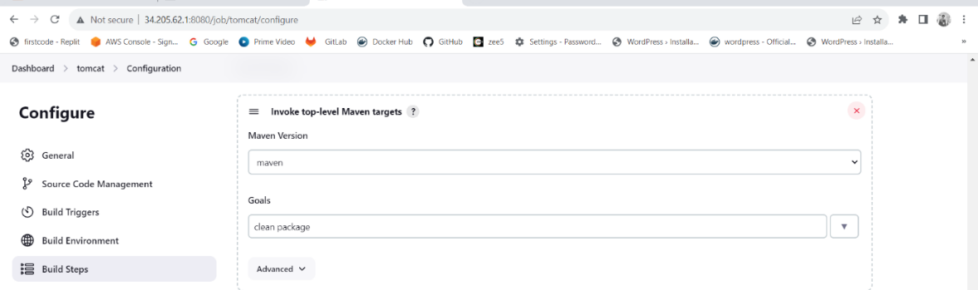
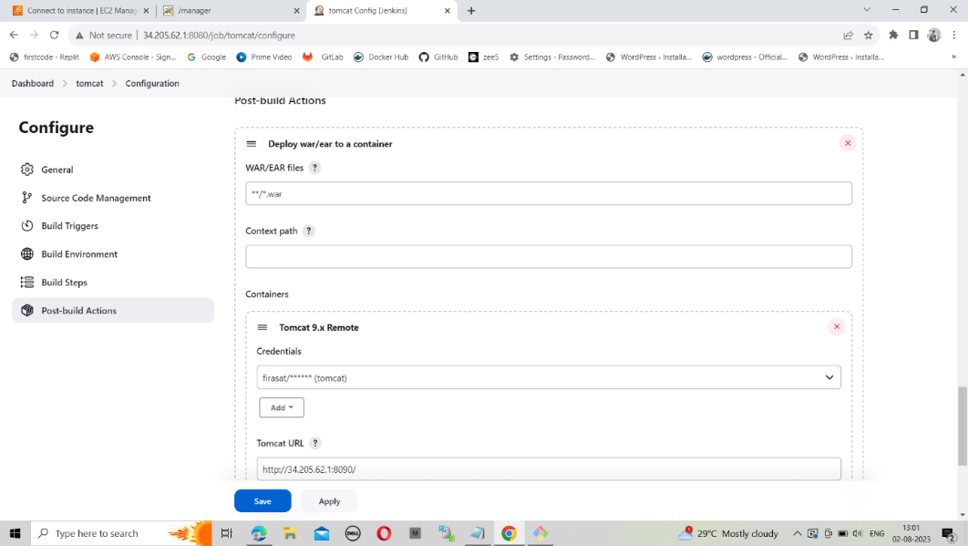
PROJECT CONFIGURATION:

Slide 17
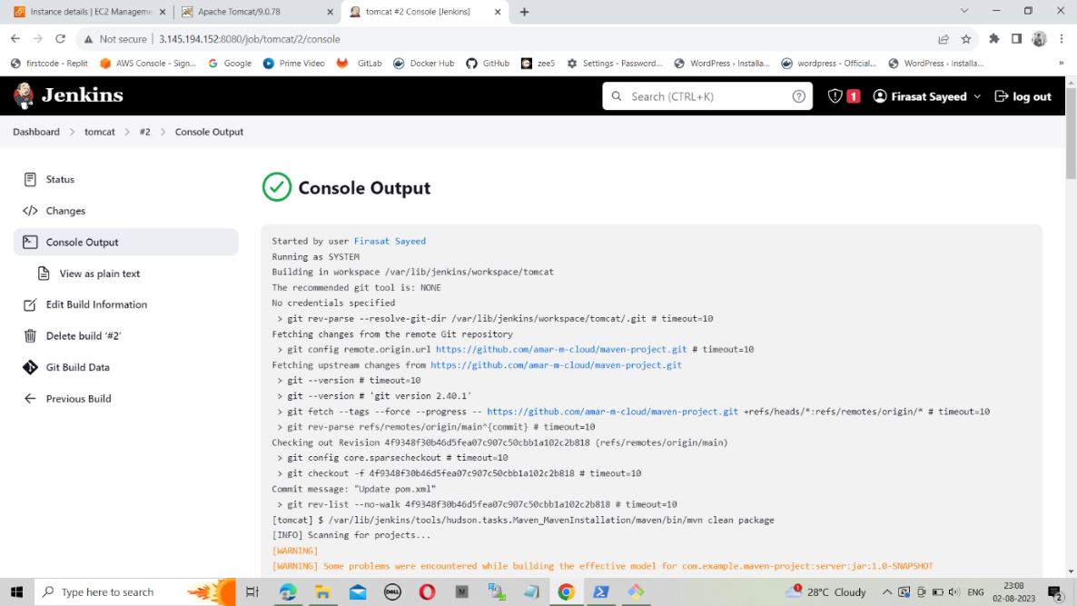
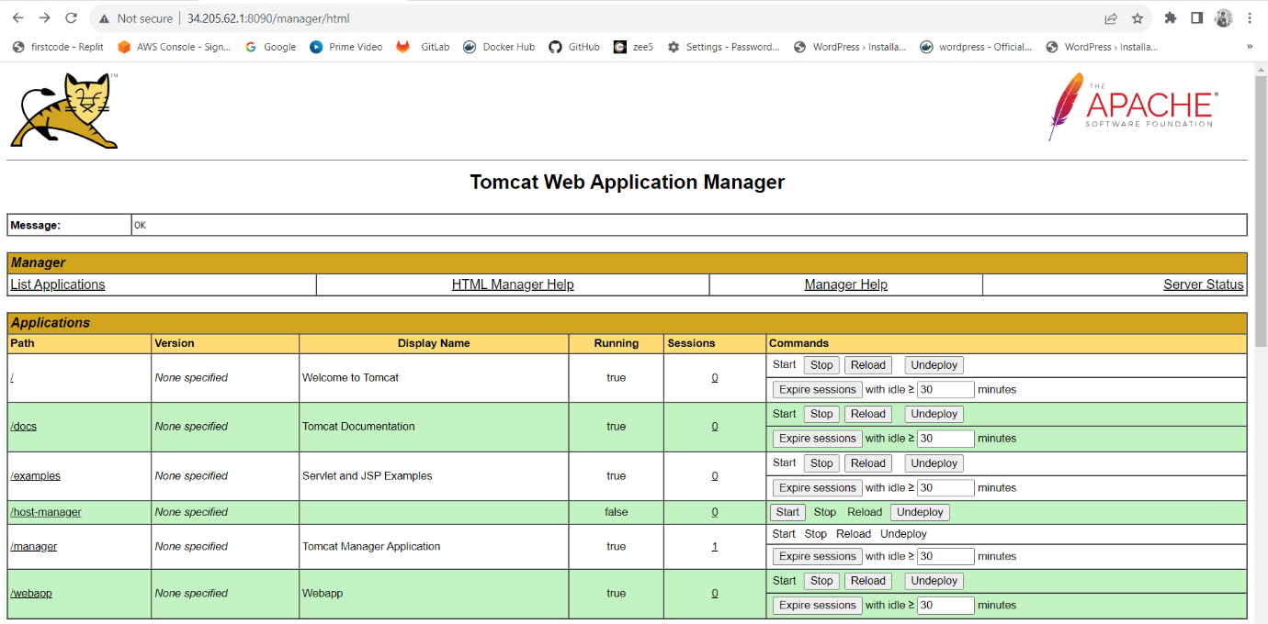
OUTPUT

Slide 18
THANK YOU

