Slide 1

PROJECT-2 WORDPRESS Deployment
BY:
Mohammed Ajlaluddin

Slide 2
What is WordPress?
WordPress is a content management system (CMS) that allows you to host and build websites. WordPress contains plugin architecture and a template system, so you can customize any website to fit your business, blog, portfolio, or online store.
Step-1:- Create IAM user and Create a custom vpc. Create a internet gateway and other vpc resources and attach to vpc.
Create 2 instance one public and one private instance
Step-2:- Create MySQL database in AWS console by providing required configuration.
Step-3:- Install MySQL in private instance and connect MySQL with database which is created in AWS.
Step-4:- Create a new SQL user with below command and provide all privileges to that user.
Step-5:- Install wordpress in public instance Copy wp-config-sample.php file with name wp-config.php.
Step-6:- Add keys and Database configurations in wp-config.php file by executing vi command.
Step-7:- Install mysql , php, php-mysql and httpd in public instance.
WordPress Deployment through Manual Method

Slide 3
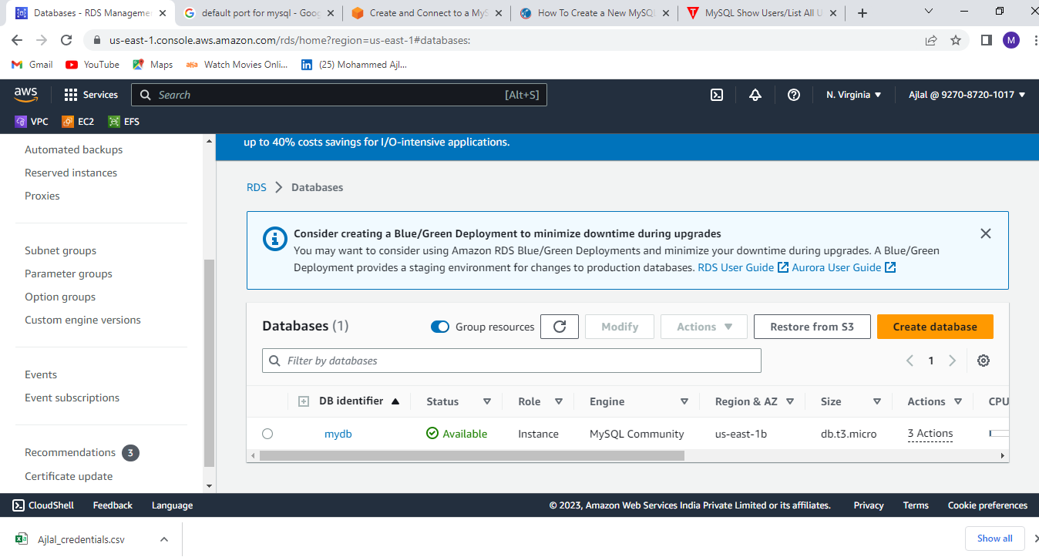
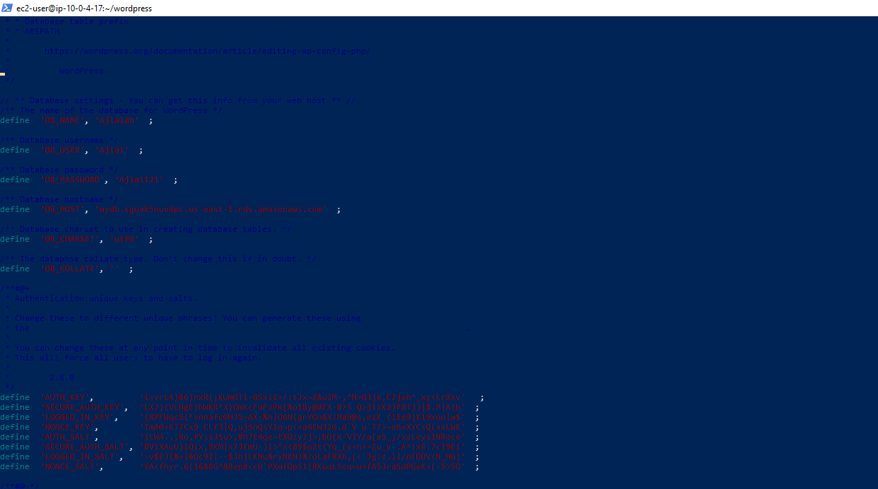
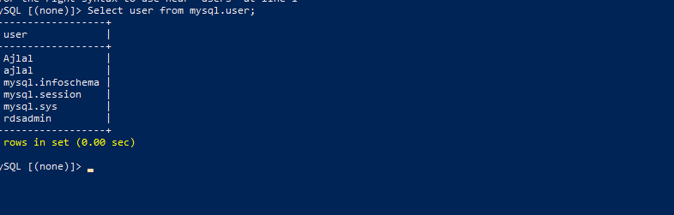
MYSQL Database
MYSQL Configurations
MYSQL USERS

Slide 4
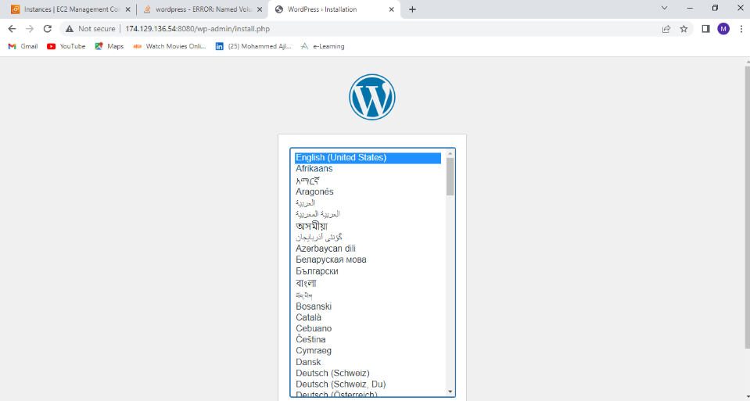
OUTPUT:-

Slide 5
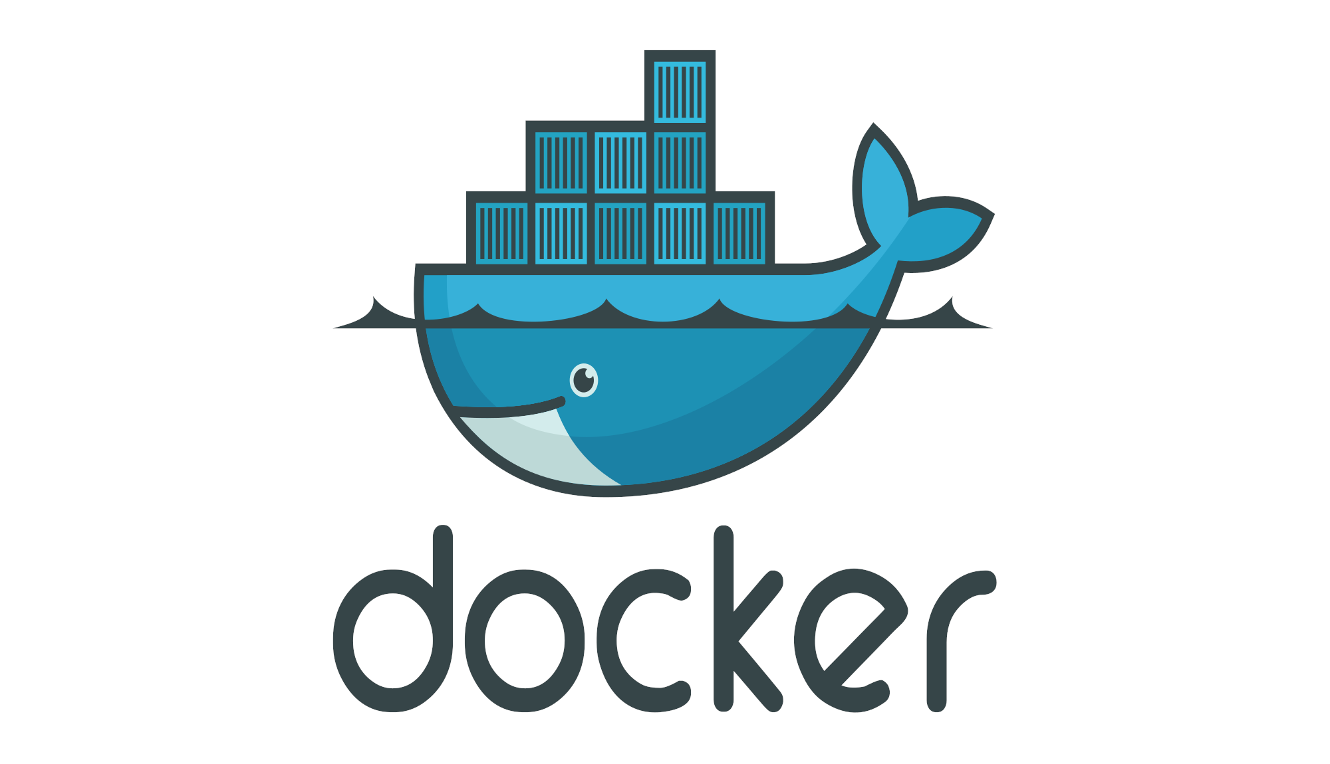
WordPress Deployment through Docker-Compose
What is Docker?
Docker is a containerization tool.
Docker is a set of platform as a service product that uses OS-level virtualization to deliver software in packages called “Container”.
Docker is used for developing, shipping and running application. Docker will take care of dependency to run an application.
What is Docker Compose?
Docker-Compose is a tool which is used to manage multi-container based application. By using docker-compose we can deploy multi-container based application.
Step-1:- Install Docker in instance.
Step-2:- Install Docker-Compose and add permissions to user.
Step-3:- Write Docker-compose file by providing MYSQL db and WordPress configurations.
Step-4:- start the containers by giving Docker-compose up command.

Slide 6
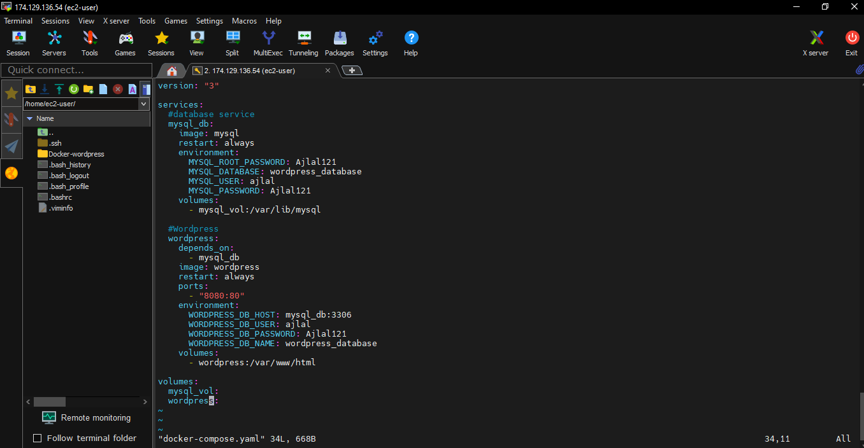
Docker-compose File

Slide 7

WORDPRESS DEPLOYMENT THROUGH JENKINS
What is Jenkins?
Jenkins is free & open source software. It is developed by using java language.
Jenkins is used to automate “Build and Deployment” process.
Using Jenkins we can implement “Continuous Integration” and “Continuous Deployment”.
Continuous integration is a development practice where a code should be deployed into servers automatically when any new code is committed.
Step-1:- launch a Instance and install Jenkins in it.
Step-2:- Login to Jenkins server with public ip of instance.
Step-3:- Create a new free style project.
Step-4:- Select Source code management as Git and provide repo URL with credentials.
Step-5:- Provide the commands in execute shell.
Step-6:- save it and build the project. Browse with public ip of instance to check WordPress output.

Slide 8
THANK YOU

