Slide 1
PROJECT-3
DEPLOYMENT OF PYTHON APPLICATION
By:-
Mohammed Ajlaluddin

Slide 2
Module-1: Manual Deployment
Module-2: Deployment Through Terraform Script
Module-3: Automation Deployment Through Jenkins
Module-4: Deployment Through Jenkins by Using Terraform Script
Tools used in this project: -
Git
Jenkins
Terraform

Slide 3
What is Flask?
Flask is a small and light weight python web framework that provides useful tools and features that make creating web applications in python easier.
It gives developer flexibility and is more accessible framework for new developers since you can build a web application quickly using only a single python file.
What is PIP?
PIP is a package management system used to install and manage software packages written in python. It stands for “Preferred Installer Program”.
PYTHON: -
Python is a computer programming language often used to build websites and software automate tools.
PRE-REQUISTES:-
AWS Account
EC2 Instance
VPC, Internet Gateway, Subnet and Route table
Git Hub

Slide 4
MODULE-1
DEPLOYMENT OF PYTHON APPLICATION MANUALLY
PROCEDURE:-
Create a IAM user and attach policies to it.
Create a custom VPC.
Create a EC2 Instance with any operating system.
Connect to EC2 instance by using Git Bash.
Update the operating machine.
Install required packages related for deployment of project.
Clone the project source code from Git Hub to your instance.
Now go to the directory and install requirement packages.
Modify the app.py file and run the flask server.
Now browse the public Ip of instance with given port to see the python web application.

Slide 5
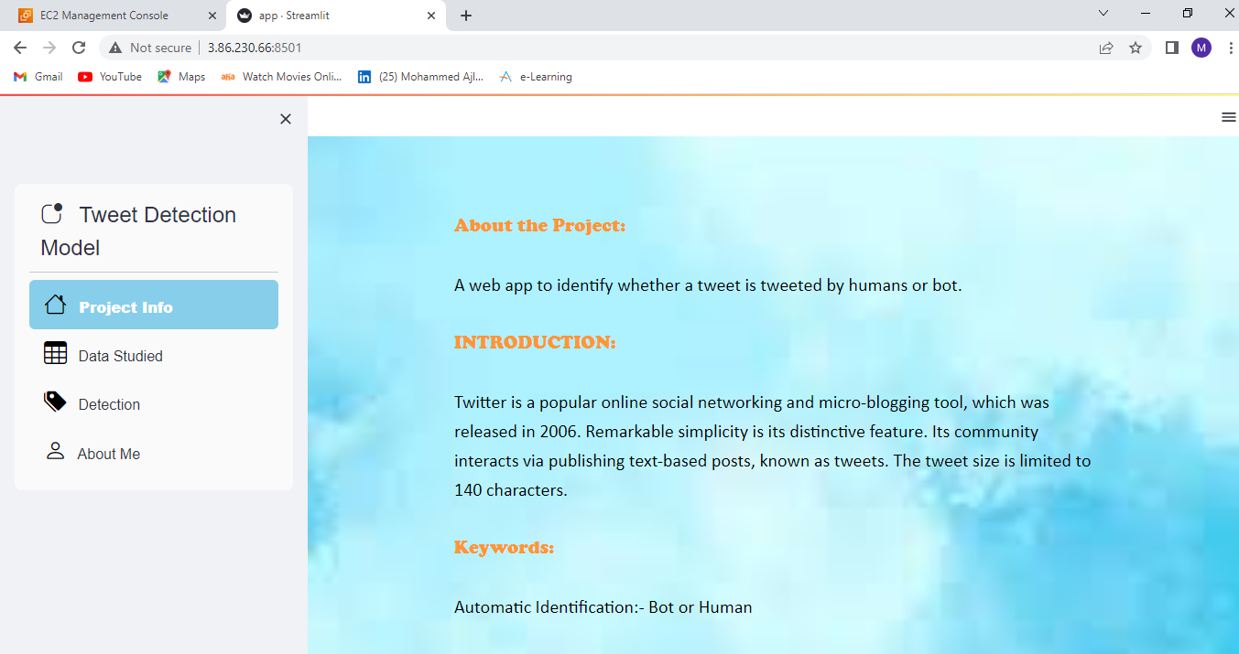
OUTPUT

Slide 6
MODULE-2
DEPLOYMENT OF PYTHON APPLICATION WITH JENKINS
PROCEDURE: -
Create a IAM user and attach policies to it.
Create a custom VPC.
Create a EC2 Instance with any operating system.
Connect to EC2 instance by using Git Bash.
Install Jenkins in EC2 instance by using certain commands.
Setup Jenkins server.
Create a new job by providing project description.
Select Git as a source code management and provide repo URL and credentials.
Select Execute Step in Build Shell and provide commands.
Build the project

Slide 7
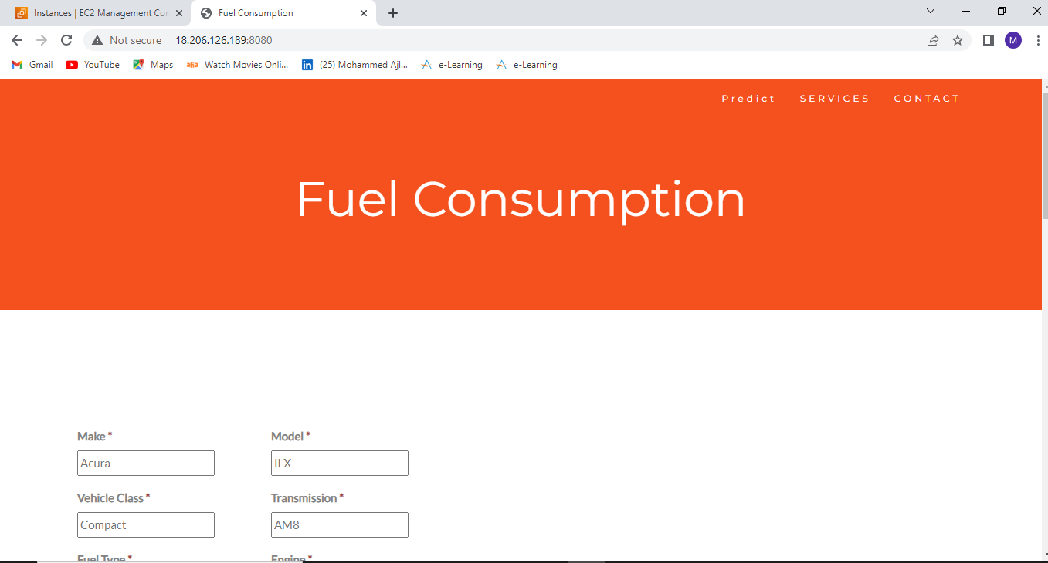
OUTPUT

Slide 8
MODULE-3
DEPLOYMENT OF PYTHON APPLIATION USING TERRAFORM SCRIPT
PROCEDURE: -
Create a IAM user and attach policies to it.
Create a custom VPC.
Create a EC2 Instance with any operating system and connect to the Instance with SSH key.
Install terraform in Instance by executing installation command.
Create a Directory and go inside the directory.
Create files for VPC, Internet gateway, Subnet, Route Table and for EC2 Instance with .tf extension.
Create user data file with .sh extension and give commands in data.sh file. Give python app URL in data.sh file
Execute terraform validate, terraform plan and terraform apply commands to build Infrastructure.

Slide 9
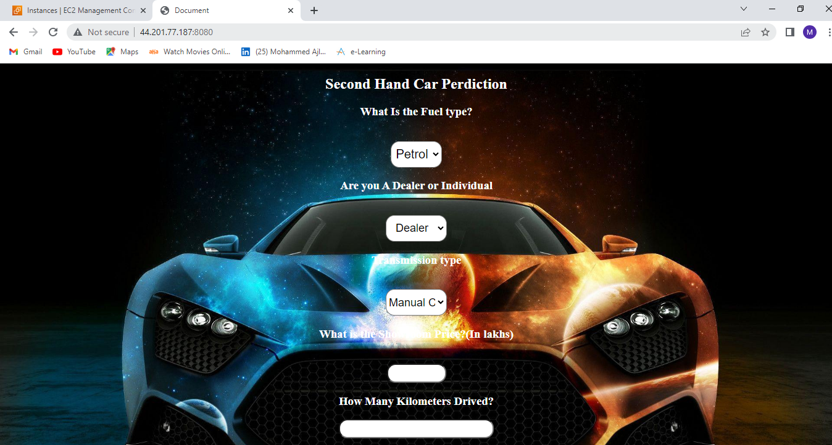
OUTPUT

Slide 10
MODULE-4
DEPLOYMENT OF PYTHON APPLICATION THROUGH JENKINS BY USING TERRAFORM SCRIPT
PROCEDURE: -
Launch a EC2 Instance by giving 8080 port in security group.
Connect to the Jenkins server by browsing public Ip of instance with 8080 port.
Create a new freestyle project and give project description .
Select Git as source code management and provide Userdata.sh repo URL with credentials.
Select Execute Shell in build steps and provide “./data.sh”.
Build the project
After building check the console output to check the output.
Browse the public Ip of instance with given port to see python web application.

Slide 11
OUTPUT

Slide 12
What is Webhook?
A webhook enables third-party services like GitHub to send real-time updates to an application. Updates are triggered by an event or an action by the webhook provider like push to a repository, any commit to a code or pull request creation.
What is POLLSCM?
Poll SCM polls the SCM periodically for checking if any changes or any new commits were made to the code and shall build the project if any new commits were pushed since the last build.
What is Build Periodically?
Build Periodically is process where we can set a time so that after every desired time the project will build automatically whether new changes or commits are happened or not.

