Slide 1
Air Quality Analysis in India
175
Exploratory data analysis of monitoring-station readings, snapshot of 30 Jan 2024
average PM2.5 reading
INDUSTRY
Environmental Data Analysis
STUDENT
Ajmal
STUDENT ID
AF05320136
Anudip Foundation
COURSE
AIML
BATCH CODE
ANP-D744
Notes:
Title slide. Project: Air Quality Analysis in India (EDA Sprint 1). Student Ajmal, ID AF05320136, Course AIML, Batch ANP-D744, Anudip Foundation.

Slide 2
Industry Overview
SELECTED INDUSTRY
31
states / UTs in the raw data
Environmental Data Analysis
Air-quality monitoring tracks pollutants such as PM2.5, PM10, NO2, SO2, CO, ozone and NH3 through stations placed across Indian cities and states.
266
cities covered
Why data analysis matters here
Turns raw station readings into clear pollution rankings
Shows where pollution is worst, so action can be targeted
Supports public health warnings and evidence-based policy
496
monitoring stations
Notes:
The dataset covers 31 states/UTs, 266 cities and 496 stations in the raw file.

Slide 3
Problem Statement
1
2
3
The problem
Why it is important
Who is affected
Readings from monitoring stations across India sit in thousands of rows. It is unclear which states and cities carry the heaviest PM2.5 and PM10 pollution.
In this dataset the average PM2.5 reading is 175, and 73.4% of PM2.5 readings are above 90, the "Poor" band used in this project. Without analysis the hotspots stay hidden.
Residents of high-pollution cities, especially children, older adults and people with breathing problems, plus the authorities who must decide where to act first.
Notes:
Problem statement taken from the project README: analyse station data to find pollution levels and the most polluted states and cities based on PM2.5 and PM10.

Slide 4
Project Objectives
1
Load, inspect and clean the raw air-quality dataset
2
Calculate summary statistics and the average value of each pollutant
3
Rank the top 10 states and cities by average PM2.5
4
Measure the share of PM2.5 readings in the "Poor" band (above 90)
5
Test the correlation between PM2.5 and PM10 across stations
Notes:
Five objectives, each answered by a specific step in the notebook.

Slide 5
Proposed Solution & Analysis Questions
Analysis questions
Proposed solution
1
How many readings exist per pollutant, and what is each one's average?
Clean the station readings, summarise and rank them, then chart the results to show which places and pollutants need attention first.
2
Which 10 states have the highest average PM2.5?
3
Which 10 cities have the highest average PM2.5?
How Python helps
pandas: clean, filter, group, rank
NumPy / SciPy: statistics, Pearson r
Matplotlib: charts that expose hotspots
4
What share of PM2.5 readings is above 90?
5
How are PM2.5 readings distributed?
6
How strongly are PM2.5 and PM10 related?
Notes:
Six analysis questions; slides 9 to 11 answer each of them.

Slide 6
Dataset Information
Dataset | Air Quality Data (Snapshot of Jan 30, 2024)
Source | Open Government Data Portal (data.gov.in)
Rows | 3,314 raw → 3,093 after cleaning
Columns | 11 raw → 10 after cleaning
File format | CSV
Coverage | 31 states / UTs, 266 cities, 496 stations
Content | One row per station and pollutant, with min, max and average reading
Important columns
state
city
station
last_update
latitude
longitude
pollutant_id
pollutant_min
pollutant_max
pollutant_avg
country*
* dropped in cleaning (always "India")
Notes:
Raw file: Dataset/dataset.csv (3,314 rows, 11 columns). Cleaned file: Dataset/cleaned dataset.csv (3,093 rows, 10 columns). Highlighted columns are the measurements.

Slide 7
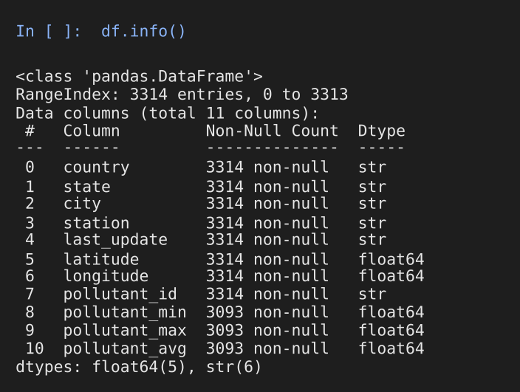
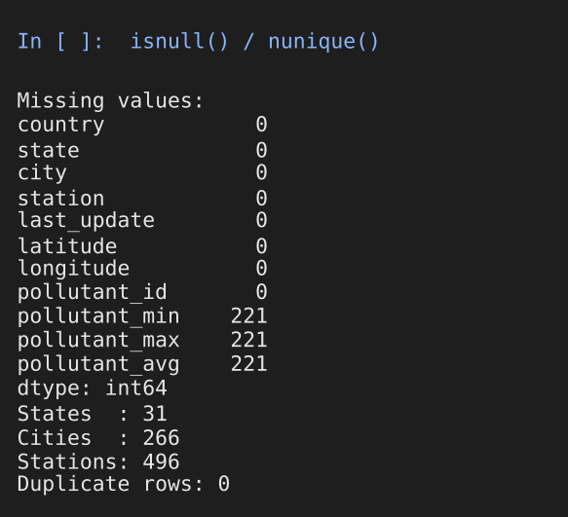
Data Collection & Understanding
Downloaded as a CSV snapshot from data.gov.in
Loaded with pd.read_csv: 3,314 rows, 11 columns
6 text columns and 5 numeric (lat, long, min, max, avg)
221 rows have no min, max or avg value
0 duplicate rows
7 pollutants across 31 states
Jupyter output: data types, missing values, duplicates
221
missing values per measure column
0
duplicate records
7
pollutant types
Notes:
Output reproduced by running Python/data_loading.py on Dataset/dataset.csv. The same missing 221 rows are missing min, max and avg together.

Slide 8
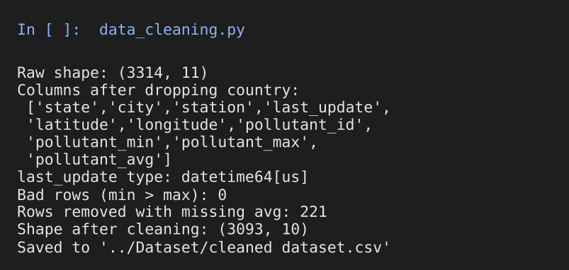
Data Cleaning & Transformation
1
Dropped the country column (always "India")
2
Standardised state and city names: underscores removed, title case
3
Converted last_update to datetime
4
Checked for min > max entries: none found
3,314 → 3,093
11 → 10
rows
columns
5
Removed 221 rows with missing pollutant_avg
Known quirk: title case turned "TamilNadu" into "Tamilnadu", and Arunachal Pradesh had only missing values, so it dropped out (31 → 30 states).
6
Filtered by pollutant_id to build PM2.5 and PM10 subsets
Notes:
Steps come from Python/data_cleaning.py. The saved cleaned CSV stores last_update as text; the datetime conversion applies inside the script. Title-casing is a small formatting quirk worth fixing in future work.

Slide 9
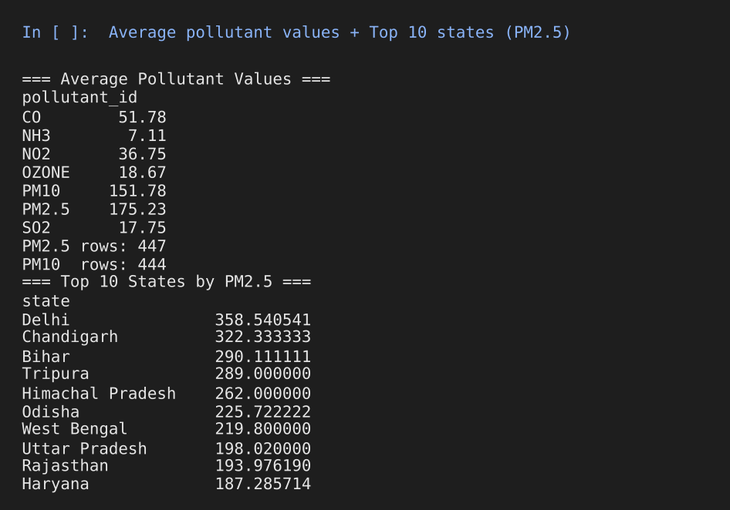
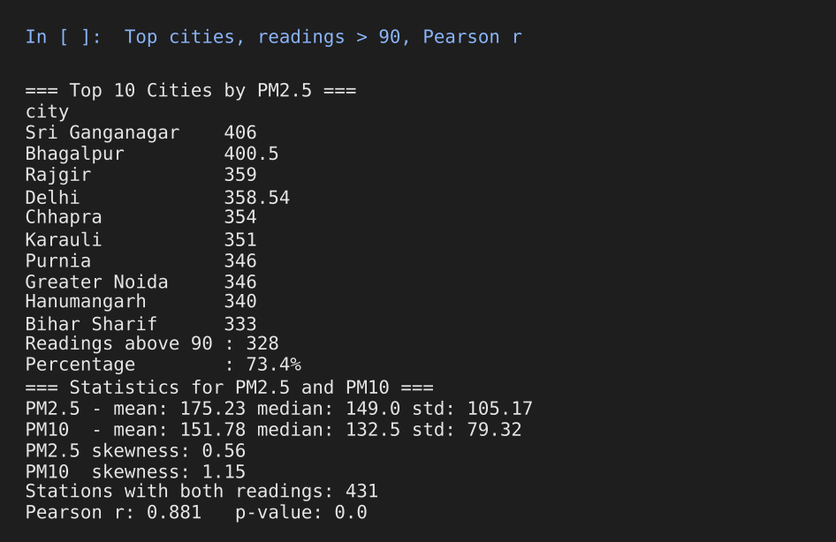
Exploratory Data Analysis
175.2
73.4%
r = 0.881
358.5
mean PM2.5 (median 149)
of PM2.5 readings above 90 (328 of 447)
PM2.5 vs PM10, 431 stations
Delhi, highest state-average PM2.5
Notes:
Libraries: pandas (groupby, filtering, describe), SciPy (pearsonr, skew). Output reproduced by running Python/exploratory_analysis.py on the cleaned CSV. PM10 skewness is 1.15 and PM2.5 skewness is 0.56.

Slide 10
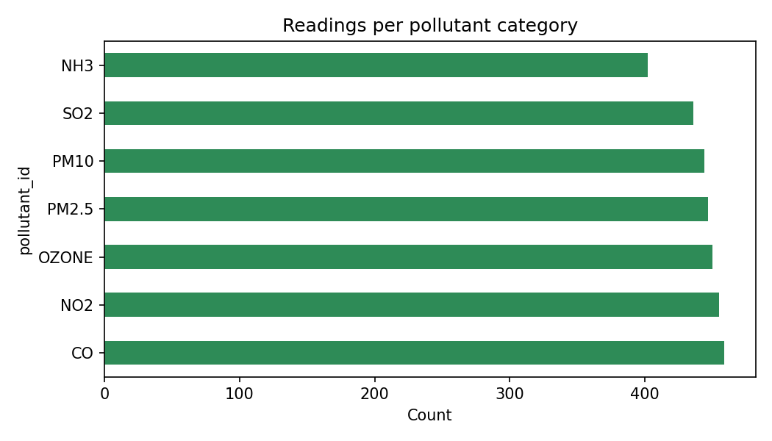
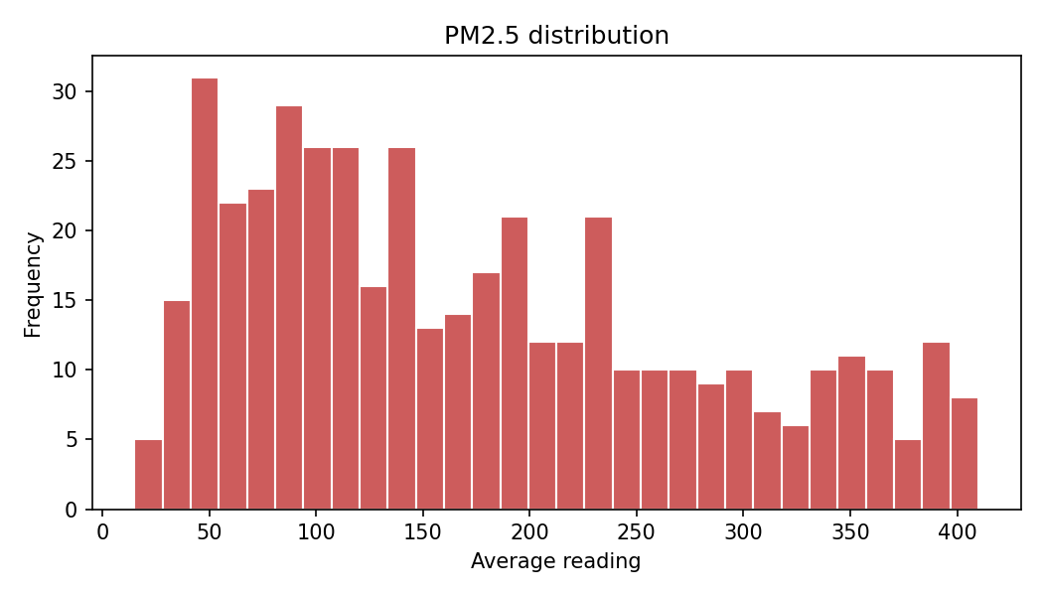
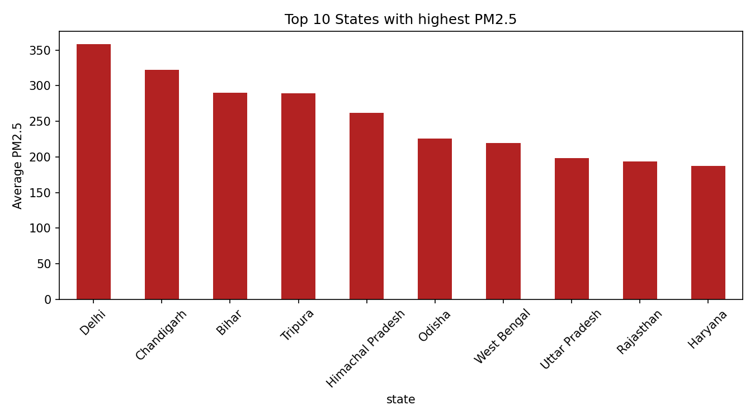
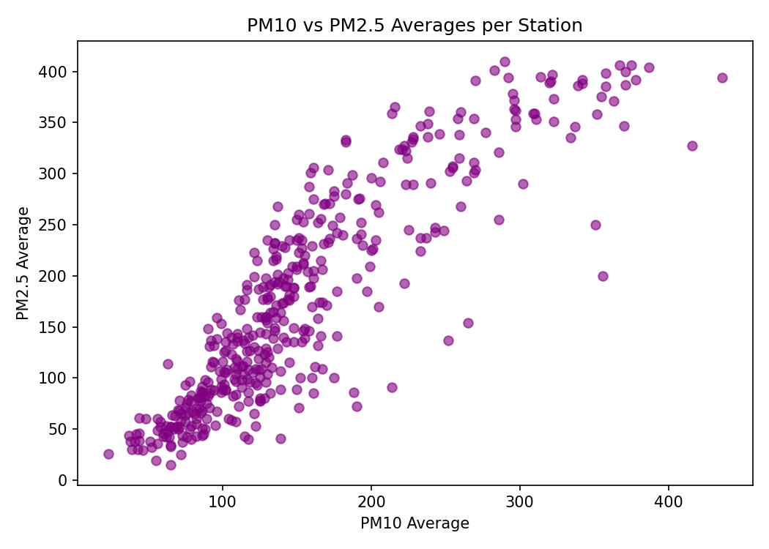
Data Visualization
Readings per pollutant (bar)
Purpose: Check coverage of each pollutant
Shows: Count of readings for 7 pollutants
Insight: Counts are balanced (402 to 459), so pollutants compare fairly
PM2.5 distribution (histogram)
Purpose: See how PM2.5 values spread
Shows: Frequency of station averages, 15 to 410
Insight: Long upper tail: many stations sit far above 90
Top 10 states by PM2.5 (bar)
Purpose: Rank the most polluted states
Shows: Average PM2.5 per state
Insight: Delhi leads at 358.5, then Chandigarh and Bihar
PM10 vs PM2.5 (scatter)
Purpose: Test how the two move together
Shows: Station averages, 431 stations
Insight: Strong upward trend, r = 0.881
Notes:
Charts built with Matplotlib (pandas plotting). Chart name, purpose, what it shows and key insight are listed beside each chart. Seaborn is installed and imported in the notebook but the four saved charts use Matplotlib.

Slide 11
Key Insights & Recommendations
Key insights
Recommendations
PM2.5 (avg 175.2) and PM10 (avg 151.8) sit far above every other pollutant, all under 52
Target controls and funding at the top-10 states and cities
Add monitoring and health warnings where PM2.5 exceeds 90
Write state-specific policies for PM2.5 and PM10 sources
1
328 of 447 PM2.5 readings (73.4%) exceed 90, the "Poor" band
2
Delhi leads the states at 358.5 average PM2.5, then Chandigarh (322.3) and Bihar (290.1)
3
Top-10 cities: 5 in Bihar, 3 in Rajasthan; Sri Ganganagar is highest at 406
4
Read with care: Tripura and Himachal Pradesh rest on 1 PM2.5 reading each, Chandigarh on 3. Confirm with more data.
PM2.5 and PM10 rise together (r = 0.881 across 431 stations)
5
Notes:
Every figure comes from the cleaned dataset (3,093 rows). Recommendations 1 to 3 follow the project README.

Slide 12
Conclusion
What was achieved
Major findings
Cleaned 3,314 raw rows into 3,093 valid readings and ran a full EDA with statistics and four charts.
73.4% of PM2.5 readings are above 90; Delhi, Chandigarh and Bihar lead the states; PM2.5 and PM10 correlate at r = 0.881.
How it addresses the problem
Future scope
Ranked hotspots show where to act first and where to issue health warnings.
Add readings over time, compute AQI, map stations by latitude and longitude, fix state-name formatting, model PM2.5 from PM10.
Notes:
Close by linking back to the problem: the analysis identifies where and how badly India's stations record PM2.5 and PM10.

