Slide 1

Xelerate Implementation for a Leading India Bank
Project Guide: Dr.Fousia M Shamsudheen
Presented By: Ajmi A (TKM18MCA005)

Slide 2
Overview
Introduction
01
02
Product Versions
Why Xelerate?
03
04
Xelerate Benefits to Clients
Xelerate Key Product Modules
05
06
Xelerate Implementation

Slide 3
Overview
Customer Relationship Management
07
08
Transaction pricing in Xelerate
Pricing Flow
09
10
Examples of Pricing
Screenshots
11
12
GitHub Status

Slide 4

Introduction
Xelerate is the technology platform of SunTec Business Solution.
Xelerate is a Revenue Management and Business Assurance System.
It is a web application developed mainly using Java and Oracle.
The products are build on top of Xelerate platform.

Slide 5
Product Versions
* TBMS – Telecom Billing Management System
TBMS * 1.x
TBMS 2.x
TBMS * 3.x
TBMS 4.x
TBMS 5.x
Xelerate 1.x
* TBMS – Transaction Business Management System

Slide 6
WHY XELERATE ?
To make the product in such a way that functionality/ feature wise selling is possible.
To incorporate new banking trends that helps service providers to create real-time personalized offerings to customers
To bring Xelerate as a front end system of the service provider where product managers/ relationship managers can rollout new offerings and attract customers
To bring a true productized approach internally

Slide 7
Xelerate – Benefits to Clients
A
Enabling the creation of highly flexible and trusted Personalized Product Offerings
Enabling the creation and proactive management of Customer Experience
Enabling high volume data driven decision making to achieve Business Assurance
B
Enabling comprehensive Revenue Management through flexible pricing and settlement structures

Slide 8
Xelerate Key Product Modules
Security and Administration
Product Catalogue
Customer and Account Management
Loyalty
Xelerate suite of products
Offer Management
Interfaces
Pricing
Invoicing and Payment Management

Slide 9
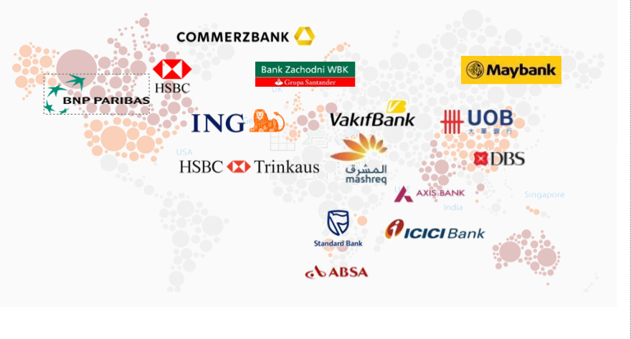
SunTec offers solutions to leading institutions globally
Designer
Programmer
Text Here
Text Here

Slide 10
Hardware Specifications
Windows 7, Linux
12GB RAM
15GB Storage
Software Specifications
Java
Apache kafka
Oracle SQL Developer
Apache NIFI

Slide 11
Xelerate Implementation
A Leading India Bank with a wide range of banking products and financial services to corporate and retail customers through a variety of delivery channels. Bank is currently using xelerate for the pricing and billing of GBO main services.

Slide 12
Project Objectives
Introduction of daily billing for products and services under the current account
Programmer
Enhanced product usage and customer relationship
Overall business improvement in GBO by effective utilization of xelerate advanced
Text Here
Text Here

Slide 13
Customer Relationship Management- CRM
Customer is an entity that avails one or more products from the financial institution.
Customer life cycle management and maintenance of customer-related data are very important for any financial institution.
Customers of a financial institution may have multiple accounts as per requirement.
An account is a representation of each product availed by the customer.
In Xelerate, corresponding to each product opted by the customer, an account is created.
Account is the entity that differentiates various products opted by the customer.

Slide 14
Customer and Account Management
The customer and account is the most important and basic business entity that avails products and services from the financial institution.
Xelerate provides the facility to create customers and accounts as part of the customer and account management process.
A customer can avail different products and services offered by a financial institution.
An account is an identification of a product availed by the customer. Relationship Managers of a financial institution initiates the account creation process based on requests from customers.
Xelerate facilitates to capture details such as general information about the account, contact details of the customer, and payment details of the account, as per business requirement.

Slide 15
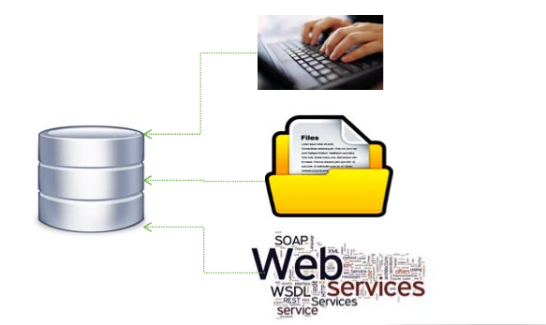
Xelerate provides the flexibility to create and update the customer and account information in three ways
Through User Interface
Through Batch Feeds (File Formats)
Through Web service

Slide 16
Transaction Pricing in Xelerate
When customers use different services, the details are recorded by different systems of the bank.
These records can be shared to Xelerate either online or offline.
These transaction records are the input to Xelerate, for price computation.
Xelerate has a standard interface for accepting transaction records for pricing in batch mode.

Slide 17
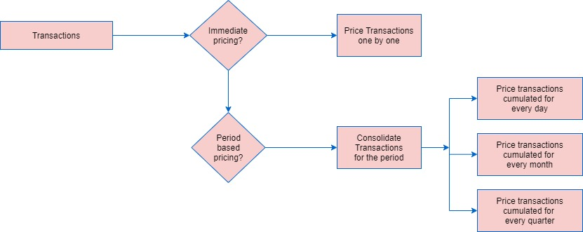
Pricing Flow

Slide 18

ICICIDemandDraft
PayOrderCharging
FundT
ransferCharging
V
alueAddedServices
CashT
ransactionProcessing
ChequeProductProcessing
INTERFACES
IciciDebitCardBPW
rapper
GenSetUniqueKey
GenResolveService
IciciCashDenomination
ConsT
ransactionCharging
IciciCAMMediationBP
GroupFreelimitMetadataLoading
CashDenominationPricing
CashDepositLoadProcess
MinMaxChrgPricing

Slide 19
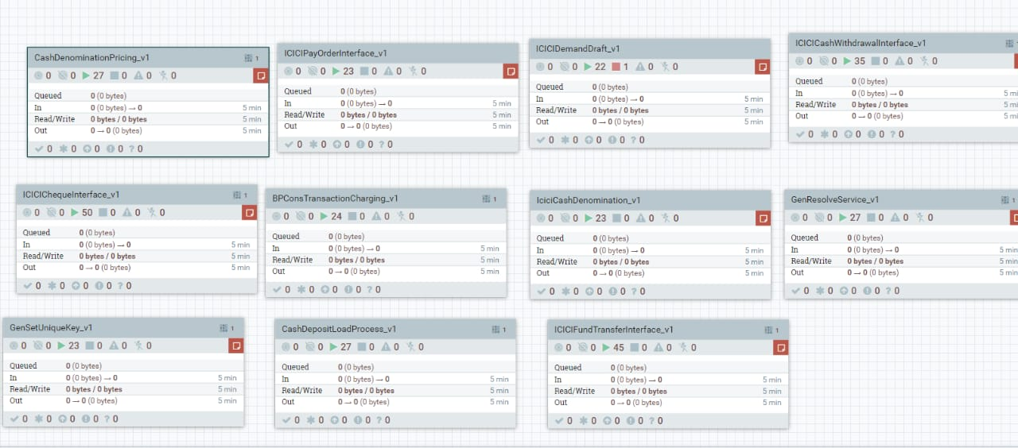
Screenshot -Deployed Interfaces
Designer
Programmer
Text Here
Text Here

Slide 20
Work Flow of Demand Draft Transaction
priced_transaction_data
businesstransaction
DD Input file
ICICIDemandDraft
demanddraft
Consolidation
consbusinesstransaction
Required?
-
DA51_862
demanddraft

Slide 21
Sample Feed File- Demand Draft
Account Number | Transaction ID | Transaction Date | Transaction Type | Transaction Sub Type | Part tran Type | Transaction remark | Transaction Amount | DD Transaction date | DD amount
123456 | M12345 | 25-03-20 | C | NP | D | Centralised Demand Draft | 322444 | 31-07-20 | 322444
123456 | M12346 | 25-03-20 | C | NP | D | Centralised Demand Draft | 322444 | 31-07-20 | 322444

Slide 22
Current Account Schedule of Charges
Demand Draft Issuance
Standard charges- Rs 2 per/1000 for the product CLS2
Standard charges- Rs 0 or Free for the product SBIVY

Slide 23
Priced Transaction Table- RESULT
Product_Variant | PTD_ORG | PTD_CHARGEABLE | PTD_CONS | PRODUCT
DDB | 322444 | 322.44 | 644.88 | CLS2
DDB | 322444 | 322.44 | 0 | SBIVY

Slide 24
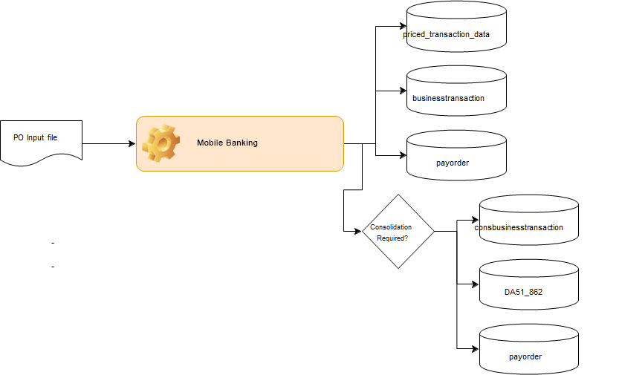
Work Flow of Mobile Banking Transaction

Slide 25
Sample Feed File- MOB
Account Number | Cam 20 | Status | Name | N1 | N2
12345 | X | CLS2 | ABC Enterprises | N | N
12345 | X | CLS2 | ABC Enterprises | N | N

Slide 26
Current Account Schedule of Charges
Mobile Banking
Standard charges- Rs 25per/month for the product CLS2
Standard charges- Rs 0 or Free for the product SBIVY

Slide 27
Priced Transaction Table- RESULT
Product_Variant | PTD_ORG | PTD_CHARGEABLE | PTD_CONS | PRODUCT
MOB | 1 | 1 | 25 | CLS2
MOB | 1 | 1 | 0 | SBIVY

Slide 28
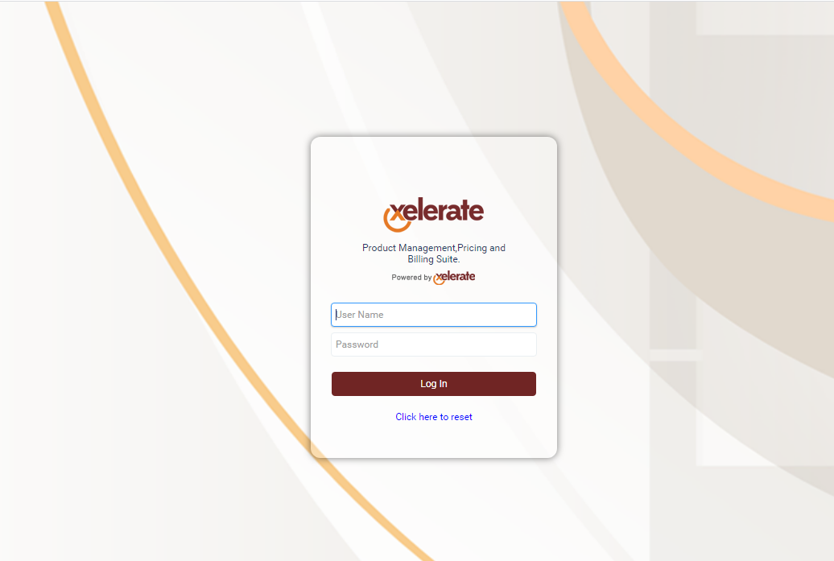

Slide 29
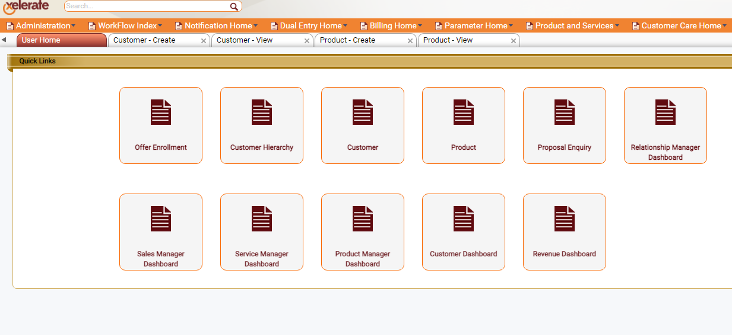
Home Page

Slide 30
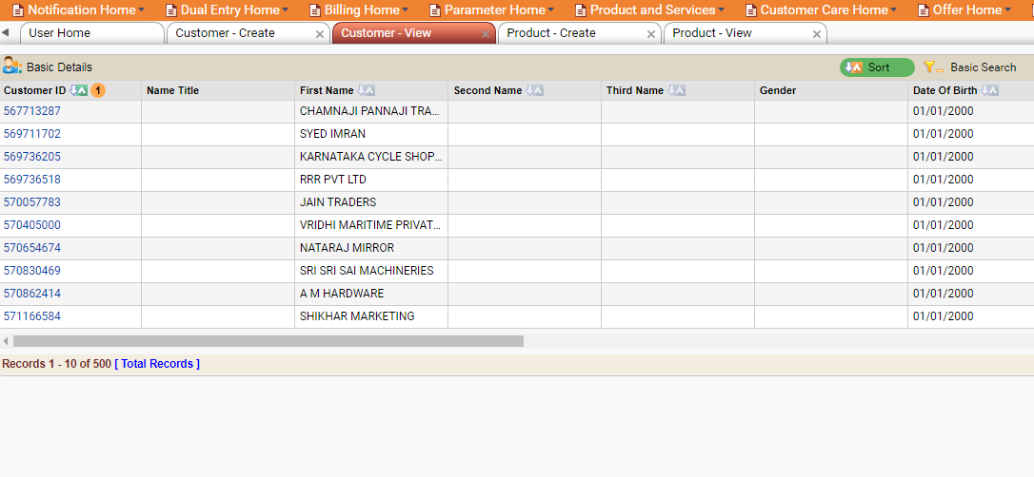
Customer -View

Slide 31
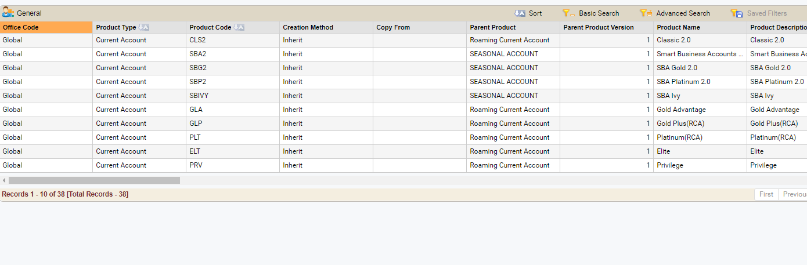
Product View

Slide 32
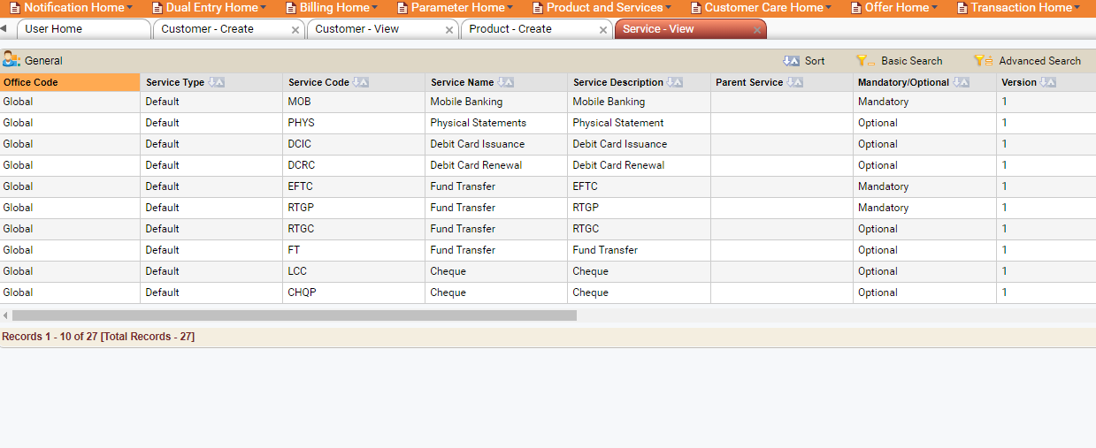
Service View

Slide 33
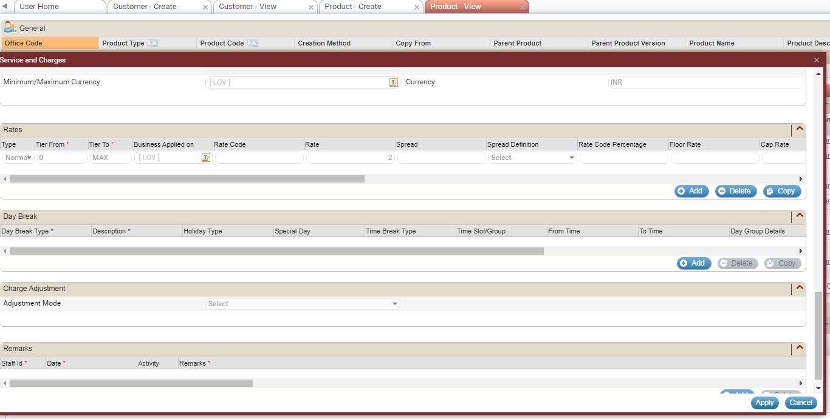
Service Charge Rate- DD

Slide 34
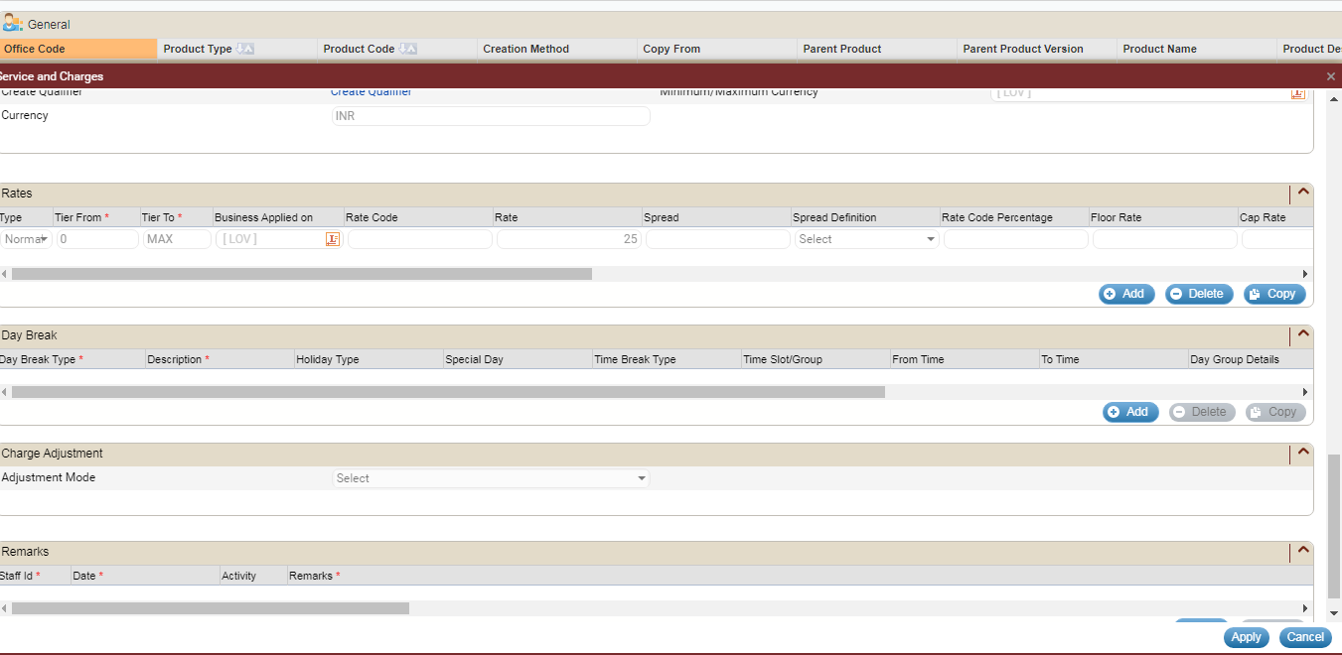
Service Charge Rate- MOB

Slide 35
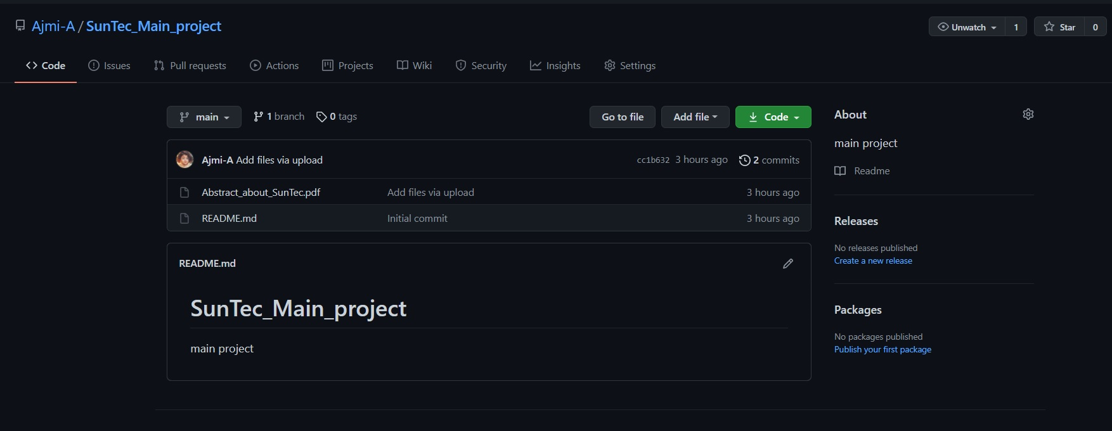
Screenshot – Git Repository

Slide 36
THANK YOU

