Slide 1
TSM II.
Marcell P. Granát

Slide 2
Table of Contents
Adatgyűjtés

Slide 3
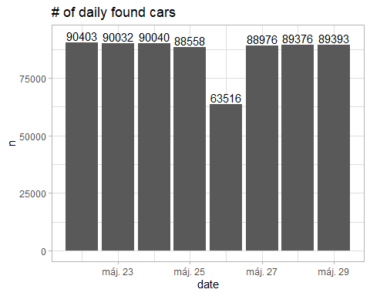
Adatgyűjtés

Slide 4
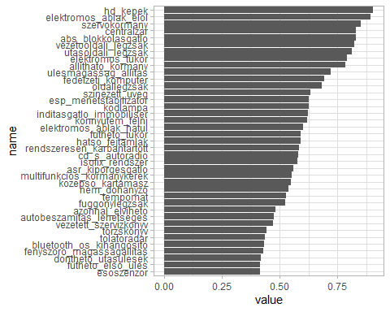

Slide 5
cars_lifetime <- available_cars %>% arrange(date) %>% group_by(url_to_car) %>% summarise(start = min(date), until = max(date)) %>% ungroup() %>% mutate(selling_type = case_when(start == until ~ "mayfly (probably not transaction)", start == as.Date("2021-05-22") & until == as.Date("2021-05-30") ~ "still alive", start != as.Date("2021-05-22") & until == as.Date("2021-05-30") ~ "new comer", start == as.Date("2021-05-22") & until != as.Date("2021-05-30") ~ "already sold", start != as.Date("2021-05-22") & until != as.Date("2021-05-30") ~ "well-known", T ~ "uncategorised"))

Slide 6
selling_type | n
already sold | 87694
mayfly (probably not transaction) | 4529
new comer | 710
still alive | 1940
well-known | 15638
Number of cars by selling type

