Slide 1

GuardLink
Protection,
together.
A community-owned path from
a hospital bill to accountable support.
Testnet prototype
Illustrative artwork
Notes:
Founder Ajnas N B. Preserve the father’s eye surgery story in natural first person. Synthetic testnet demonstration. Artwork is AI-generated, not a research photograph. Source: founder account and PRODUCT.md.

Slide 2
We had the documents.
Our family still had to borrow.
Bills. Discharge summary. Prescriptions.
Every visit brought another requirement.
The claim waited. The financial pressure did not.
“Insurance should protect a family, not exhaust it.”
GuardLink
Notes:
Founder-reported personal experience, supplied in chat and VIDEO_BRIEF.md. Do not state that all insurance delays are intentional or profitable. No real medical records appear.

Slide 3
One case stays with the member.
01
Join and contribute
A non-transferable NFT records membership and coverage.
02
Submit evidence
A clear request asks for any missing document under the same case ID.
03
Receive human review
Three eligible jurors review the case. Two matching decisions resolve it.
04
Follow the payment
Approved USDC reaches the claimant wallet. A rejection can receive one appeal.
GuardLink
Notes:
Working behavior: stable UUID through missing-document request and response. AI organizes evidence and prepares recommendations, never decides or pays. Sources: packages/domain, worker/workflow, live-verification.json.

Slide 4
People decide.
A different panel hears the appeal.
Initial review
Independent appeal
Three eligible jurors
Two matching decisions
A recorded reason for each vote
Three different jurors
One appeal per rejected case
A separate accountable outcome
AI helps prepare the evidence. It has no vote or payout authority.
GuardLink
Notes:
Contract selection is operator-controlled in this prototype, not proven random or fully decentralized. Initial and appeal panels are disjoint; conflicts and duplicate votes revert. One appeal. Sources: GuardLinkPool.sol and 152-test run.

Slide 5
Members govern future rules.
Existing coverage stays intact.
One verified member, one vote.
Coverage and contribution changes apply prospectively.
The contract preserves the terms already issued to a member.
Live demonstration: nine votes increased new-policy coverage
from 5 to 6 test USDC. Earlier policies kept their 5 USDC limit.
GuardLink
Notes:
Snapshot eligibility, half-member quorum and two-thirds support among votes cast. 72 hours. Early execution only if all snapshot voters voted. Actual proposal: 9/9 support, executed. Future limit6 testUSDC, policies1/2 preserve5. Source demo-run.public.json and getProposal chain reads.

Slide 6
The payment rules are inspectable.
Arc
Arkiv
Swarm
Reserve, policy NFT,
jury authority and
confirmed USDC payout
Searchable public
case milestones and
wallet-owned records
Encrypted documents.
Authorized PDF retrieval.
Public ciphertext reference.
Uniswap converted test WETH to USDC. A separate Arc deposit issued policy #3.
GuardLink
Notes:
Arc holds USDC and enforces coverage and payout authority. Blockchain cannot establish evidence truth or automatically make human decisions fair. Arkiv public records are wallet-owned by the disclosed service writer, not by each individual member. Sources: https://docs.arc.io/arc/concepts/stablecoin-native-model, arkiv-verification.json, swarm-verification.json and contribution-route.base-sepolia.public.json. A 0.001 WETH swap gave 2.243326 USDC; after CCTP the wallet increased by 1.096341 USDC and a 1 USDC deposit issued policy #3.

Slide 7
Three claims paid on Arc Testnet.
0.50
0.25
0.40
test USDC
test USDC
test USDC
Initial jury approval
Filmed jury approval
Paid after appeal
Fresh wallet: 1 test USDC funded policy #4 on the same Arc pool.
GuardLink
Notes:
Verified canonical USDC payout receipts and recipient balances for synthetic cases A, C and B. Fresh demo wallet paid 1 test USDC and received policy #4 with 6 test USDC coverage for 30 days. See demo-run.public.json and membership-live.public.json.

Slide 8
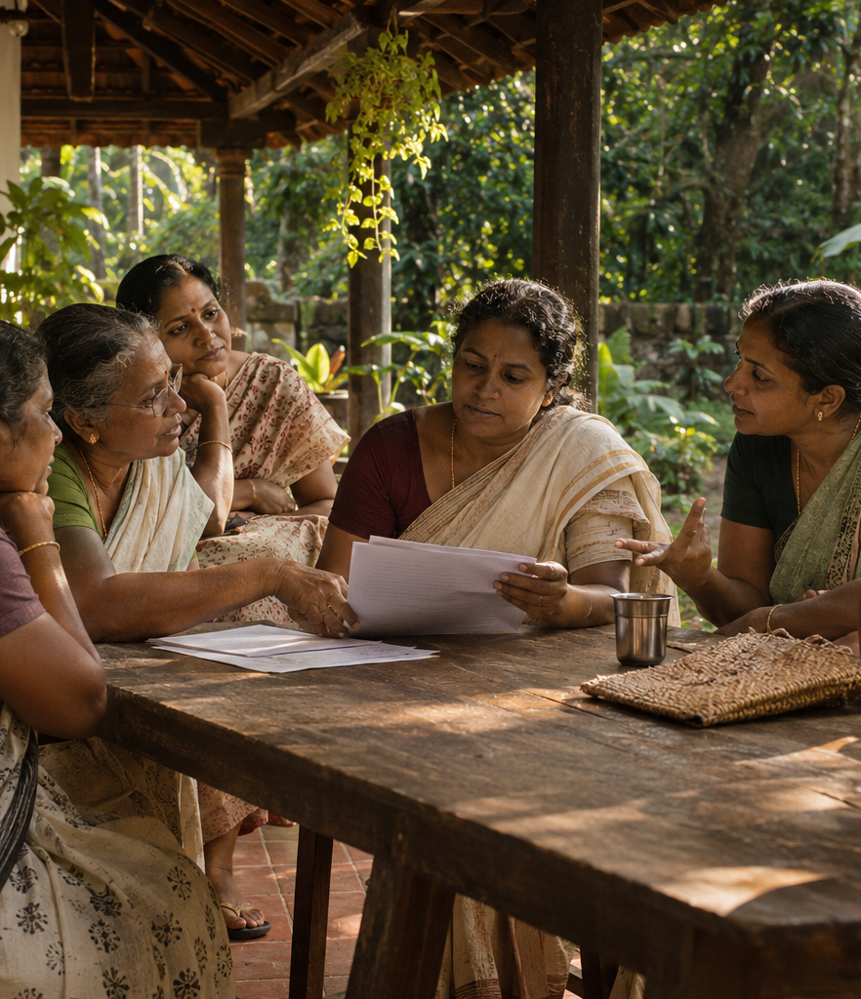
A year of persistence.
Rooted in community.
Conversations with women and families
in Kerala shaped the problem.
The next step is a consented pilot
that measures understanding, reviewer
participation and payment reliability.
Illustration, not a photograph of participants
Notes:
Founder reports interviews and interest collection involving Kudumbashree community members. No verified organization partnership or insured-member count is asserted. Do not use the conflicting 6,000/200,000 outreach figures. Generated illustrative image.

Slide 9
The prototype is working.
Launch readiness needs more proof.
Verified now
Next evidence
Contribution and coverage
Missing-document follow-up
Human decisions and appeal
Three payouts and a nine-voter DAO
Arkiv, Swarm and Uniswap route
Swarm postage provenance
Human-narrated demo
Confirm Arc Studio judge access
Consented community pilot
Independent security and operating review
GuardLink
Notes:
Current limitations. Swarm ciphertext/PDF/Arkiv link verified; gateway postage batch provenance still needed. Base Sepolia Uniswap swap, CCTP arrival and separate Arc deposit verified; email provider setup pending; human narration not supplied. Dependencies retain upstream advisories. A lawful insurance operating structure, actuarial pricing, real consent and independent audit are required before real coverage.

Slide 10
Protection should feel like a right.
Not a favour.
Submit once. Understand the decision.
Follow the payment.
guardlink.ajnasnb.com
Built for people. Built for dignity.
GuardLink
Notes:
Close with the founder’s own voice. Invite volunteers to test the synthetic workflow and give feedback, not to buy real insurance. Live app https://guardlink.ajnasnb.com. Continuity disclosure README and baseline commit370a135a7eb1fa883a4fca00111a3a8c2e5c226b. Source code, artwork and presentation assisted by AI.

