Slide 1

AI Passport
Run AI.
Trace its inputs.
Qarinah + Arkiv
AI Passport · Built by Ajnas NB
passport.ajnasnb.com
Notes:
Original AI-generated conceptual artwork. This is an illustration, not a photograph or customer evidence. AI Passport combines new MIT graph/admission integration with a disclosed Apache-2.0 Qarinah baseline. Source: https://github.com/AjnasNB/app-passport/blob/main/PREEXISTING.md

Slide 2

Connected evidence
Current review
Exact bytes
Original source
Context
Task
Model
Tool
Accepted authors
Result
Traceable inputs, useful outputs
AI Passport · Built by Ajnas NB
passport.ajnasnb.com
Notes:
Editable conceptual data diagram matching the implemented node and edge contract. Source: https://github.com/AjnasNB/app-passport/blob/main/ARCHITECTURE.md. A signed identity establishes authorship and byte bindings, not truth or universal safety.

Slide 3
The execution path
Public / synthetic sources
Select task
Read Arkiv
Verify sources
Admit context
Validate output
Run real AI
Select memory
Run scoped tool
Rejected evidence → no model call
AI Passport · Built by Ajnas NB
passport.ajnasnb.com
Notes:
Editable multilayer architecture. All inference first checks the current graph, actual public source digests, packet identity and live accepted context/runtime reviews. Deterministic tools run before hosted inference. Model output is validated; generated guards pass six cases. Full architecture: https://passport.ajnasnb.com/architecture.html and https://github.com/AjnasNB/app-passport/blob/main/ARCHITECTURE.md

Slide 4

Made useful
in India
Lakh & crore
UPI safety
English & Hindi
Learning tools · No wallet
AI Passport · Built by Ajnas NB
passport.ajnasnb.com
Notes:
Conceptual AI-generated India learning illustration; no users or adoption are claimed. Actual products: India number tutor and UPI Safety Quest at https://passport.ajnasnb.com. Learning summary sources: https://www.npci.org.in/fraud-awareness and https://www.npci.org.in/what-we-do/upi/faqs. Exact arithmetic and game scoring are deterministic; AI explanations can be wrong.

Slide 5
Why Arkiv
Shared state
Browser
Producer
Signed evidence
on Arkiv
Reviewer
SDK / CLI
Accepted authors
Current reviews
AI Passport · Built by Ajnas NB
passport.ajnasnb.com
Notes:
Arkiv stores indexed entities, creator metadata and expiry; graph traversal is implemented by the SDK. It is not a native Cypher database. Different consumers can choose accepted reviewers over the same public evidence. A conventional database is sufficient for a single operator; Arkiv matters for independently readable shared authorship and current review/withdrawal state. Docs: https://docs.arkiv.network/json-rpc/querying-data/

Slide 6
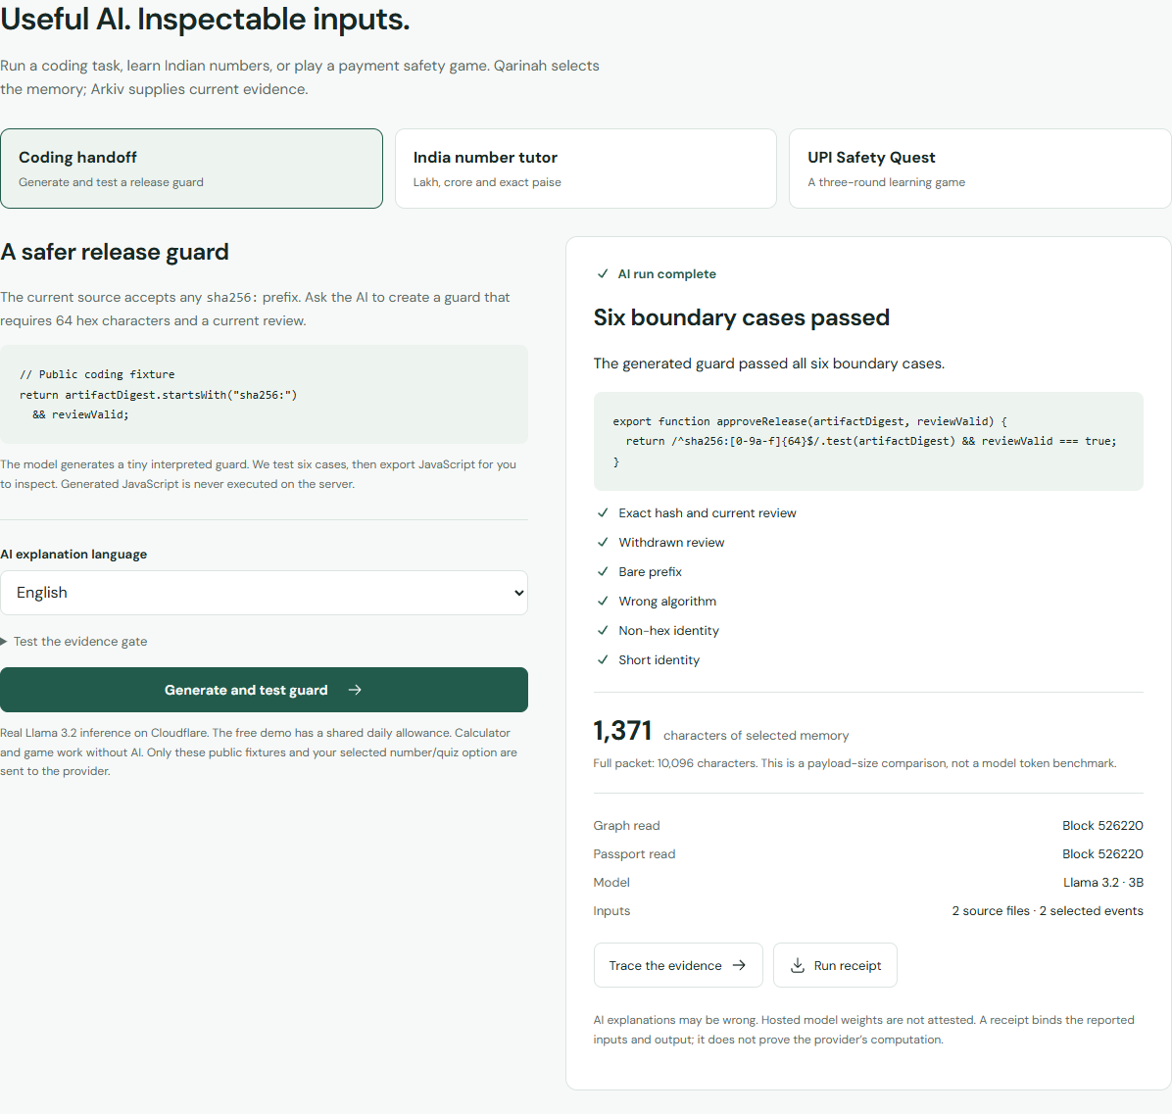
A working coding handoff
Real inference
Six boundary tests
Original sources
AI Passport · Built by Ajnas NB
passport.ajnasnb.com
Notes:
Actual public website screenshot from a real coding run. The hosted model generated a constrained guard; six deterministic boundary cases passed. Live evaluation receipt: https://passport.ajnasnb.com/data/ai-evaluation.json. No arbitrary generated JavaScript is executed. Hosted weights are not attested.

Slide 7
Selected memory
2
selected events
Approximate tokens
are labelled estimates
AI Passport · Built by Ajnas NB
passport.ajnasnb.com
Notes:
Native editable chart, units are JSON characters, measured from one actual successful coding run. Full Qarinah packet length and compact selected-memory length are recorded in https://passport.ajnasnb.com/data/ai-evaluation.json. This is a payload size comparison, not an exact token benchmark or proof of improved model accuracy. Values are literal snapshot evidence, not a formula workbook.

Slide 8
Reproduce the evidence
10 / 10
8 / 8
27
43
Real tool calls
Live AI & gate cases
Graph nodes
Graph edges
Try it. Inspect it. Read it independently.
passport.ajnasnb.com
AI Passport · Built by Ajnas NB
passport.ajnasnb.com
Notes:
Measured project-run results. Ten pinned artifacts and ten MCP controlled calls are disclosed in https://passport.ajnasnb.com/data/protocol-evaluation.json. Live AI suite: https://passport.ajnasnb.com/data/ai-evaluation.json. Signed graph counts: https://passport.ajnasnb.com/data/ai-chain-evidence.json. Source and licenses: https://github.com/AjnasNB/app-passport. All wallets are project-controlled demo roles. No universal security, independent reviewer organization, paid adoption, computation proof or perpetual availability is claimed.

