Slide 1
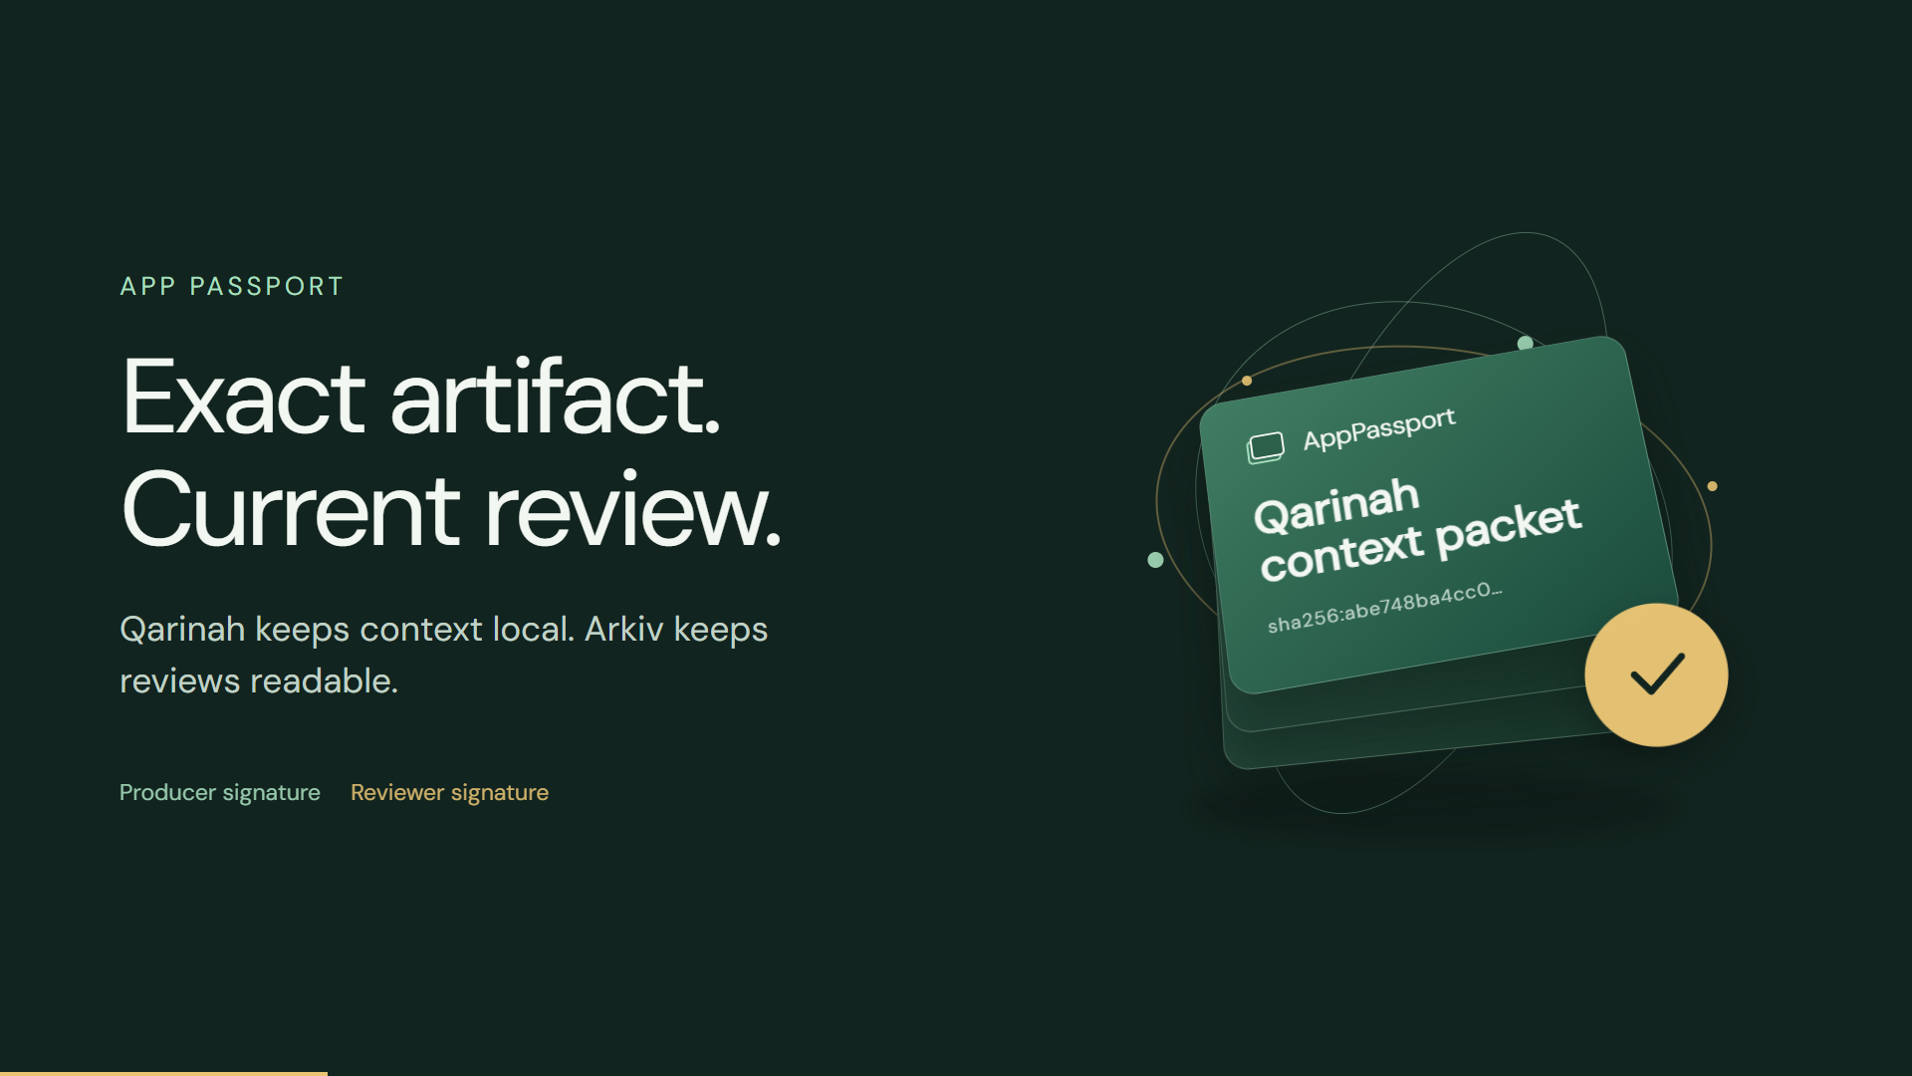
Notes:
AppPassport is newly built integration code over a disclosed pre-existing Qarinah compiler. Source: https://github.com/AjnasNB/app-passport/blob/main/PREEXISTING.md. Both demo wallets are project controlled. The physical passport is an original motion illustration, not a photograph.

Slide 2
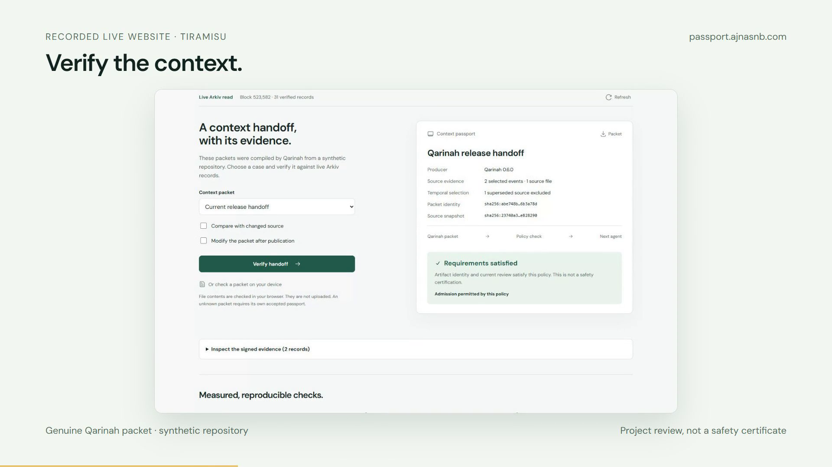
Notes:
This image is a recording of the actual public website over a genuine Qarinah packet generated from a synthetic repository. Evidence: https://passport.ajnasnb.com/data/context-evaluation.json and https://passport.ajnasnb.com/data/browser-evaluation.json. No private memory is published.

Slide 3
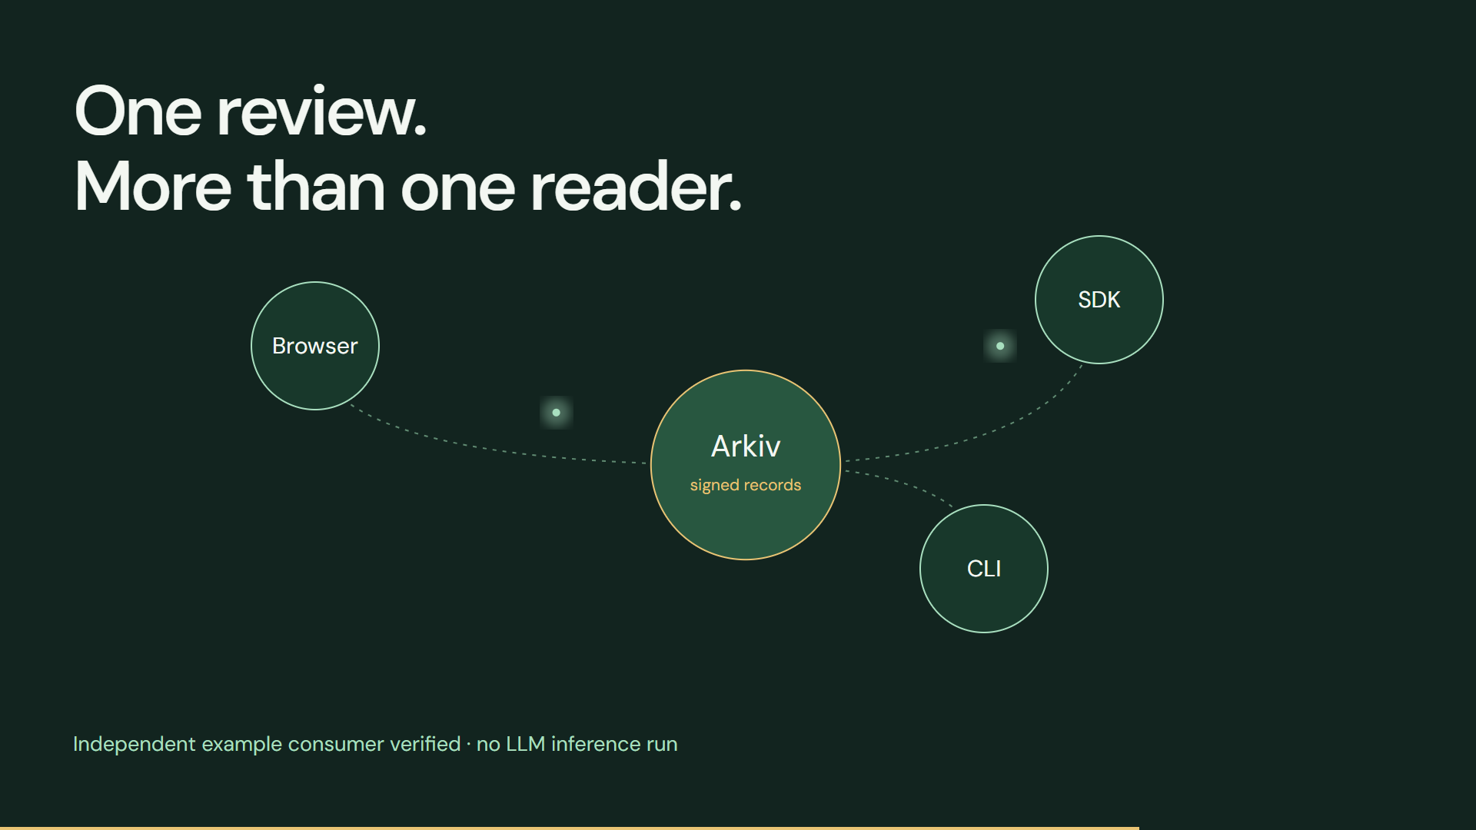
Notes:
The independent example consumer and CLI were tested through the raw Tiramisu RPC without the website backend. Evidence: https://passport.ajnasnb.com/data/consumer-evaluation.json. No second LLM inference or external adoption is claimed. The diagram illustrates readers and the shared data layer.

Slide 4
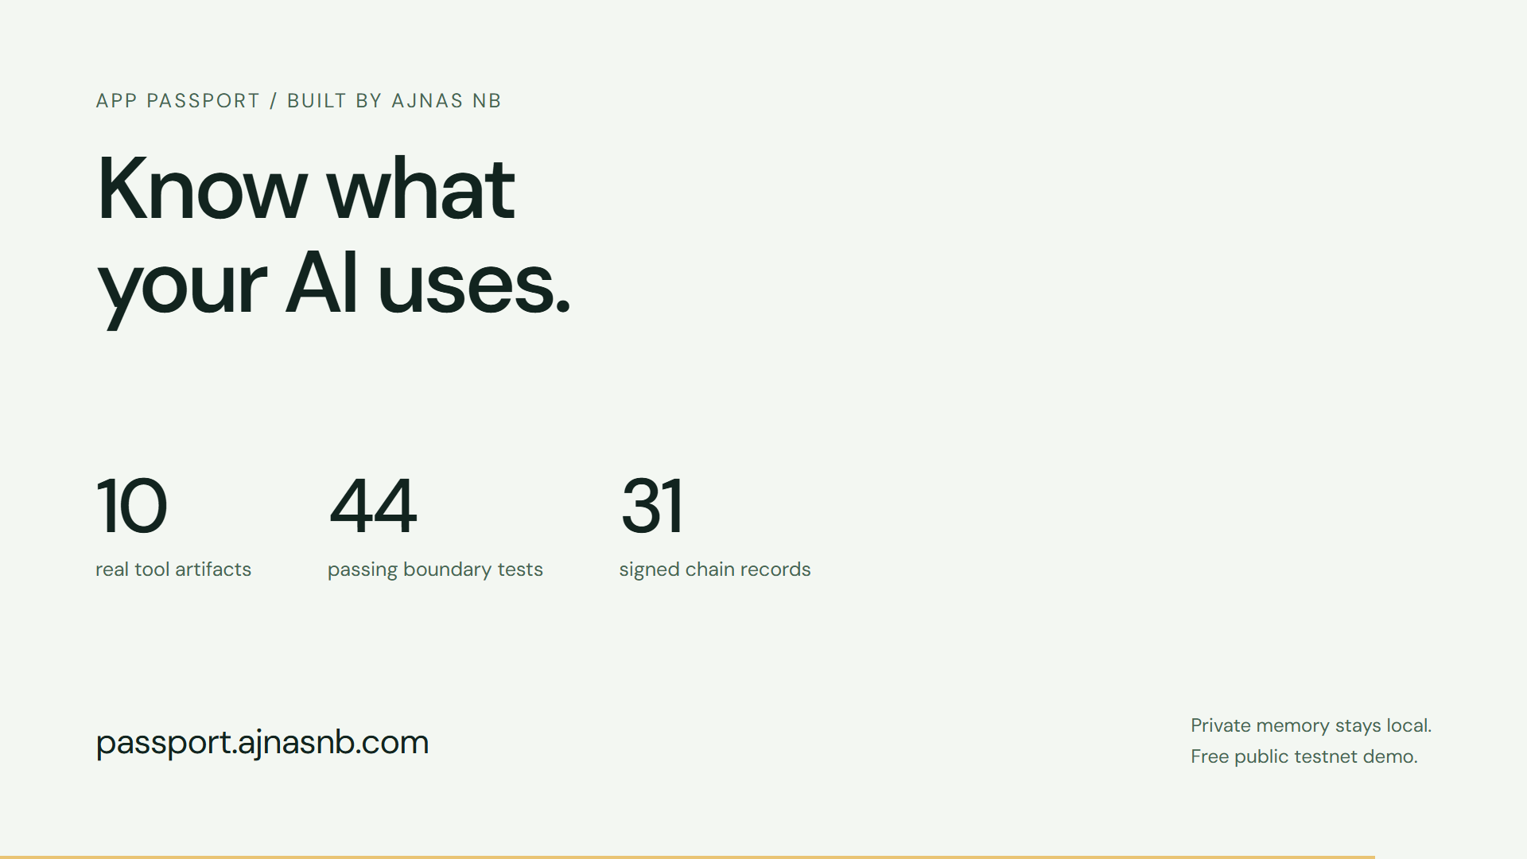
Notes:
Measured results: ten pinned tool artifacts, ten controlled MCP calls, 44 SDK/API/source-file tests, and 31 signed chain records. Evidence: /data/protocol-evaluation.json, /data/security-evaluation.json and /data/live-verification.json at https://passport.ajnasnb.com. These checks do not certify production security or malware safety.

