Slide 1

Arkiv Graph
Shared graph evidence
for AI tools
A copied approval can
outlive its review
AI-tool developers
Security reviewers
I built this: Ajnas NB
1 / 7
Notes:
Problem and users: copied AI-tool context can remain in circulation after its review is withdrawn. A content hash identifies bytes but does not discover connected sources, accepted authors or current withdrawal records. Arkiv Graph is a reusable MIT TypeScript SDK with CLI and stdio MCP; AI Passport is the working reference app. Target users are AI-tool developers and security reviewers. Open Source and Security are the proposed hackathon tracks. All wallets and demo consumers are project-controlled. There is no outside-adoption claim. Builder: Ajnas NB. Product source: https://github.com/AjnasNB/arkiv-graph/blob/main/ARKIV_GRAPH.md . Official judging rubric: https://github.com/Arkiv-Network/global-tour-stop-pre-devcon/blob/main/docs/scoring-rubric.md . Artwork is generated conceptual imagery.

Slide 2

Why Arkiv
Readers query shared records
without my application API
Arkiv
Indexed entities, creator metadata, expiry
Arkiv Graph
Signed membership and graph traversal
Private memory and inference stay off chain
I built this: Ajnas NB
2 / 7
Notes:
Why Arkiv: it supplies a shared public indexed entity/query layer with protocol creator metadata, time-limited storage and transactions. A separately installed reader can query those records without this project's website API and choose its accepted authors and root policy. The SDK verifies signed graph membership and performs traversal; Arkiv is not represented as a native graph database or Cypher engine. A private conventional database can support a single operator's app. Another public protocol could implement a similar model; Arkiv's indexed public entity model is the concrete fit used here. Private Qarinah memory, original full source, inference and secrets stay off chain. Evidence: https://arkivgraph.ajnasnb.com/data/backend-independence.json . Current package reuse: https://arkivgraph.ajnasnb.com/data/npm-trust-consumer.json . Architecture: https://github.com/AjnasNB/arkiv-graph/blob/main/ARCHITECTURE.md . Arkiv query docs: https://docs.arkiv.network/json-rpc/querying-data/ . RPC metadata, current history and query completeness remain provider assumptions.

Slide 3

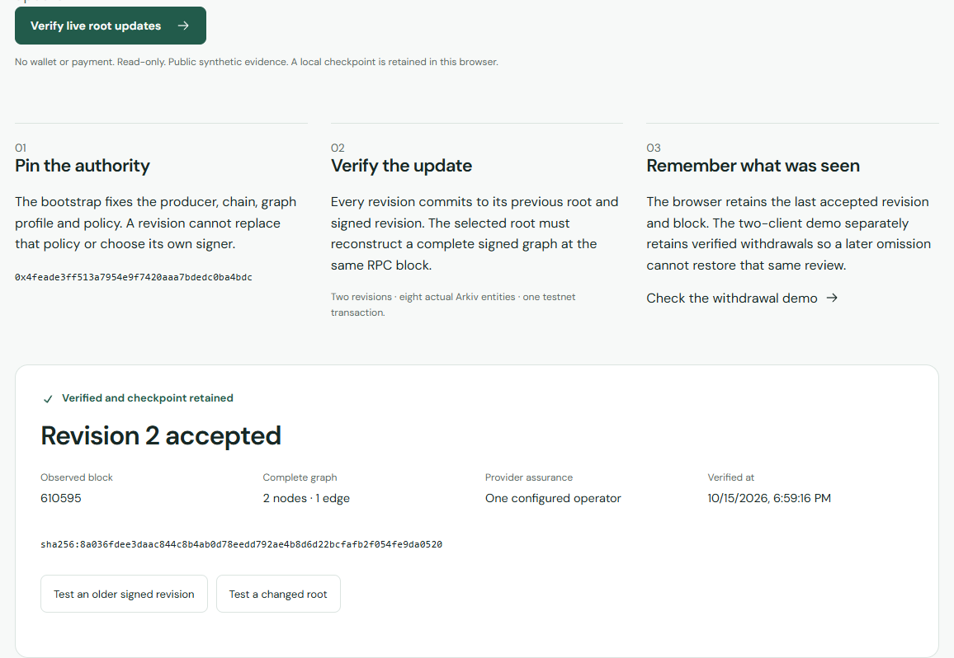
Authenticated root updates
Pinned authority
Scope and previous digest
Deadline and retained checkpoint
2 revisions
8 entities in 1 transaction
Separate tiny graph. Actual Tiramisu publication.
I built this: Ajnas NB
3 / 7
Notes:
Actual root update: 2 signed root-revision envelopes plus complete tiny graphs, 8 readonly entities in 1 batch transaction. Transaction https://tiramisu.explorer.arkiv.network/tx/0x4802ca8904dad4e118257f6761299e7b525d12abb09dcdecb79786be6cce8ff8 confirmed at block 608212. The root-update demonstration is a separate public synthetic tiny graph, not a migration of the larger signed AI reference graph. Revision one has 1 node, 0 edges and 2 graph entities. Revision two has 2 nodes, 1 edge and 4 graph entities. The remaining 2 entities are the signed revision envelopes. Reader policy pins authority, chain, registry, graph profile, policy digest and genesis root. Each revision binds sequence, previous root, previous revision digest, issue time and deadline. Verification rejects tampering, expired heads and rollback/forks relative to a retained checkpoint. Source: https://github.com/AjnasNB/arkiv-graph/blob/main/packages/arkiv-graph/src/root-registry.ts . Public proof: https://arkivgraph.ajnasnb.com/data/root-update-publication.json and https://arkivgraph.ajnasnb.com/data/trust-safeguards.json . An authority-signed root is authorization, not proof of source truth. A fresh reader cannot discover a newer head omitted by all sources. Product capture is the actual hosted trust view, not generated UI.

Slide 4

Withdrawal blocks the next task
3 real transactions
2 project-run clients both refused
Withdrawal retained while target is absent
Storage failure refuses admission
Cross-tab lock guards the journal
Retained history survives reload
Resetting local storage loses that history
I built this: Ajnas NB
4 / 7
Notes:
Actual lifecycle: passport transaction at block603788, review at603792 and same-author withdrawal at603917. Consumers A and B admitted at603794 and603795. B's next request refused at603919 and A's next request refused at603920. Both consumers and publisher/reviewer wallets are project-controlled. Recorded session: https://arkivgraph.ajnasnb.com/data/two-client-session.json . Withdrawal tx: https://tiramisu.explorer.arkiv.network/tx/0xfc8d4ae3df1948b1497e2b090476a2954f43f997bc122e923c155768fed6bc62 . New safeguards retain an authentic withdrawal even when its target is temporarily absent, persist the journal before admitting a task, and serialize same-origin browser access through Web Locks. Storage/lock failures refuse admission. Browser tests cover reload and separate same-origin tabs. Replay evidence and synthetic omissions are distinct from live RPC reads: https://arkivgraph.ajnasnb.com/data/trust-safeguards.json and https://arkivgraph.ajnasnb.com/data/browser-evaluation.json . Storage lifetime must cover the target and signed deadlines. This is next-request enforcement, not instantaneous revocation of an already-running task. Deleting local storage loses observed history. A single provider can hide an unseen withdrawal from a fresh reader.

Slide 5

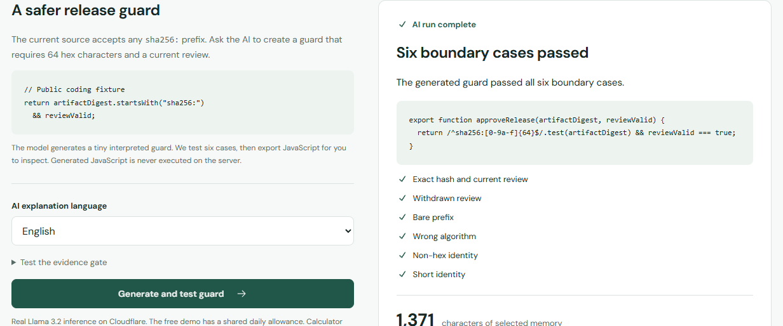
AI Passport in use
Source-bound coding handoff
English and Hindi number tools
UPI safety learning
Private Qarinah
memory stays local
Public and synthetic evidence only
I built this: Ajnas NB
5 / 7
Notes:
Working reference application: AI Passport verifies connected source evidence, context packet, runtime declaration and current review before hosted inference. The real product model is Cloudflare Workers AI @cf/meta/llama-3.2-3b-instruct. Six deterministic coding guard cases and hosted inference are separate evidence. Actual tasks include a source-driven coding handoff, exact integer-paise and lakh/crore number tools in English/Hindi, and a UPI safety learning quest with optional AI coach. India relevance is the bilingual tools and safety learning demonstration; no Indian deployment partners, measured social outcomes or external users are claimed. Qarinah private project memory stays local; public demo packets are synthetic. The original Qarinah folders remain unchanged. Runtime input receipt: https://arkivgraph.ajnasnb.com/data/ai-journey-run.json . Real use/guard evidence: https://arkivgraph.ajnasnb.com/data/ai-evaluation.json . Public app: https://arkivgraph.ajnasnb.com/?view=handoff and https://arkivgraph.ajnasnb.com/?view=tools . Qarinah reuse baseline and licenses: https://github.com/AjnasNB/arkiv-graph/blob/main/README.md . The screenshot is an actual hosted workspace. Artwork is conceptual, not a photo of users.

Slide 6

Measured evidence
271
34
19
8
Local tests
Browser checks
Trust checks
Installed SDK checks
Mobile Lighthouse. Median of 3 per route and phase.
18 cold-load lab runs. Simulated desktop, no physical-phone or field claim.
I built this: Ajnas NB
6 / 7
Notes:
Actual project-run results, not an independent security audit or outside adoption: 271/271 local unit/API/security tests; 34/34 hosted browser checks; 19/19 trust checks; 8/8 isolated installed public npm trust checks; 8/8 actual MCP checks. Test sets overlap in feature coverage and are not added into one denominator. Sources: https://arkivgraph.ajnasnb.com/data/security-evaluation.json , https://arkivgraph.ajnasnb.com/data/browser-evaluation.json , https://arkivgraph.ajnasnb.com/data/trust-safeguards.json , https://arkivgraph.ajnasnb.com/data/npm-trust-consumer.json , https://arkivgraph.ajnasnb.com/data/graph-infrastructure-evaluation.json . Native chart uses actual baseline and final medians, not illustrative data. Mobile method: Lighthouse13.5.0, three fresh Chrome profiles for each route in each release, 18 samples total. Viewport412x823, 4x simulated CPU slowdown,150msRTT,1638.4kbps. Overview87 to98, Context88 to98, Two-client41 to96. Final median LCP:1.996s,2.067s,2.414s. Final median TBT:4.5ms,0ms,0ms. Final median CLS:0,0,0.01085. Lab results on a Windows desktop, not a physical phone or field Core Web Vitals. No INP or production scale claim. Background historical signature verification can continue after first paint. Measurement: https://arkivgraph.ajnasnb.com/data/mobile-performance.json . Reproduce: npm exec --yes --package lighthouse@13.5.0 -- node scripts/mobile-performance.mjs baseline; deploy candidate; repeat with final.

Slide 7

Open toolkit. Explicit trust.
npm install @ajnasnb/arkiv-graph@0.4.0
@ajnasnb/ai-passport 0.6.0
npx arkiv-graph verify apps/web/public/data/arkiv-graph-reader.json
npx arkiv-graph mcp apps/web/public/data/arkiv-graph-reader.json
Friction documented
Wire time uses seconds. eth_getProof is unavailable.
Withdrawal lifetime must cover its target.
Fresh readers still trust RPC completeness
arkivgraph.ajnasnb.com/judges.html
I built this: Ajnas NB
7 / 7
Notes:
Setup: npm install @ajnasnb/arkiv-graph@0.4.0 . AI Passport adapter: @ajnasnb/ai-passport@0.6.0 . Both public registry packages and anonymous byte integrity are documented at https://arkivgraph.ajnasnb.com/data/npm-release.json . Download the public reader configuration at https://arkivgraph.ajnasnb.com/data/arkiv-graph-reader.json and independently inspect accepted authority/root policy; npm package installation does not establish trust. Run npx arkiv-graph verify reader.json or npx arkiv-graph mcp reader.json . Root-trust configuration: https://arkivgraph.ajnasnb.com/data/root-trust-config.json . Repro commands and exact query fields: https://github.com/AjnasNB/arkiv-graph/blob/main/ARKIV_GRAPH.md , https://github.com/AjnasNB/arkiv-graph/blob/main/arkiv/schema.md . Friction with exact observations and fixes: https://github.com/AjnasNB/arkiv-graph/blob/main/arkiv/friction.md . Actual SDK0.8.1 transport timing is epoch seconds, converted to milliseconds. The official hosted RPC returned -32601 for eth_getProof; no state-proof verifier is implemented. Withdrawal storage must cover target storage and signed validity. Root bootstrap is pinned; authenticated revisions and local checkpoints do not prove fresh-client non-omission. Only one live provider, finite200node/500edge/8page/depth8bounds, no native Cypher or production scale claim. Original full source/private memory/model inference remain off chain. Public source is MIT with disclosed Apache-2.0 Qarinah reuse. Both publishers/consumers project-operated. This deck answers the four equal25point areas: problem/pillar/India, WhyArkiv, actualfeatureuse, reproduciblefriction.

