Slide 1
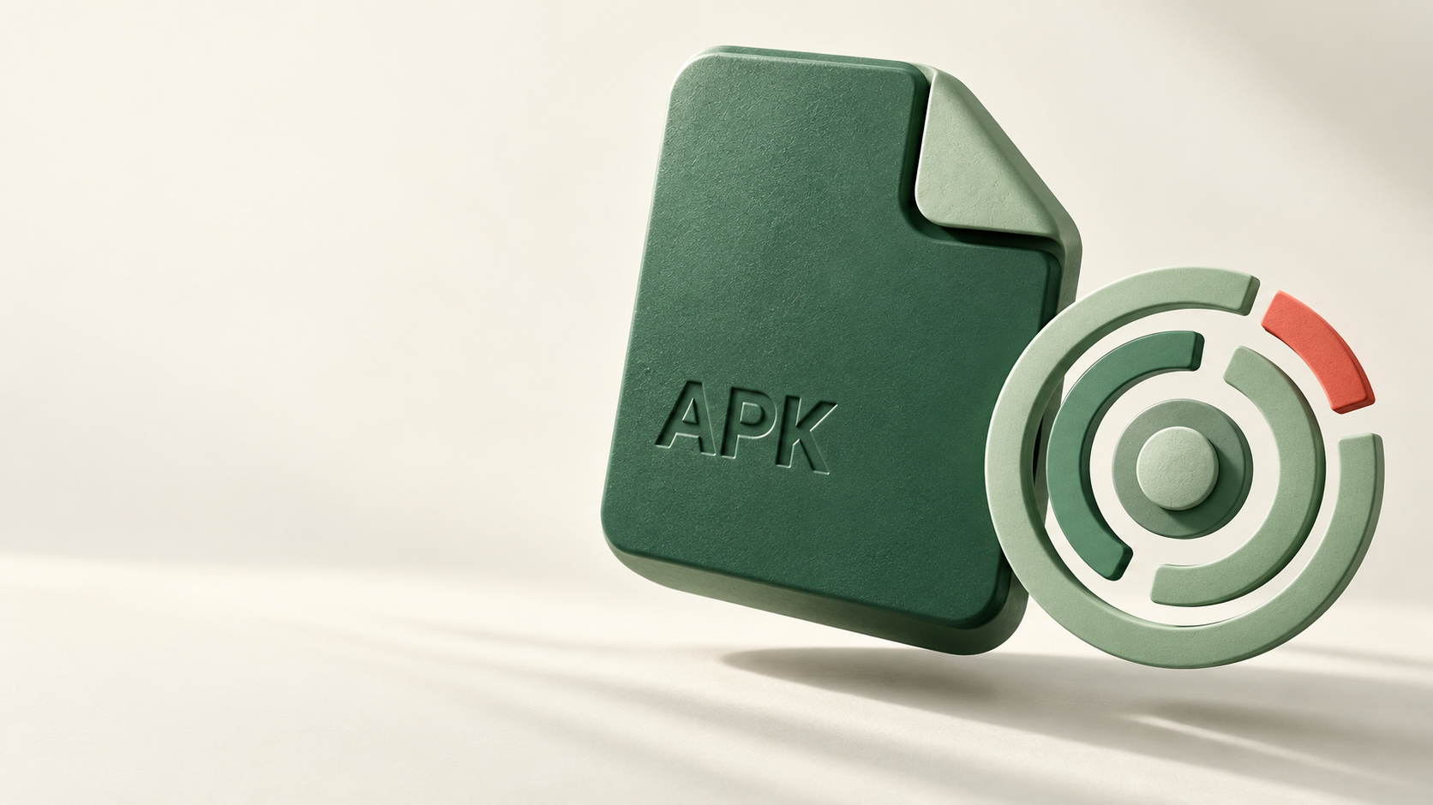

ScamSignal
+ AppPassport
Understand an APK
before installing it
Android APK analysis with shared public evidence
Notes:
Product implementation brief. Artwork generated with OpenAI image generation. Static analysis cannot establish safety.

Slide 2

A useful pause
for India
Someone sends you an APK.
You want evidence before installing.
Upload from your phone
Read signature and permission findings
Compare the release and review warnings
English + Hindi. No wallet or fee.
Notes:
Intended consumer scenario. No measured adoption or fraud-reduction claims. Hindi permission explanations are implemented in scanner/evaluation.json. Artwork is a generated illustration, not a photograph of a real event.

Slide 3
Evidence has different jobs
APK identity
Warning authorship
Verify the signature. Compare the file hash and signing identity with a reviewed artifact reference.
Check the Arkiv record’s actual wallet creator against the reviewer policy. A copied name earns no trust.
A valid signature does not establish safety
Notes:
Android apksigner documentation https://developer.android.com/tools/apksigner . Arkiv system attributes and creator filtering https://docs.arkiv.network/typescript-sdk/querying-data/ . The project uses a documented reviewer allowlist; blockchain authorship alone does not establish reviewer expertise.

Slide 4

Useful beyond
one website
19 public records:
12 artifact references + 7 warnings.
Independent clients can read
the same author-checked records.
Raw APK uploads stay outside Arkiv.
Notes:
Arkiv network fundamentals https://docs.arkiv.network/start-here/fundamentals/ . This describes existing public-record reads independent of the ScamSignal analysis backend. New scans still require analysis service availability. Artwork is generated.

Slide 5
Twelve measured APKs
5 upstream releases · 5 documented malicious · 2 training controls
Application | Permissions | Source context
KeePassDX | 9 | Upstream open source release
Aegis | 6 | Upstream open source release
NewPipe | 11 | Upstream open source release
Fossify Calculator | 1 | Upstream open source release
Fossify File Manager | 6 | Upstream open source release
InsecureBankv2 | 12 | Intentionally insecure training app
PIVAA | 12 | Intentionally insecure training app
Training controls are deliberately vulnerable, not confirmed scams.
All twelve APK signatures verified. Identity is only one piece of evidence.
Notes:
Source: scanner/evaluation.json and scanner/live-evaluation.json. Androguard 4.1.4 and Android Build Tools 35.0.0. All twelve files were statically inspected through the live scanner; no app was installed or executed. Sources: https://github.com/Kunzisoft/KeePassDX/releases/tag/4.5.5
https://github.com/beemdevelopment/Aegis/releases/tag/v3.4.3
https://github.com/TeamNewPipe/NewPipe/releases/tag/v0.29.1
https://github.com/FossifyOrg/Calculator/releases/tag/1.4.0
https://github.com/FossifyOrg/File-Manager/releases/tag/1.6.2
https://github.com/dineshshetty/Android-InsecureBankv2/tree/3c8cc3a3ce45ed56d0f58f236b541b41f992e51f
https://github.com/HTBridge/pivaa/tree/7fde8956083ec4c6023c75f013f72023d60eda12

Slide 6
Signed can still be malicious
Five historical samples backed by primary research and exact IOCs
Application | Permissions | Source context
Exodus spyware | 13 | Documented malicious sample
Fake MetaMask clipper | 3 | Documented malicious sample
Fake BtcTurk phishing | 6 | Documented malicious sample
Fake BtcTurk beta | 8 | Documented malicious sample
Fake Koineks phishing | 8 | Documented malicious sample
Fake BtcTurk: verified signature, zero sensitive manifest permissions.
Its ESET-backed phishing warning supplies the missing context.
This evaluation demonstrates the flow, not detection accuracy.
Notes:
Malicious classification comes from primary ESET/Lookout research and exact published IOCs; static capability flags are not sufficient on their own. Fake BtcTurk exact MD5 336ce9cdf788228a71a3757558faa012; ESET https://www.welivesecurity.com/2019/06/17/malware-google-permissions-2fa-bypass/ . Source-backed historical advisories are project-reviewer records, not official authority endorsements. Evidence: https://github.com/sk3ptre/AndroidMalware_2019/blob/eef650faedacb06f11a778fb1e3a18bae4e5af36/README.md https://github.com/securitywithoutborders/website/blob/f5d6c338a4dd373720dcaea2b138250fce6b3bb5/source/blog/posts/2019-03-29-exodus.html.markdown https://github.com/sk3ptre/AndroidMalware_2019/blob/eef650faedacb06f11a778fb1e3a18bae4e5af36/README.md
https://github.com/sk3ptre/AndroidMalware_2019/blob/eef650faedacb06f11a778fb1e3a18bae4e5af36/README.md https://www.welivesecurity.com/2019/02/08/first-clipper-malware-google-play/ https://github.com/sk3ptre/AndroidMalware_2019/blob/eef650faedacb06f11a778fb1e3a18bae4e5af36/README.md
https://github.com/sk3ptre/AndroidMalware_2019/blob/eef650faedacb06f11a778fb1e3a18bae4e5af36/README.md https://www.welivesecurity.com/2019/06/17/malware-google-permissions-2fa-bypass/ https://github.com/sk3ptre/AndroidMalware_2019/blob/eef650faedacb06f11a778fb1e3a18bae4e5af36/README.md
https://github.com/sk3ptre/AndroidMalware_2019/blob/eef650faedacb06f11a778fb1e3a18bae4e5af36/README.md https://www.welivesecurity.com/2019/06/17/malware-google-permissions-2fa-bypass/ https://github.com/sk3ptre/AndroidMalware_2019/blob/eef650faedacb06f11a778fb1e3a18bae4e5af36/README.md
https://github.com/sk3ptre/AndroidMalware_2019/blob/eef650faedacb06f11a778fb1e3a18bae4e5af36/README.md https://www.welivesecurity.com/2019/06/17/malware-google-permissions-2fa-bypass/ https://github.com/sk3ptre/AndroidMalware_2019/blob/eef650faedacb06f11a778fb1e3a18bae4e5af36/README.md

Slide 7
Evidence before
installation
Try the live upload or explore twelve measured sample reports.
scamsignal.ajnasnb.com
Static findings cannot guarantee safety. Permissions show declared capabilities. New scans require the analysis service.
Notes:
Product limitations are derived from the scanner coverage in scanner/evaluation.json. No detection-accuracy claim. Public records remain readable independently of our analysis backend when Arkiv is available.

