Slide 1
CS 415: Programming Languages
Chapter 1
Aaron Bloomfield
Fall 2005

Slide 2
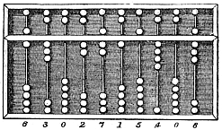
The first computers
Scales – computed relative weight of two items
  Computed if the first item’s weight was less than, equal to, or greater than the second item’s weight
Abacus – performed mathematical computations
  Primarily thought of as Chinese, but also Japanese, Mayan, Russian, and Roman versions
  Can do square roots and cube roots

Slide 3

Stonehenge

Slide 4
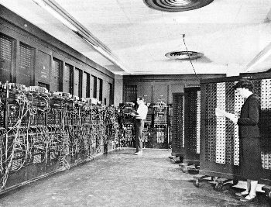
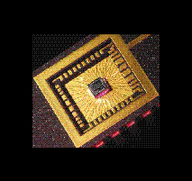
Computer Size
ENIAC then…
ENIAC today…
With computers (small) size does matter!

Slide 5
Why study programming languages?
Become a better software engineer
  Understand how to use language features
  Appreciate implementation issues
Better background for language selection
  Familiar with range of languages
  Understand issues / advantages / disadvantages
Better able to learn languages
  You might need to know a lot

Slide 6
Why study programming languages?
Better understanding of implementation issues
  How is “this feature” implemented?
  Why does “this part” run so slowly?
Better able to design languages
  Those who ignore history are bound to repeat it…

Slide 7
Why are there so many programming languages?
There are thousands!
Evolution
  Structured languages -> OO programming
Special purposes
  Lisp for symbols; Snobol for strings; C for systems; Prolog for relationships
Personal preference
  Programmers have their own personal tastes
Expressive power
  Some features allow you to express your ideas better

Slide 8
Why are there so many programming languages?
Easy to use
  Especially for teaching / learning tasks
Ease of implementation
  Easy to write a compiler / interpreter for
Good compilers
  Fortran in the 50’s and 60’s
Economics, patronage
  Cobol and Ada, for example

Slide 9
End of lecture on 24 Aug 2005

Slide 10
Programming domains
Scientific applications
  Using the computer as a large calculator
  Fortran and friends, some Algol, APL
  Using the computer for symbol manipulation
  Mathematica
Business applications
  Data processing and business procedures
  Cobol, some PL/1, RPG, spreadsheets
Systems programming
  Building operating systems and utilities
  C, PL/S, ESPOL, Bliss, some Algol and derivitaves

Slide 11
Programming domains
Parallel programming
  Parallel and distributed systems
  Ada, CSP, Modula, DP, Mentat/Legion
Artificial intelligence
  Uses symbolic rather than numeric computations
  Lists as main data structure
  Flexibility (code = data)
  Lisp in 1959, Prolog in the 1970s
Scripting languages
  A list of commands to be executed
  UNIX shell programming, awk, tcl, Perl

Slide 12
Programming domains
Education
  Languages designed to facilitate teaching
  Pascal, BASIC, Logo
Special purpose
  Other than the above…
  Simulation
  Specialized equipment control
  String processing
  Visual languages

Slide 13
Programming paradigms
You have already seen assembly language
We will study five language paradigms:
  Top-down (Algol 60 and Fortran)
  Functional (Scheme and/or OCaml)
  Logic (Prolog)
  Object oriented (Smalltalk)
  Aspect oriented (AspectJ)

Slide 14
Programming language history
Pseudocodes (195X) – Many
Fortran (195X) – IBM, Backus
Lisp (196x) – McCarthy
Algol (1958) – Committee (led to Pascal, Ada)
Cobol (196X) – Hopper
Functional programming – FP, Scheme, Haskell, ML
Logic programming – Prolog
Object oriented programming – Smalltalk, C++, Python, Java
Aspect oriented programming – AspectJ, AspectC++
Parallel / non-deterministic programming

Slide 15
Compilation vs. Translation
Translation: does a ‘mechanical’ translation of the source code
  No deep analysis of the syntax/semantics of the code
Compilation: does a thorough understanding and translation of the code
A compiler/translator changes a program from one language into another
  C compiler: from C into assembly
    An assembler then translates it into machine language
  Java compiler: from Java code to Java bytecode
    The Java interpreter then runs the bytecode

Slide 16
Compilation stages
Scanner
Parser
Semantic analysis
Intermediate code generation
Machine-independent code improvement (optional)
Target code generation
Machine-specific code improvement (optional)
For many compilers, the result is assembly
  Which then has to be run through an assembler
These stages are machine-independent!
  The generate “intermediate code”

Slide 17
Compilation: Scanner
Recognizes the ‘tokens’ of a program
  Example tokens: ( 75 main int { return ; foo
Lexical errors are detected here
  More on this in a future lecture

Slide 18
Compilation: Parser
Puts the tokens together into a pattern
  void main ( int argc , char ** argv ) {
  This line has 11 tokens
  It is the beginning of a method
Syntatic errors are detected here
  When the tokens are not in the correct order:
  int int foo ;
  This line has 4 tokens
  After the type (int), the parser expects a variable name
    Not another type

Slide 19
Compilation: Semantic analysis
Checks for semantic correctness
A semantic error:
  foo = 5;
  int foo;
In C (and most languages), a variable has to be declared before it is used
  Note that this is syntactically correct
    As both lines are valid lines as far as the parser is concerned

Slide 20
Compilation: Intermediate code generation (and improvement)
Almost all compilers generate intermediate code
  This allows part of the compiler to be machine-independent
That code can then be optimized
  Optimize for speed, memory usage, or program footprint

Slide 21
Compilation: Target code generation (and improvement)
The intermediate code is then translated into the target code
  For most compilers, the target code is assembly
  For Java, the target code is Java bytecode
That code can then be further optimized
  Optimize for speed, memory usage, or program footprint

