Slide 1



Software Tool Time

Slide 2
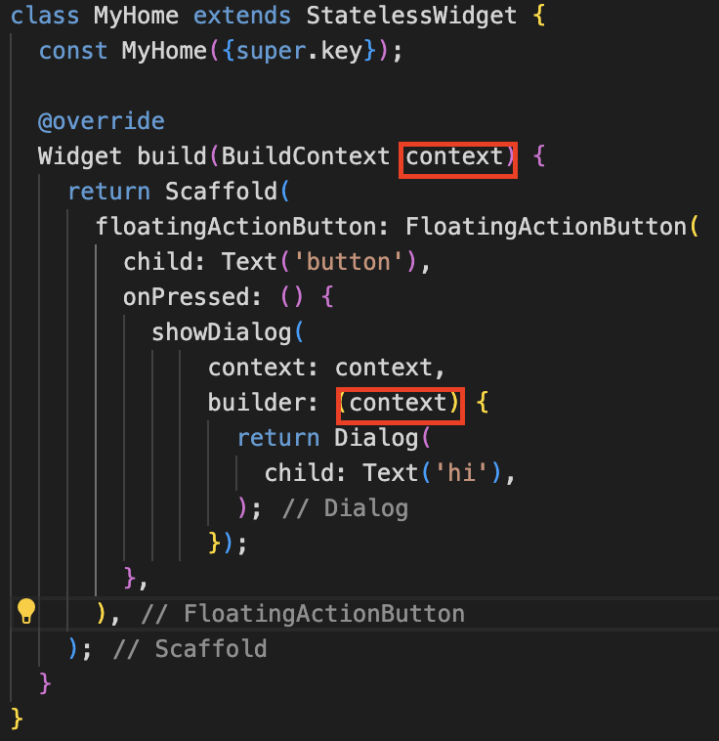
Context?
Widget tree 구조에서 현재 widget의 위치를 알 수 있음
각각 widget들은 고유의 Context를 가짐

Slide 3
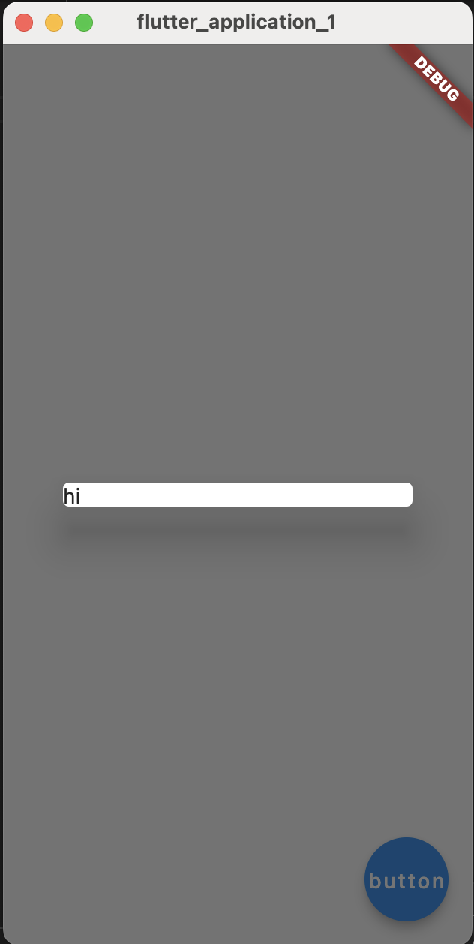
Dialog widget
팝업 창
showDialog 를 이용하여 화면에 표시

Slide 4
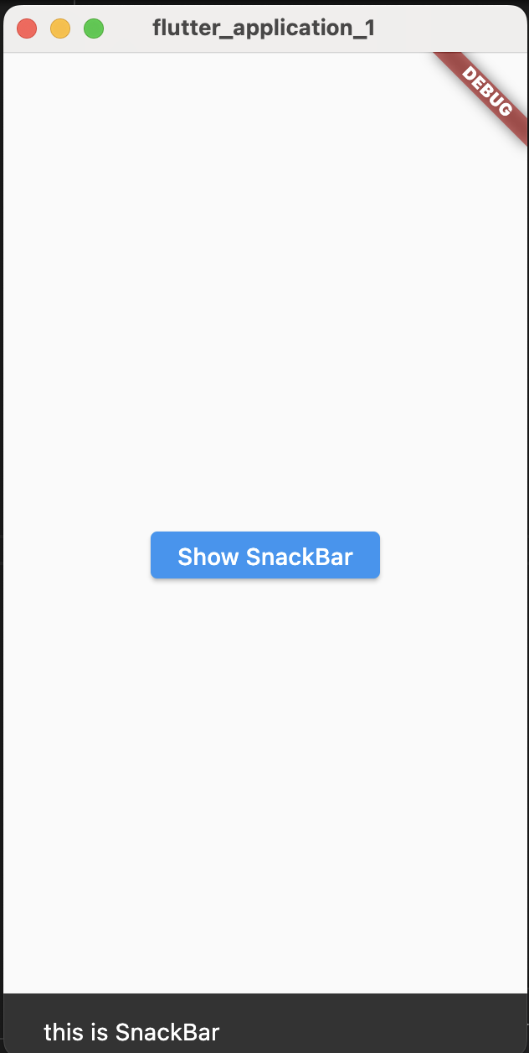
SnackBar
사용자에게 간단한 메시지를 보여주고 사라지는 위젯
중요한 정보나 알림을 전달(작업의 성공,실패)

Slide 5
Software Tool Time (소프트웨어 툴 타임)
(CC-BY-NC 4.0) Hwanyong Lee, Yeongbeom Song and Ajou University
Visit “Software Tool Time” channel in YouTube : https://www.youtube.com/c/SoftwareToolTime
All product names, trademarks, and/or company names are used solely for identification and belong to their respective owners.
“Software Tool Time” video is licensed to the public under a Creative Commons Attribution 4.0 License (https://creativecommons.org/license/by/4.0/)
Twin Musicom’s African Drums (Sting) is licensed to the to the public under a Creative Commons Attribution 4.0 License (Artist: http://www.twinmusicom.org/)

Slide 6


