Slide 1
X Education Lead Scoring CASE STUDY REPORT
Date: 10th Jun, 2019
By:
Gajendra Kumar
Ajoy Nambiar

Slide 2
X Education Case Study
Business Overview: X Education, an education company, sells online courses to industry professionals. Professionals who are interested in the courses land on their website and browse for courses.
Objective:
To identify hot leads (potential buyer) so sales team can focus better and increase productivity
Analysis to be performed on leads dataset containing approx. 9000 data points
Notes:
Business objective: The objective is to identify the best sectors, countries, and a suitable investment type for making investments. The overall strategy is to invest where others are investing, implying that the 'best' sectors and countries are the ones 'where most investors are investing'.

Slide 3
Analysis Approach
Following high level approach to be used for performing the Lead Scoring analysis:
Step1: Load, Analyse, clean and impute the data.
Step2: Check correlation between continuous variables and remove unwanted attributes
Step3: Perform visualization univariate/bivariate/multivariate and create new attributes if needed (created ‘Oversees’ attribute as the conversion rate is high)
Step4: Create dummy variables for: Lead Origin, Lead Source, Last Activity, Last Notable Activity and deleted repeated variables
Step5: Check Outliers and retain data between 0.5 and 0.95 percentile
Step6: Perform feature standardization for the continuous variables and calculate initial conversion rate
Step7: Split data into train/test and build first logistic model utilizing train data. As the number of variables are quite high, use RFE to get top 15 variables.
Step8: Optimize the model by dropping variables having p<0.5 and VIFs<5
Step9: Optimize the threshold score so the lead conversion ratio is at 80%
Step10: Use this model to predict the scores on test data and compare the result with train data
Notes:
Business objective: The objective is to identify the best sectors, countries, and a suitable investment type for making investments. The overall strategy is to invest where others are investing, implying that the 'best' sectors and countries are the ones 'where most investors are investing'.

Slide 4
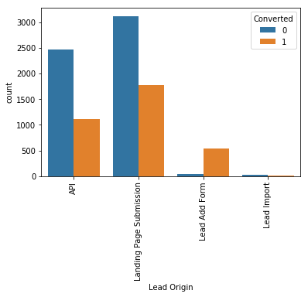
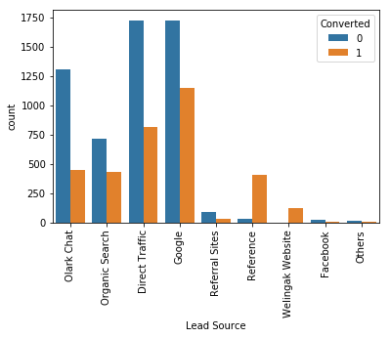
Visualization
First Plot (Lead Origin) :
Generate more leads from Lead Add Form as the conversion percentage is clearly very high to improve overall lead conversion rate
Focus on improving lead conversion of API and Landing Page Submission origin
Second Plot (Lead Source):
Conversion Rate of reference leads and leads through welingak website is quite high. So more leads should be generated using this feature.
Google and Direct traffic generates maximum number of leads.

Slide 5
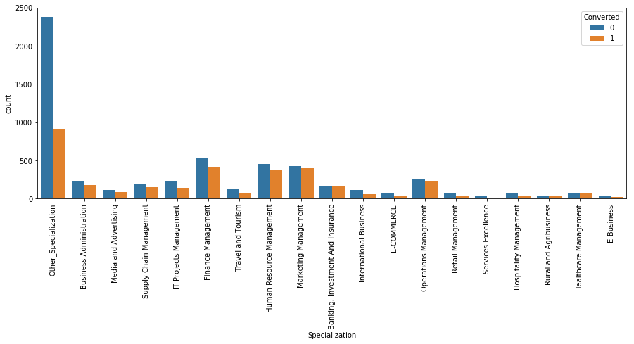
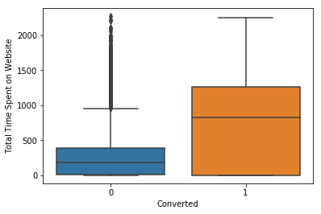
Analysis: 1. Total time spent on website 2. Specialization
Total time spent on website: Leads spending more time on the website are more likely to be converted.
Specialization: Focus should be more on the Specialization with high conversion rate.

Slide 6
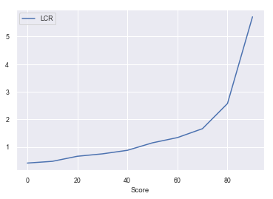
LCR (Lead Conversion Rate)
Logistics regression model above create a lead score from 0-100. It will scale up the GLM probability 0-1 to 0-100 score. So a probability of 0.5. will mean score of 50. Based on our model we know a score of 35 will yield approx. 80% lead conversion rate. This score we will fix as threshold for sales team to action in normal times as the CEO wants to aim for 80% conversion rate.

Slide 7
Stats Comparison
 | Train Data (%) | Test Data (%)
Accuracy | 77.3 | 75.3
Sensitivity | 84.5 | 83.3
Specificity | 72.2 | 70.0
Precision | 68.3 | 64.5
Recall | 84.53 | 83.3
Lead Conversion Ratio (Total leads actually converted/ total leads predicted) | 80.8 | 77.4
The final model on trained data set has high sensitivity (>80%) and high lead conversion ratio (80.8%) as per the ask.
After running the model on test data, Sensitivity still remains at 83.3% and LCR at 77.4% indicating model is quite stable and not overfit.

Slide 8
Executive Summary
 | Inference
Factors affecting the lead scores | Lead_Source_Welingak Website, Lead_Source_Reference LastActivity_Had a Phone Conversation Conversion Rate of reference leads and leads through welingak website is quite high. So more leads should be generated using this feature.
Factors where focus is needed to increase lead scores | Generate more leads from Lead Add Form as the conversion percentage is clearly very high to improve overall lead conversion rate People who spent more time on X Education website should be targeted as they have clear higher percentage conversion rate
Notes:
Please check the country code legend: That is not sorted ! Do we have a way to sort it?

