Slide 1

Monitoring of manufacturing process using Deep Learning
Presenter-Amlanjyoti Pegu(200103010)
Karan Koch(200103057)
BTP Supervisor: Dr Sukhomay Pal
Department of Mechanical Engineering
Indian Institute of Technology Guwahati
ME 398 BTP Phase I Presentation
29th Nov. 2022, IIT Guwahati,India

Slide 2
Plan of Presentation
Objective
Introduction
Datasets
Methodology
Observation
Results and Interpretation
Future Work/Phase 3 work
References

Slide 3
Objectives
The main objective of this project is to build a Convolution Neural Network Algorithm to classify Metal Surface Defects.

Slide 4
Introduction
CNN:
Convolutional Neural Network (CNN) is a popular deep learning neural network widely utilised in various image and video analysis applications.
A Convolutional Neural Network (CNN) comprises several layers: convolutional, pooling, and fully connected.
Metal Defects:
Metal surface defects are common in manufacturing and can significantly impact the quality of the final product. It might be due to overheating or overcooling during manufacturing, or poor maintenance. Some of the most common metal surface defects that we are going to classify in this project are rolled-in scale (RS), patches (Pa), crazing (Cr), pitted surface (PS), inclusion (In), and scratches (Sc).

Slide 5
Datasets
The proposed architecture in this study aims to detect six common surface defects of hot-rolled steel strips taken from The NEU Metal Surface Defects Database via Kaggle.
The training dataset consists of 256 grayscale images for each defect subclass, while the test and validation classes have 12 grayscale images in each subgroup.
Besides, we use data augmentation to increase the diversity and variability of the training data to improve the model's ability to generalise to unseen data and enhance its robustness to different variations in the input data.
Data augmentation techniques like Rescale, shear Range, Zoom range and horizontal flip are used.

Slide 6
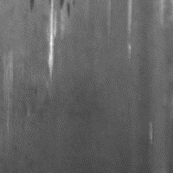
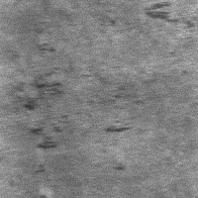
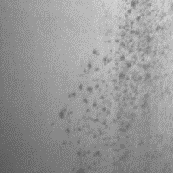
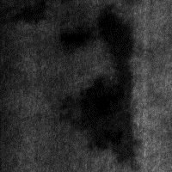
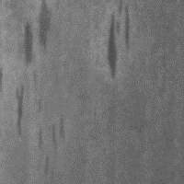
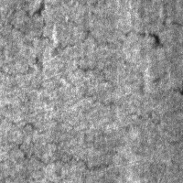
Datasets
We use the “ImageDataGenerator” Library in Keras to generate augmented images on-the-fly during training. The augmentation is applied to the original images to create variations, but it does not change the original image files or add more images to the dataset directory.
The six types of dataset images are shown below:
Rolled
Scratches
patches
pitted surface
inclusion
crazing

Slide 7

Methodology
We first import the necessary Libraries.
We then process the data with data augmentation like recalling, Shear Range and Horizontal Flip. ImageDataGenerator is used to implement data augmentation to the training dataset.

Slide 8
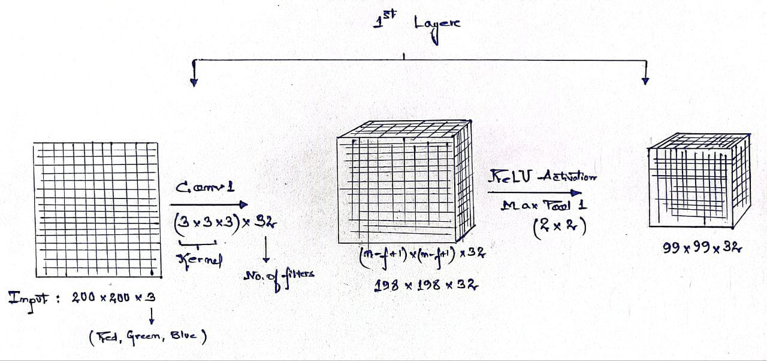
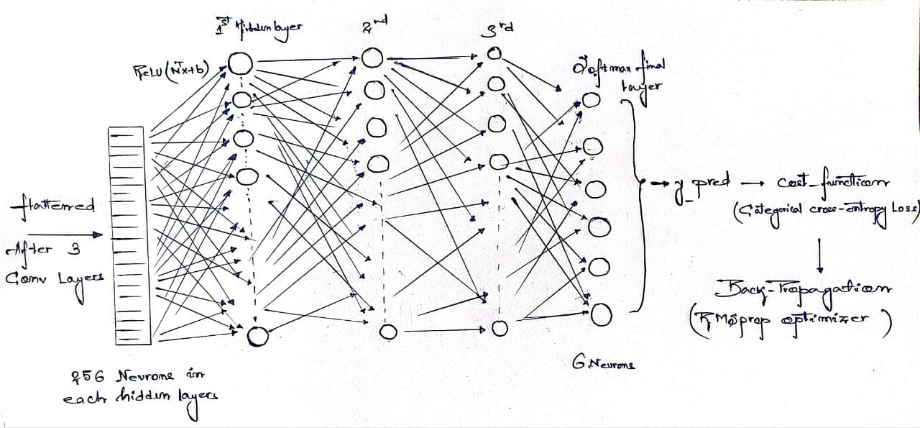
Then, we developed the Conv model consisting of a series of convolutional layers that utilise ReLU activation functions, followed by max-pooling layers.
The output is then flattened and connected to a stack of fully connected layers using ReLU activation functions. The final output layer utilises a softmax activation function.

Slide 9
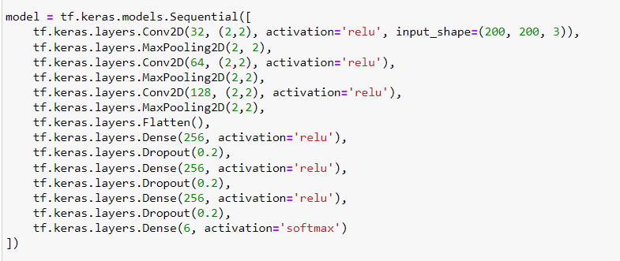
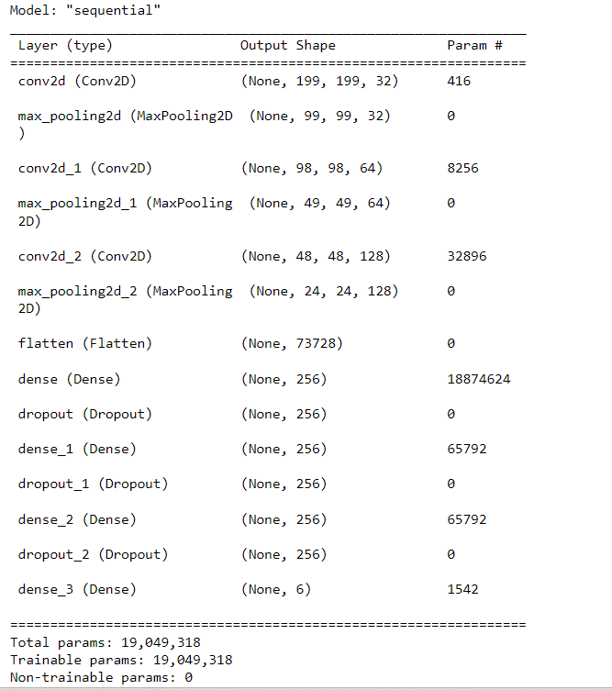
The code and summary of the model are as follows
It contains a total of 19,049,318 trainable
parameters

Slide 10
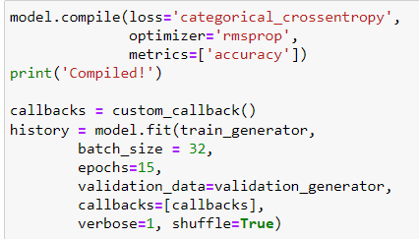
The training dataset is then fed into the model in batches of 10, while the validation dataset is generated using ImageDataGenerator. Finally, the model is trained for 15 epochs, and the training history is saved in the history variable.

Slide 11
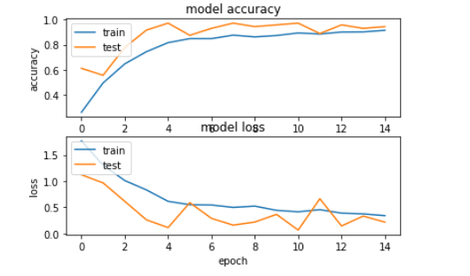
Observations
We can see from the following graphs that with an increase in the number of epochs accuracy increases and loss decreases.
However, after 15 epoch, both accuracy and loss curve changes very slowly

Slide 12
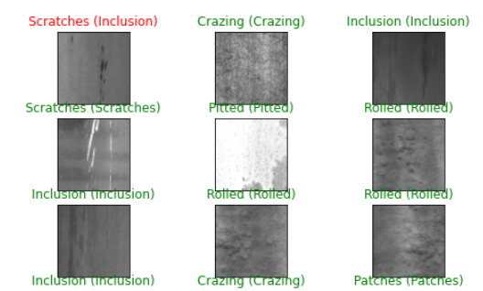
Results and Interpretation
In our assignment work, The following results were obtained
test accuracy: 93.05 %
train accuracy: 98.61%
Below are our predicted test images. The green colour shows that the image has been predicted correctly, while the red indicates that it is predicted incorrectly.

Slide 13
Future Scope
In this semester, we work on classifying metal defects using CNN. In the next semester, we will try to improve data collection and preparation methods, explore different model architectures and optimisation techniques, develop real-time monitoring models, and integrate data from multiple modalities.

Slide 14
References
Medak, D., Posilović, L., Subašić, M., Budimir, M., & Lončarić, S. (2022). DefectDet: A deep learning architecture for detecting defects with extreme aspect ratios in ultrasonic images. Neurocomputing, 473, 107-115.
https://doi.org/10.1016/j.neucom.2021.12.008

Slide 15
THANK YOU

