Slide 1
☾
✦
Association between sleep duration, demographic
characteristics, health status, and lifestyle
A cross-sectional analysis based on NHANES 2017–2018 data
zzz
ALEJANDRO REQUENA MARTÍN
IT ACADEMY · FINAL PROJECT · JULY 2026

Slide 2
CONTEXT
✦
• Sleep is an essential biological process for physical and mental health.
☾
• During sleep, the body and brain repair tissues, consolidate memory, and regulate hormones.
• Sleeping less or more than recommended has been associated with cardiovascular disease, diabetes, obesity, and cognitive impairment.
Sleep matters
across the lifespan
• Understanding these associations may support prevention strategies and healthier sleep habits.

Slide 3
HYPOTHESIS
✦
Sleep duration below or above the recommended range
will be associated with a less favorable health and lifestyle profile.
☾

Slide 4
METHODOLOGY
✦
Project workflow
NHANES
→
Integration
→
Python
→
Feature engineering
↙
Statistical analysis
←
EDA
←
Cleaning

Slide 5
DATA PREPARATION
✦
Data loading and renaming
Categorical variables were defined according to international clinical recommendations:
• WHO
Creation of categorical variables
• AASM
• ACC
• ADA

Slide 6
SAMPLE DESCRIPTION
✦
4,103
51% / 49%
51.82
Participants
Women / Men
Mean age
2.53
Good · Intermediate · Poor
Healthy · Intermediate · Unhealthy
Mean Poverty Index
Health profile
Lifestyle profile

Slide 7
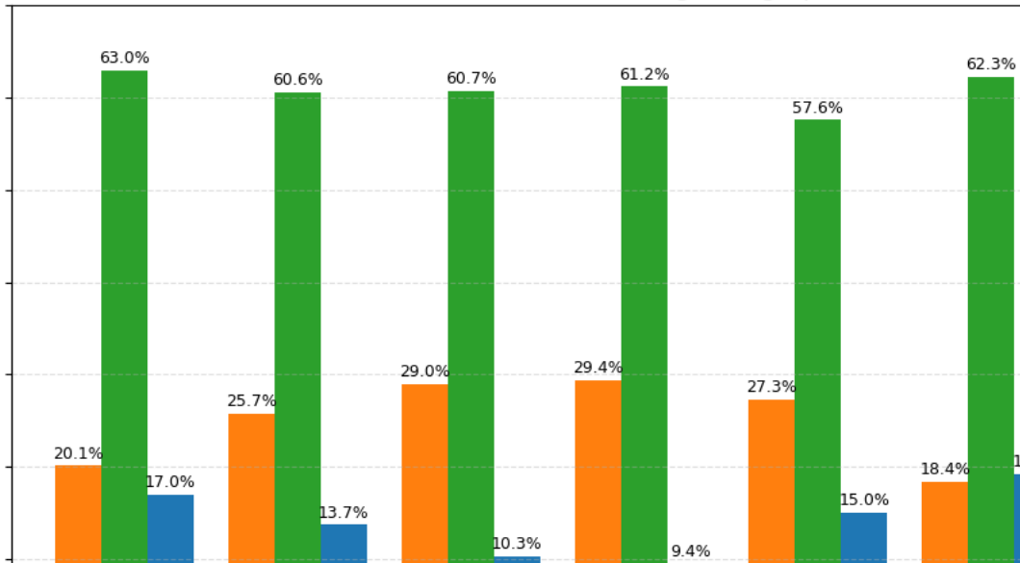
HOW DOES SLEEP VARY BY AGE?
✦
• Recommended sleep was the predominant category in every age group (~60%).
• Short- and long-sleep categories showed opposite trends across age.
χ² = 40.51 | p < 0.001 | Cramér’s V = 0.071

Slide 8
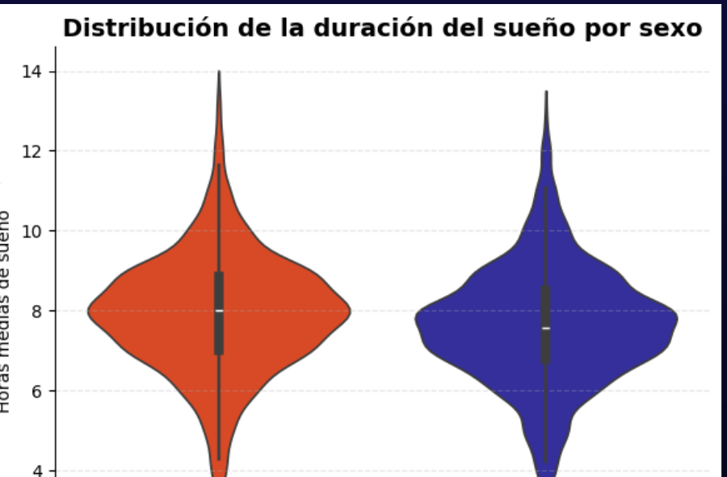
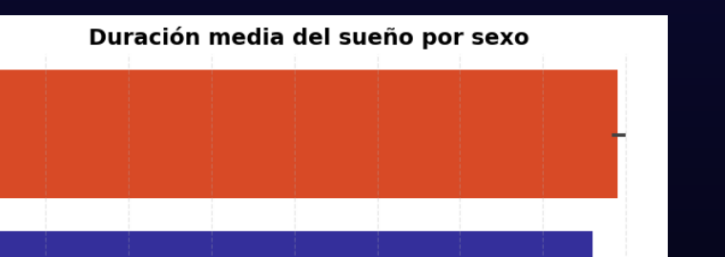
HOW DOES SLEEP VARY BY GENDER?
✦
Women reported a slightly longer mean sleep duration
18 minutes more sleep per night for women
The overall sleep-duration distributions were very similar between sexes.

Slide 9
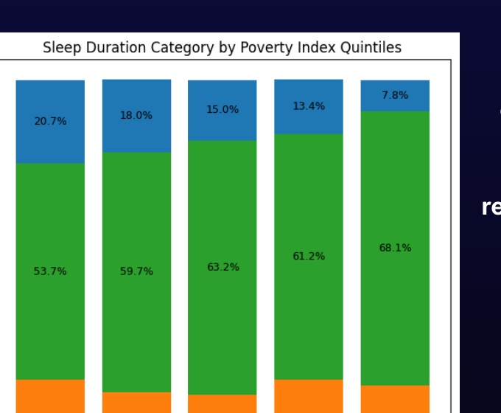
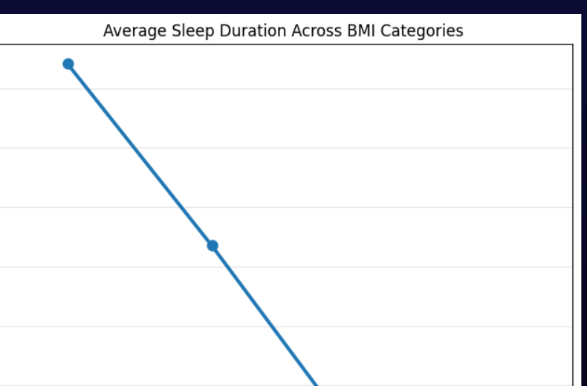
DO OTHER DEMOGRAPHIC FACTORS INFLUENCE SLEEP DURATION?
✦
Does mean sleep duration differ by BMI?
Does sleep duration change by Poverty Index?

Slide 10
BUILDING HEALTH AND LIFESTYLE PROFILES
✦
HEALTH PROFILE
LIFESTYLE PROFILE
• BMI — body mass index
• Physical activity — weekly exercise level
• HbA1c — glycemic control
• Smoking — never / former / current
• Blood pressure — systolic/diastolic
• Alcohol use — frequency and intensity
• HDL cholesterol
• Healthy (1,249) · Intermediate (1,893) · Unhealthy (961)
• Good health (1,964) · Intermediate (1,206) · Poor health (753)
Scores were based on the percentage of the maximum possible score for the indicators available for each participant.

Slide 11
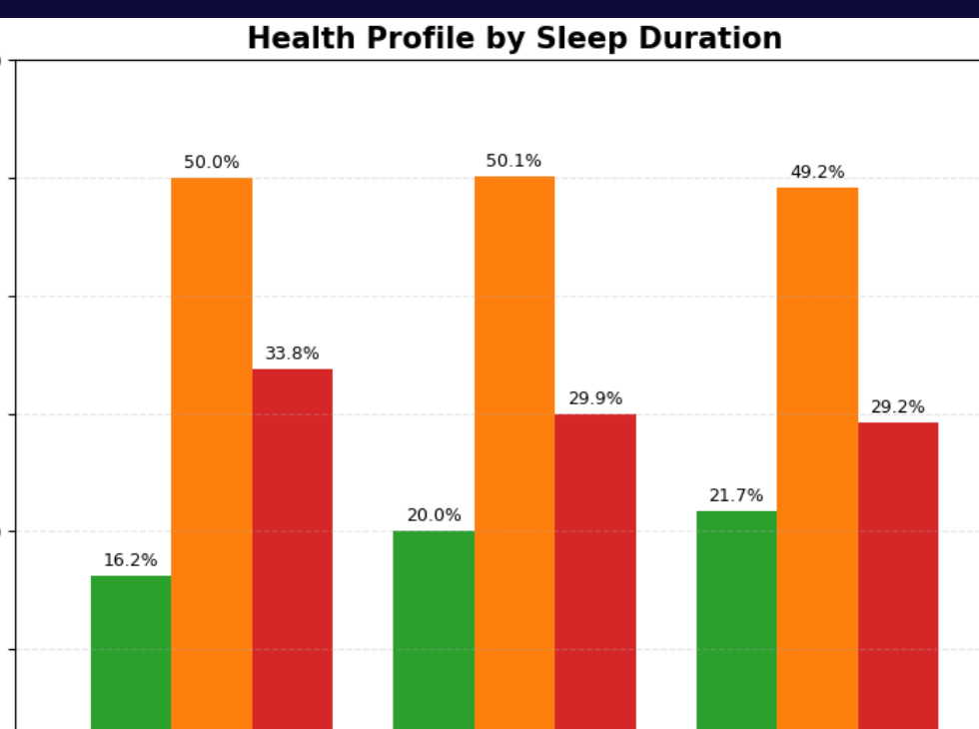
HOW IS SLEEP DURATION RELATED TO HEALTH PROFILE?
✦
Short sleep included the highest proportion of participants with a poor health profile (33.8%).
Recommended and long sleep showed similar distributions.
χ² = 11.05 | p = 0.026 | Cramér’s V = 0.038

Slide 12
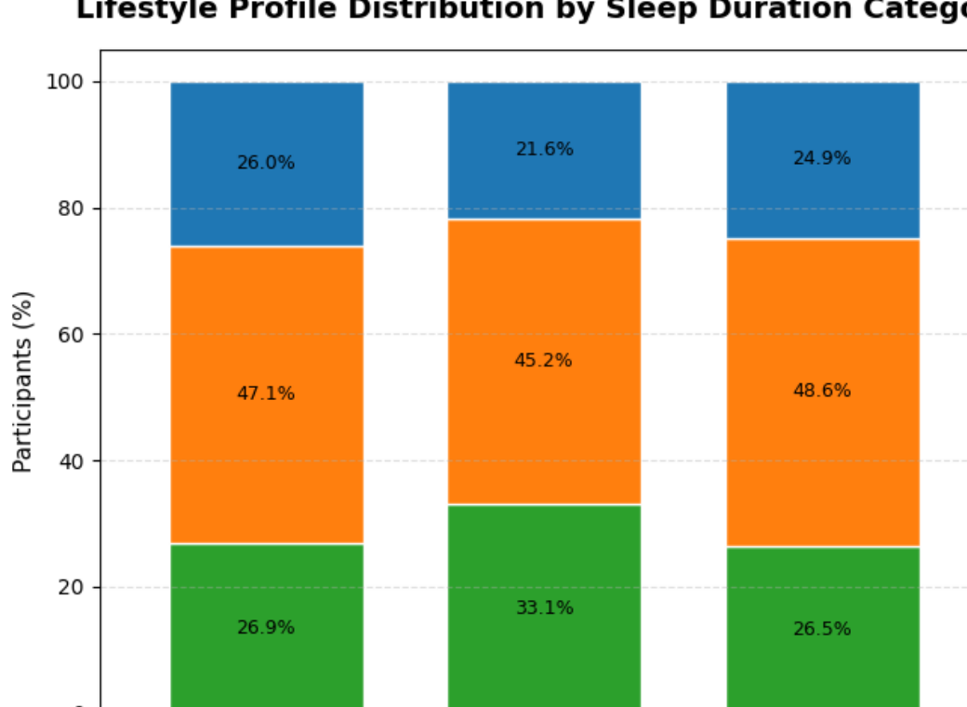
IS SLEEP DURATION RELATED TO LIFESTYLE?
✦
Recommended sleep had the highest percentage of a healthy lifestyle profile (33.1%).
Short sleep had the largest proportion of participants with an unhealthy lifestyle (26.0%).
χ² = 20.92 | p < 0.001 | Cramér’s V = 0.051

Slide 13
SUMMARY OF STATISTICAL ASSOCIATIONS
✦
All variables showed statistically significant associations with sleep duration (p < 0.05), but every effect size was very weak (Cramér’s V < 0.10).
Variable
p-value
Cramér’s V
Effect size
Age group
<0.001
0.071
Very weak
Poverty Index
<0.001
0.094
Very weak
Health profile
0.026
0.038
Very weak
Lifestyle profile
<0.001
0.051
Very weak
Poverty Index and age group showed the strongest associations, although their magnitude remained very weak.

Slide 14
CONCLUSIONS AND FUTURE WORK
✦
CONCLUSIONS
LIMITATIONS & FUTURE WORK
• The hypothesis was partially supported.
• The cross-sectional design does not establish causality.
• Sleep duration was significantly associated with demographic, health, and lifestyle factors.
• Diet, mental health, and some chronic diseases were not included.
• Low Cramér’s V values indicate weak relationships and suggest that sleep duration is influenced by multiple factors.
• Future research could combine additional NHANES cycles, add variables, and apply predictive or longitudinal methods.
• The findings reinforce the importance of healthy habits for better sleep quality and duration.

Slide 15
✦
THANK YOU!
“If sleep does not serve an absolutely vital function, it is the greatest mistake evolution ever made.”
— Allan Rechtschaffen
Thank you for your attention
Questions?

