Slide 1
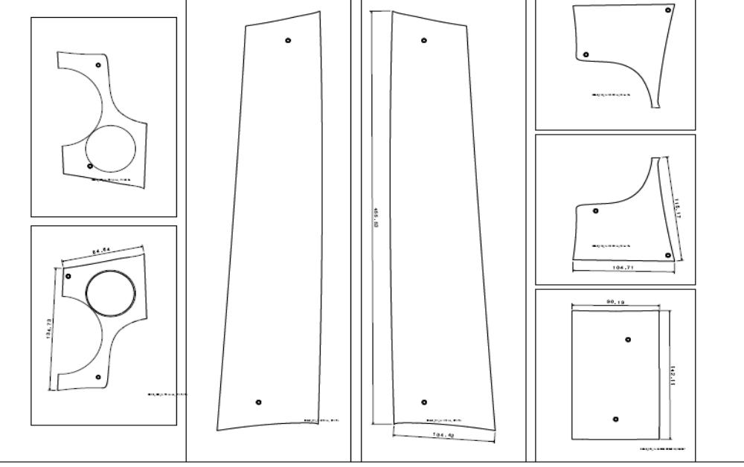
FS li RL
00249_770_15
FS re RL
00249_769_15
FS re LL
00249_770_14
BFS RL
00249_771_15
BFS LL
00249_771_14
Businessmiko Cupholder
00249_737_14
FS li LL
00249_769_14

Slide 2
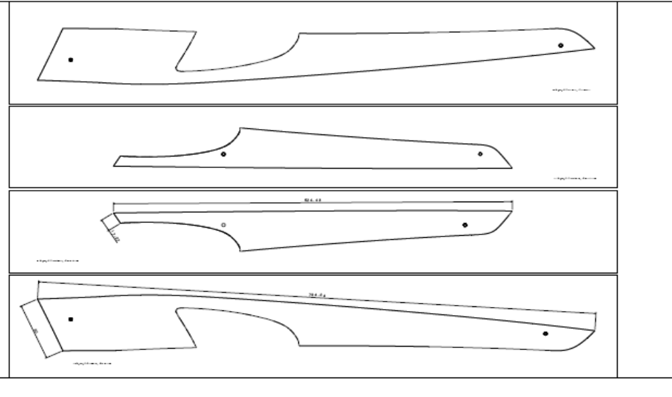
Tür vorn links
00249_787_14
Tür hinten links
00249_795_14
Tür hinten rechts 00249_795_15
Tür vorn rechts
00249_787_15

Slide 3
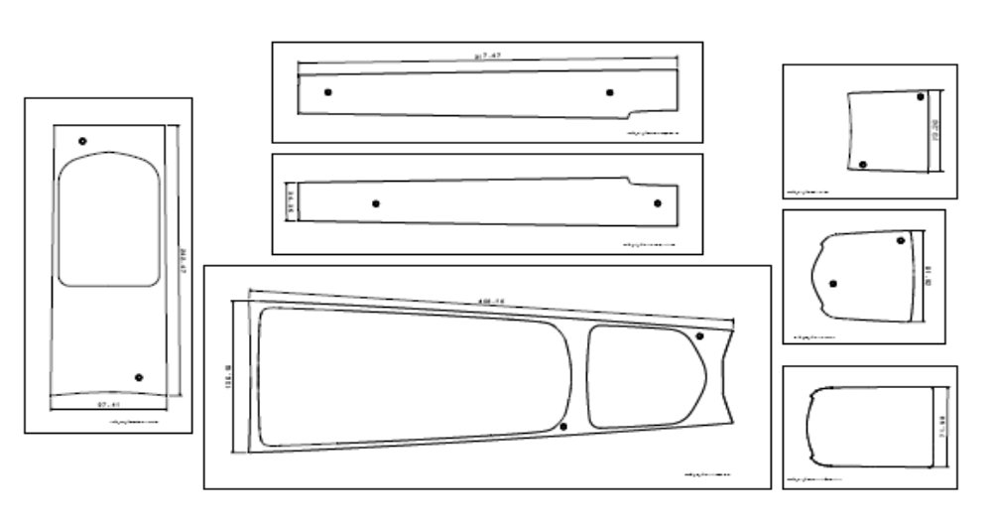
Ablagefach links
00249_730_14
Blende Fond
00249_732_14
Ablagefach rechts
00249_731_14
Ascher
00249_726_14
Blende Miko vorn
00249_725_14
Cupholder
00249_728_14
Blende Miko hinten
00249_727_14

