Slide 1
Sorting algorithms

Slide 2
Sorting algorithms
Sorting algorithm is an algorithm made up of a series of instructions that takes an array as input and outputs a sorted array
There are many sorting algorithms

Slide 3
Bubble Sort
Bubble sort is a sorting algorithm that compares two adjacent elements and swaps them until they are in the intended order.
Just like the movement of air bubbles in the water that rise up to the surface, each element of the array move to the end in each iteration. Therefore, it is called a bubble sort.

Slide 4
Bubble Sort - Algorithm
Step 1: Compare each pair of adjacent elements in the list
Step 2: Swap two elements if necessary
Step 3: Repeat this process for all the elements until the entire array is sorted

Slide 5
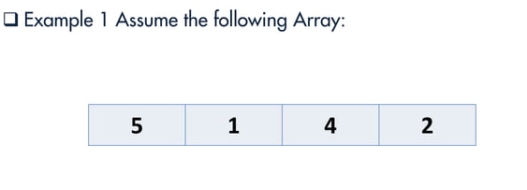
Bubble Sort

Slide 6
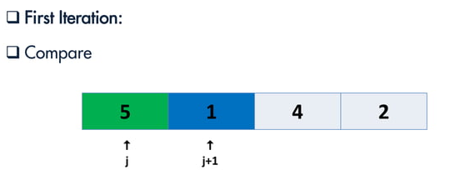
Bubble Sort

Slide 7
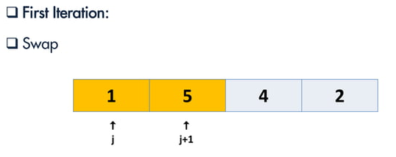
Bubble Sort

Slide 8
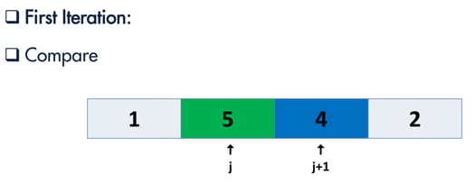
Bubble Sort

Slide 9
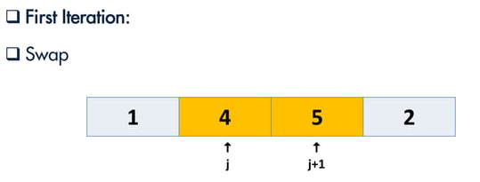
Bubble Sort

Slide 10
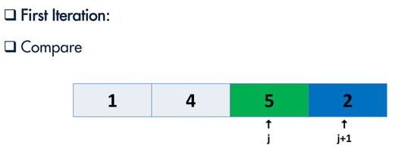
Bubble Sort

Slide 11
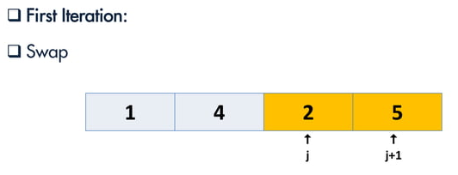
Bubble Sort

Slide 12
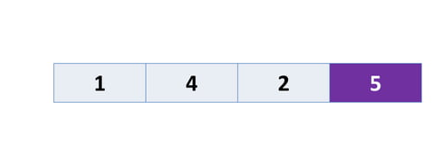
Bubble Sort

Slide 13
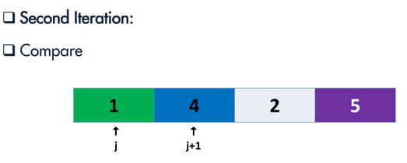
Bubble Sort

Slide 14
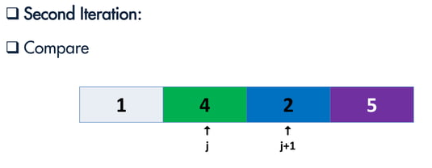
Bubble Sort

Slide 15
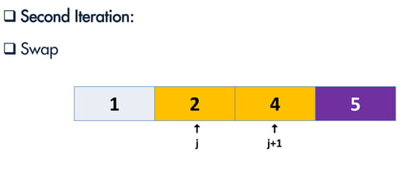
Bubble Sort

Slide 16
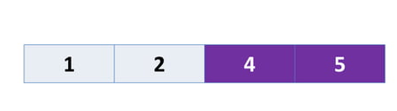
Bubble Sort

Slide 17
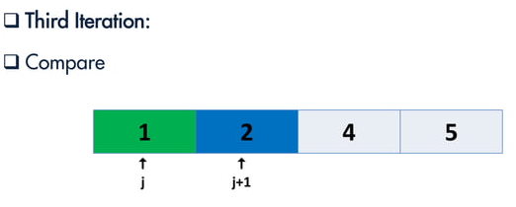
Bubble Sort

Slide 18
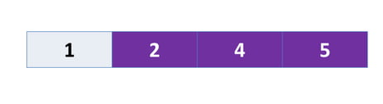
Bubble Sort

Slide 19
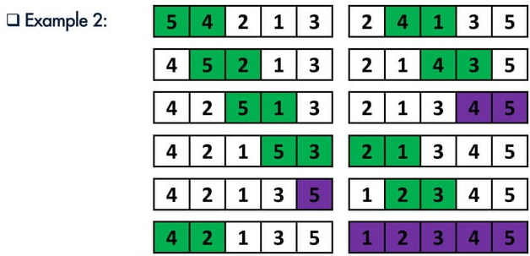
Bubble Sort

Slide 20
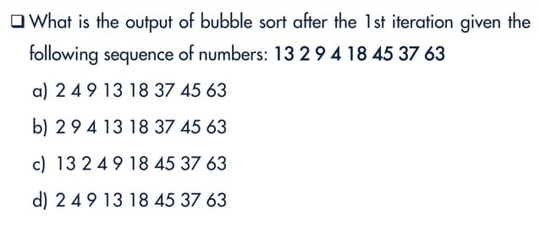
Bubble Sort

Slide 21
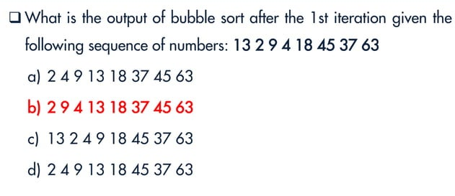
Bubble Sort

Slide 22
Bubble Sort
void bubbleSort(int arr[], int n) {
for (int i = 0; i < n - 1; i++) {
for (int j = 0; j < n - 1 - i; j++) {
if (arr[j] > arr[j + 1]) {
int temp = arr[j];
arr[j] = arr[j + 1];
arr[j + 1] = temp;
}}}}

Slide 23
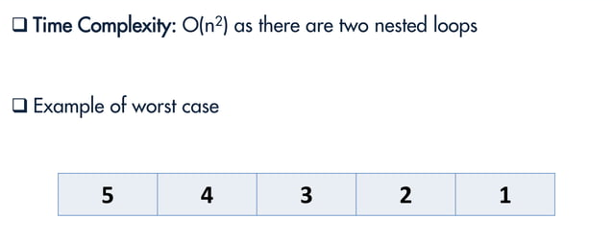
Bubble Sort

Slide 24
Insertion Sort

Slide 25
Insertion sort
Insertion sort is a sorting algorithm that places an unsorted element at its suitable place in each iteration.
Insertion sort works similarly as we sort cards in our hand in a card game.
We assume that the first card is already sorted then, we select an unsorted card. If the unsorted card is greater than the card in hand, it is placed on the right otherwise, to the left. In the same way, other unsorted cards are taken and put in their right place.
A similar approach is used by insertion sort.

Slide 26
Insertion sort - algorithm
Step 1: Compare each pair of adjacent elements in the list
Step 2: Insert elements into the sorted list, until it occupies correct position
Step 3: Swap two elements if necessary
Step 4: Repeat this process for all the elements until the entire array is sorted

Slide 27
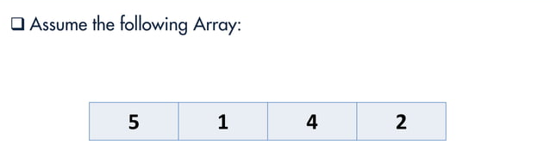
Insertion sort

Slide 28
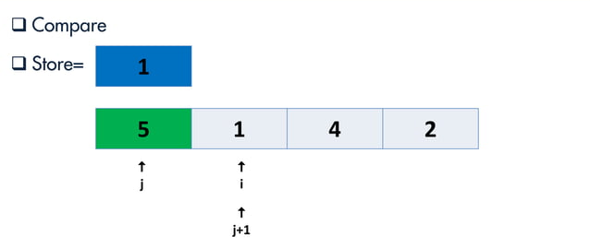
Insertion sort

Slide 29
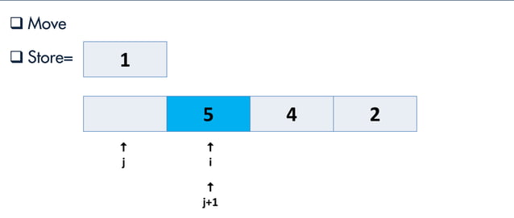
Insertion sort

Slide 30
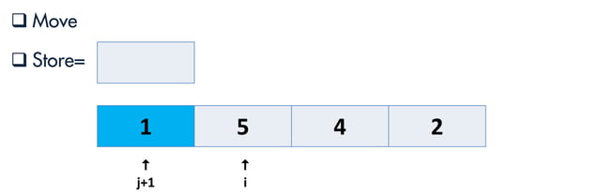
Insertion sort

Slide 31
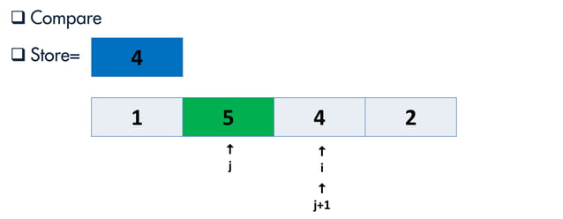
Insertion sort

Slide 32
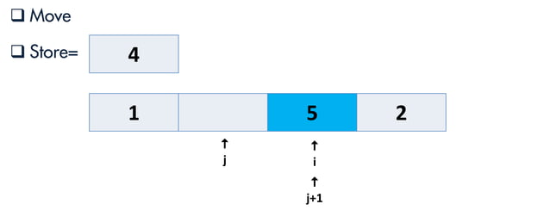
Insertion sort

Slide 33
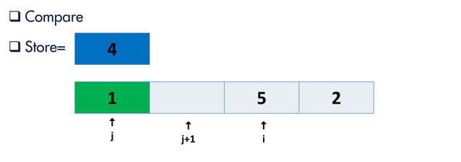
Insertion sort

Slide 34
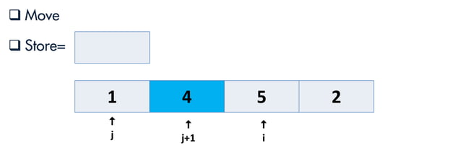
Insertion sort

Slide 35
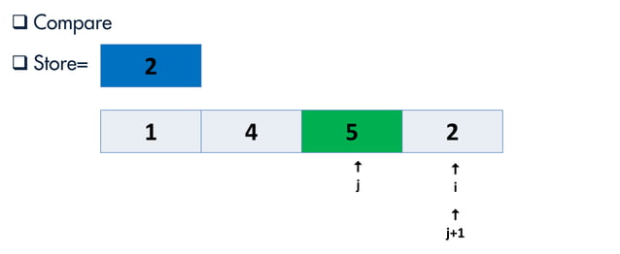
Insertion sort

Slide 36
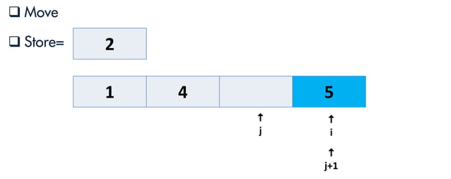
Insertion sort

Slide 37

Insertion sort

Slide 38

Insertion sort

Slide 39

Insertion sort

Slide 40
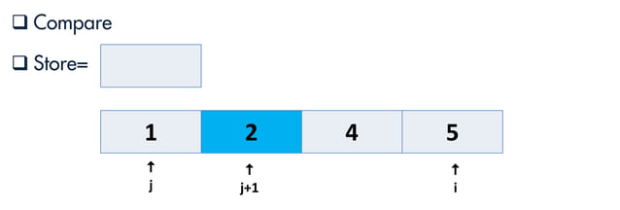
Insertion sort

Slide 41
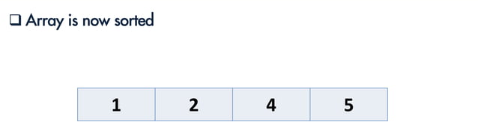
Insertion sort

Slide 42
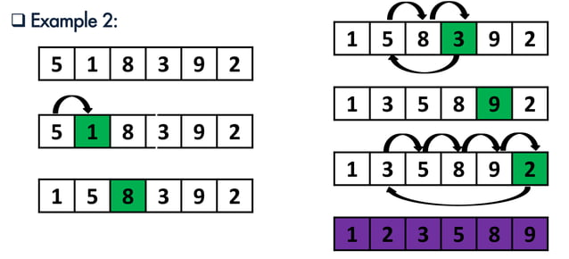
Insertion sort

Slide 43
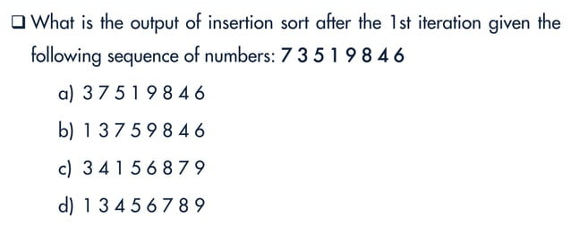
Insertion sort

Slide 44
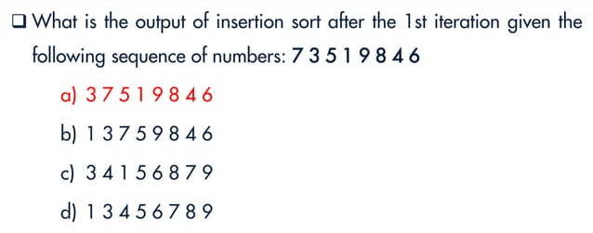
Insertion sort

Slide 45
Insertion Sort
void insertionSort(int arr[], int n) {
for (int i = 1; i < n; i++) {
int j, key = arr[i];
for (j = i - 1;j >= 0 && arr[j] > key;j--) {
arr[j + 1] = arr[j];
}
arr[j + 1] = key;
}}

Slide 46
Selection Sort

Slide 47
Selection Sort
Selection sort is a sorting algorithm that selects the smallest element from an unsorted list in each iteration and places that element at the beginning of the unsorted list.

Slide 48
Working of Selection Sort
1. Set the first element as minimum
2. Compare minimum with the second element.
If the second element is smaller than minimum, assign the second element as minimum.
Compare minimum with the third element.
Again, if the third element is smaller, then assign minimum to the third element otherwise do nothing. The process goes on until the last element.
3. After each iteration, minimum is placed in the front of the unsorted list.
4. For each iteration, indexing starts from the first unsorted element. Step 1 to 3 are repeated until all the elements are placed at their correct positions.

Slide 49
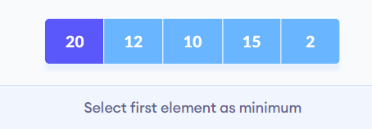
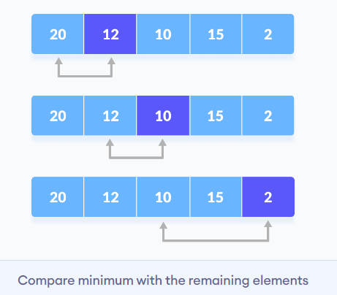
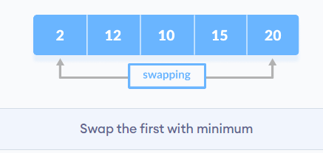

Slide 50
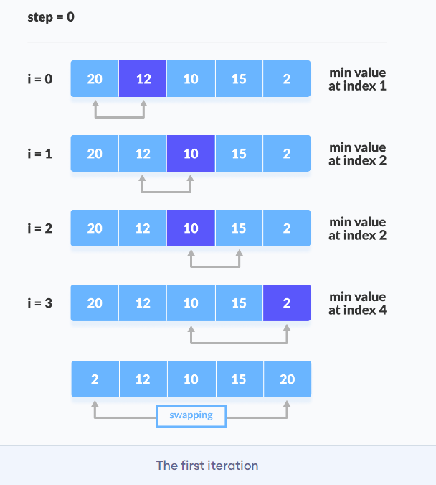

Slide 51
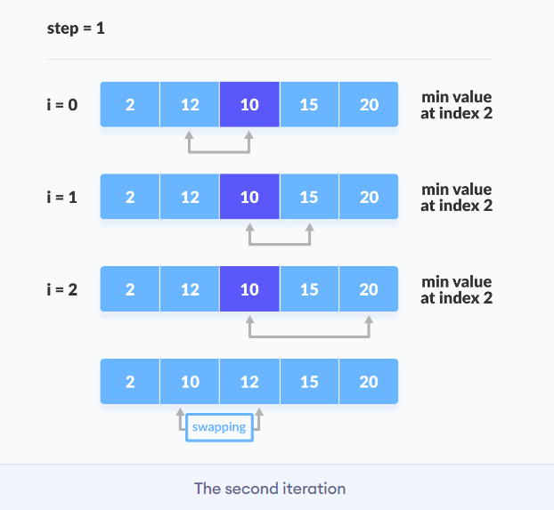

Slide 52
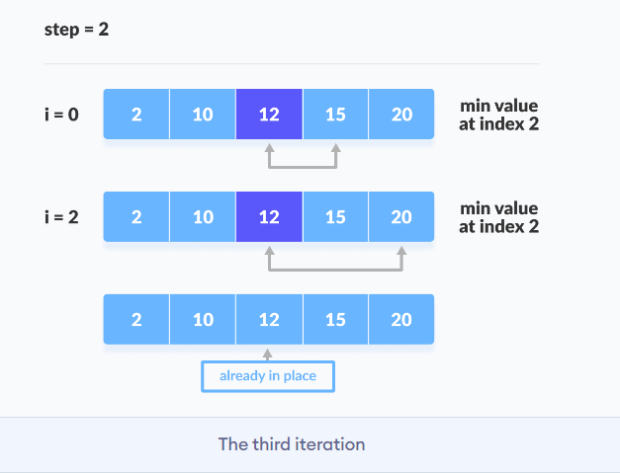

Slide 53
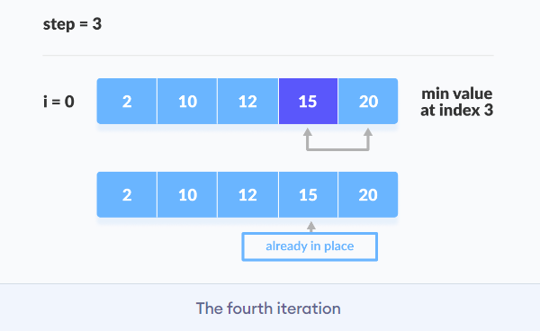

Slide 54
Quick Sort

Slide 55
Quicksort
Quicksort is a sorting algorithm based on the divide and conquer approach where
An array is divided into subarrays by selecting a pivot element (element selected from the array). While dividing the array, the pivot element should be positioned in such a way that elements less than pivot are kept on the left side and elements greater than pivot are on the right side of the pivot.
The left and right subarrays are also divided using the same approach. This process continues until each subarray contains a single element.
At this point, elements are already sorted. Finally, elements are combined to form a sorted array.

Slide 56
Working of Quicksort Algorithm
1. Select the Pivot Element
There are different variations of quicksort where the pivot element is selected from different positions. Here, we will be selecting the rightmost element of the array as the pivot element.
2. Rearrange the Array
Now the elements of the array are rearranged so that elements that are smaller than the pivot are put on the left and the elements greater than the pivot are put on the right.

Slide 57
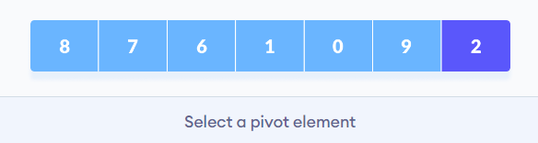
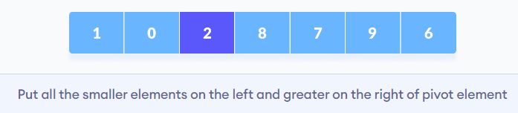
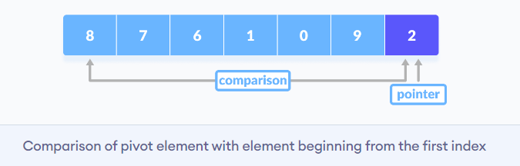

Slide 58
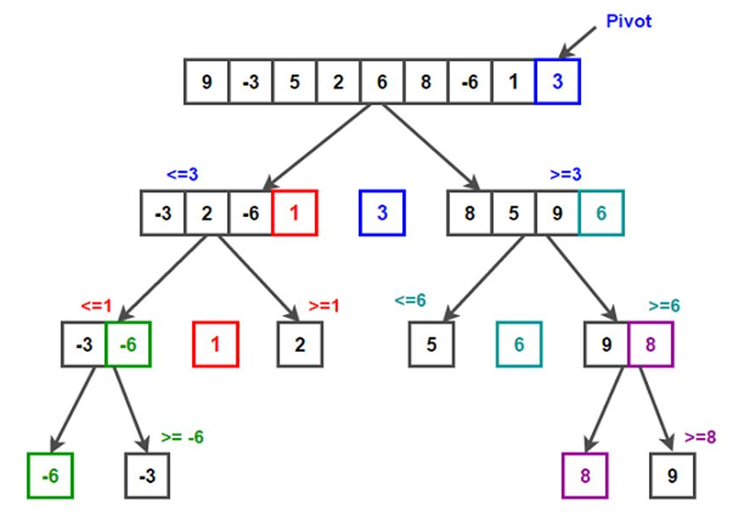

Slide 59
Merge Sort

Slide 60
Merge Sort
Merge Sort is one of the most popular sorting algorithms that is based on the principle of Divide and Conquer Algorithm.
Here, a problem is divided into multiple sub-problems. Each sub-problem is solved individually. Finally, sub-problems are combined to form the final solution.

Slide 61
Merge Sort Algorithm
- The MergeSort function repeatedly divides the array into two halves until we reach a stage where we try to perform MergeSort on a subarray of size 1.
- After that, the merge function comes into play and combines the sorted arrays into larger arrays until the whole array is merged.

Slide 62
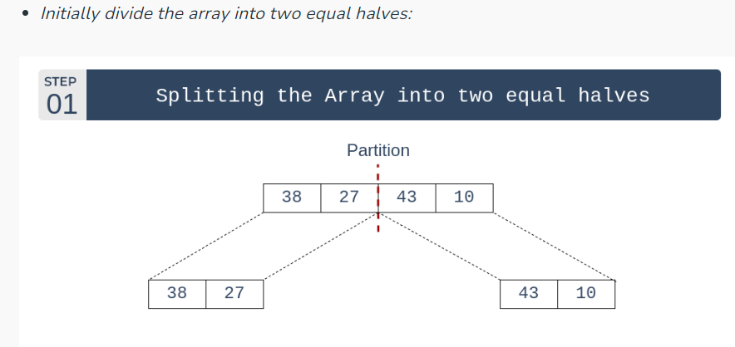

Slide 63
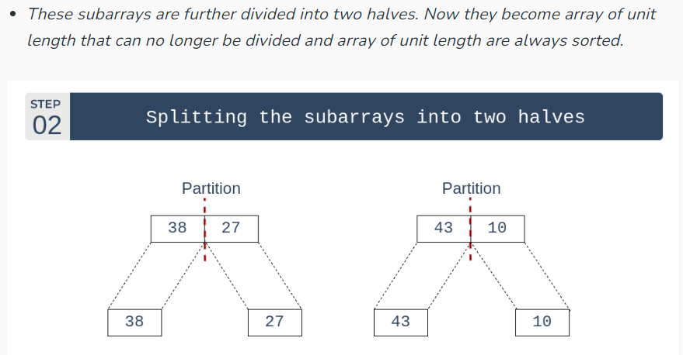

Slide 64
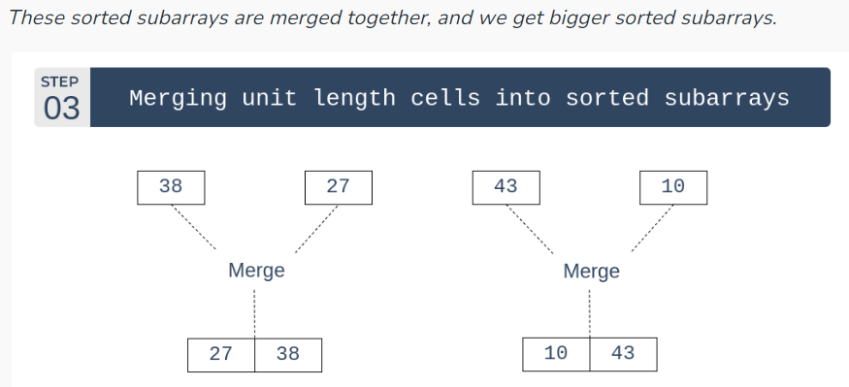

Slide 65
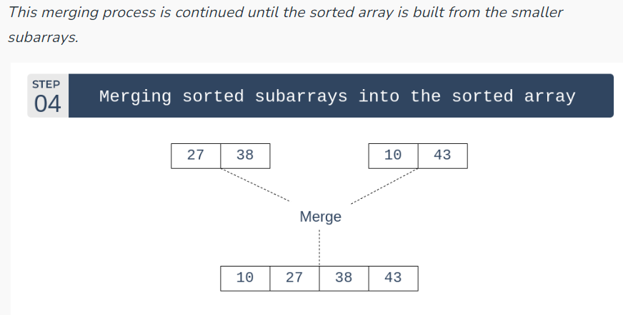

Slide 66
Heap sort

Slide 67
Heap sort
Heap Sort is a popular and efficient sorting algorithm in computer programming.
Learning how to write the heap sort algorithm requires knowledge of two types of data structures - arrays and trees.
Heap sort works by visualizing the elements of the array as a special kind of complete binary tree called a heap.

Slide 68
Heap Data structure
What is Tree Data Structure?
A tree data structure is a hierarchical structure that is used to represent and organize data in a way that is easy to navigate and search. It is a collection of nodes that are connected by edges and has a hierarchical relationship between the nodes.
The topmost node of the tree is called the root, and the nodes below it are called the child nodes. Each node can have multiple child nodes, and these child nodes can also have their own child nodes, forming a recursive structure.

Slide 69
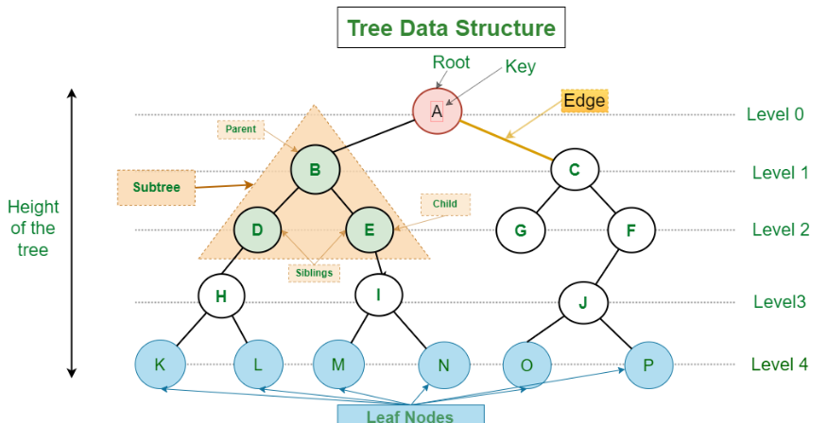

Slide 70
Heap Data structure
What is Heap Data Structure?
Heap is a special tree-based data structure. A binary tree is said to follow a heap data structure if it is a complete binary tree
All nodes in the tree follow the property that they are greater than their children i.e. the largest element is at the root and both its children and smaller than the root and so on. Such a heap is called a max-heap. If instead, all nodes are smaller than their children, it is called a min-heap
Note: A complete binary tree is a binary tree in which every level, except possibly the last, is completely filled, and all nodes in the last level are as far left as possible.

Slide 71
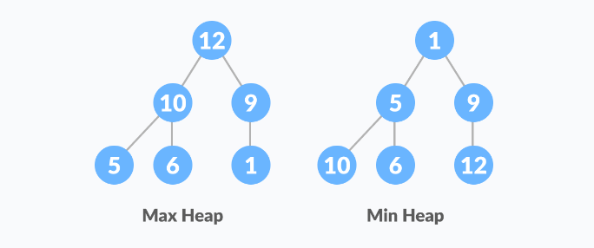

Slide 72
Operations of Heap Data Structure
Heapify: a process of creating a heap from an array.
Insertion: process to insert an element in existing heap time complexity O(log N).
Deletion: deleting the top element of the heap or the highest priority element, and then organizing the heap and returning the element with time complexity O(log N).
Peek: to check or find the first (or can say the top) element of the heap.

Slide 73
Relationship between Array Indexes and Tree Elements
A complete binary tree has an interesting property that we can use to find the children and parents of any node.
If the index of any element in the array is i, the element in the index 2i+1 will become the left child and element in 2i+2 index will become the right child. Also, the parent of any element at index i is given by the lower bound of (i-1)/2.

Slide 74



Position of left child of i = 2*i +1 Position of right child of i = 2*i+2 Position of parent of i = (i-1)/2

Slide 75
How to "heapify" a tree
Starting from a complete binary tree, we can modify it to become a Max-Heap by running a function called heapify on all the non-leaf elements of the heap.

Slide 76


Slide 77


Slide 78


Slide 79
Working of Heap Sort
First convert the array into heap data structure using heapify, then one by one delete the root node of the Max-heap and replace it with the last node in the heap and then heapify the root of the heap. Repeat this process until size of heap is greater than 1.
Build a heap from the given input array.
Repeat the following steps until the heap contains only one element:
Swap the root element of the heap (which is the largest element) with the last element of the heap.
Remove the last element of the heap (which is now in the correct position).
Heapify the remaining elements of the heap.
The sorted array is obtained by reversing the order of the elements in the input array.

Slide 80


Slide 81


Slide 82


Slide 83


Slide 84

Compare sorting algorithm

