Slide 1
Greedy Algorithm
Activity selection problem, Fractional knapsack, Huffman coding

Slide 2
Greedy Algorithm
A greedy algorithm is an approach for solving a problem by selecting the best option available at the moment.
It doesn't worry whether the current best result will bring the overall optimal result.
The algorithm never reverses the earlier decision even if the choice is wrong. It works in a top-down approach.
This algorithm may not produce the best result for all the problems. It's because it always goes for the local best choice to produce the global best result.

Slide 3
Advantages of Greedy Approach
The algorithm is easier to describe.
This algorithm can perform better than other algorithms (but, not in all cases).

Slide 4
Drawback of Greedy Approach
As mentioned earlier, the greedy algorithm doesn't always produce the optimal solution. This is the major disadvantage of the algorithm.

Slide 5
Different Types of Greedy Algorithm
Activity Selection Problem
Knapsack Problem
Huffman Coding
Minimum Spanning Tree
Selection Sort
Single-Source Shortest Path Problem
Job Scheduling Problem
Prim's Minimal Spanning Tree Algorithm
Kruskal's Minimal Spanning Tree Algorithm
Dijkstra's Minimal Spanning Tree Algorithm
Ford-Fulkerson Algorithm

Slide 6
Activity Selection Problem
The Activity Selection Problem is an optimization problem which deals with the selection of non-conflicting activities that needs to be executed by a single person or machine in a given time frame.
Each activity is marked by a start and finish time.
Greedy technique is used for finding the solution since this is an optimization problem.

Slide 7
Activity Selection Problem
Let's consider that you have n activities with their start and finish times,
the objective is to find solution set having maximum number of non-conflicting activities that can be executed in a single time frame,
assuming that only one person or machine is available for execution.

Slide 8
Activity Selection Problem
Step 1: Sort the given activities in ascending order according to their finishing time.
Step 2: Select the first activity from sorted array activity[] and add it to result[] array.
Step 3: Repeat steps 4 and 5 for the remaining activities in activity[].
Step 4: If the start time of the currently selected activity is greater than or equal to the finish time of previously selected activity, then add it to the result[] array.
Step 5: Select the next activity in activity[] array.
Step 6: Print the result[] array.

Slide 9
Example
Activity Name | Start Time(s) | Finish Time(f)
A1 | 5 | 9
A2 | 1 | 2
A3 | 3 | 4
A4 | 0 | 6
A5 | 5 | 7
A6 | 8 | 9

Slide 10
Example
Activity Name | Start Time(s) | Finish Time(f)
A2 | 1 | 2
A3 | 3 | 4
A4 | 0 | 6
A5 | 5 | 7
A1 | 5 | 9
A6 | 8 | 9

Slide 11
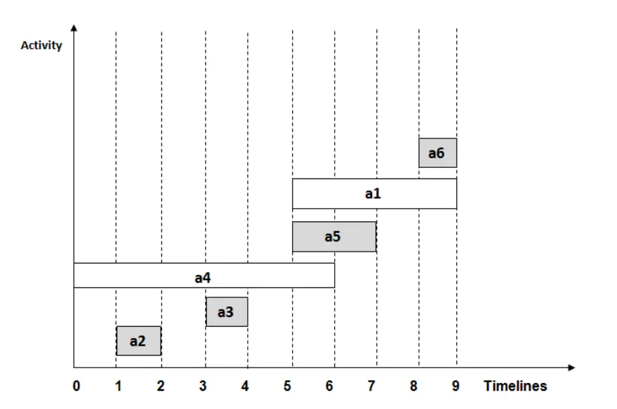

Slide 12
Activity Selection Problem
void selectActivities(Match m[], int n) {
cout << "Selected Activities are:" << endl;
cout << m[0].name << " ";
int k = 0;
for (int i = 1; i < n; i++) {
if (m[i].stime >= m[k].ftime) {
cout << m[i].name << " ";
k = i;
}}}

Slide 13
Activity Selection Problem
The time complexity of the activity selection O(n log n).

Slide 14
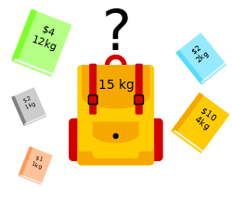
Knapsack Problem
Given a set of items, each with a weight and a value, determine which items to include in the collection so that the total weight is less than or equal to a given limit and the total value is as large as possible.

Slide 15
Knapsack Problem
The basic idea of the greedy approach is to calculate the ratio profit/weight for each item and sort the item on the basis of this ratio.
Then take the item with the highest ratio and add them as much as we can (can be the whole element or a fraction of it).
This will always give the maximum profit because, in each step it adds an element such that this is the maximum possible profit for that much weight.

Slide 16
Knapsack Problem
The knapsack problem had two versions that are as follows:
Fractional Knapsack Problem
0 /1 Knapsack Problem
The fractional Knapsack problem using the Greedy Method is an efficient method to solve it, where you need to sort the items according to their ratio of value/weight.
In a fractional knapsack, we can break items to maximize the knapsack's total value. This problem in which we can break an item is also called the Fractional knapsack problem.

Slide 17
Knapsack Problem
Step 1: Calculate the ratio (profit/weight) for each item.
Step 2: Sort all the items in decreasing order of the ratio.
Step 3: Initialize res = 0, curr_capacity = given_capacity.
Step 4: Do the Step 5 and Step 6 for every item i in the sorted order:
Step 5: If the weight of the current item is less than or equal to the remaining capacity then add the value of that item into the result
Step 6: Else add the current item as much as we can and break out of the loop.
Step 7: Return res.

Slide 18
Knapsack Problem
Example: For the given set of items and the knapsack capacity of 10 kg, find the subset of the items to be added in the knapsack such that the profit is maximum.
Items | Weights (in kg) | Profits
1 | 3 | 10
2 | 3 | 15
3 | 2 | 10
4 | 5 | 20
5 | 1 | 8

Slide 19
Knapsack Problem
Calculate profit/weight ratio(P_{i}/W_{i}) for all the items
Items | Weights (in kg) | Profits | P_{i}/W_{i}
1 | 3 | 10 | 3.3
2 | 3 | 15 | 5
3 | 2 | 10 | 5
4 | 5 | 20 | 4
5 | 1 | 8 | 8

Slide 20
Knapsack Problem
Arrange all the items in descending order based on P_{i}/W_{i}
Items | Weights (in kg) | Profits | P_{i}/W_{i}
5 | 1 | 8 | 8
2 | 3 | 15 | 5
3 | 2 | 10 | 5
4 | 5 | 20 | 4
1 | 3 | 10 | 3.3

Slide 21
Knapsack Problem
Without exceeding the knapsack capacity, insert the items in the knapsack with maximum profit.
Items | Weights (in kg) | Profits | P_{i}/W_{i} | Knapsack
5 | 1 | 8 | 8 | 1
2 | 3 | 15 | 5 | 1
3 | 2 | 10 | 5 | 1
4 | 5 | 20 | 4 | 4/5
1 | 3 | 10 | 3.3 | 0

Slide 22
Knapsack Problem
Knapsack holds the weights = [(1 * 1) + (1 * 3) + (1 * 2) + (4/5 * 5)] = 10
Maximum profit(profit*knapsack) of [(1 * 8) + (1 * 15) + (1 * 10) + (4/5 * 20)] = 49
Items | Weights (in kg) | Profits | P_{i}/W_{i} | Knapsack
5 | 1 | 8 | 8 | 1
2 | 3 | 15 | 5 | 1
3 | 2 | 10 | 5 | 1
4 | 5 | 20 | 4 | 4/5
1 | 3 | 10 | 3.3 | 0

Slide 23
Knapsack Applications
Cutting raw materials without losing too much material
Picking through the investments and portfolios
Selecting assets of asset-backed securitization
Generating keys for the Merkle-Hellman algorithm
Cognitive Radio Networks
Power Allocation
Network selection for mobile nodes

Slide 24
Knapsack
The time complexity of the fractional knapsack problem is O(n log n).

Slide 25
Huffman Coding
Huffman Coding is a technique of compressing data to reduce its size without losing any of the details.
It was first developed by David Huffman.
Huffman Coding is generally useful to compress the data in which there are frequently occurring characters.

Slide 26
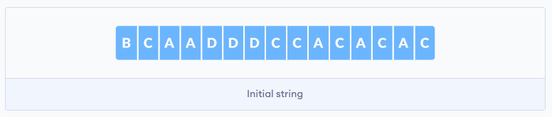
How Huffman Coding works?
Suppose the string below is to be sent over a network.
Each character occupies 8 bits. There are a total of 15 characters in the above string. Thus, a total of 8 * 15 = 120 bits are required to send this string.
Using the Huffman Coding technique, we can compress the string to a smaller size.

Slide 27
Huffman Coding
Huffman coding first creates a tree using the frequencies of the character and then generates code for each character.
Once the data is encoded, it has to be decoded. Decoding is done using the same tree.
Huffman Coding prevents any ambiguity in the decoding process using the concept of prefix code ie. a code associated with a character should not be present in the prefix of any other code. The tree created above helps in maintaining the property.

Slide 28
Huffman Coding Algorithm
Calculate the frequency of each character in the string.
Sort the characters in increasing order of the frequency. These are stored in a priority queue Q.
Make each unique character as a leaf node.
Create an empty node z. Assign the minimum frequency to the left child of z and assign the second minimum frequency to the right child of z. Set the value of the z as the sum of the above two minimum frequencies.
Remove these two minimum frequencies from Q and add the sum into the list of frequencies
Insert node z into the tree.
Repeat steps 3 to 5 for all the characters.
For each non-leaf node, assign 0 to the left edge and 1 to the right edge.

Slide 29
Huffman Coding Example
Character | Frequency
A | 5
B | 1
C | 6
D | 3

Slide 30
Huffman Coding Example
Character | Frequency
B | 1
D | 3
A | 5
C | 6

Slide 31
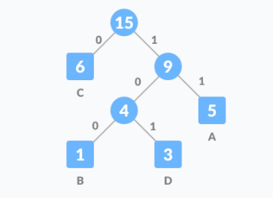
Character | Frequency
B | 1
D | 3
A | 5
C | 6

Slide 32
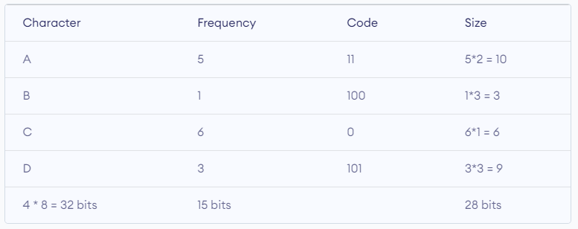

Slide 33
Implementation
create a priority queue Q consisting of each unique character.
sort then in ascending order of their frequencies.
for all the unique characters:
create a newNode
extract minimum value from Q and assign it to leftChild of newNode
extract minimum value from Q and assign it to rightChild of newNode
calculate the sum of these two minimum values and assign it to the value of newNode
insert this newNode into the tree
return rootNode

Slide 34
Huffman Coding Complexity
The time complexity for encoding each unique character based on its frequency is O(nlog n).
Extracting minimum frequency from the priority queue takes place 2*(n-1) times and its complexity is O(log n). Thus the overall complexity is O(n log n).

Slide 35
Huffman Coding Complexity
Create two lists: one to track the positions of police officers (pol) and the other for thieves (thi).
Go through the input string character by character:
If you find a 'P', add its position to the police list (pol).
If you find a 'T', add its position to the thief list (thi).
Initialize two pointers, one for each list, and set them both to the beginning.

Slide 36
Huffman Coding Complexity
While there are elements in both lists, do the following:
Check the distance (position difference) between the current thief and the current police officer.
If the distance is less than or equal to 'k', it means the police can catch the thief. So, increase the result count and move both pointers forward.
If the distance is greater than 'k':
If the thief is ahead of the police officer, move the police pointer to the right.
If the police officer is ahead of the thief, move the thief pointer to the right.
Continue this process until you've checked all possible combinations of police officers and thieves.
The result is the maximum number of thieves that the police can catch within a distance of 'k'.

Slide 37
Policemen Catch Thieves Problem
Given an array of size n that has the following specifications:
1.Each element in the array contains either a policeman or a thief.
2.Each policeman can catch only one thief.
A policeman cannot catch a thief who is more than K units away from the policeman. Write a Program to find the maximum number of thieves that can be caught.
Example
Input
PTTPT
1
Output
2

Slide 38
Policemen Catch Thieves Problem
Initialize the count of caught thieves to 0.
Separate the building line into two lists: one for police positions and another for thief positions.
Start with two pointers, one for thieves and one for police, both at the beginning of their lists.
While there are still positions in both lists:
Calculate the distance between the current thief and police officer.
If the distance is less than or equal to 'k', increase the count of caught thieves and move both pointers forward.
If the distance is too large (greater than 'k'), move the pointer associated with the side having the lower position.

Slide 39
Policemen catch thieves problem
Continue this process until one of the lists runs out of positions.
Return the count of caught thieves, which is the maximum number of thieves caught by police officers within the given distance 'k'.

