Slide 1
Searching
LINEAR SEARCH & BINARY SEARCH ALGORITHM

Slide 2
Problem: Search
We are given a list of records.
Each record has an associated key.
Give efficient algorithm for searching for a record containing a particular key.
Efficiency is quantified in terms of average time analysis (number of comparisons) to retrieve an item.

Slide 3



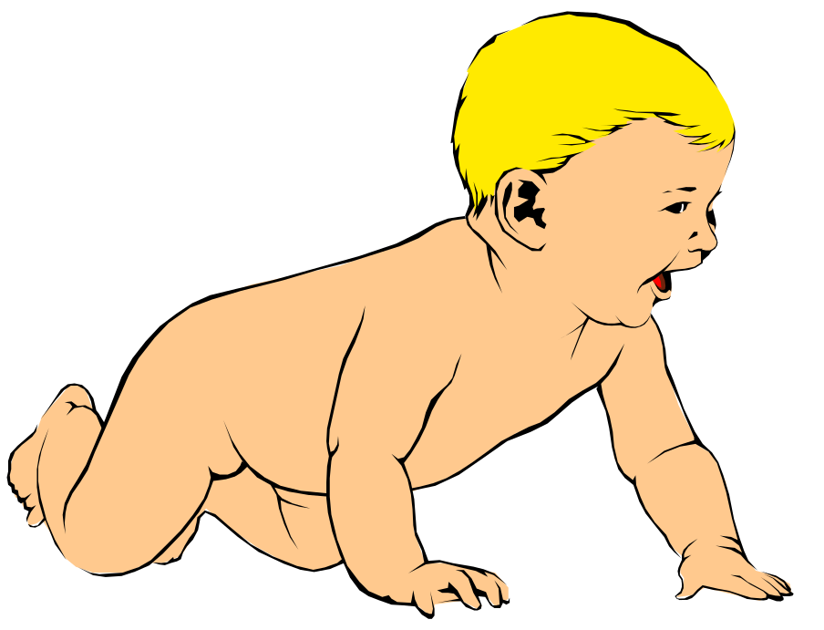


Search
[ 0 ]
[ 1 ]
[ 2 ]
[ 3 ]
[ 4 ]
[ 700 ]
…
Number 701466868
Number 281942902
Number 233667136
Number 580625685
Number 506643548
Number 155778322
Each record in list has an associated key.
In this example, the keys are ID numbers.
Given a particular key, how can we efficiently retrieve the record from the list?
Number 580625685

Slide 4
Linear Search
Step through array of records, one at a time.
Look for record with matching key.
Search stops when
  record with matching key is found
  or when search has examined all records without success.

Slide 5
Pseudocode for Linear Search
// Search for a desired item in the n array elements
// starting at a[first].
// Returns pointer to desired record if found.
// Otherwise, return NULL
…
for(i = first; i < n; ++i )
if(a[first+i] is desired item)
return &a[first+i];
// if we drop through loop, then desired item was not found
return NULL;

Slide 6
Linear Search Analysis
What are the worst and average case running times for linear search?
We must determine the O-notation for the number of operations required in search.
Number of operations depends on n, the number of entries in the list.

Slide 7
Worst Case Time for Linear Search
For an array of n elements, the worst case time for linear search requires n array accesses: O(n).
Consider cases where we must loop over all n records:
  desired record appears in the last position of the array
  desired record does not appear in the array at all

Slide 8
Average Case for Linear Search
Assumptions:
  All keys are equally likely in a search
  We always search for a key that is in the array
Example:
We have an array of 10 records.
If search for the first record, then it requires 1 array access; if the second, then 2 array accesses. etc.
The average of all these searches is:
  (1+2+3+4+5+6+7+8+9+10)/10 = 5.5

Slide 9
Average Case Time for Linear Search
Generalize for array size n.
Expression for average-case running time:
(1+2+…+n)/n = n(n+1)/2n = (n+1)/2
Therefore, average case time complexity for serial search is O(n).

Slide 10
Binary Search
Perhaps we can do better than O(n) in the average case?
Assume that we are give an array of records that is sorted. For instance:
  an array of records with integer keys sorted from smallest to largest (e.g., ID numbers), or
  an array of records with string keys sorted in alphabetical order (e.g., names).

Slide 11
Binary Search Pseudocode
…
if(size == 0)
found = false;
else {
middle = index of approximate midpoint of array segment;
if(target == a[middle])
target has been found!
else if(target < a[middle])
search for target in area before midpoint;
else
search for target in area after midpoint;
}
…

Slide 12
Binary Search
Example: sorted array of integer keys. Target=7.
[ 0 ]
[ 1 ]
[ 2 ]
[ 3 ]
[ 4 ]
[ 5 ]
[ 6 ]
3
6
7
11
32
33
53

Slide 13
Binary Search
Example: sorted array of integer keys. Target=7.
[ 0 ]
[ 1 ]
[ 2 ]
[ 3 ]
[ 4 ]
[ 5 ]
[ 6 ]
3
6
7
11
32
33
53
Find approximate midpoint

Slide 14
Binary Search
Example: sorted array of integer keys. Target=7.
[ 0 ]
[ 1 ]
[ 2 ]
[ 3 ]
[ 4 ]
[ 5 ]
[ 6 ]
3
6
7
11
32
33
53
Is 7 = midpoint key? NO.

Slide 15
Binary Search
Example: sorted array of integer keys. Target=7.
[ 0 ]
[ 1 ]
[ 2 ]
[ 3 ]
[ 4 ]
[ 5 ]
[ 6 ]
3
6
7
11
32
33
53
Is 7 < midpoint key? YES.

Slide 16
Binary Search
Example: sorted array of integer keys. Target=7.
[ 0 ]
[ 1 ]
[ 2 ]
[ 3 ]
[ 4 ]
[ 5 ]
[ 6 ]
3
6
7
11
32
33
53
Search for the target in the area before midpoint.

Slide 17
Binary Search
Example: sorted array of integer keys. Target=7.
[ 0 ]
[ 1 ]
[ 2 ]
[ 3 ]
[ 4 ]
[ 5 ]
[ 6 ]
3
6
7
11
32
33
53
Find approximate midpoint

Slide 18
Binary Search
Example: sorted array of integer keys. Target=7.
[ 0 ]
[ 1 ]
[ 2 ]
[ 3 ]
[ 4 ]
[ 5 ]
[ 6 ]
3
6
7
11
32
33
53
Target = key of midpoint? NO.

Slide 19
Binary Search
Example: sorted array of integer keys. Target=7.
[ 0 ]
[ 1 ]
[ 2 ]
[ 3 ]
[ 4 ]
[ 5 ]
[ 6 ]
3
6
7
11
32
33
53
Target < key of midpoint? NO.

Slide 20
Binary Search
Example: sorted array of integer keys. Target=7.
[ 0 ]
[ 1 ]
[ 2 ]
[ 3 ]
[ 4 ]
[ 5 ]
[ 6 ]
3
6
7
11
32
33
53
Target > key of midpoint? YES.

Slide 21
Binary Search
Example: sorted array of integer keys. Target=7.
[ 0 ]
[ 1 ]
[ 2 ]
[ 3 ]
[ 4 ]
[ 5 ]
[ 6 ]
3
6
7
11
32
33
53
Search for the target in the area after midpoint.

Slide 22
Binary Search
Example: sorted array of integer keys. Target=7.
[ 0 ]
[ 1 ]
[ 2 ]
[ 3 ]
[ 4 ]
[ 5 ]
[ 6 ]
3
6
7
11
32
33
53
Find approximate midpoint.
Is target = midpoint key? YES.

Slide 23
Binary Search Implementation
void search(const int a[ ], size_t first, size_t size, int target, bool& found, size_t& location)
{
_{size_t middle;}
_{if(size == 0) found = false;}
_{else {}
_{middle = first + size/2;}
_{if(target == a[middle]){}
_{location = middle;}
_{found = true;}
}
_{else if (target < a[middle])}
// target is less than middle, so search subarray before middle
search(a, first, size/2, target, found, location);
_{else}
// target is greater than middle, so search subarray after middle
search(a, middle+1, (size-1)/2, target, found, location);
}
}

Slide 24
Summary
Linear search: average case O(n)
Binary search: average case O(log₂n)

