Slide 1
Time Complexity

Slide 2
Time Complexity
Defined as the amount of time taken by an algorithm to run, as a function of the length of the input.
It measures the time taken to execute each statement of code in an algorithm.
The idea behind time complexity is that it can only measure the algorithm's execution time in a way that is dependent solely on the algorithm and its input.

Slide 3
Common notations used to express time complexity are

Slide 4
Big-oh(O) Notation: Specifies the asymptotic upper bound for a function f(n). Denotes the worst case of an algorithm.
Big-omega(Ω) Notation: Specifies the asymptotic lower bound for a function f(n). Denotes the best runtime of an algorithm.
Big-Theta(Θ) notation: Specifies a bound for a function f(n). Denotes average case time complexity.

Slide 5
Best Case − Minimum time required for program execution.
Average Case − Average time required for program execution.
Worst Case − Maximum time required for program execution.

Slide 6
Common time complexities and their descriptions

Slide 7
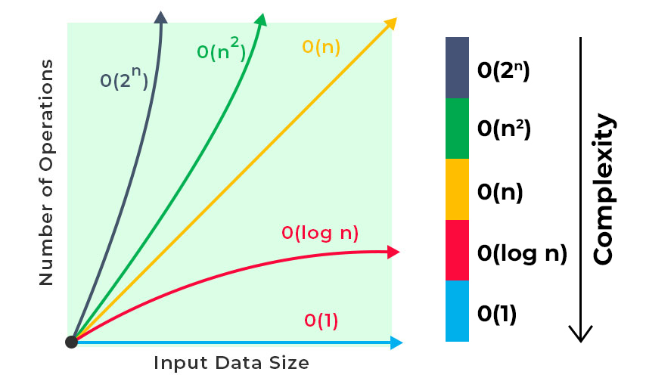

Slide 8
Constant time – O (1)
An algorithm is said to have constant time with order O (1) when it is not dependent on the input size n.
Irrespective of the input size n, the runtime will always be the same.
Example:It's as quick as grabbing one ingredient from the kitchen, no matter how many ingredients we have.

Slide 9
Example
#include <iostream>
using namespacse std;
int main() {
int x = 42;
cout << "The value of x is: " << x << endl;
return 0;
}

Slide 10
Example 2
#include <iostream>
// A function that returns the square of a number
int square(int n) {
return n * n;
}
int main() {
int num = 5;
int result = square(num);
std::cout << "The square of " << num << " is: " << result << std::endl;
return 0;
}

Slide 11
In this example, the square function calculates the square of an integer n.
The time it takes to execute this function is constant, regardless of the value of n.
Whether n is 5 or 1,000, the function performs a single multiplication operation, which takes a constant amount of time.
Therefore, the time complexity of the square function is O(1).

Slide 12
Linear time – O(n)
An algorithm is said to have a linear time complexity when the running time increases linearly with the length of the input.
When the function involves checking all the values in input data, with this order O(n).
Example: This is like making a sandwich for each person at a picnic. If you have 10 people, you make 10 sandwiches. If you have 100 people, you make 100 sandwiches. The time it takes grows directly with the number of people.

Slide 13
Example
int main() {
int n;
cout << "Enter a positive integer n: ";
cin >> n;
int sum = 0;
for (int i = 1; i <= n; ++i) {
sum += i;
}
cout << "The sum of numbers from 1 to " << n << " is: " << sum << endl;
return 0;
}

Slide 14
In this code, the program calculates the sum of numbers from 1 to the input value n using a loop.
The time it takes to execute the loop is directly proportional to the value of n, so the time complexity is O(n).

Slide 15
Logarithmic time – O (log n)
Logarithmic time complexity means the number of operations decreases as the input size increases.
Examples: Binary Search, Merge sort
Example: Imagine we have a phone book with a lot of names, and we're trying to find a name. We can quickly narrow down our search by looking in the middle of the book first, and then in the middle of the remaining half, and so on. It's faster than looking at every page one by one.

Slide 16
Quadratic time – O (n^2)
The execution time grows with the square of the input size.
Commonly seen in nested loops.
Exampe: Imagine comparing each item in a list to every other item. If you have 10 items, it's like doing 10x10 = 100 comparisons.

Slide 17
Example 1
int findMax(int arr[], int size) {
int maxElement = arr[0];
for (int i = 0; i < size; ++i) {
for (int j = i + 1; j < size; ++j) {
if (arr[j] > maxElement) {
maxElement = arr[j];
}
}
}
return maxElement;
}
int main() {
int myArray[] = {12, 5, 21, 8, 17, 6};
int arraySize = 6;
int max = findMax(myArray, arraySize);
cout << "The maximum element in the array is: " << max << endl;
return 0;
}

Slide 18
In this code, the findMax function uses two nested loops to compare every element in the array with every other element to find the maximum.
Since there are two nested loops, the time complexity of this algorithm is O(n^2)

Slide 19
Exponential Time - O(2^n)
The execution time grows exponentially with the input size.
This is highly inefficient and should be avoided whenever possible.

Slide 20
Linearithmic Time Complexity (O(n log n)):
Algorithms whose execution time grows in a manner that is roughly proportional to the product of the input size (n) and the logarithm of the input size (log n).
As the size of the input data (n) increases, the number of operations performed by the algorithm increases at a rate
Example: MergeSort

Slide 21
mathematical analysis of recursive algorithm
Mathematical analysis of recursive algorithms involves determining their time complexity using mathematical notation and techniques.
The most common mathematical notation for expressing time complexity is Big O notation (O),

Slide 22
Example:(The algorithm calculates the sum of elements in an array using recursion)
int sumArray(int arr[], int n) {
if (n == 0) {
return 0; // Base case: when the array is empty, the sum is 0
} else {
return arr[n - 1] + sumArray(arr, n - 1); // Recursive case
}
}

