Slide 1
Hashing & Hash Table
iamneo.io

Slide 2
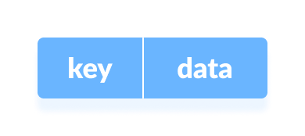
Hash Table
The Hash table data structure stores elements in key-value pairs where
Key- unique integer that is used for indexing the values
Value - data that are associated with keys.
Key and Value in Hash Table
iamneo.io

Slide 3
Direct Address Table
Direct Address Table is a data structure that has the capability of mapping records to their corresponding keys using arrays.
In direct address tables, records are placed using their key values directly as indexes.
They facilitate fast searching, insertion and deletion operations.
iamneo.io

Slide 4
Hashing
Hashing is a technique or process of mapping keys, and values into the hash table by using a hash function.
It is done for faster access to elements.
The efficiency of mapping depends on the efficiency of the hash function used.
iamneo.io

Slide 5
Hashing
In a hash table, a new index is processed using the keys. And, the element corresponding to that key is stored in the index. This process is called hashing.
Let k be a key and h(x) be a hash function.
Here, h(k) will give us a new index to store the element linked with k.
iamneo.io

Slide 6
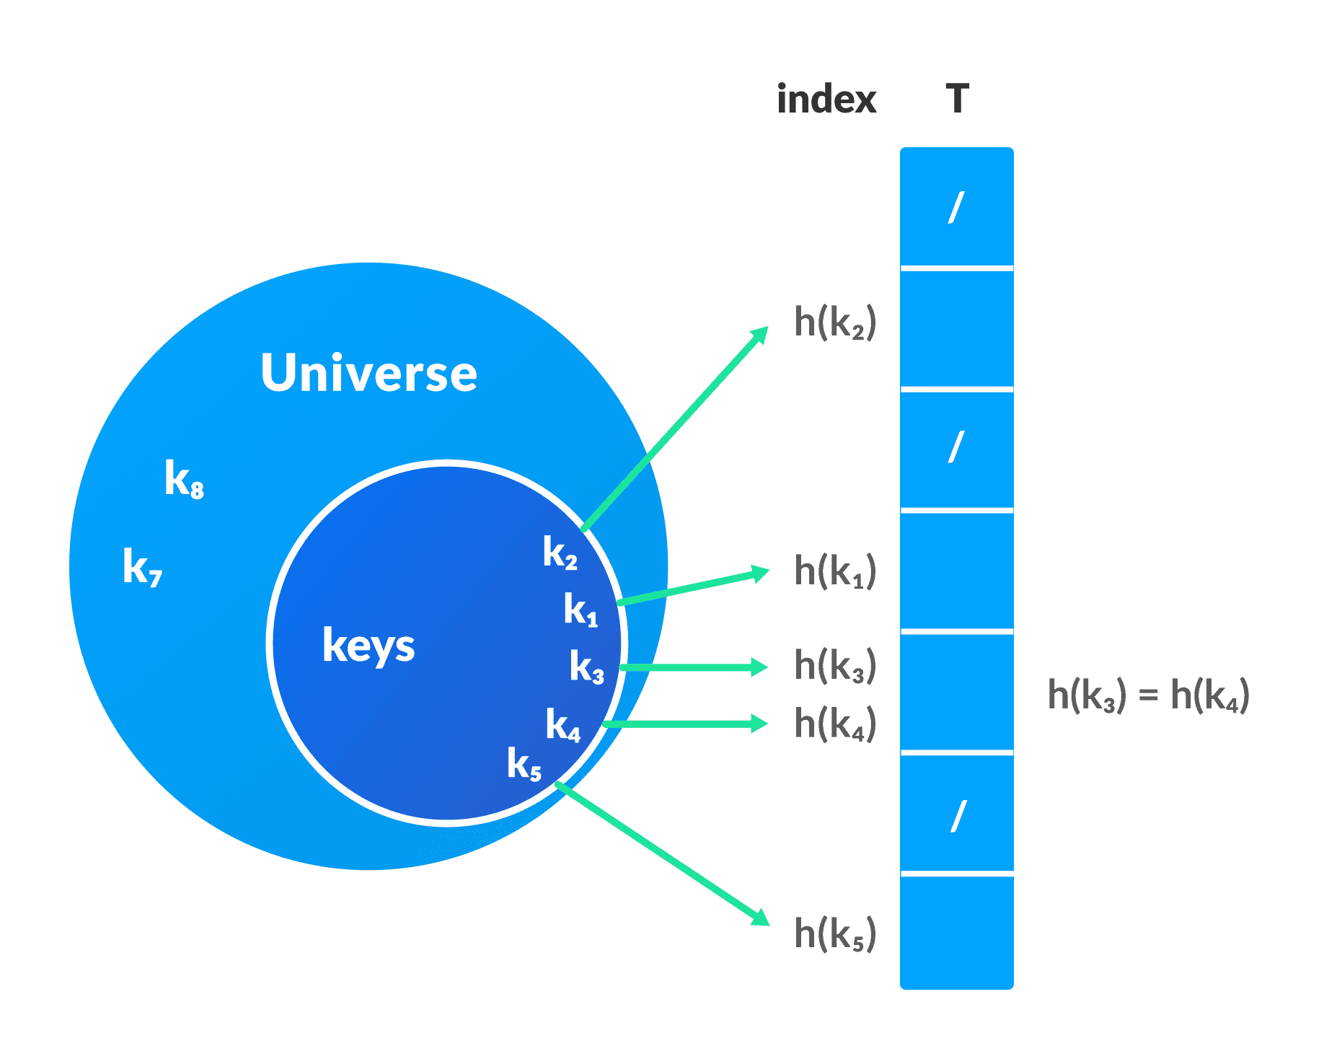

Slide 7
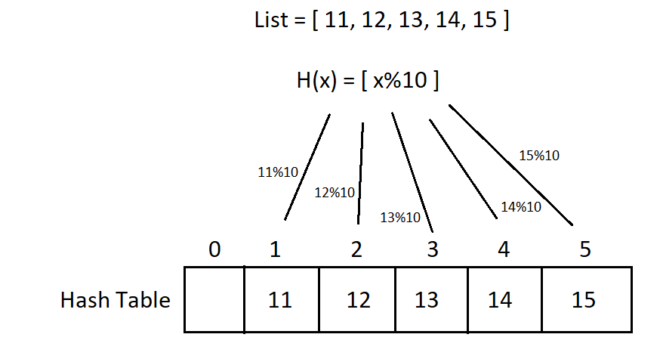
Hashing
Let a hash function H(x) maps the value x at the index x%10 in an Array. For example if the list of values is [11,12,13,14,15] it will be stored at positions {1,2,3,4,5} in the array or Hash table respectively.
iamneo.io

Slide 8
Hash Functions
There are many hash functions that use numeric numeric or alphanumeric keys.
Division Method
Mid Square Method
iamneo.io

Slide 9
Division Method
This is the easiest method to create a hash function. The hash function can be described as h(k) = k mod n
Here, h(k) is the hash value obtained by dividing the key value k by size of hash table n using the remainder. It is best that n is a prime number as that makes sure the keys are distributed with more uniformity.
An example of the Division Method is as follows: k=1276, n=10, h(1276) = 1276 mod 10 = 6, The hash value obtained is 6
A disadvantage of the division method id that consecutive keys map to consecutive hash values in the hash table. This leads to a poor performance.
iamneo.io

Slide 10
Mid Square Method
The mid square method is a very good hash function. It involves squaring the value of the key and then extracting the middle r digits as the hash value. The value of r can be decided according to the size of the hash table.
An example of the Mid Square Method is as follows:
Suppose the hash table has 100 memory locations. So r=2 because two digits are required to map the key to memory location.
k = 50
k*k = 2500
h(50) = 50
The hash value obtained is 50
iamneo.io

Slide 11
Why hashing is needed?
After storing a large amount of data, we need to perform various operations on these data.
Lookups are inevitable for the datasets. Linear search and binary search perform lookups/search with time complexity of O(n) and O(log n) respectively.
As the size of the dataset increases, these complexities also become significantly high which is not acceptable.
We need a technique that does not depend on the size of data. Hashing allows lookups to occur in constant time i.e. O(1).
iamneo.io

Slide 12
Hash Collision
When the hash function generates the same index for multiple keys, there will be a conflict (what value to be stored in that index). This is called a hash collision.
We can resolve the hash collision using one of the following techniques.
Collision resolution by chaining
Open Addressing: Linear/Quadratic Probing and Double Hashing
iamneo.io

Slide 13
Collision resolution by chaining
In chaining, if a hash function produces the same index for multiple elements, these elements are stored in the same index by using a doubly-linked list.
If j is the slot for multiple elements, it contains a pointer to the head of the list of elements. If no element is present, j contains NIL.
iamneo.io

Slide 14
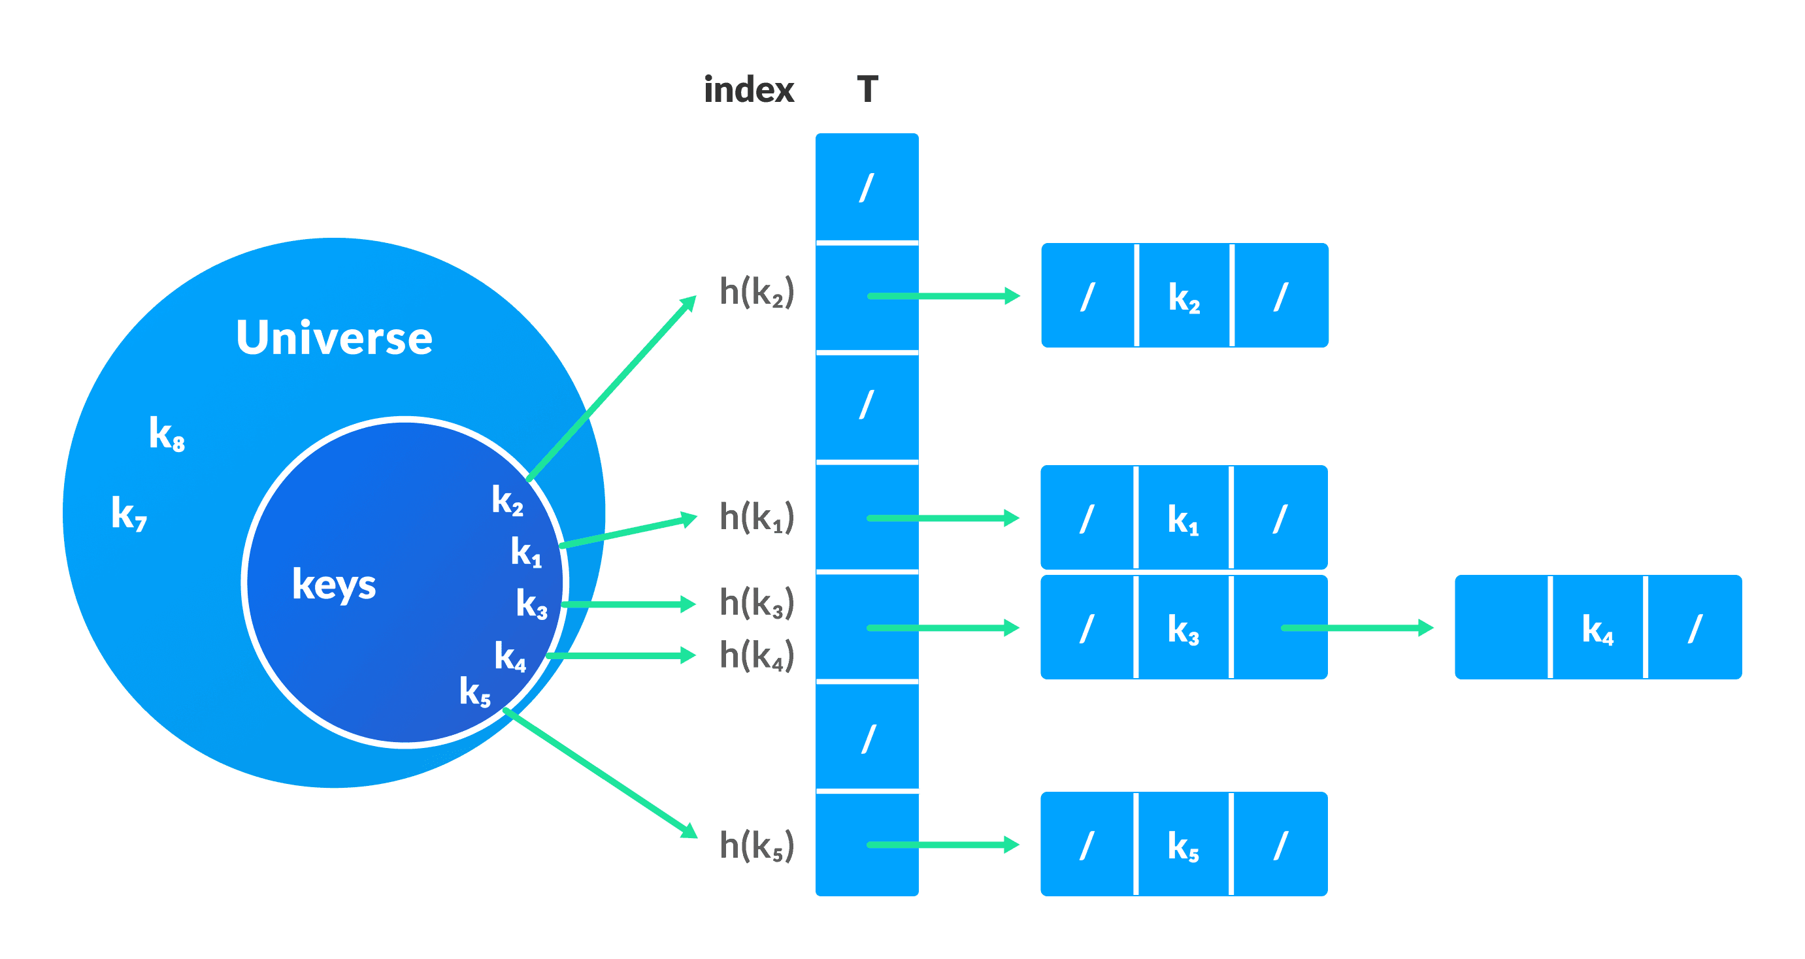

Slide 15
Collision resolution by Open addressing
Unlike chaining, open addressing doesn't store multiple elements into the same slot. Here, each slot is either filled with a single key or left NIL.
Different techniques used in open addressing are:
Linear Probing
Double Hashing
iamneo.io

Slide 16
Linear Probing
In linear probing, collision is resolved by checking the next slot.
h(k, i) = (h′(k) + i) mod m where i = {0, 1, ….} h'(k) is a new hash function
If a collision occurs at h(k, 0), then h(k, 1) is checked. In this way, the value of i is incremented linearly.
The problem with linear probing is that a cluster of adjacent slots is filled. When inserting a new element, the entire cluster must be traversed. This adds to the time required to perform operations on the hash table.
iamneo.io

Slide 17
Double hashing
If a collision occurs after applying a hash function h(k), then another hash function is calculated for finding the next slot.
h(k, i) = (h1(k) + ih2(k)) mod m
iamneo.io

Slide 18
Application of Hash Table
Database indexing: Hashing is used to index and retrieve data efficiently in databases and other data storage systems.
Password storage: Hashing is used to store passwords securely by applying a hash function to the password and storing the hashed result, rather than the plain text password.
Data compression: Hashing is used in data compression algorithms, such as the Huffman coding algorithm, to encode data efficiently.
iamneo.io

Slide 19
Application of Hash Table
Search algorithms: Hashing is used to implement search algorithms, such as hash tables and bloom filters, for fast lookups and queries.
Cryptography: Hashing is used in cryptography to generate digital signatures, message authentication codes (MACs), and key derivation functions.
iamneo.io

