Slide 1
String Algorithms
Naïve, Rabin Karp, KMP, Z, Manacher’s

Slide 2
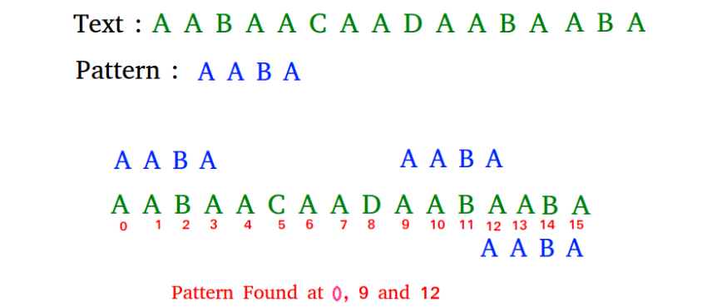
Pattern Searching
The Pattern Searching algorithms are sometimes also referred to as String Searching Algorithms and are considered as a part of the String algorithms.
These algorithms are useful in the case of searching a string within another string.

Slide 3
Pattern Searching
Naive Pattern Searching
Rabin-Karp Algorithm
KMP Algorithm
Z algorithm
Manacher‘s Algorithm

Slide 4
Naive Algorithm
Given text string with length n and a pattern with length m, the task is to prints all occurrences of pattern in text.
Input: text = “acaabc”, pattern = “aab” Output: Pattern found at index 2

Slide 5
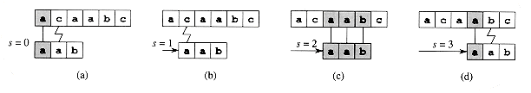
Naive Algorithm

Slide 6
Naive Algorithm
void naivePatternMatching(string text, string pattern) {
int textLength = text.length();
int patternLength = pattern.length();
int i,j;
for (i = 0; i <= textLength - patternLength; ++i) {
for (j= 0; j < patternLength; ++j) {
if (text[i + j] != pattern[j])
break;
}
if (j == patternLength)
cout << "Pattern found at position " << i;
}}

Slide 7
Rabin-Karp Algorithm
Rabin-Karp algorithm is an algorithm used for searching/matching patterns in the text using a hash function.
Unlike Naive string matching algorithm, it does not travel through every character in the initial phase rather it filters the characters that do not match and then performs the comparison.
A hash function is a tool to map a larger input value to a smaller output value. This output value is called the hash value.

Slide 8
How Rabin-Karp Algorithm Works?
A sequence of characters is taken and checked for the possibility of the presence of the required string. If the possibility is found then, character matching is performed.

Slide 9


How Rabin-Karp Algorithm Works?
STEP 1
Let the text be:
String to be searched in the above text be:

Slide 10

How Rabin-Karp Algorithm Works?
STEP 2
Let us assign a numerical value(v)/weight for the characters we will be using in the problem. Here, we have taken first ten alphabets only (i.e. A to J).

Slide 11
How Rabin-Karp Algorithm Works?
STEP 3
n be the length of the pattern and m be the length of the text. Here, m = 10 and n = 3.
Let d be the number of characters in the input set. Here, we have taken input set {A, B, C, ..., J}. So, d = 10. You can assume any suitable value for d.

Slide 12

How Rabin-Karp Algorithm Works?
STEP 4
Let us calculate the hash value of the pattern.
Hash value for pattern(p) = Σ(v * dm-1) mod 13
= ((3 * 102) + (4 * 101) + (4 * 100)) mod 13
= 344 mod 13
= 6

Slide 13
How Rabin-Karp Algorithm Works?
STEP 5
Calculate the hash value for the text-window of size m.
For the first window ABC,
hash value for text(t) = Σ(v * dn-1) mod 13
= ((1 * 102) + (2 * 101) + (3 * 100)) mod 13
= 123 mod 13
= 6

Slide 14
How Rabin-Karp Algorithm Works?
STEP 6
Compare the hash value of the pattern with the hash value of the text. If they match then, character-matching is performed.
In the above examples, the hash value of the first window (i.e. t) matches with p so, go for character matching between ABC and CDD. Since they do not match so, go for the next window.

Slide 15
How Rabin-Karp Algorithm Works?
STEP 7
We calculate the hash value of the next window by subtracting the first term and adding the next term as shown below.
t = ((1 * 102) + ((2 * 101) + (3 * 100)) * 10 + (3 * 100)) mod 13
= 233 mod 13
= 12
In order to optimize this process, we make use of the previous hash value in the following way.
t = ((d * (t - v[character to be removed] * h) + v[character to be added] ) mod 13
= ((10 * (6 - 1 * 9) + 3 )mod 13
= 12
Where, h = dm-1 = 103-1 = 100.

Slide 16
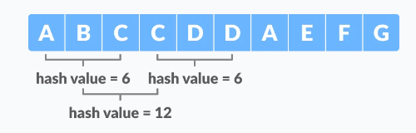
How Rabin-Karp Algorithm Works?
STEP 8
For BCC, t = 12 (≠6). Therefore, go for the next window.
After a few searches, we will get the match for the window CDA in the text.

Slide 17
Algorithm
n = t.length
m = p.length
h = dm-1 mod q
p = 0
t0 = 0
for i = 1 to m
p = (dp + p[i]) mod q
t0 = (dt0 + t[i]) mod q
for s = 0 to n - m
if p = ts
if p[1.....m] = t[s + 1..... s + m]
print "pattern found at position" s
If s < n-m
ts + 1 = (d (ts - t[s + 1]h) + t[s + m + 1]) mod q

Slide 18
Limitations of Rabin-Karp Algorithm
Spurious Hit
When the hash value of the pattern matches with the hash value of a window of the text but the window is not the actual pattern then it is called a spurious hit.
Spurious hit increases the time complexity of the algorithm. In order to minimize spurious hit, we use modulus. It greatly reduces the spurious hit.

Slide 19
Rabin-Karp Algorithm Complexity
The average case and best case complexity of Rabin-Karp algorithm is O(m + n) and the worst case complexity is O(mn).
The worst-case complexity occurs when spurious hits occur a number for all the windows.

Slide 20
Rabin-Karp Algorithm Applications
For pattern matching
For searching string in a bigger text

Slide 21
KMP
KMP (Knuth Morris Pratt) Pattern Searching

Slide 22
KMP
The Knuth-Morris-Pratt (KMP) algorithm is a string matching algorithm.
It was developed by Donald Knuth, Vaughan Pratt, and James H. Morris in 1977.
KMP algorithm compares character by character from left to right.
But whenever a mismatch occurs, it uses a preprocessed table called "Prefix Table" to skip characters comparison while matching.
The time complexity of the KMP algorithm is O(n+m) in the worst case.

Slide 23
How the KMP algorithm works
Preprocessing:
Build a prefix function (also known as the "failure function") for the pattern.
The prefix function is an array that stores the length of the longest proper prefix (which is also a suffix) of the pattern for each position in the pattern.
To construct this array, you start with the first element as 0 and iterate through the pattern character by character, updating the prefix function as you go. The idea is to find the longest prefix of the pattern that is also a suffix.

Slide 24
How the KMP algorithm works
Searching:
Iterate through the text from left to right, comparing each character in the text with the corresponding character in the pattern.
If a mismatch occurs at position i in the pattern, you can use the information from the prefix function to determine how many characters you can skip in the pattern without missing a potential match in the text.
Specifically, you move the pattern index to the position given by the prefix function value for position i in the pattern and continue comparing characters.
This avoids unnecessary comparisons and allows the algorithm to be more efficient.

Slide 25
How the KMP algorithm works
Finding Matches:
When a complete match is found, you've found an occurrence of the pattern in the text.
Depending on your application, you can either record the starting position of the match or continue searching for additional matches.

Slide 26
Z Algorithm
Linear time pattern searching Algorithm

Slide 27
Z Algorithm
Z algorithm is used to find the occurrence of a pattern in a string in linear time.
Suppose if the length of the string is n and the size of the pattern to be searched is m, the time taken to solve will be of the order O(m+n).
The z-algorithm uses a Z array to find the occurrence of a pattern.

Slide 28
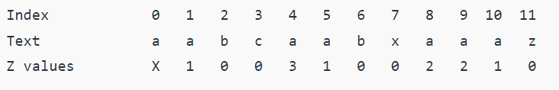
What is Z Array?
For a string str[0..n-1], Z array is of same length as string. An element Z[i] of Z array stores length of the longest substring starting from str[i] which is also a prefix of str[0..n-1]. The first entry of Z array is meaning less as complete string is always prefix of itself.
Example:

Slide 29
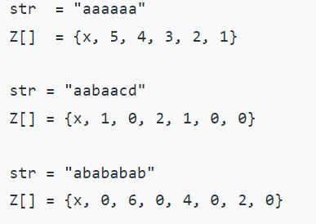
What is Z Array?
Example:

Slide 30
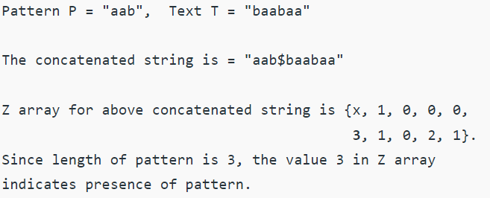
How is Z array helpful in Searching Pattern in Linear time?
The idea is to concatenate pattern and text, and create a string “P$T” where P is pattern, $ is a special character should not be present in pattern and text, and T is text.
Build the Z array for concatenated string.
In Z array, if Z value at any point is equal to pattern length, then pattern is present at that point.
Example:

Slide 31
How to construct Z array?
A Simple Solution is to run two nested loops, the outer loop goes to every index and the inner loop finds length of the longest prefix that matches the substring starting at the current index. The time complexity of this solution is O(n2).
We can construct Z array in linear time.

Slide 32
Z Algorithm
The idea is to maintain an interval [L, R] which is the interval with max R such that [L,R] is prefix substring (substring which is also prefix).
Steps for maintaining this interval are as follows –
If i > R then there is no prefix substring that starts before i and ends after i, so we reset L and R and compute new [L,R] by comparing str[0..] to str[i..] and get Z[i] (= R-L+1).
If i <= R then let K = i-L, now Z[i] >= min(Z[K], R-i+1) because str[i..] matches with str[K..] for atleast R-i+1 characters (they are in [L,R] interval which we know is a prefix substring).

Slide 33
Z Algorithm
Now two sub cases arise –
If Z[K] < R-i+1 then there is no prefix substring starting at str[i] (otherwise Z[K] would be larger) so Z[i] = Z[K] and interval [L,R] remains same.
If Z[K] >= R-i+1 then it is possible to extend the [L,R] interval thus we will set L as i and start matching from str[R] onwards and get new R then we will update interval [L,R] and calculate Z[i] (=R-L+1).

Slide 34
Z Algorithm
1. Initialize an array called the "Z-array" with the same length as the concatenated string. The Z-array will store the length of the longest substring starting at each position that matches a prefix of the concatenated string.
2. Initialize two pointers, L and R, both initially set to 0. These pointers represent a "window" [L, R] that denotes the rightmost substring that has been matched in the text.

Slide 35
Z Algorithm
3. For each position i from 1 to the length of the concatenated string - 1, do the following:
Case 1: If i is greater than R, perform a naive comparison:
Start from position i and compare characters from the concatenated string with the pattern until a mismatch is found.
Set Z[i] to be the number of characters that match.
Update the window [L, R] if a match extends beyond the current window.
Case 2: If i is less than or equal to R, use previously computed values in the Z-array to avoid unnecessary comparisons:
Calculate k = i - L (the distance from i to the left edge of the window).

Slide 36
Z Algorithm
4. If Z[k] is less than R - i + 1, set Z[i] to Z[k] because the matching substring at position i is contained within the current window.
If Z[k] is greater than or equal to R - i + 1, it means the matching substring extends beyond the current window. Perform a comparison to find the remaining matching characters and update Z[i].
If Z[i] equals the length of the pattern, it means a complete match of the pattern has been found at position i - |pattern| - 1 in the concatenated string. Add (i - |pattern| - 1) to the list of starting positions where the pattern is found.

Slide 37
Z Algorithm
5. Update the window [L, R] as follows:
If i + Z[i] - 1 is greater than R, update L and R to i and i + Z[i] - 1, respectively, to ensure that the window covers the rightmost matched substring.
6. Repeat steps 3-5 until all positions in the concatenated string have been processed.
7. After processing all positions, return the list of starting positions where the pattern is found in the text.

Slide 38
Z Algorithm
Z Algorithm (JavaScript Demo) (utdallas.edu)

Slide 39
Manacher’s Algorithm
Linear Time Longest Palindromic Substring

Slide 40
Manacher’s Algorithm
Manacher's algorithm is used to find the longest palindromic substring in any string.
It is required to solve sub-problems of some very hard problems.
The problem statement it solves is: Given a string 's' with the length of 'n'. Find the longest palindromic substring in the given string.
A string is a palindrome when it is equal to the reverse of itself.
Time complexity - O(N)

