Slide 1
REACT
JavaScript library for building reusable UI components

Slide 2
Introduction
ReactJS is a declarative, efficient, and flexible JavaScript library for building reusable UI components.
It is an open-source, component-based front end library responsible only for the view layer of the application.

Slide 3
Introduction
It can be used to develop small applications as well as big, complex applications.
ReactJS provides minimal and solid feature set to kick-start a web application.
React community compliments React library by providing large set of ready-made components to develop web application in a record time.
React community also provides advanced concept like state management, routing, etc., on top of the React library.

Slide 4
History
It was created by Jordan Walke, who was a software engineer at Facebook.
It was initially developed and maintained by Facebook and was later used in its products like WhatsApp & Instagram.
Facebook developed ReactJS in 2011 in its newsfeed section, but it was released to the public in the month of May 2013.
Current version of React.JS is V18.0.0 (April 2022).

Slide 5
How does React work?
React creates a VIRTUAL DOM in memory.
Instead of manipulating the browser's DOM directly, React creates a virtual DOM in memory, where it does all the necessary manipulating, before making the changes in the browser DOM.
React finds out what changes have been made, and changes only what needs to be changed.

Slide 6
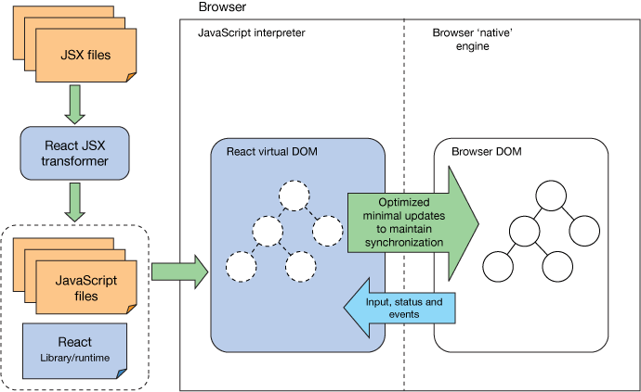
React workflow

Slide 7
React Features

Slide 8

React Features
Virtual DOM
JSX
Components
One-way Data Binding
Simplicity
Performance

Slide 9
Virtual DOM

Slide 10
Virtual DOM
React contains a lightweight representation of real DOM in the memory called Virtual DOM.
Manipulating real DOM is much slower compared to VDOM as nothing gets drawn on the screen.
When any object’s state changes, VDOM modifies only that object in real DOM instead of updating whole objects.
That makes things move fast, particularly compared with other front-end technologies that have to update each object even if only a single object changes in the web application.

Slide 11
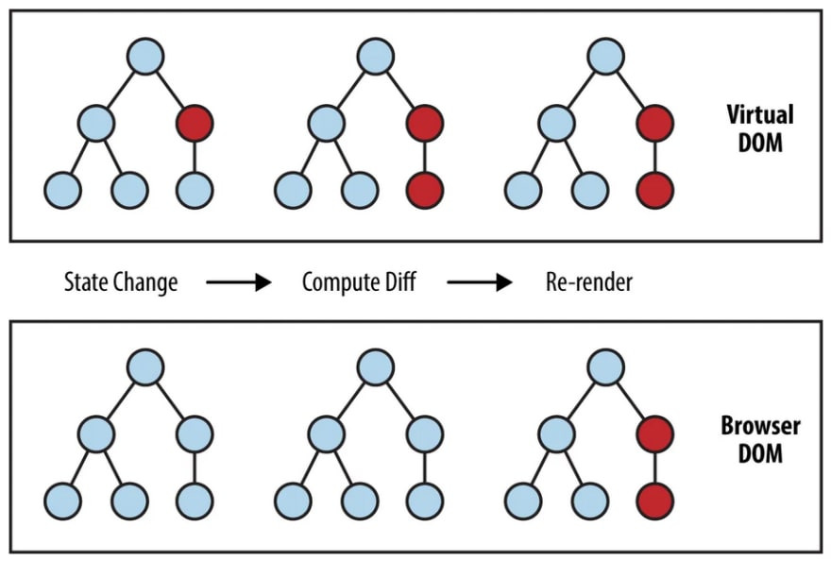
Virtual DOM

Slide 12
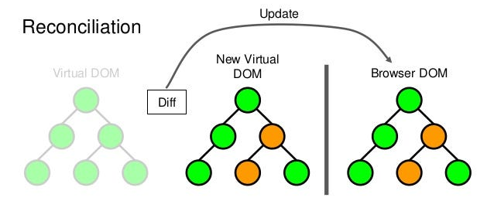
Virtual DOM
The Virtual DOM is a programming concept where an ideal or virtual representation of a UI is kept in memory and synced with the real DOM by a library such as ReactDOM. This process is called reconciliation.

Slide 13
NPM
Node package manager

Slide 14
NPM
A package manager for managing software dependencies and packages.
NPM stands for Node Package Manager
package.json is npm’s configuration file.
It’s a JSON file that can be found in root directory of a project and it holds various meta data.
It has the detailed overview of the project.

Slide 15
NPM
Some Important npm commands are:
NPM Install Command: Installs a package in the package.json file in the local node_modules folder.
npm install

Slide 16
NPM
NPM Uninstall Command: Remove a package from the package.json file and removes the module from the local node_modules folder.
npm uninstall
NPM Update Command: This command updates the specified package. If no package is specified then it updates all the packages in the specified location.
npm update

Slide 17
NPM
NPM Global Update Command: This command will apply the update action to each globally installed package.
npm update –g
NPM Initialize Command: Creates a package.json file in our directory. It basically asks some questions and finally creates a package.json file in the current project directory.
npm init

Slide 18
NPM
NPM Start Command: Runs a command that is defined in the start property in the scripts. If not defined it will run the node server.js command.
npm start
NPM Build Command: It is used to build a package.
npm build

Slide 19
JSX
JavaScript Extension

Slide 20
JSX
JSX(JavaScript Extension), is a React extension which allows writing JavaScript code that looks like HTML.
JSX is an HTML-like syntax used by React that extends ECMAScript so that HTML-like syntax can co-exist with JavaScript/React code.
The syntax is used by preprocessors (i.e., transpilers like babel) to transform HTML-like syntax into standard JavaScript objects that a JavaScript engine will parse.

Slide 21
JSX
JSX provides you to write HTML/XML-like structures (e.g., DOM-like tree structures) in the same file where you write JavaScript code, then preprocessor will transform these expressions into actual JavaScript code.
Just like XML/HTML, JSX tags have a tag name, attributes, and children.

Slide 22
Why use JSX?
It is faster than regular JavaScript because it performs optimization while translating the code to JavaScript.
Instead of separating technologies by putting markup and logic in separate files, React uses components that contain both.
It is type-safe, and most of the errors can be found at compilation time.
It makes easier to create templates.

Slide 23
JSX Comments
JSX allows us to use comments that begin with /* and ends with */ and wrapping them in curly braces {} just like in the case of JSX expressions.

Slide 24
Transpiler
Source to source compiler

Slide 25
What is a transpiler?
It is a tool that is used to convert source code into another source code that is of the same level.
That is why it is also known as a source-to-source compiler.
Both the codes are equivalent in nature, considering the fact that one works with the specific version of the browser and one doesn’t.

Slide 26
Babel
Babel is a JavaScript compiler
Babel is a very famous transpiler that basically allows us to use future JavaScript in today’s browsers.
In simple words, it can convert the latest version of JavaScript code into the one that the browser understands.

Slide 27
Webpack
Module bundler

Slide 28
Webpack
Webpack is a module bundler we can use to minify multiple files in a JavaScript project and increase the overall efficiency.
A module bundler takes in all the assets and comes up with a single output file.
This artefact can be imported into our HTML, making it a more lightweight project.

Slide 29
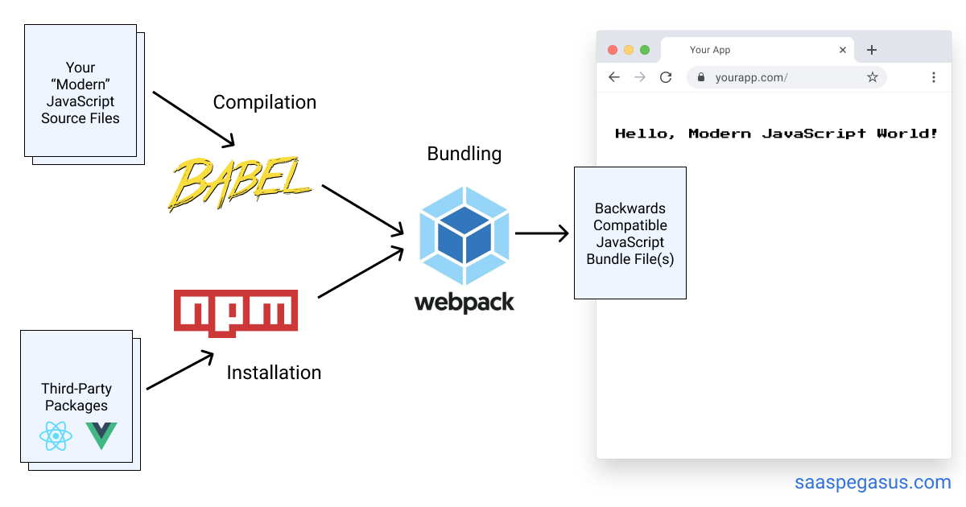

Slide 30
SPA
Single page application

Slide 31
SPA
SPA is a type of web application or website that interacts with the user by dynamically rewriting the current page rather than loading entire new pages from the server.
It aim to provide a more seamless and responsive user experience by updating the content on the page dynamically, often without requiring a full page reload.
It loads content dynamically as needed, typically using AJAX (Asynchronous JavaScript and XML) or the Fetch API.
This allows for updates to specific parts of the page without requiring a full page reload.

Slide 32
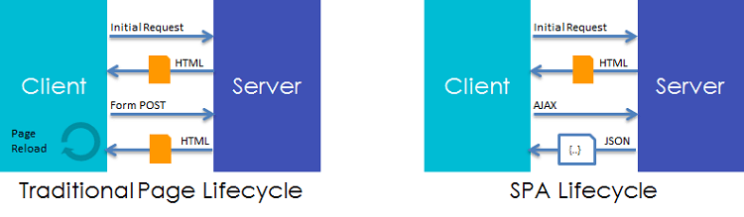

Slide 33
Installation

Slide 34
Installation
Install node: Node.js (nodejs.org)
Install and Create: npx create-react-app reactproject
Start project: npm start
OR
Install react: npm install -g create-react-app
Create project: create-react-app reactproject

Slide 35
Installation
Another way - Using vite
Install and Create: npm create vite
Select Framework: react and lang: javascript
npm install
Start project: npm run dev

Slide 36
Installation
Simple React Snippets
ES7+, Prettier, ES Lint
Settings->emmet->emmet include language

Slide 37
Project Structure
node_modules: It contains the React library and any other third party libraries needed.
public: It holds the public assets of the application. It contains the index.html where React will mount the application by default on the <div id="root"></div> element.
src: It contains the App.css, App.js, App.test.js, index.css, index.js, and serviceWorker.js files. Here, the App.js file always responsible for displaying the output screen in React.

Slide 38
Project Structure
package-lock.json: It is generated automatically for any operations where npm package modifies either the node_modules tree or package.json. It cannot be published. It will be ignored if it finds any other place rather than the top-level package.
package.json: It holds various metadata required for the project. It gives information to npm, which allows to identify the project as well as handle the projects dependencies.
README.md: It provides the documentation to read about React topics.

Slide 39
Components
Core building blocks

Slide 40
Components
Earlier, the developers write more than thousands of lines of code for developing a single page application. These applications follow the traditional DOM structure, and making changes in them was a very challenging task. If any mistake found, it manually searches the entire application and update accordingly.
The component-based approach was introduced to overcome an issue. In this approach, the entire application is divided into a small logical group of code, which is known as components.

Slide 41
Components
A Component is considered as the core building blocks of a React application.
It makes the task of building UIs much easier.
Each component exists in the same space, but they work independently from one another and merge all in a parent component, which will be the final UI of your application.

Slide 42
Components
Every React component have their own structure, methods as well as APIs.
They can be reusable as per your need.
For better understanding, consider the entire UI as a tree. Here, the root is the starting component, and each of the other pieces becomes branches, which are further divided into sub-branches.

Slide 43
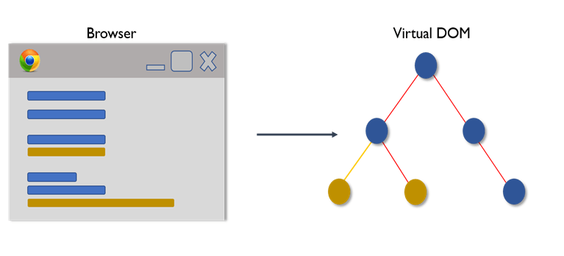
Components

Slide 44
Components
Components contain:
Template
Logic
Components come in two types:
Class components
Function components

Slide 45
Function Component
A Function component also returns HTML, and behaves much the same way as a Class component.
Function components can be written using much less code, are easier to understand.

Slide 46
Example
Function component

Slide 47
Function Component
function HelloWorldComponent() {
return <div>Hello, World!</div>;
}
export default HelloWorldComponent;

Slide 48
Function Component
import HelloWorldComponent from './HelloWorldComponent';
function App() {
return (
<div>
<HelloWorldComponent />
</div>
);
}
export default App;

Slide 49
Example
Function component - Arrow function

Slide 50
Function Component
const HelloWorldComponent = () => {
return <div>Hello, World!</div>;
}
export default HelloWorldComponent;

Slide 51
Class Component
A class component must include the extends React.Component statement.
This statement creates an inheritance to React.Component, and gives component access to React.Component's functions.
The component also requires a render() method, this method returns HTML.

Slide 52
Example
Class component

Slide 53
Class Component
import { Component } from 'react';
class HelloWorldComponent extends Component {
render() {
return <div>Hello, World!</div>;
}
}
export default HelloWorldComponent;

Slide 54
Class Component
import HelloWorldComponent from './HelloWorldComponent';
function App() {
return (
<div>
<HelloWorldComponent />
</div>
);
}
export default App;

Slide 55
Thank You

