Slide 1
Testing

Slide 2
JEST
Jest is a popular JavaScript testing framework developed by Facebook.
It is widely used for testing JavaScript code, including React applications.
Jest provides a simple and efficient way to write unit tests and ensures that your code works as expected.
If you're using Create React App, Jest is configured out of the box.
You can run tests using the npm test command.

Slide 3
JEST
import React from "react";
function Form() {
return (
<div>
<h1>React Test - JEST</h1>
<input type="text"></input>
<button>Submit</button>
</div>
);
}
export default Form;

Slide 4
JEST
//App.test.js
import { render, screen } from "@testing-library/react";
import App from "./App";
test("renders heading React App", () => {
render(<App />);
const linkElement = screen.getByText(/React Test - JEST/i);
expect(linkElement).toBeInTheDocument();
});

Slide 5
JEST
test("renders textbox", () => {
render(<App />);
const textInput = screen.getByRole("textbox");
expect(textInput).toBeInTheDocument();
});
test("renders button", () => {
render(<App />);
const button = screen.getByRole("button");
expect(button).toBeInTheDocument();
});

Slide 6
Deploying React App to Web

Slide 7
Deploying
Deploying using Netlify drag-and-drop
One of the coolest features that Netlify offers is the ability to drag and drop your site folder on the Netlify dashboard and have it deploy your app like magic.
You can also connect GitHub, GitLab, or Bitbucket, depending on where your project is stored. This allows automatic deployment whenever you push your changes.
For your React app, you’ll have to drag and drop the build folder onto the Netlify Dashboard. Run npm run build beforehand to deploy the latest build.

Slide 8
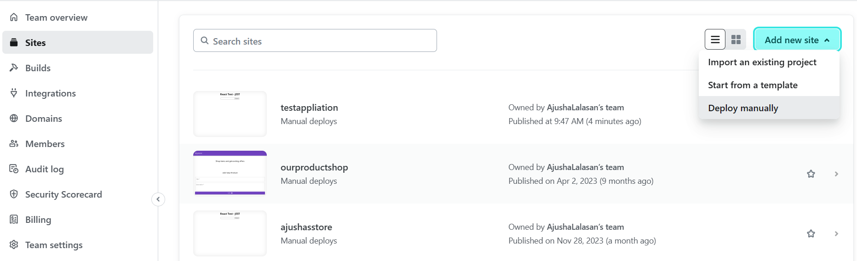

Slide 9
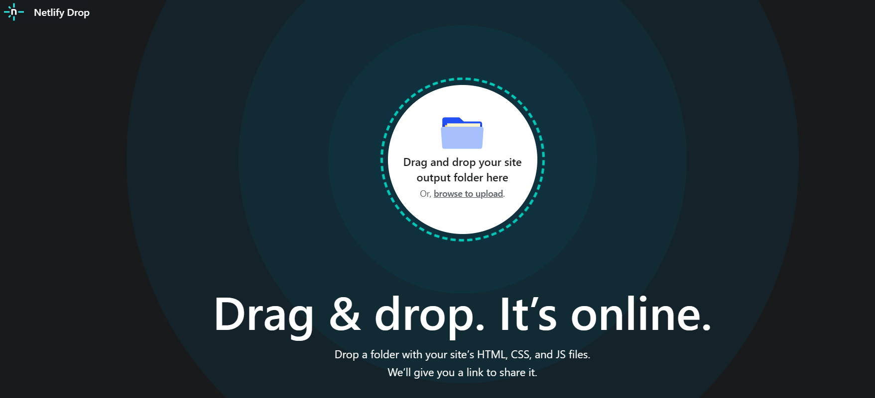

Slide 10
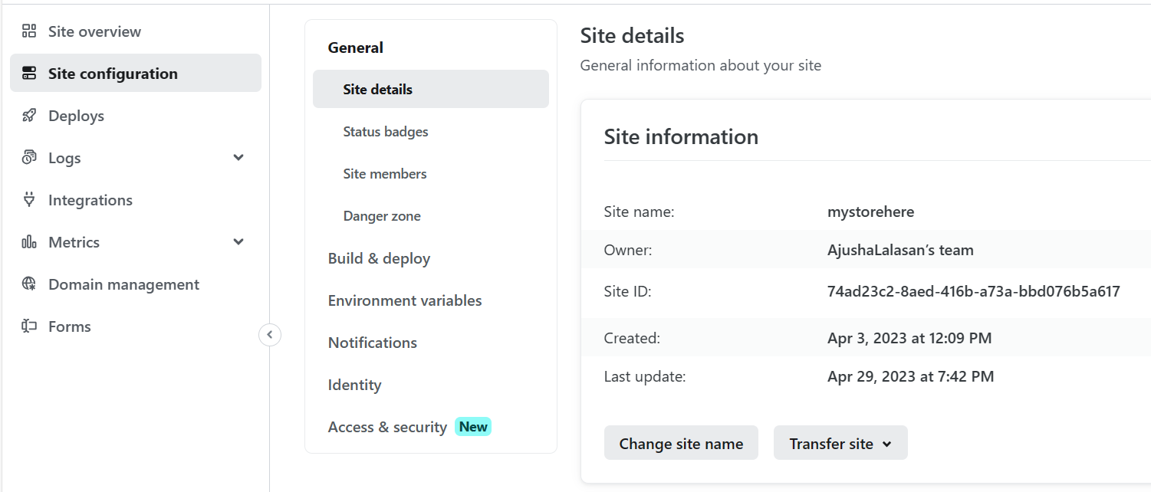

Slide 11
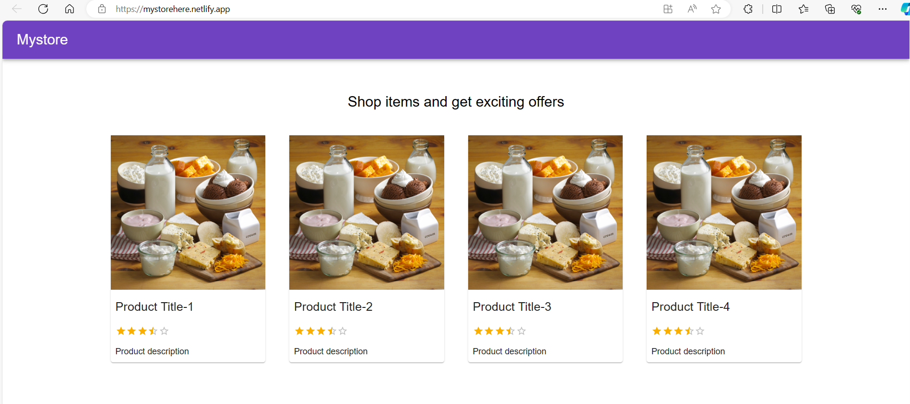

Slide 12
Thank you

