Slide 1
State

Slide 2
State
A state is a variable which exists inside a component, that cannot be accessed and modified outside the component and can only be used inside the component.
Works very similarly to a variable that is declared inside a function that cannot be accessed outside the scope of the function in normal javascript.
State Can be modified using this.setState or useState().
State can be asynchronous.

Slide 3
State
import { useState } from "react";
function StateExample() {
const [name, setName] = useState("John");
return (
<div>
<h1>State Example</h1>
<hr></hr>
<h3>Name is {name}</h3>
<button onClick={changeName}>Change Name</button>
</div>
);
}
export default StateExample;

Slide 4
Props

Slide 5
Props
Props stand for Properties and is a keyword used in React.
These props pass the data between the different components.
The major part to focus in props is that the dataflow is unidirectional which means that props pass the data one way from the parent to the child.
Props are immutable which means they are read-only and the data which comes from the parent to the child cannot be changed by the child components.

Slide 6
Props
function PropsDemo({ props }) {
return (
<div>
<h1>An example to demostrate props</h1>
<p>I'm a props ie. state passed from the parent component is {props}</p>
</div>
);
}
export default PropsDemo;

Slide 7
Props
import "./App.css";
import PropsDemo from "./components/PropsDemo";
function App() {
return (
<div className="App">
<PropsDemo props={name} />
</div>
);
}
export default App;

Slide 8
Prop Types
We can use the propType for validating any data we are receiving from props.
The propTypes are like objects where keys are the prop names and values are their types.
For the props which do not validate the type of data specified by propTypes, a warning on the console will occur.
ComponentClassName.propTypes{
propName1 : PropTypes.string,
propName2 : PropTypes.bool,
propName3 : PropTypes.array,
.. . .
propNamen : PropTypes.anyOtherType
}

Slide 9
Default Props
The defaultProps allows you to set default values for the props argument.
If the prop property is passed, it will be changed.
The defaultProps can be defined as a property on the component class itself, to set the default props for the class.
ComponentClassName.defaultProps{
propName1 : defaultvalue,
propName2 : defaultvalue,
}

Slide 10
State vs Props
State | Props
State is managed within the component | Props gets passed to the component
State can be changed(mutable) | Props are read only and cannot be changed (immutable)
State changes can be asynchronous | Props are read only
State is controlled by react components | Props are controlled by whoever renders the components
State can used to display changes with the component | Props are used to communicate between components
State can be accessed using the use state hooks in functional components and in-class components can be accessed using this. State | Props can be accessed in functional component using props parameter and in-class component, props can the accessed using this.props

Slide 11
Event

Slide 12
Events
Events are interactions or occurrences that take place in the user interface, such as mouse clicks, keyboard inputs, or changes in form elements.
Events are named using camelCase, similar to how they are named in standard JavaScript. Examples include onClick, onChange, onSubmit, etc.

Slide 13
Event Handlers
Event handlers are functions that handle specific events. They define the behavior that should occur when an event is triggered.
Event handlers are assigned as props to JSX elements, indicating which function should be called when a particular event occurs.

Slide 14
Events
const AlertButton = () => {
const handleClick = () => {
alert('Button Clicked!');
};
return (
<div>
<button onClick={handleClick}>
Click me
</button>
</div>
);
};
export default AlertButton;

Slide 15
Events Passing Arguments
To pass an argument to an event handler, use an arrow function
function Football() {
const shoot = (arg) => {
alert(arg);
}
return (
<button onClick={() => shoot("Goal!")}>Take the shot!</button>
);
}

Slide 16
Event Object
Event handlers have access to the React event that triggered the function.
function Football() {
const shoot = (arg, event) => {
alert(event.type);
/* ‘event' represents the React event that triggered the function, in this case the 'click' event*/
}
return (
<button onClick={(event) => shoot("Goal!", event)}>Take the shot!</button>
);
}

Slide 17
Conditional Rendering

Slide 18
Conditional Rendering
React, we can create multiple components which encapsulate behavior that we need. After that, we can render them depending on some conditions or the state of our application.
Based on one or several conditions, a component decides which elements it will return.
Works the same way as the conditions work in JavaScript.

Slide 19
Conditional Rendering
Consider an example of handling a login/logout button. The login and logout buttons will be separate components. If a user logged in, render the logout component to display the logout button. If a user not logged in, render the login component to display the login button. In React, this situation is called as conditional rendering.

Slide 20
Conditional Rendering
function Login() {
const [isLoggedIn, setLoggedIn] = useState(false);
const handleLogin = () => {
setLoggedIn(true);
}; const handleLogout = () => {
setLoggedIn(false);
};

Slide 21
Conditional Rendering
return (
<div>
<button onClick={handleLogin}>Log In</button>
<button onClick={handleLogout}>Log Out</button>
<ConditionalComponent isLoggedIn={isLoggedIn} />
</div>
);
}

Slide 22
Conditional Rendering
const ConditionalComponent = ({ isLoggedIn }) => {
return (
<div>
{ isLoggedIn ?
( <p>Welcome, User! You are logged in.</p> )
:
( <p>Please log in to access the content.</p> )
}
</div>
);
};

Slide 23
Routing

Slide 24
Routing
Routing is a process in which a user is directed to different pages based on their action or request.
ReactJS Router is mainly used for developing Single Page Web Applications.
React Router is used to define multiple routes in the application.
When a user types a specific URL into the browser, and if this URL path matches any 'route' inside the router file, the user will be redirected to that particular route.

Slide 25
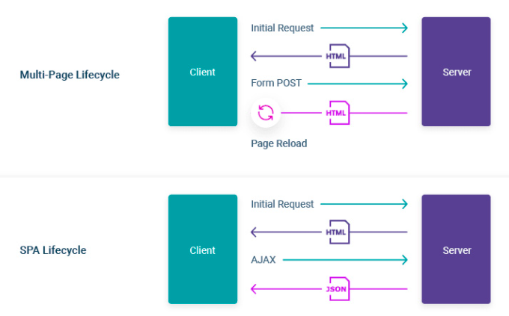

Slide 26
Routing
React contains three different packages for routing.
react-router: It provides the core routing components and functions for the React Router applications.
react-router-native: It is used for mobile applications.
react-router-dom: It is used for web applications design.
npm install react-router-dom

Slide 27
Routing
BrowserRouter: It is the parent component that is used to store all of the other components. Add BrowserRouter aliased as Router to your app.js file in order to wrap all the other components. It can have only single child.
Routes: To render a single component, wrap all the routes inside the Routes Component.
Route: Route component will now help us to establish the link between component’s UI and the URL.
Link: Link component uses the to prop to describe the location where the links should navigate to.

Slide 28
Routing
import { Route, Routes } from 'react-router-dom';
export default function App() {
return (
<Routes>
<Route exact path='/' element={<Home />} />
<Route path='/about' element={<About />} />
</Routes>
);
}

Slide 29
Routing
const Layout = () => {
return (
<>
<nav>
<ul>
<li> <Link to="/">Home</Link> </li>
<li> <Link to="/about“>About</Link> </li>
</ul>
</nav>
</>
)
};
export default Layout;

Slide 30
Thank you

