Slide 1
Component Life Cycle

Slide 2
Life Cycle
Life cycle of a component represents the different stages of the component during its existence.
React provides callback function to attach functionality in each and every stages of the React life cycle.

Slide 3
Life Cycle
Each React component has three distinct stages.
Mounting − Mounting represents the rendering of the React component in the given DOM node.
Updating − Updating represents the re-rendering of the React component in the given DOM node during state changes / updates.
Unmounting − Unmounting represents the removal of the React component.

Slide 4
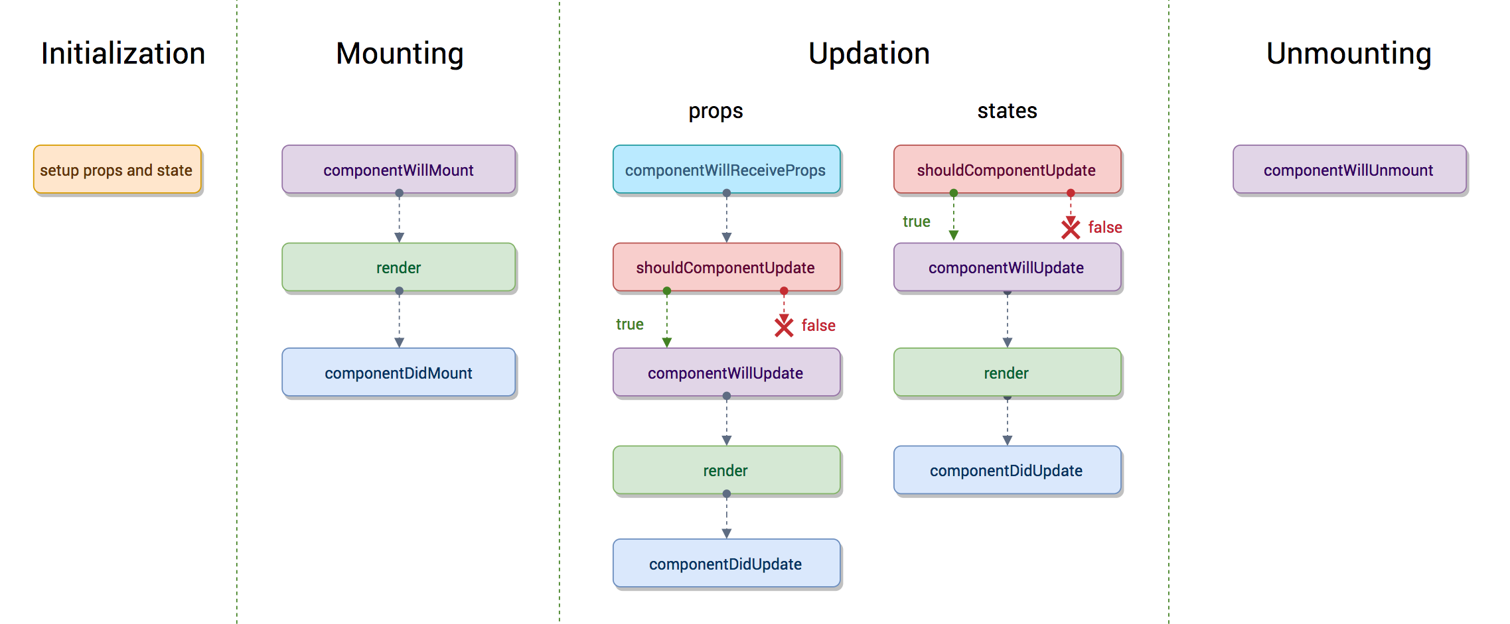
Component Life cycle

Slide 5
Life Cycle
constructor() − Invoked during the initial construction phase of the React component. Used to set initial state and properties of the component.
render() − Invoked after the construction of the component is completed. It renders the component in the virtual DOM instance. This is specified as mounting of the component in the DOM tree.
componentDidMount() − Invoked after the initial mounting of the component in the DOM tree. It is the good place to call API endpoints and to do network requests.

Slide 6
Life Cycle
componentDidUpdate() − Similar to ComponentDidMount() but invoked during the update phase. Network request can be done during this phase but only when there is difference in component’s current and previous properties.
componentWillUnmount() − Invoked after the component is unmounted from the DOM. This is the good place to clean up the object.
shouldComponentUpdate() − Invoked during the update phase. Used to specify whether the component should update or not. If it returns false, then the update will not happen.

Slide 7
Example
Class component

Slide 8
Life Cycle
import React, { Component } from "react";
class LifecycleClass extends Component {
constructor(props) {
super(props);
this.state = {
message: "Hello, React!",
};
console.log("Constructor called");
}

Slide 9
Life Cycle
componentDidMount() {
console.log("ComponentDidMount called");
}
componentDidUpdate(prevProps, prevState) {
console.log("ComponentDidUpdate called");
}
componentWillUnmount() {
console.log("ComponentWillUnmount called");
}
handleClick = () => {
this.setState({ message: "Updated message!" });
};

Slide 10
Life Cycle
render() {
console.log("Render called");
return (
<div>
<p>{this.state.message}</p>
<button onClick={this.handleClick}>Update Message</button>
</div>
);
}
}
export default LifecycleClass;

Slide 11
Example
functional component

Slide 12
Life Cycle
import { useState, useEffect } from "react";
const LifecycleFunctional = () => {
const [message, setMessage] = useState("Hello, React!");
useEffect(() => {
console.log("ComponentDidMount called");
// Cleanup function for componentWillUnmount
return () => {
console.log("ComponentWillUnmount called");
};
}, []); // Empty dependency array ensures it runs only on mount

Slide 13
Life Cycle
useEffect(() => {
console.log("ComponentDidUpdate called");
}, [message]); // Run only when the 'message' state changes
const handleClick = () => {
setMessage("Updated message!");
};
console.log("Render called");

Slide 14
Life Cycle
return (
<div>
<p>{message}</p>
<button onClick={handleClick}>Update Message</button>
</div>
);
};
export default LifecycleFunctional;

Slide 15
Pure Component

Slide 16
Pure Component
Pure Components in React are the components which do not re-renders when the value of state and props has been updated with the same values.
If the value of the previous state or props and the new state or props is the same, the component is not re-rendered.
Pure Components restricts the re-rendering ensuring the higher performance of the Component

Slide 17
Pure Component
Prevents re-rendering of Component if props or state is the same
Takes care of “shouldComponentUpdate” implicitly
State and Props are Shallow Compared
Pure Components are more performant in certain cases

Slide 18
Pure Component
In functional components, you can use the React.memo higher-order component to achieve the same effect as a pure component.
React.memo is a higher-order component provided by React that can be used to memoize the result of a functional component.
Memoization is a technique used to optimize performance by memoizing (caching) the result of a function based on its input parameters. In the context of React, React.memo is used to prevent unnecessary renders of a functional component by memoizing its output.
In class components, you can extend the React.PureComponent class.

Slide 19
Example
Functional component

Slide 20
Pure Component
const MyComponent = React.memo((props) => {
// Your component logic here
return (
<div>
{/* Render your component */}
</div>
);
});
export default MyComponent;

Slide 21
Example
Class component

Slide 22
Pure Component
import { PureComponent } from 'react';
class MyPureComponent extends PureComponent {
render() {
// Your component logic here
return (
<div>
{/* Render your component */}
</div>
);
}
}
export default MyPureComponent;

Slide 23
Error Handling

Slide 24
Debugging
Debugging is one of the most useful skills a developer can possess.
It allows you to navigate properly, spot errors in your code, and apply fixes quickly and efficiently to deliver production-ready, error-free, high-quality software systems.
In the modern web development industry, this is made possible by using various tools and techniques.

Slide 25
Tools
Google developer tools
React Devtool

Slide 26
React Developer Tools
React Developer Tools is a solution to inspect and analyze React components.
It lets you edit component props and the state for debugging purposes.
It also offers an inbuilt profiler for performance analysis.
It comes as an official browser extension and an Electron-based standalone desktop app. The browser extension is available for Chrome, Firefox, and Edge. For Safari and other web browsers, the React development team offers the standalone Electron app via the react-devtools package.

Slide 27
Error Boundaries

Slide 28
Error Boundaries
A component that implements either one or both of the life cycle methods static getDerivedStateFromError() or componentDidCatch() becomes an error boundary.
static getDerivedStateFromError() - is a lifecycle method that allows the Error Boundary a chance to update the state and thus triggering a last render().
componentDidCatch() - is a lifecycle method designed for triggering side-effects.
Good practices suggest to create a component that is purpose-built as an Error Boundary instead of mixing error-handling logic into your generic components.

Slide 29
Error Boundaries
import React, { Component } from "react";
export class ErrorBoundary extends Component {
constructor(props) {
super(props);
this.state = {
error: null,
};
}
componentDidCatch(error, info) {
console.log(error, info);
}
static getDerivedStateFromError(error) {
return { error: error };
}

Slide 30
Error Boundaries
render() {
if (this.state.error) {
return (
<div>
<p>Something went wrong!!</p>
</div>
);
}
return this.props.children;
}
}
export default ErrorBoundary;

Slide 31
Fragment

Slide 32
Fragment
React Fragment is a feature in React that allows you to return multiple elements from a React component by allowing you to group a list of children without adding extra nodes to the DOM.
To return multiple elements from a React component, you'll need to wrap the element in a root element.
Use <React.Fragment> </React.Fragment> tag or shorthand <> </>

Slide 33
Fragment Advantages
The code readability of React Fragment is higher.
Because React fragments have a smaller DOM, they render faster and use less memory.
React Fragment allows React components to be rendered as intended without causing any parent-child relationship issues.
Fragments allow the return of multiple JSX elements, which addresses the issue of invalid HTML markups within react applications that were caused by the must-have constraint of only one element returning per component.

Slide 34
Fragment
const MyComponent = () => {
return (
<React.Fragment>
<h1>Hello</h1>
<p>This is a paragraph.</p>
</React.Fragment>
);
};
export default MyComponent;

Slide 35
Fragment
const MyComponent = () => {
return (
<>
<h1>Hello</h1>
<p>This is a paragraph.</p>
</>
);
};
export default MyComponent;

Slide 36
HOC
Higher order component

Slide 37
HOC
Higher-order components or HOC is the advanced method of reusing the component functionality logic.
It simply takes the original component and returns the enhanced component.
Syntax:
const EnhancedComponent = higherOrderComponent(OriginalComponent);

Slide 38
HOC
Reason to use Higher-Order component:
Easy to handle
Get rid of copying the same logic in every component
Makes code more readable

Slide 39
HOC
const withCounter = (WrappedComponent) => {
return () => {
const [count, setCount] = useState(0);
const handleIncrement = () => {
setCount(count + 1);
};
return <WrappedComponent count={count} onIncrement={handleIncrement} />;
};
};
export default withCounter;

Slide 40
HOC
import withCounter from "./withCounter";
const ButtonClick = ({ count, onIncrement }) => {
return (
<div>
<button onClick={onIncrement}>Clicked {count} times</button>
</div>
);
};
export default withCounter(ButtonClick);

Slide 41
HOC
import withCounter from "./withCounter";
const MouseOver = ({ count, onIncrement }) => {
return (
<div>
<h1 onMouseOver={onIncrement}>Count: {count}</h1>
</div>
);
};
export default withCounter(MouseOver);

Slide 42
HOC
function App() {
return (
<div className="App">
<ButtonClick />
<MouseOver />
</div>
);
}
export default App;

Slide 43
Thank you

