Slide 1
Hooks
Usestate, useeffect, useref, usecontext, usememo

Slide 2
Hooks
Hooks were added to React in version 16.8.
Hooks allow function components to have access to state and other React features.

Slide 3
What is Hooks?
Hooks allow us to "hook" into React features such as state and lifecycle methods.
There are 3 rules for hooks:
Hooks can only be called inside React function components.
Hooks can only be called at the top level of a component.
Hooks cannot be conditional

Slide 4
useState Hook
Track state

Slide 5
useState Hook
The React useState Hook allows us to track state in a function component.
State generally refers to data or properties that need to be tracking in an application.

Slide 6
useState Hook
Initialize useState
We initialize our state by calling useState in our function component.
useState accepts an initial state and returns two values:
The current state.
A function that updates the state.
Syntax: const [state, setState] = useState(initialstate)

Slide 7
useState Hook
import { useState } from "react";
function FavoriteColor() {
const [color, setColor] = useState("red");
return (
<>
<h1>My favorite color is {color}!</h1>
<button type="button" onClick={() =>setColor("blue")}>Blue</button>
</>
)
}

Slide 8
useState Hook
The useState Hook can be used to keep track of strings, numbers, booleans, arrays, objects, and any combination of these.

Slide 9
useEffect Hook
Perform side effects

Slide 10
useEffect Hook
The useEffect Hook allows you to perform side effects in your components.
Some examples of side effects are: fetching data, directly updating the DOM, and timers.
useEffect accepts two arguments. The second argument is optional.
Syntax: useEffect(<function>, <dependency>)

Slide 11

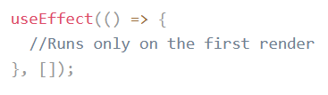
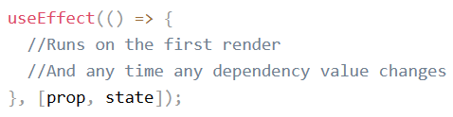
useEffect Hook
We should always include the second parameter which accepts an array. We can optionally pass dependencies to useEffect in this array.

Slide 12
useEffect Hook
function Timer() {
const [count, setCount] = useState(0);
useEffect(() => {
setTimeout(() => {
setCount((count) => count + 1);
}, 1000);
}, []); // <- add empty brackets here
return <h1>I've rendered {count} times!</h1>;
}

Slide 13
useContext Hook
State management

Slide 14
useContext Hook
React Context is a way to manage state globally.
It can be used together with the useState Hook to share state between deeply nested components more easily than with useState alone.
React context provides data to components no matter how deep they are in the components tree.
The context is used to manage global data, e.g. global state, theme, services, user settings, and more.

Slide 15
useContext Hook
State should be held by the highest parent component in the stack that requires access to the state.
To illustrate, we have many nested components. The component at the top and bottom of the stack need access to the state.
To do this without Context, we will need to pass the state as "props" through each nested component. This is called "prop drilling".
In the following example even though components 2-3 did not need the state, they had to pass the state along so that it could reach component 4.

Slide 16
useContext Hook
function Component1() {
const [user, setUser] = useState("Jesse Hall");
return (
<>
<h1>{`Hello ${user}!`}</h1>
<Component2 user={user} />
</>
);
}

Slide 17
useContext Hook
function Component2({ user }) {
return (
<>
<h1>Component 2</h1>
<Component3 user={user} />
</>
);
}

Slide 18
useContext Hook
function Component3({ user }) {
return (
<>
<h1>Component 3</h1>
<Component4 user={user} />
</>
);
}

Slide 19
useContext Hook
function Component4({ user }) {
return (
<>
<h1>Component 4</h1>
<h2>{`Hello ${user} again!`}</h2>
</>
);
}

Slide 20
When do you need context?
You can hold inside the context:
global state
theme
application configuration
authenticated user name
user settings
preferred language
a collection of services

Slide 21
How to use the context?
Using the context in React requires 3 simple steps:
Creating the context
Providing the context
Consuming the context

Slide 22
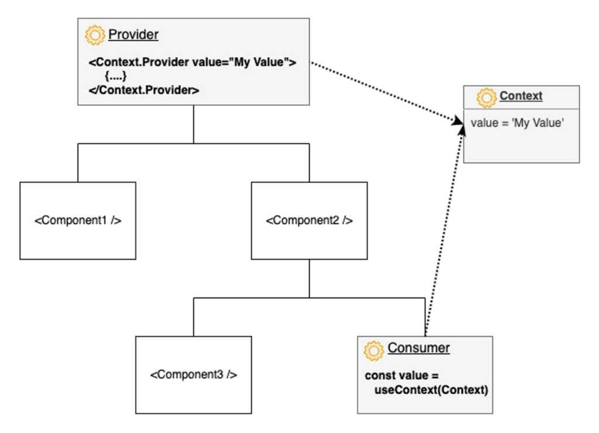
useContext Hook

Slide 23
useContext Hook
1. Creating the Context
To create context, you must Import createContext and initialize it:
const UserContext = createContext(‘default value’)

Slide 24
useContext Hook
2. Providing the context
Wrap child components in the Context Provider and supply the state value.
Now, all components in this tree will have access to the user Context.
<UserContext.Provider value={value}>
<Component1/>
<Component2/>
</UserContext.Provider>

Slide 25
useContext Hook
3. Consuming the context
In order to use the Context in a child component, we need to access it using the useContext Hook.
const user = useContext(UserContext);

Slide 26
Example
usecontext

Slide 27
useContext Hook
const UserContext = createContext();
function Component1() {
const [user, setUser] = useState("Jesse Hall");
return (
<UserContext.Provider value={user}>
<h1>{`Hello ${user}!`}</h1>
<Component2 />
</UserContext.Provider>
);
}

Slide 28
useContext Hook
function Component2() {
return (
<>
<h1>Component 2</h1>
<Component3 />
</>
);
}

Slide 29
useContext Hook
function Component3() {
return (
<>
<h1>Component 3</h1>
<Component4 />
</>
);
}

Slide 30
useContext Hook
function Component4() {
const user = useContext(UserContext);
return (
<>
<h1>Component 4</h1>
<h2>{`Hello ${user} again!`}</h2>
</>
);
}

Slide 31
useRef Hook

Slide 32
useRef Hook
The useRef Hook allows you to persist values between renders.
It can be used to store a mutable value that does not cause a re-render when updated.
It can be used to access a DOM element directly.

Slide 33
useRef Hook
If we tried to count how many times our application renders using the useState Hook, we would be caught in an infinite loop since this Hook itself causes a re-render.
To avoid this, we can use the useRef Hook.
useRef() only returns one item. It returns an Object called current.
When we initialize useRef we set the initial value: useRef(0).

Slide 34
Example

Slide 35
useRef Hook
function App() {
const [inputValue, setInputValue] = useState("");
const count = useRef(0);
useEffect(() => {
count.current = count.current + 1;
});

Slide 36
useRef Hook
return (
<>
<input
type="text"
value={inputValue}
onChange={(e) => setInputValue(e.target.value)}
/>
<h1>Render Count: {count.current}</h1>
</>
);}

Slide 37
useRef Hook
In general, we want to let React handle all DOM manipulation.
But there are some instances where useRef can be used without causing issues.
In React, we can add a ref attribute to an element to access it directly in the DOM.

Slide 38
Example

Slide 39
useRef Hook
function App() {
const inputElement = useRef();
const focusInput = () => {
inputElement.current.focus();
};
return (
<>
<input type="text" ref={inputElement} />
<button onClick={focusInput}>Focus Input</button>
</>
);
}

Slide 40
useMemo Hook

Slide 41
useMemo Hook
The React useMemo Hook returns a memoized value.
Think of memoization as caching a value so that it does not need to be recalculated.
The useMemo Hook only runs when one of its dependencies update.
This can improve performance.
The useMemo and useCallback Hooks are similar. The main difference is that useMemo returns a memoized value and useCallback returns a memoized function.

Slide 42
useMemo Hook
import { useState, useMemo } from "react";
import ReactDOM from "react-dom/client";
const App = () => {
const [count, setCount] = useState(0);
const [todos, setTodos] = useState([]);
const calculation = useMemo(() => expensiveCalculation(count), [count]);
const increment = () => {
setCount((c) => c + 1);
};

Slide 43
useMemo Hook
const addTodo = () => {
setTodos((t) => [...t, "New Todo"]);
};
return (
<div>
<div>
<h2>My Todos</h2>
{todos.map((todo, index) => {
return <p key={index}>{todo}</p>;
})}
<button onClick={addTodo}>Add Todo</button>

Slide 44
useMemo Hook
</div>
<hr />
<div>
Count: {count}
<button onClick={increment}>+</button>
<h2>Expensive Calculation</h2>
{calculation}
</div>
</div>
);
};

Slide 45
useMemo Hook
const expensiveCalculation = (num) => {
console.log("Calculating...");
for (let i = 0; i < 1000000000; i++) {
num += 1;
}
return num;
};
const root = ReactDOM.createRoot(document.getElementById('root'));
root.render(<App />);

Slide 46
Reference
A Guide to React Context and useContext() Hook (dmitripavlutin.com)

Slide 47
Thank You

