Slide 1
Axios
HTTP client for making requests to API’s

Slide 2
Axios
Axios is a promise-based HTTP client for making requests to APIs in both browser and Node.js environments.
It is designed to be lightweight, easy to use, and supports many advanced features such as interceptors, request and response transformations, and error handling.

Slide 3
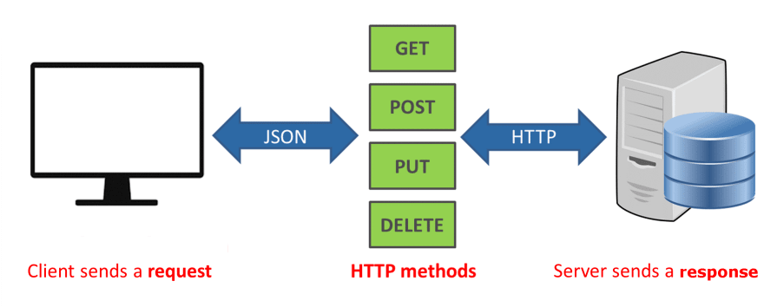

Slide 4
Axios
Axios, which is a popular library is mainly used to send asynchronous HTTP requests to REST endpoints.
This library is very useful to perform CRUD operations.
This popular library is used to communicate with the backend.
Axios supports the Promise API, native to JS ES6.
Using Axios we make API requests in our application. Once the request is made we get the data in Return, and then we use this data in our project.

Slide 5
Axios Features
JSON data is transformed automatically.
It transforms the request and response data.
Useful in making HTTP requests from Node.js
It makes XMLHttpRequests from the browser.
Supports promise API.
Ability to cancel the request.

Slide 6
Axios
Response Objects in Axios: When you send a request to the server, you receive a response object from the server with the below properties
data: You receive data from the server in JSON form and parse back into a JavaScript object to you.
status: You get the HTTP code returned from the server.
statusText: HTTP status message returned by the server.
headers: All the headers are sent back by the server.
config: original request configuration.
request: actual XMLHttpRequest object.

Slide 7
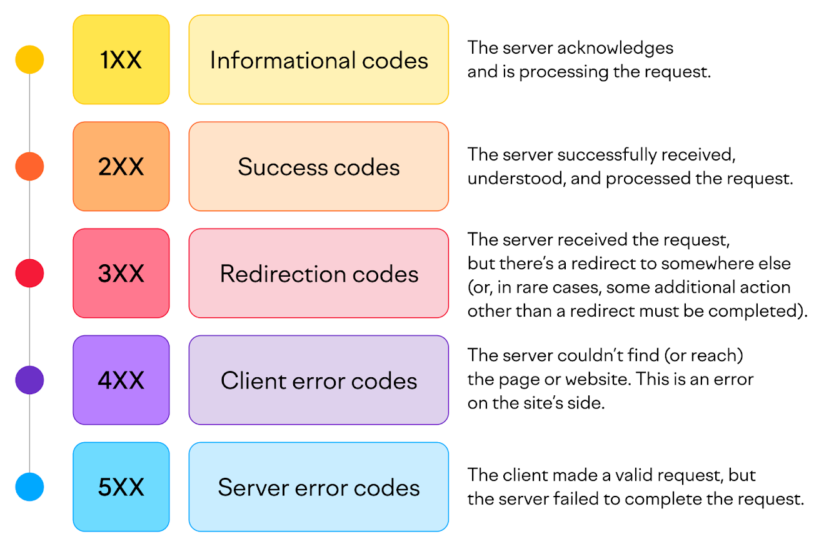
Axios

Slide 8
Axios
Error Object: You will get an error object if there will be a problem with the request. Promise will be rejected with an error object with the properties given
message: Error message text.
response: Response object (if received).
request: Actual XMLHttpRequest object (when running in a browser).
config: Original request configuration.

Slide 9
Axios
Shorthand Methods in Axios:
axios.get(url[, config])
axios.post(url[, data[, config]])
axios.put(url[, data[, config]])
axios.delete(url[, config])

Slide 10
Axios
To start using Axios with React, you first need to install the Axios package.
Install JSON Server and Start JSON Server
npm install axios
npm install -g json-server
json-server --watch db.json --port 3001

Slide 11
Axios
Create a db.json File:
{
"users": [
{ "id": 1, "name": "John Doe" },
{ "id": 2, "name": "Jane Doe" },
{ "id": 3, "name": "Bob Smith" }
]
}

Slide 12
Axios - GET Request
Making a GET Request with Axios and React
Let's create a simple React component that fetches data from a public API using Axios and displays the results.
We'll use the JSON Server/JSONPlaceholder API to fetch some sample data.
First, create a new functional component called GetData:

Slide 13
Axios
axios.get('https://api.example.com/data')
.then(response => {
// handle success
})
.catch(error => {
// handle error
});

Slide 14
Axios - GET Request
axios.get('https://api.example.com/data'): This line initiates an HTTP GET request to the specified URL using the axios library. The axios.get method returns an asynchronous operation.
.then(response => { /* handle success */ }): This is a callback that is executed when the HTTP request is successful. The response parameter contains the data returned from the server.
.catch(error => { /* handle error */ }): This is a callback that is executed when an error occurs during the HTTP request. The error parameter contains information about the error.

Slide 15
Example
Get request

Slide 16
Axios
function AxiosGet() {
const [employees, setEmployees] = useState([]);
useEffect(() => {
axios
.get(`http://localhost:3001/users`)
.then((res) => {
setEmployees(res.data)
});
}, []);

Slide 17
Axios
return (
<div>
AxiosGet
<ul>
{employees.map((employee) => (
<li>{employee.name}</li>
))}
</ul>
</div>
);
}

Slide 18
Example
Post request

Slide 19
Axios
function AxiosPost() {
const [name, setName] = useState("");
const handleChange = (event) => {
setName(event.target.value);
};
const handleSubmit = (event) => {
event.preventDefault();
axios
.post(`http://localhost:3001/users`, { name })
.then((res) => {
console.log(res.data);
})

Slide 20
Axios
.catch((error) => {
console.log("Error: " + error);
});
};
return (
<div>
AxiosPost
<form onSubmit={handleSubmit}>
<input type="text" value={name} onChange={handleChange}></input>
<button type="submit">Submit</button>
</form>
</div>
);
}

Slide 21
Example
Put request

Slide 22
Axios
function AxiosPut() {
const [name, setName] = useState("");
const [id, setId] = useState();
const handleChange = (event) => {
setName(event.target.value);
};
const handleId = (event) => {
setId(event.target.value);
};
const handleSubmit = (event) => {
event.preventDefault();

Slide 23
Axios
axios
.put(`http://localhost:3001/users/${id}`, { name })
.then((res) => {
console.log(res.data);
})
.catch((error) => {
console.log("Error:" + error);
});
};

Slide 24
Axios
return (
<div>
AxiosPut
<form onSubmit={handleSubmit}>
<input type="number" onChange={handleId}></input>
<input type="text" value={name} onChange={handleChange}></input>
<button type="submit">Submit</button>
</form>
</div>
);
}

Slide 25
Example
Delete request

Slide 26
Axios
function AxiosDelete() {
const [id, setId] = useState("");
const handleId = (event) => {
setId(event.target.value);
};
const handleSubmit = (event) => {
event.preventDefault();
axios
.delete(`http://localhost:3001/users/${id}`)
.then((res) => {
console.log(res.data);

Slide 27
Axios
console.log(`Deleted ID: ${id}`);
})
.catch((error) => {
console.log("Error: ", error);
});
};

Slide 28
Axios
return (
<div>
AxiosDelete
<form onSubmit={handleSubmit}>
<input type="text" value={id} onChange={handleId}></input>
<button type="submit">Submit</button>
</form>
</div>
);
}

Slide 29
asyn and await keyword
The asyn keyword is used to make an asynchronous request to the server to fetch the list of users.
The await keyword is used with axios.get to wait for the promise to resolve before continuing.
This allows the component to wait for the data before updating the state with setUsers. reframe the sentence

Slide 30
Thank You

