Slide 1
Presentation on Programming
Presented by: Ajut Dangol

Slide 2
What is Programming?
Computer programming is the process of performing a particular computation, usually by designing and building an executable computer program.
In a simple language, programming is how you get computers to solve problems.

Slide 3
What is Program?
A program is a set of instructions or statement to carry out some specific job at computer.

Slide 4
Two most important thing needed for programming
You: without the programmer (you), the computer is useless. It does what you tell it to do.
Computer: They are complex tools, admittedly, but they are not mysterious or magical: they exist to make tasks easier.

Slide 5
Programming language
Unfortunately, computers don’t understand languages like English or Nepali, so we have to use a programming language they understand to give them instructions.
Programming language is a language which helps us to make a common platform for developing programs or applications in a computer.

Slide 6
The Programming Process
Developing a program involves steps similar to any problem-solving task. There are five main ingredients in the programming process:
Defining the problem
Planning the solution
Coding the program
Testing the program
Documenting the program

Slide 7
Importance of Computer Programming
System Knowledge
Creative Platform
Interactive Education
Defining Future
Machine Language

Slide 8
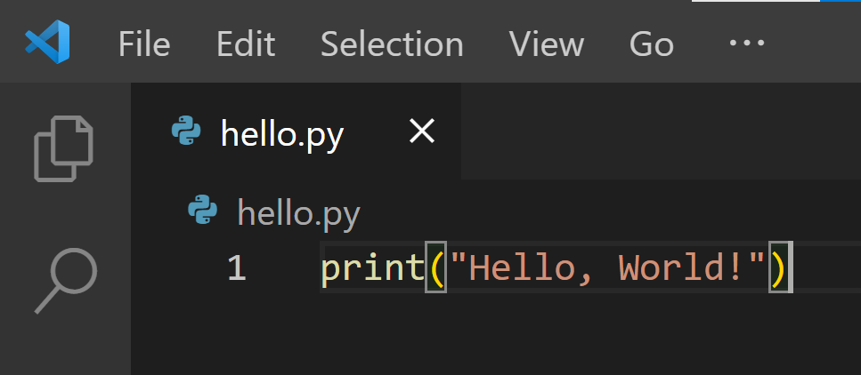
Examples of Programming in different languages
To print hello world in python

Slide 9
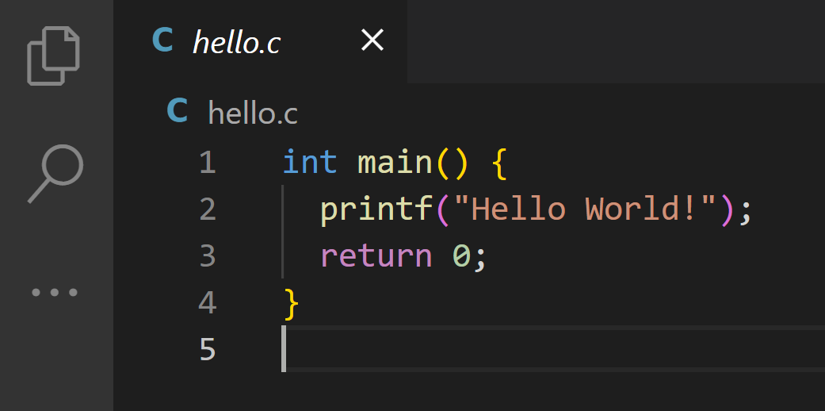
To print hello world in C

Slide 10
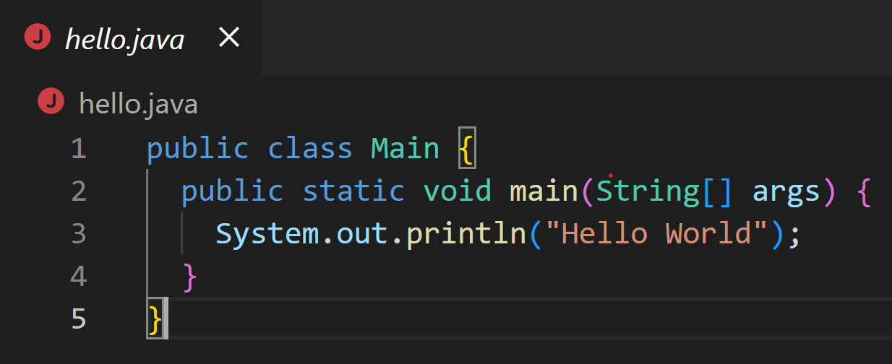
To print Hello world in Java

