Slide 1
LifeLink
AI-Based Blood Donor Management System
Final Project Presentation (PRES1)
Tharsika Kailayapathy — JF/BSCSD/18/43
BSc (Hons) Software Engineering — ICBT / Cardiff Metropolitan University
Notes:
TRANSITION IN: Open with a confident greeting and introduce yourself before advancing.
SCRIPT:
Good morning/afternoon. My name is Tharsika Kailayapathy, and today I'll be presenting my final year project: LifeLink, an AI-Based Blood Donor Management System built for the Sri Lankan healthcare context. Over the next few minutes I'll walk through the problem this project addresses, what I built, how I evaluated it honestly, and then I'll show you the system running live before taking your questions.

Slide 2
Introduction
• LifeLink is a full-stack, AI-assisted blood donor management system built for the Sri Lankan context
• Combines a Laravel web application (three portals: Donor, Hospital, Admin) with an independent Python/FastAPI machine-learning microservice
• Goal: replace informal, manual donor coordination with predictive, data-driven matching and forecasting
Notes:
TRANSITION IN: After the title slide, move straight into what the project actually is.
SCRIPT:
LifeLink is a full-stack web application with three separate portals — one for donors, one for hospitals, and one for administrators — backed by a real machine learning service written in Python. The Laravel application and the AI service run as two independent processes that talk to each other over a REST API, which turned out to be an important design decision I'll come back to later. The core idea is simple: instead of hospitals relying on phone calls and social media posts to find a compatible donor in an emergency, LifeLink predicts donor eligibility, ranks compatible donors automatically, and forecasts blood demand ahead of time.

Slide 3
Problem Statement
• Donor records are still largely paper-based or in spreadsheets — no real-time searchable database
• Emergency donor contact relies on phone calls, WhatsApp, or social media — slow and unreliable, especially for rare groups like AB− or O−
• No predictive analytics — hospitals can't anticipate shortages; red blood cells only last 35–42 days, so poor forecasting causes both wastage and shortage
• Low donor retention — no automated eligibility reminders or personalised engagement
Notes:
TRANSITION IN: Having said what LifeLink is, explain why it needed to exist.
SCRIPT:
So why does this matter? In Sri Lanka today, blood donor management is still largely manual. Donor details sit in paper registers or spreadsheets rather than a searchable digital database. When a hospital has an emergency need — particularly for a rarer group like AB negative or O negative — staff or relatives fall back on phone calls, WhatsApp groups, or social media posts, which is slow and unreliable exactly when speed matters most. On top of that, there's no predictive planning: blood products have a shelf life of only 35 to 42 days, so without forecasting, blood banks swing between wastage and shortage. And because there's no automated way to re-engage past donors, retention is low — people donate once and are never followed up with.
LIKELY EXAMINER QUESTION:
Q: Is this problem specific to Sri Lanka, or more general?
A: The proposal frames it around the Sri Lankan context specifically — the National Blood Transfusion Service's partly manual, fragmented processes — but the underlying problem, informal donor coordination and no predictive planning, is common to many developing healthcare systems.

Slide 4
Objectives
• 1. Donor eligibility prediction — a machine learning classifier, honestly evaluated on held-out data
• 2. Donor–hospital matching — rank compatible donors by blood group, Rh, location, urgency and reliability
• 3. Blood demand forecasting — estimate near-term demand per blood group from real request history
• 4. A three-role web portal — Donor, Hospital and Administrator, each with their own interface
• 5. Rigorous, honest evaluation — report the real performance and limitations of every AI component
Notes:
TRANSITION IN: Move from the problem to the five concrete objectives set out to address it.
SCRIPT:
To address that, I set five objectives. First, build a genuine machine learning classifier for donor eligibility and evaluate it honestly. Second, build a donor-hospital matching mechanism that considers blood compatibility, location, urgency and reliability together. Third, forecast blood demand per blood group so planning can be proactive instead of reactive. Fourth, deliver all of this through three role-specific portals. And fifth — which I'd argue is the most important one — evaluate every single AI component rigorously and report its real performance, including its limitations, rather than an assumed or aspirational figure.

Slide 5
Scope
In scope:
• Donor, Hospital and Admin portals
• AI eligibility prediction, donor matching, demand forecasting
• Sri Lankan context, SQLite development database
• Automated test suite covering all three roles
Deferred to future work:
• Notification Module (automated SMS / email alerts)
• Mobile application
• Multi-language (Sinhala / Tamil) interface
• MySQL production deployment, formal security audit
Notes:
TRANSITION IN: Objectives set the destination; scope draws the boundary around what was actually attempted this year.
SCRIPT:
It's worth being explicit about scope, because a project like this could grow without limit. In scope for this academic year: the three portals, all three AI capabilities, built and tested against a SQLite development database. Deliberately deferred to future work — and I'll be upfront about this rather than glossing over it — is the Notification Module for automated SMS or email alerts, a mobile app, multi-language support, migrating to MySQL for production, and a formal security audit.

Slide 6
Technologies Used
Layer | Technology
Backend | Laravel 12 (PHP 8.2) — routing, 3-guard auth, Eloquent ORM
Frontend | Blade templates + Tailwind CSS 4 (via Vite)
AI Service | Python + FastAPI (Pydantic request/response models)
AI Libraries | scikit-learn (k-NN, Logistic Regression, Random Forest, Isolation Forest, K-Means, Linear Regression), pandas, joblib
Database | SQLite (development) — MySQL driver already configured
Testing | PHPUnit — 96 automated feature tests
Version Control | Git (two repositories: Laravel app + AI service)
Notes:
TRANSITION IN: With scope agreed, run through the concrete technology stack that scope was built on.
SCRIPT:
On the technology side: the web application is Laravel 12 on PHP 8.2, with Blade templates and Tailwind CSS for the front end. The AI side is a completely separate Python service built with FastAPI, using scikit-learn for every model — k-Nearest Neighbours, Logistic Regression, Random Forest, Isolation Forest, K-Means and Linear Regression, depending on the task. The development database is SQLite, though Laravel's MySQL driver is already configured and ready for a production switch. And the whole thing is backed by 96 automated PHPUnit tests, which I'll come back to.

Slide 7
System Architecture
• Three-tier architecture: Presentation → Application → Data & AI
• Laravel app and Python AI service are two independent processes communicating over REST
• AI service can be retrained or restarted without redeploying the web application
Presentation Layer
Donor / Hospital / Admin Browsers
Application Layer
Laravel 12 MVC + AiEligibilityService / DonorMatchingService + Python FastAPI
Data & AI Layer
SQLite Database + Trained Model Artefacts (metrics.json)
Notes:
TRANSITION IN: Technologies are the building blocks; architecture is how they actually fit together.
SCRIPT:
Architecturally, LifeLink is a three-tier system. At the top, donor, hospital and admin browsers. In the middle, the Laravel application — handling routing, the three authentication guards, and two key service classes I'll mention shortly — alongside the independent Python FastAPI service. At the bottom, the database and the trained model files. The important design decision here is that the Laravel app and the Python service are two separate processes talking over a REST API, not one monolith. That means the AI models can be retrained, or the AI service restarted, without ever redeploying the web application.
TECHNICAL HIGHLIGHT: Two independently deployable processes — AiEligibilityService is the single Laravel-side point of contact with the Python service.

Slide 8
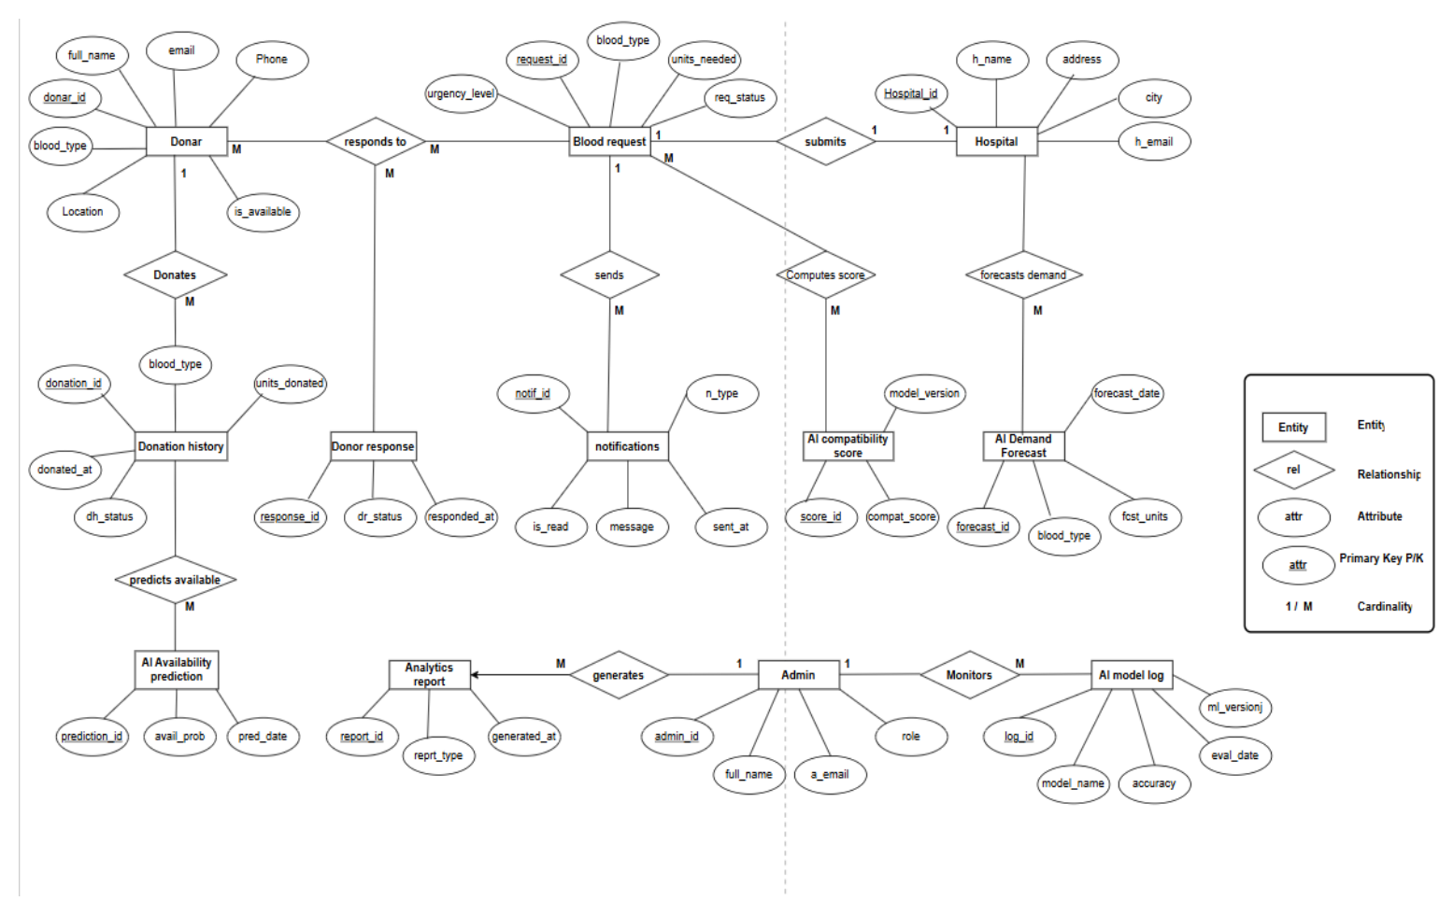
ER Diagram
Finalised in the project proposal — reproduced here unchanged
Notes:
TRANSITION IN: With the architecture in mind, go one level deeper into how the data itself is structured.
SCRIPT:
This is the Entity-Relationship diagram exactly as it was finalised in my project proposal, before implementation began. I'm showing you the original design, not a diagram redrawn after the fact to match what I built. Some of the AI-related entities here — like a separate compatibility-score table, a demand-forecast table, and a model-log table — were, during implementation, deliberately consolidated into live, on-demand computations plus one unified AI-prediction audit table, rather than one persisted table per output type. I made that reconciliation explicit in my written report rather than quietly changing the diagram.
LIKELY EXAMINER QUESTION:
Q: Why not just redraw the ER diagram to match what you built?
A: I wanted to show the actual design process honestly — the proposal's diagram is the starting point, and my report documents exactly where and why the implementation diverged from it, which is more informative than presenting a diagram that looks like it was right the first time.

Slide 9
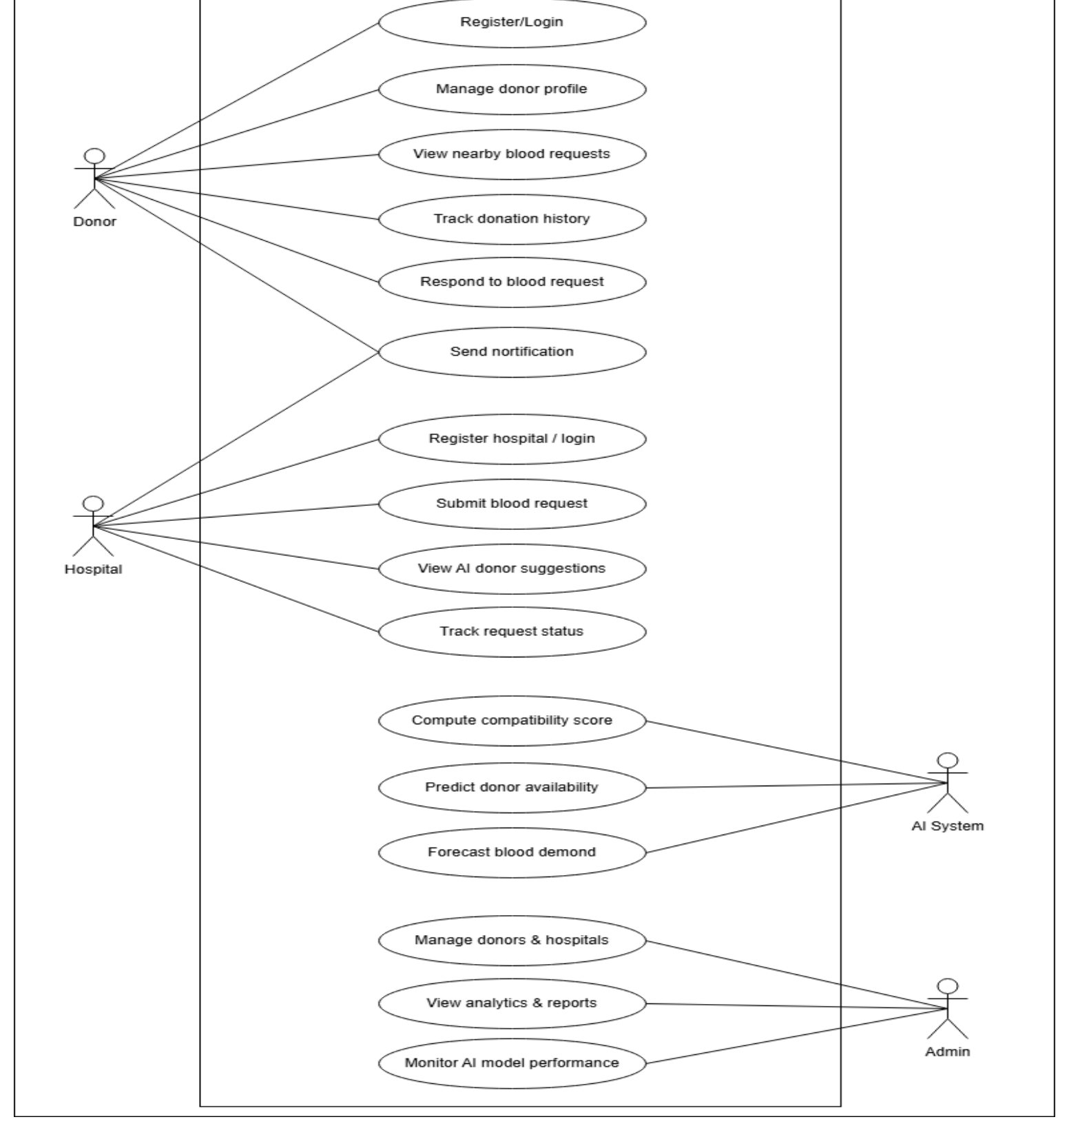
Use Case Diagram
Finalised in the project proposal — reproduced here unchanged
Notes:
TRANSITION IN: The ER diagram shows the data; the use case diagram shows the behaviour around that data.
SCRIPT:
Similarly, this is the Use Case diagram as finalised in the proposal, with four actors: Donor, Hospital, Admin, and the AI System as a secondary actor. Two donor use cases here — viewing nearby blood requests and responding to one — were initially deferred in favour of a hospital-initiated model, where the hospital submits a request and the system immediately ranks compatible donors for the hospital to contact. I want to be upfront that I later added the donor-facing side back in: donors can now view compatible open requests and mark themselves available or not available, which closes the loop between both actors.

Slide 10
Database Design
Table | Purpose
donors | Personal + medical profile, AI eligibility/confidence/response fields
hospitals | Organisation profile, verification status
admins | Administrator accounts
blood_requests | Hospital-submitted requests (group, urgency, status)
donations | Donation history per donor
ai_predictions | Audit log of every AI call — model, input, output, confidence
donor_responses | NEW — a donor's available / not-available response to a request
Notes:
TRANSITION IN: That's the intended design; here's the schema actually implemented and migrated.
SCRIPT:
The implemented schema has seven real business tables. Donors, hospitals and admins are deliberately kept as three separate tables — not one shared users table — because each role authenticates through its own Laravel guard. Blood requests belong to a hospital; donations belong to a donor. The ai_predictions table is worth highlighting: every single AI call the system makes, for any donor, for any prediction type, is logged there with the model name, its input, its output and its confidence — a complete audit trail. And donor_responses is the newest table, recording whether a donor has confirmed availability for a specific request.

Slide 11
System Modules — Status
Module | Status
Donor Module | DONE
Hospital Module | DONE
AI Recommendation Module | DONE
Admin Module | MOSTLY DONE
Notification Module | NOT STARTED
Notes:
TRANSITION IN: With the schema covered, step back and assess each proposed module against what actually runs today.
SCRIPT:
Against the five modules proposed at the start of the project: the Donor Module is done, including the ability to view and respond to compatible blood requests, which I added most recently. The Hospital Module is done — submit a request, see AI-ranked donors, and now revisit that request later to check for responses. The AI Recommendation Module is done — all three predictive capabilities are live. The Admin Module is mostly done; the one gap is a dedicated report-export feature, since the dashboard currently shows live analytics on-screen rather than a downloadable report. And the Notification Module has not been started — that's the single biggest gap, and I'll come back to it under Pending Features.

Slide 12
Implementation Highlights
• Service Layer pattern — AiEligibilityService and DonorMatchingService centralise all AI/matching logic outside controllers
• Custom authentication middleware — three independent guards (donor / hospital / admin)
• Graceful degradation — every AI-dependent feature has a rule-based fallback if the Python service is unreachable
• Live model metrics — a cached /model-info call replaces what used to be a hardcoded accuracy figure
Notes:
TRANSITION IN: Status tells you what exists; implementation explains how it was actually built underneath.
SCRIPT:
A few implementation decisions I'm proud of. First, the Service Layer pattern: all AI and matching logic sits in two classes, AiEligibilityService and DonorMatchingService, rather than being scattered across controllers. Second, three custom authentication middleware classes enforce that a donor session genuinely cannot reach hospital or admin routes, and vice versa — that's independently tested. Third, every AI-dependent feature degrades gracefully: if the Python service is down, eligibility checking falls back to simple threshold rules, clearly labelled as a fallback rather than silently pretending to be an AI result. And fourth, the model accuracy shown to users is queried live and cached, not hardcoded — which matters, because I did find and fix a hardcoded, outdated accuracy figure earlier in development.
TECHNICAL HIGHLIGHT: Repository and Observer patterns were deliberately NOT used — only patterns actually present in the codebase are claimed.

Slide 13
Testing
Metric | Result
Automated feature tests | 96 passing (240 assertions), <5 seconds
Eligibility model (k-NN) | 95.63% accuracy / 96.17% precision / 99.02% recall / 97.58% F1
Shortage model (Logistic Regression) | 89.56% accuracy / 86.49% precision / 87.44% recall / 86.94% F1
Evaluation method | Held-out test split the model never trained on
Notes:
TRANSITION IN: All of that implementation only means something if it's actually been tested — here's the evidence.
SCRIPT:
On testing: 96 automated PHPUnit tests currently pass, covering registration, the three-way authentication isolation, the donor-matching logic, AI prediction logging, and the new donor-response feature. On the AI side, both live models are evaluated on a held-out test split they were never trained on: the eligibility k-Nearest-Neighbours model reaches 95.63% accuracy, and the Logistic Regression shortage model reaches 89.56% accuracy. Every one of these numbers was pulled live from the running system just before this presentation was prepared — nothing here is remembered or estimated.
LIKELY EXAMINER QUESTION:
Q: How do you know 95.63% accuracy is a trustworthy number and not inflated?
A: Because I first found and fixed two real integrity bugs: a dropna() call silently discarding 78% of training rows, and label leakage in a related model. The figure now comes from evaluation on data the model never saw during training, recomputed live rather than hardcoded.

Slide 14
Live Demonstration
Donor registration → AI eligibility → Hospital request → AI-ranked matches → Donor response → Admin dashboard
Notes:
TRANSITION IN: This is the pivot point of the whole talk — slow down and speak to the room, not the screen.
SCRIPT:
At this point I'd like to switch over and show you LifeLink actually running, rather than just describing it. I'll register a donor and show the AI eligibility check happening in real time, submit a blood request as a hospital and show the AI-ranked matched donors, respond to that request from the donor side, and finally show the admin dashboard with live AI metrics. [SWITCH TO BROWSER / LOCALHOST NOW.]
TECHNICAL HIGHLIGHT: Artefact Demonstration is 45% of the PRES1 mark — by far the largest single component. Budget real time for this.

Slide 15
Current Project Status
• All three AI capabilities are live: eligibility prediction, donor matching, demand/shortage forecasting
• Four of the five proposed modules are functionally complete (Donor, Hospital, AI, Admin)
• The Notification Module is the one module not yet started
• 96 automated tests passing; both live models evaluated on held-out data
Notes:
TRANSITION IN: Having just shown it live, summarise where the project genuinely stands right now.
SCRIPT:
So, stepping back: as of today, all three AI capabilities are live and evaluated. Four of the five proposed modules — Donor, Hospital, AI Recommendation, and Admin — are functionally complete. The Notification Module remains the one module not yet started. The automated test suite passes in full, and both deployed AI models have real, held-out accuracy figures behind them.

Slide 16
Completed Features
• Donor / Hospital / Admin registration & authentication (three independent guards)
• AI eligibility prediction (k-NN) with live confidence score
• AI-assisted donor–hospital matching — ABO/Rh compatibility + district + urgency-weighted AI signals
• Blood shortage prediction and per-blood-group demand forecasting
• Donor donation history and a full AI-prediction audit trail
• Donor can view and respond to compatible blood requests (new)
• Admin analytics dashboard with live AI model metrics
• 96 automated tests
Notes:
TRANSITION IN: Let's itemise exactly what's completed, in checklist form.
SCRIPT:
In checklist form, what's completed: full registration and authentication for all three roles; AI eligibility prediction with a live confidence score; AI-assisted donor-hospital matching that blends blood compatibility, location and urgency; blood shortage prediction and demand forecasting; a complete donation history and AI-prediction audit trail; the donor's ability to view and respond to compatible requests, which I built most recently; a live admin analytics dashboard; and a 96-test automated suite backing all of it.

Slide 17
Pending / Not Yet Implemented
• Notification Module — automated SMS / email alerts to matched donors
• Email verification at donor registration
• MySQL production migration (development uses SQLite; MySQL driver already configured)
• Admin report export / generation feature
• Formal security audit
Notes:
TRANSITION IN: Just as important as what's done is being clear about what genuinely isn't.
SCRIPT:
Equally important is being clear about what isn't done. The Notification Module — automated SMS or email alerts — has not been built; a hospital sees ranked donors on-screen, but the system doesn't yet contact them directly. Email verification at donor registration isn't implemented. The production database is still SQLite, not the MySQL the proposal specified, though the MySQL driver is already configured in Laravel so this is a configuration change rather than a rewrite. There's no report-export feature for admins, and no formal security audit has been performed.

Slide 18
Challenges
• Found and fixed a dropna() bug that was silently discarding 78% of training rows
• Found and fixed label leakage in the response-prediction model
• Diagnosed and fixed a ~33-second admin dashboard slowdown caused by repeated AI-service timeouts
• Chose deterministic compatibility rules + existing AI signals over building a new, unvalidated matching classifier
• Reconciling a hospital-push matching model against the proposal's donor-browse model
Notes:
TRANSITION IN: None of that came for free — here are the real problems encountered along the way.
SCRIPT:
This project ran into some real, non-trivial problems. A data-cleaning step was silently discarding seventy-eight percent of the training rows before I caught it. A separate model had label leakage — a feature that was effectively giving away the answer. The admin dashboard once took about thirty-three seconds to load because it kept retrying a failed AI call for every blood group instead of stopping after the first failure. I chose not to build a new matching classifier because there was no honest label to train it on. And I had to reconcile the proposal's donor-browsing model against the hospital-push model I actually built first — which I resolved by building both.

Slide 19
Future Enhancements
• Partner with NBTS or a hospital for real donor/request data to validate the models properly
• Build the Notification Module (SMS / email)
• Migrate to MySQL for production
• Mobile application
• Sinhala / Tamil language support
• Formal security audit
• Structured user research (interviews / surveys) with real donors and hospital staff
Notes:
TRANSITION IN: That naturally leads into where this project would go next, given more time.
SCRIPT:
Looking ahead: the highest-priority next step is a real data partnership — with NBTS or a hospital — to validate the models on genuine donor and request data rather than the synthetic dataset used here. After that: build the Notification Module, migrate to MySQL for production, extend to a mobile app, add Sinhala and Tamil language support, commission a formal security audit, and carry out structured user research with real donors and hospital staff, which this academic-timeline version did not include.

Slide 20
Conclusion
• All five objectives substantially achieved; four of five proposed modules functionally complete
• Every AI component evaluated honestly on held-out data — no inflated or hardcoded figures
• Recurring theme: find a real problem, fix it, verify it live
• A credible, evaluable prototype — not a finished product, but an honest one
Notes:
TRANSITION IN: Bring the whole talk back to the objectives you opened with.
SCRIPT:
To conclude: all five objectives set out at the start of this project have been substantially achieved, and four of the five proposed modules are functionally complete. Every AI component has been evaluated honestly against held-out data, with no inflated or hardcoded figures anywhere in the system. The theme running through this whole project has been finding a real problem — a data bug, a leakage bug, a slow page — fixing it, and verifying the fix against the live running application. LifeLink isn't a finished, production-ready product yet, but I believe it's a credible and honestly-evaluated prototype for what a real deployment could build on.

Slide 21
Thank You
Questions?
Notes:
TRANSITION IN: Close warmly and open the floor.
SCRIPT:
Thank you for your time. I'm happy to answer any questions you have, either about the technical implementation, the AI evaluation methodology, or the project's scope and limitations.

