Slide 1
+
LifeLink
LifeLink
AI-Based Blood Donor Management System
Donor Eligibility Prediction • AI-Assisted Donor Matching • Blood Demand Forecasting
BSc (Hons) Software Engineering — Final Year Project Presentation
Tharsika Kailayapathy | Student ID: JF/BSCSD/18/43
Laravel 12
Python / FastAPI
6 ML Models
Donor • Hospital • Admin

Slide 2
THE CHALLENGE
Problem Statement
02 / 21
• No real-time donor search. Donor records live in registers or spreadsheets — no shared system to search by blood group, location, or current eligibility.
• Manual, slow emergency coordination. Hospitals rely on phone calls and social media to find compatible donors, especially for rarer groups like AB− or O−.
• Reactive stock management. No forward-looking view of demand or donor availability — blood has a limited shelf life, so this drives both wastage and shortages.
• Low repeat donation. Without eligibility tracking or structured follow-up, first-time donors are rarely engaged again.
!
Impact
Urgent patients wait longer for compatible blood, hospitals over- or under-stock, and willing donors are never re-engaged — all solvable with a connected, predictive system.
LifeLink • AI-Based Blood Donor Management System

Slide 3
PROJECT GOALS
Objectives
03 / 21
1
Donor Eligibility Prediction
2
Donor–Hospital Matching
3
Blood Demand Forecasting
Train and evaluate a classifier that predicts whether a donor is currently eligible to donate.
Rank compatible donors for a request using blood compatibility, distance, and AI reliability signals.
Estimate near-term demand per blood group from real historical request data.
4
Three-Role Web Portal
5
Rigorous, Honest AI Evaluation
Deliver full Donor, Hospital, and Administrator portals with isolated authentication.
Evaluate every model on held-out data and report real accuracy — not assumed performance.
LifeLink • AI-Based Blood Donor Management System

Slide 4
COMPARISON
Existing System vs. Proposed System (LifeLink)
04 / 21
Aspect | Existing / Manual Approach | LifeLink (Implemented)
Donor discovery | Phone calls & social media appeals | Instant AI-ranked donor search
Eligibility check | Self-reported, not verified | ML classifier at registration & every profile update
Donor selection | Unordered manual list | Explainable match_score + breakdown per donor
Stock management | Reactive, paper/manual | Live thresholds, auto alerts, demand forecast
Location awareness | None / word of mouth | Real geographic distance (Haversine) + district
Oversight & audit | No structured record | Full AI-decision & activity audit trail
Communication | Ad-hoc, unlogged | In-app notifications, role-isolated, event-driven
LifeLink • AI-Based Blood Donor Management System

Slide 5
TECHNICAL DESIGN
System Architecture
05 / 21
Three-tier design: independent Laravel web app and Python AI microservice, communicating over REST/JSON.
Presentation Layer
Donor / Hospital / Admin browsers
Laravel 12 Application
Guards • Controllers • Services • Blade Views
SQLite / MySQL Database
Donors • Requests • Logs
AiEligibilityService / DonorMatchingService
Laravel-side AI client + matching logic
Python FastAPI AI Microservice
6 ML models (scikit-learn) + chatbot — /predict, /predict-response, /detect-anomaly, /predict-shortage, /forecast-demand, /cluster-donors, /chatbot
Deployed as two
independent processes.
AI service can be
retrained/restarted
without redeploying
the web app.
LifeLink • AI-Based Blood Donor Management System

Slide 6
ACCESS MODEL
User Roles: Donor, Hospital, Admin
06 / 21
D
H
A
Donor Portal
Hospital Portal
Admin Portal
Registers, tracks eligibility, views donation history, books appointments.
Submits blood requests, views AI-ranked donor matches, manages inventory.
Oversees donors & hospitals, monitors AI activity, manages system-wide reports.
Isolated login guard
Separate session & routes
Cannot access other roles' data
Isolated login guard
Separate session & routes
Cannot access other roles' data
Isolated login guard
Separate session & routes
Cannot access other roles' data
Enforced by three dedicated middleware classes — DonorAuthenticated, HospitalAuthenticated, AdminAuthenticated — verified by automated cross-role security tests.

Slide 7
MODULE BREAKDOWN
Donor Module & Submodules
07 / 21
Registration
Login / Logout
Dashboard
Personal + health details; AI eligibility check runs instantly
Isolated donor session guard
Eligibility status, AI confidence, health breakdown, donation history
Profile Editing
Appointments
Notifications
Re-runs the AI eligibility check on any health-data change
Book, view, cancel donation appointments at a hospital
Real-time alerts for matches, appointments, reminders
Find Donors (Public)
Search eligible donors by blood group, district, min. donations
LifeLink • AI-Based Blood Donor Management System
AI touch-point: eligibility check on registration & every profile update

Slide 8
MODULE BREAKDOWN
Hospital Module & Submodules
08 / 21
Registration
Dashboard
AI Donor Matching
Pending admin verification before full access
Live request stats + create a new blood request
Ranked, explainable donor list per request
Request List & Fulfilment
Blood Inventory
Appointments
Track and mark requests fulfilled
Per-group stock levels, thresholds, full history
Approve, reject, reschedule, complete donor bookings
Reports & Analytics
Notifications & Profile
Own-data reports, export to PDF / Excel
Real-time alerts; hospital profile & location
LifeLink • AI-Based Blood Donor Management System
AI touch-point: ranked donor matching on every request

Slide 9
MODULE BREAKDOWN
Admin Module & Submodules
09 / 21
Dashboard
Donor Management
Hospital Management
Shortage risk, demand forecast, clustering, model info
View, toggle eligibility, record donations, remove
View, verify / unverify, remove
Appointments Oversight
Inventory Oversight
AI Prediction Audit Log
Cross-hospital appointment visibility
Aggregate stock across all hospitals
Every AI decision ever made, searchable
Activity Log
Reports & Analytics
Notifications & Profile
System-wide action audit trail
7 report types, PDF / Excel export
System-wide alerts; admin account settings
LifeLink • AI-Based Blood Donor Management System
Admin is the most AI-integrated screen — 4 live model calls combined per page load

Slide 10
ARTIFICIAL INTELLIGENCE
AI / ML Features & Models
10 / 21
Capability | Model / Technique | Purpose
Donor Eligibility | k-Nearest Neighbours | Predicts if a donor can currently donate (age, weight, hemoglobin, group)
Response Likelihood | Random Forest | Predicts how likely a donor is to respond / be reliable
Anomaly Detection | Isolation Forest | Flags unusual donor registrations for admin review
Blood Shortage Risk | Logistic Regression | Predicts shortage risk per blood group
Demand Forecasting | Linear Regression | Forecasts near-term demand from real request history
Donor Clustering | K-Means | Groups donors for admin-side pattern insight
Conversational Assistant | Intent-classification chatbot | Context-aware Q&A (e.g. “Am I eligible?”)
Why it adds value
• Replaces manual judgement with a data-driven, auditable eligibility score
• Turns reactive stock control into proactive planning
• Ranks donors instead of an unordered list
• Every AI call is logged — fully explainable, not a black box
LifeLink • AI-Based Blood Donor Management System
All 6 models evaluated on held-out test data

Slide 11
CORE ALGORITHM
Blood Matching Algorithm
11 / 21
DonorMatchingService combines deterministic domain rules with live AI signals into one explainable score.
ABO/Rh Compatibility
Deterministic rule engine
Distance
Real Haversine km, or district
AI Eligibility Confidence
k-NN model output
AI Response Probability
Random Forest output
Request Urgency
Dynamic re-weighting
match_score (0–100)
+ match_breakdown per donor
Urgency | Distance Weight | Reliability Weight
Critical | 35% | 30%
Urgent | 30% | 40%
Standard | 15% | 55%
A critical request weights immediacy (compatibility + distance) most heavily; a standard request can afford to optimise for overall donor reliability. Every result shows its full breakdown — nothing is a hidden black-box score.
LifeLink • AI-Based Blood Donor Management System

Slide 12
STOCK CONTROL
Blood Inventory Management
12 / 21
• Per-group stock trackingAvailable units + minimum threshold, per hospital, per blood group
• Automatic status tiersSufficient → Low Stock → Critical, computed live
• Full audit trailEvery add / remove / threshold change logged with before & after units
• Auto-deduction on fulfilmentStock reduces automatically when a request is fulfilled
Sufficient
Low Stock
Critical
Automatic Notifications
• Critical → hospital + all admins alerted
• Low stock → owning hospital alerted
• Replenished → hospital notified stock recovered
• Only fires on a real tier change (no repeat spam)
LifeLink • AI-Based Blood Donor Management System
Admin sees an aggregate, cross-hospital view

Slide 13
GEOGRAPHIC INTELLIGENCE
Location-Based Donor Matching
13 / 21
• Real coordinates. Donors and hospitals can set an exact location via an interactive map picker (optional).
• Haversine great-circle distance. Accurate km distance calculated directly between hospital and donor coordinates.
• Graceful fallback. No coordinates set? The system falls back to district-level proximity or a neutral score — never breaks.
• Folded into matching. Distance carries up to 35% of the match score for critical requests.
Travel-Category Bands
●
Very Near
≤ 5 km
●
Near
≤ 15 km
●
Moderate
≤ 30 km
●
Far
> 30 km
LifeLink • AI-Based Blood Donor Management System
Shown to hospitals directly on the matched-donors screen

Slide 14
ENGAGEMENT
Real-Time Notification System
14 / 21
Every role has an in-app notification centre with an unread badge — fully role-isolated and event-driven.
Donor receives
Hospital receives
Admin receives
• New matching blood request
• Appointment approved / rejected / rescheduled
• Donation completed
• Appointment reminder
• Donor responded to request
• New appointment booked
• Low / critical stock alert
• Stock replenished
• New hospital registration
• Anomalous donor registration
• Critical shortage (any hospital)
• Donation completed (any hospital)
Notifications only fire on real state changes (e.g. a stock-tier change) — not spammed on every update.
LifeLink • AI-Based Blood Donor Management System

Slide 15
DATA MODEL
Database / ER Diagram Overview
15 / 21
Donor
Appointment
BloodRequest
Hospital
Donation
AiPrediction / Notification / ActivityLog
DonorResponse
Admin
BloodInventory
12 core tables in total — including migrations for AI predictions, notifications, blood inventory logs, and activity logs, each with role-scoped access.

Slide 16
PROTECTION
Security Features
16 / 21
✓
Password Hashing
✓
CSRF Protection
✓
Guard-Isolated Sessions
Bcrypt hashing for every account type
Token verification on every form submission
Donor / Hospital / Admin sessions cannot cross-access
✓
Rate Limiting
✓
Security Headers
✓
Session Hardening
Login 5/min, Register 10/hr, Chat 15/min, Requests 10/min
CSP, X-Frame-Options, HSTS, Permissions-Policy
Session ID regenerated on login, invalidated on logout
✓
Password Re-confirmation
✓
File Upload Validation
✓
Unauthorized-Access Logging
Current password required before any change
MIME/extension allow-list, SVG blocked, size-limited
Every 401 / 403 event centrally logged
LifeLink • AI-Based Blood Donor Management System
Verified by a dedicated automated security test suite (9 test files)

Slide 17
QUALITY ASSURANCE
Testing
17 / 21
385
885
55
100%
Automated tests passed
Assertions verified
Feature test files
Suite passing
Coverage across every module:
• Authentication & cross-role guard isolation
• Donor–hospital matching logic & scoring
• AI prediction logging & audit trail
• Reports, export, and localization
• Security: CSRF, rate limits, headers, sessions, uploads
• Notifications, appointments, and inventory transitions
• Location / distance service accuracy
• Activity logging across every module
LifeLink • AI-Based Blood Donor Management System
php artisan test — last verified run

Slide 18
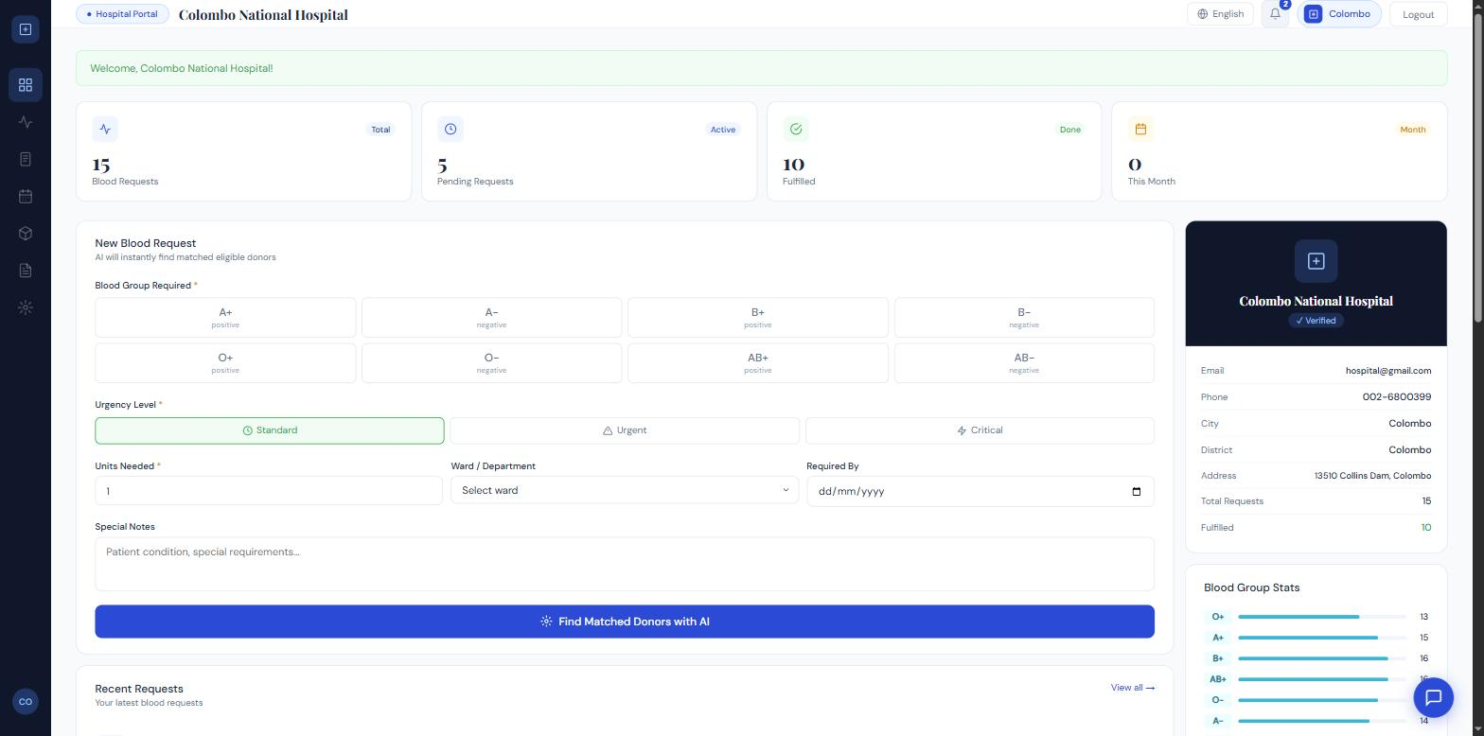
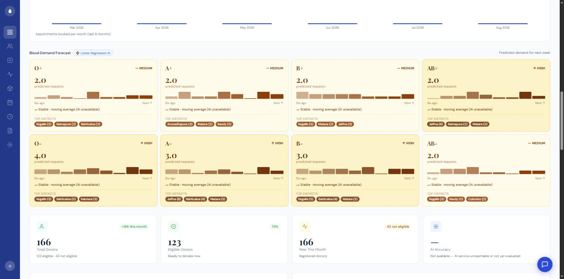
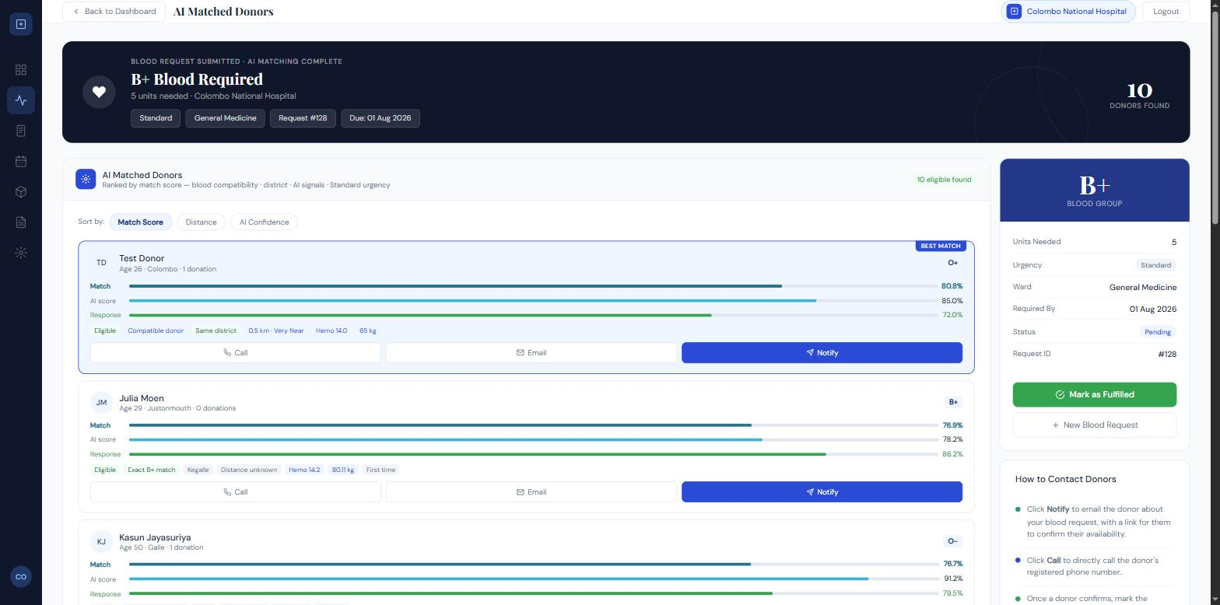
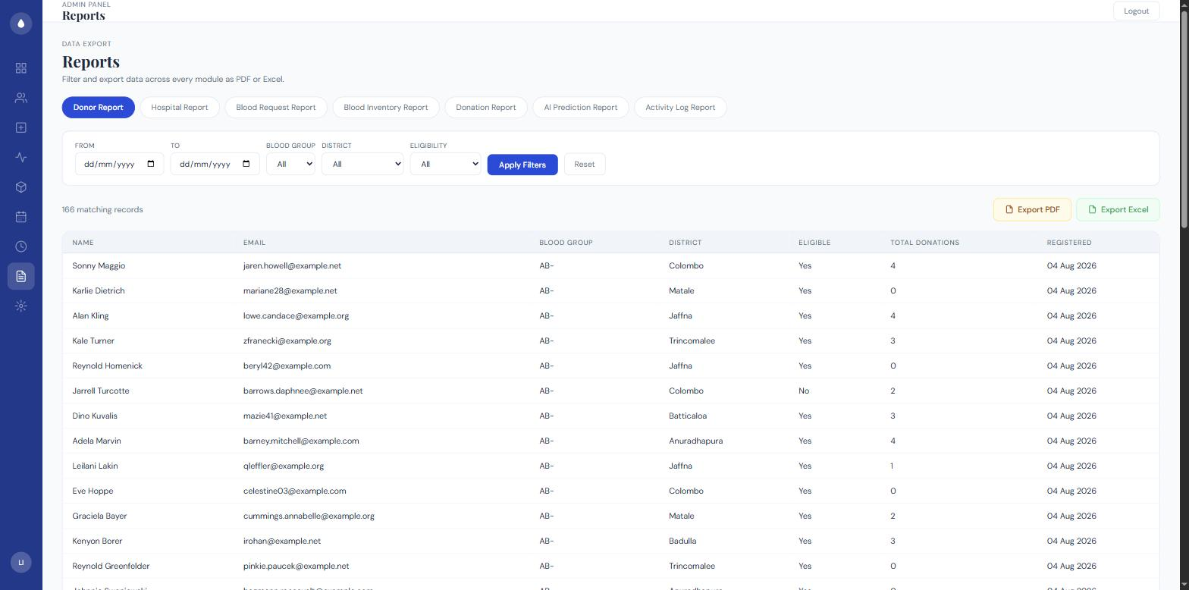
LIVE APPLICATION
Key Dashboards & UI
18 / 21
Hospital Dashboard — Create Request
Admin Dashboard — AI Demand Forecast
AI-Ranked Donor Matching
Reports & Analytics
LifeLink • AI-Based Blood Donor Management System
Real screenshots captured from the running application

Slide 19
VALUE DELIVERED
Benefits / Expected Outcomes
19 / 21
Faster emergency response
Proactive stock planning
Consistent, auditable decisions
Ranked, explainable donor matches replace slow manual search
Forecasting + threshold alerts reduce wastage and shortages
Every AI prediction is logged — nothing is a hidden black box
Lower administrative burden
Wider accessibility
Data-backed confidence
Automated notifications, reports, and activity logs
Full interface available in English, Sinhala, and Tamil
385 automated tests validate correctness across every module
LifeLink • AI-Based Blood Donor Management System

Slide 20
ROADMAP
Future Enhancements
20 / 21
Real donor data partnership
Formal security audit
MySQL migration
Retrain models on real, anonymised donor records (currently synthetic training data)
Independent penetration testing before any real deployment
Move from the SQLite development database to the proposed production MySQL setup
Mobile application
SMS / email outreach
Forecast backtesting
Extend donor access via a dedicated mobile app
Extend today's in-app notifications to SMS and email channels
Formal MAPE evaluation of demand forecasts against held-out history
LifeLink • AI-Based Blood Donor Management System

Slide 21
CONCLUSION
A complete, working AI-driven platform
• Full three-role portal (Donor, Hospital, Admin) with isolated authentication
• Six evaluated ML models plus a context-aware chatbot — not a concept demo
• Explainable, urgency-weighted donor matching with real geographic distance
• Inventory management, real-time notifications, and full activity auditing
• Security-hardened and validated by 385 automated tests (885 assertions)
By the numbers
6
ML models
3
user portals
385
automated tests
3
Thank you — Questions & Discussion
languages supported

