Slide 1

HOTEL BOOKING
Presented by:
Rehab AL Zaidi
Ajwad Almajnuni
Reem Alghamdi

Slide 2
Introduction
The purpose of this project is to predict if someone canceled the reservation or not by using Classification algorithms. We worked with data (HOTEL BOOKING ) .
About Data: This dataset contains observations for a City Hotel and a Resort Hotel. Each observation represents a hotel booking between the 1st of July 2015 and 31st of August 2017, including booking that effectively arrived.
It’s contained:
32 Features .
119390 Observations .

Slide 3
Preprocessing
1
2
3
Check null values, Duplicates,
Change Type
Get Dummies
visualization

Slide 4
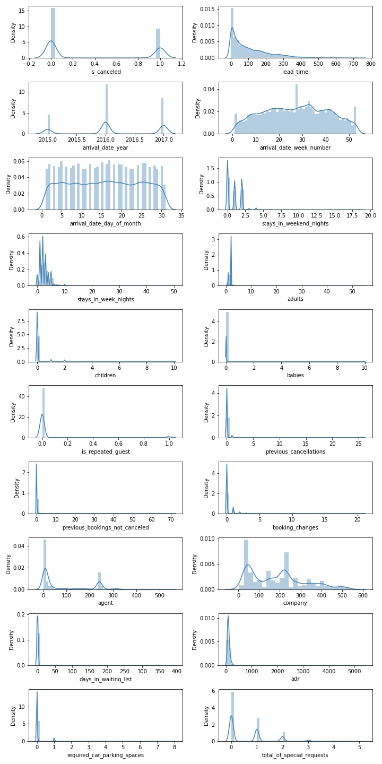
Visualize data

Slide 5
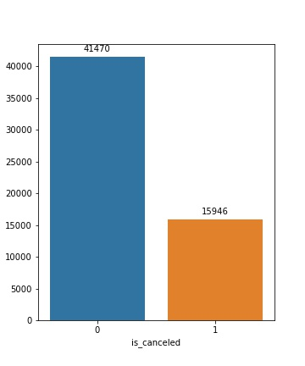
ClASSES

Slide 6
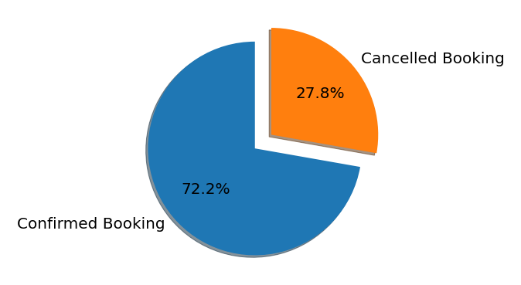
Cancellation Rate

Slide 7
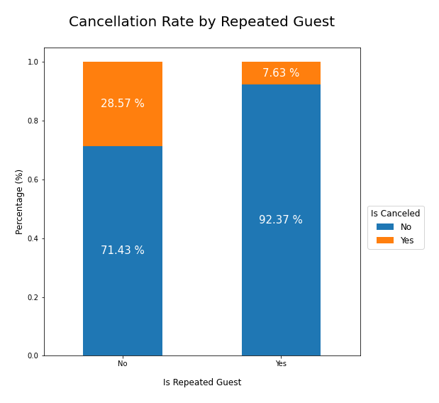
Repeated Guest and Cancellation

Slide 8
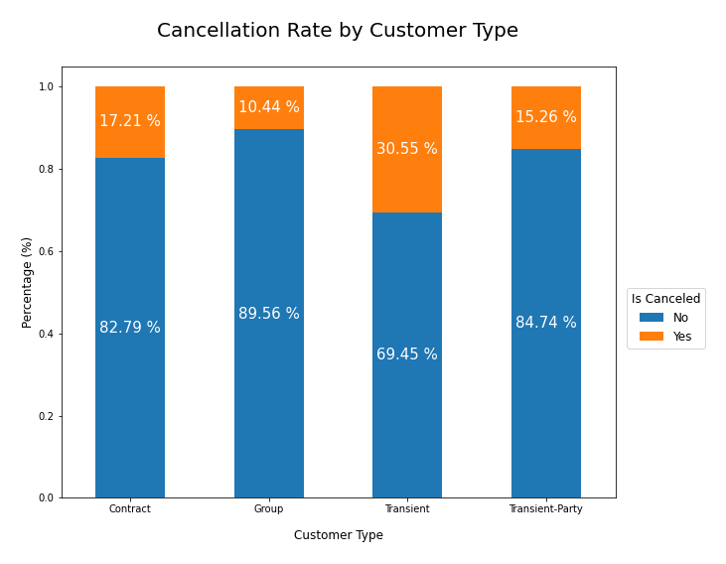
Cancellation Rate by Customer Type
60%

Slide 9
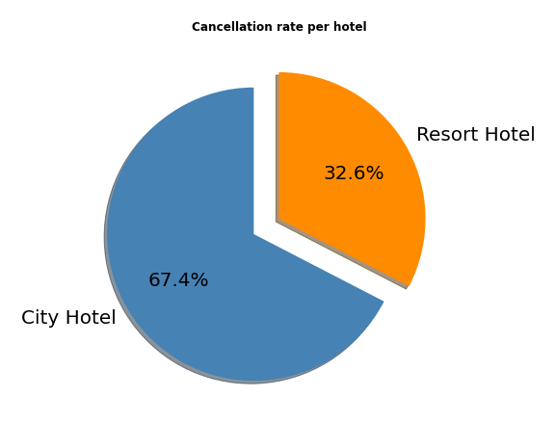
What is the cancellation rate for each hotel?

Slide 10
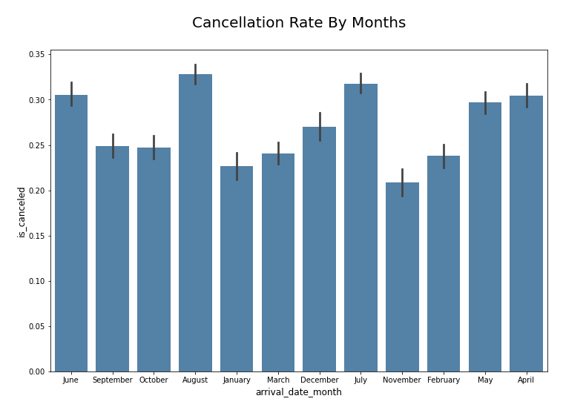
Cancellation Rate By Months

Slide 11
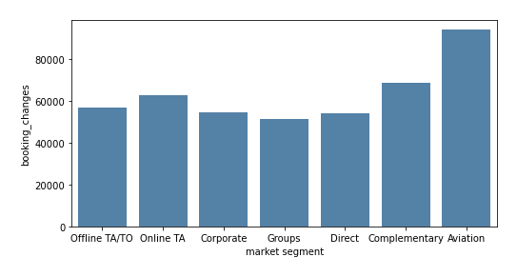
Is the number of changes of the reservation affected by (market segment)?

Slide 12
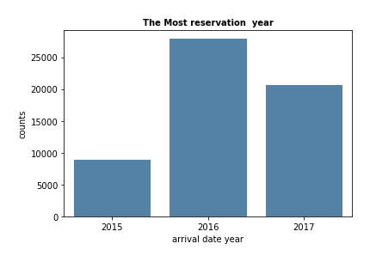
The Most reservation year

Slide 13
Models
Models | f1_score
 | Train | validation | Test
KNN | 0.86 | 0.57 | 0.55
Logistic Regression | 0.95 | 0.91 | 0.90
Random Forest | 1.0 | 1.0 | 1.0
Decision Tree | 1.0 | 1.0 | 1.0

Slide 14
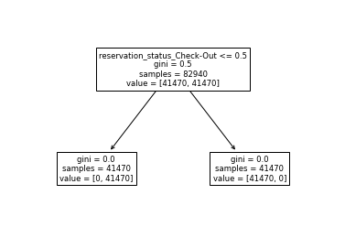
Decision Tree

Slide 15
Models
Models | f1_score
 | Train | validation | Test
Voting | 1.0 | 1.0 | 1.0
Stacking Classifier | 1.0 | 1.0 | 1.0
AdaBoost | 1.0 | 1.0 | 1.0
Gradiant Boosting | 1.0 | 1.0 | 1.0

Slide 16
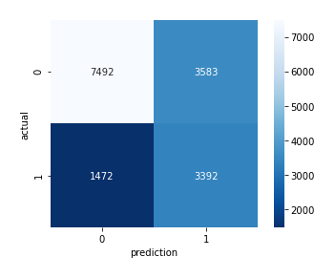
KNN Evaluation
precision | recall
1.0 | 1.0

Slide 17
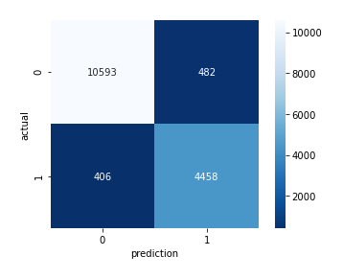
Logstic Evaluation
precision | recall
0.90 | 0.91

Slide 18
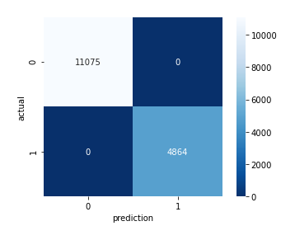
Random Forest Evaluation
precision | recall
1.0 | 1.0

Slide 19
Voting Evaluation
precision | recall
1.0 | 1.0

Slide 20
Stacking Evaluation
precision | recall
1.0 | 1.0

Slide 21
AdaBoost Evaluation
precision | recall
1.0 | 1.0

Slide 22
Gradiant Boosting Evaluation
precision | recall
1.0 | 1.0

Slide 23
Conclusion
In attempts to predict the best model if a person cancels the reservation or not, we made several models to determine the best model.
The best result is Random Forest
Train : 1.0
Validation : 1.0
Test : 1.0

Slide 24
Thank You

