Slide 1
תכנות מונחה עצמים תרגול 9
מייל : simon.pikalov@msmail.ariel.ac.il
נכתב ע"י : סמיון פיקלוב

Slide 2
נושאים להיום
Python

Slide 3
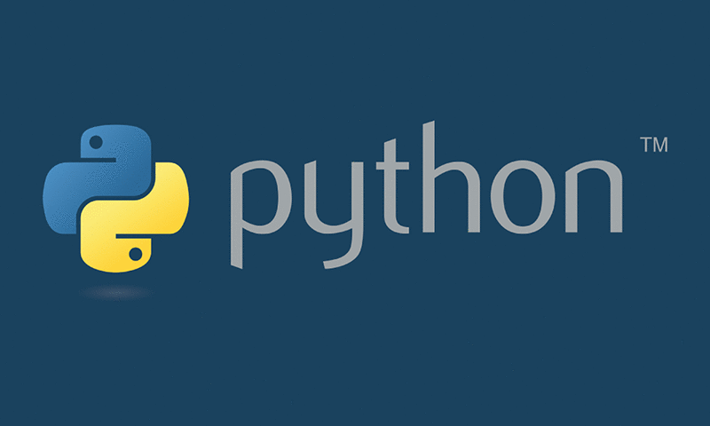
python

Slide 4
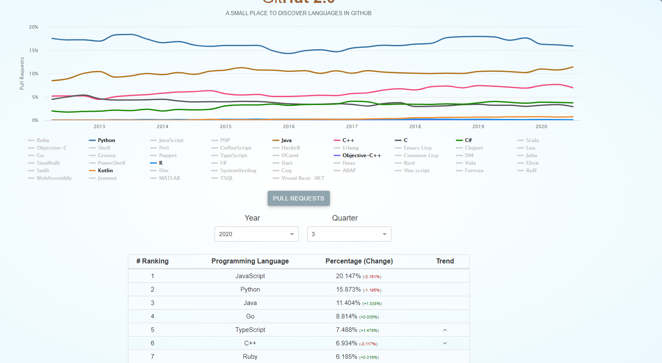
Why Python?
Python works on different platforms (Windows, Mac, Linux, Raspberry Pi, etc).
Python has a simple syntax similar to the English language.
Python has syntax that allows developers to write programs with fewer lines than some other programming languages.
Python runs on an interpreter system, meaning that code can be executed as soon as it is written. This means that prototyping can be very quick.
Python can be treated in a procedural way, an object-oriented way or a functional way.

Slide 5
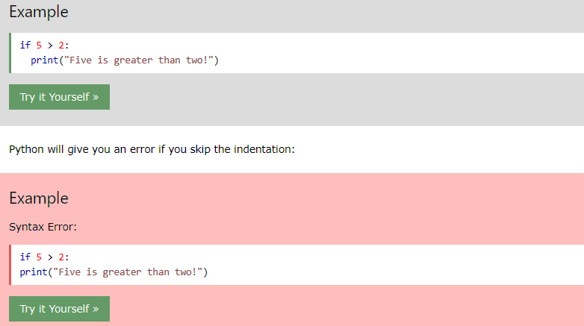
Python Indentation
Indentation refers to the spaces at the beginning of a code line.
Where in other programming languages the indentation in code is for readability only, the indentation in Python is very important.
Python uses indentation to indicate a block of code.

Slide 6
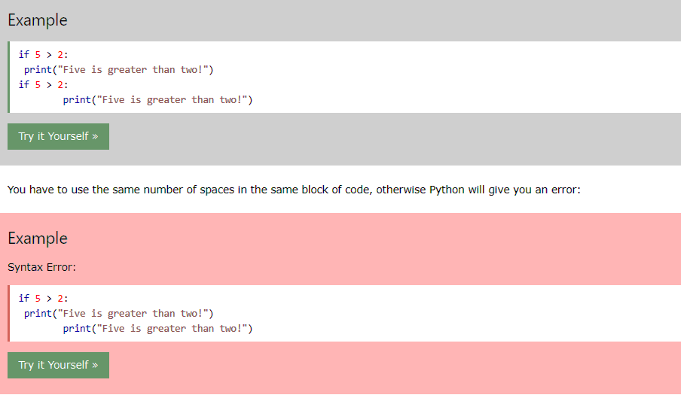
Python Indentation cont
Indentation refers to the spaces at the beginning of a code line.
Where in other programming languages the indentation in code is for readability only, the indentation in Python is very important.
Python uses indentation to indicate a block of code.

Slide 7
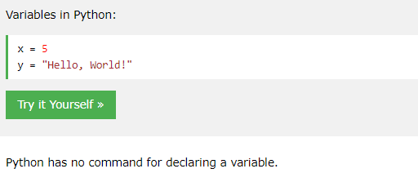
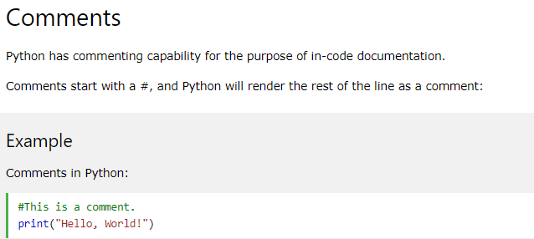
Python syntax basics
In Python, variables are created when you assign a value to it

Slide 8
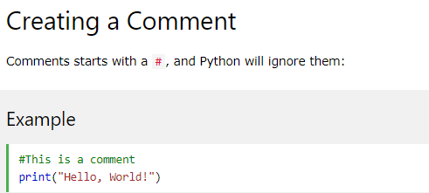
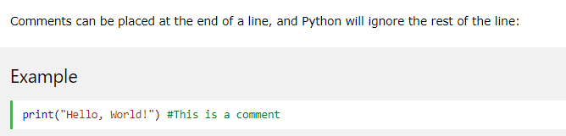
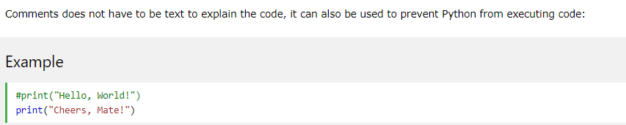
Python Comments
Comments can be used to explain Python code.
Comments can be used to make the code more readable.
Comments can be used to prevent execution when testing code.

Slide 9
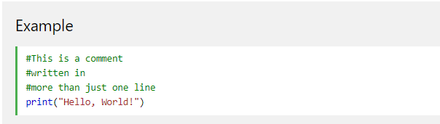
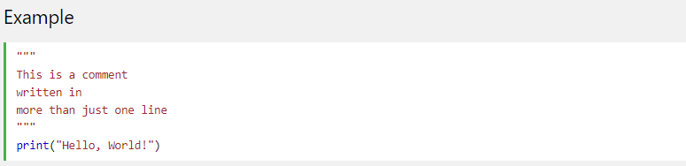
Multi Line Comments
First way for a Multi Line Comments
Second way for a Multi Line Comments

Slide 10
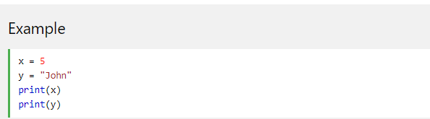

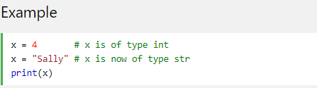
Python Variables
Creating Variables
Python has no command for declaring a variable.
A variable is created the moment you first assign a value to it.
Variables do not need to be declared with any particular type, and can even change type after they have been set.

Slide 11
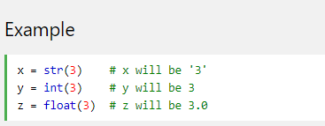
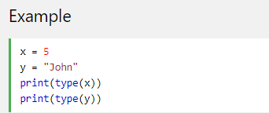
Python Variables
If you want to specify the data type of a variable, this can be done with casting.
Get the Type
You can get the data type of a variable with the type() function.

Slide 12
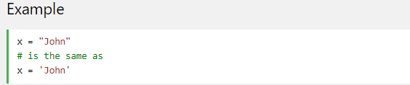
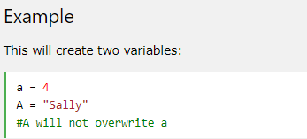
Python Variables
Single or Double Quotes? (Same as java)
String variables can be declared either by using single or double quotes:
Case-Sensitive (Same as java)
Variable names are case-sensitive.

Slide 13
Python Variables
Creating Variables
Python has no command for declaring a variable.
A variable is created the moment you first assign a value to it.
Variables do not need to be declared with any particular type, and can even change type after they have been set.

Slide 14
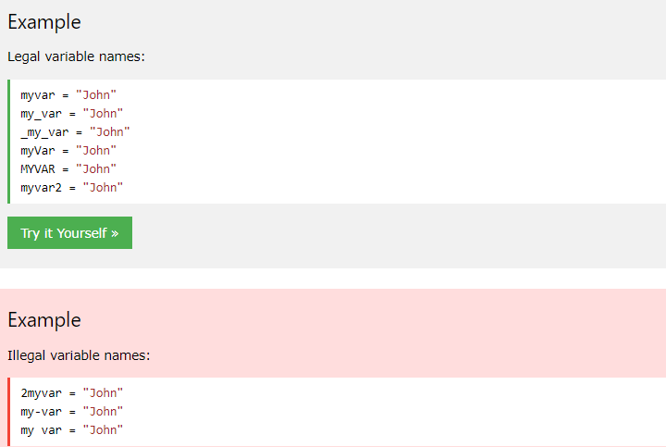
Python - Variable Names
A variable can have a short name (like x and y) or a more descriptive name (age, carname, total_volume). Rules for Python variables:
A variable name must start with a letter or the underscore character
A variable name cannot start with a number
A variable name can only contain alpha-numeric characters and underscores (A-z, 0-9, and _ )
Variable names are case-sensitive (age, Age and AGE are three different variables)

Slide 15
Python - Variable Names
A variable can have a short name (like x and y) or a more descriptive name (age, carname, total_volume). Rules for Python variables:
A variable name must start with a letter or the underscore character
A variable name cannot start with a number
A variable name can only contain alpha-numeric characters and underscores (A-z, 0-9, and _ )
Variable names are case-sensitive (age, Age and AGE are three different variables)

Slide 16
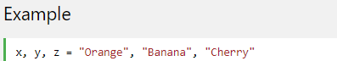
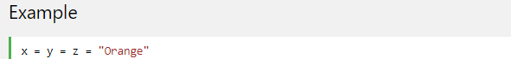
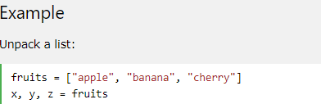
Python Variables - Assign Multiple Values
Many Values to Multiple Variables
Python allows you to assign values to multiple variables in one line:
One Value to Multiple Variables
And you can assign the same value to multiple variables in one line:
Unpack a Collection
If you have a collection of values in a list, tuple etc. Python allows you extract the values into variables. This is called unpacking.

Slide 17
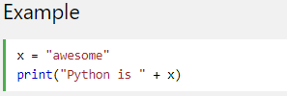

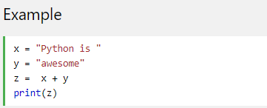

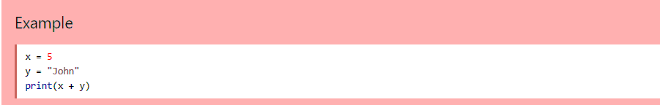
Output Variables
The Python print statement is often used to output variables.
To combine both text and a variable, Python uses the + character:
You can also use the + character to add a variable to another variable:
If you try to combine a string and a number, Python will give you an error:

Slide 18
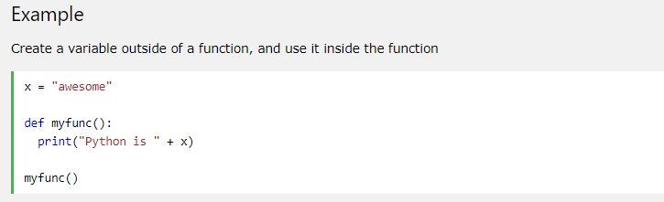

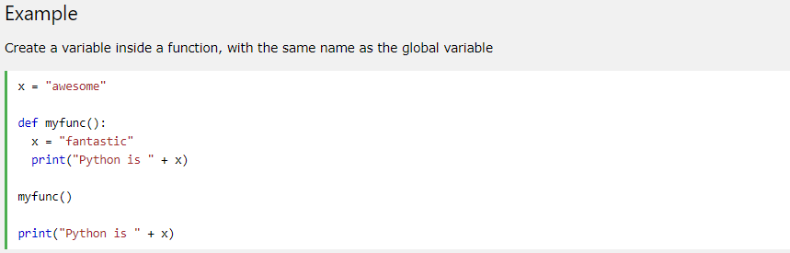
Python - Global Variables
Global Variables
Variables that are created outside of a function (as in all of the examples above) are known as global variables.
Global variables can be used by everyone, both inside of functions and outside.
If you create a variable with the same name inside a function, this variable will be local, and can only be used inside the function. The global variable with the same name will remain as it was, global and with the original value.

Slide 19
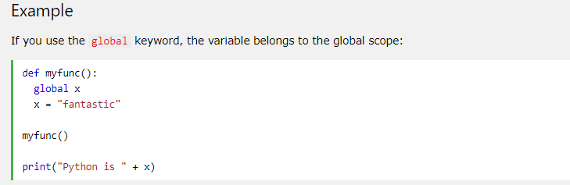

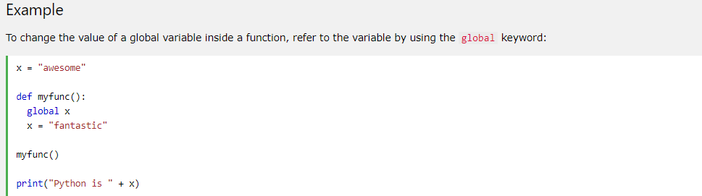

Python - Global Variables Cont.
The global Keyword
Normally, when you create a variable inside a function, that variable is local, and can only be used inside that function.
To create a global variable inside a function, you can use the global keyword.
Also, use the global keyword if you want to change a global variable inside a function.

Slide 20
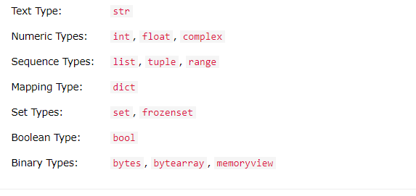
Python Data Types
Built-in Data Types
In programming, data type is an important concept.
Variables can store data of different types, and different types can do different things.
Python has the following data types built-in by default, in these categories:

Slide 21
Python Data Types
Built-in Data Types
In programming, data type is an important concept.
Variables can store data of different types, and different types can do different things.
Python has the following data types built-in by default, in these categories:

Slide 22
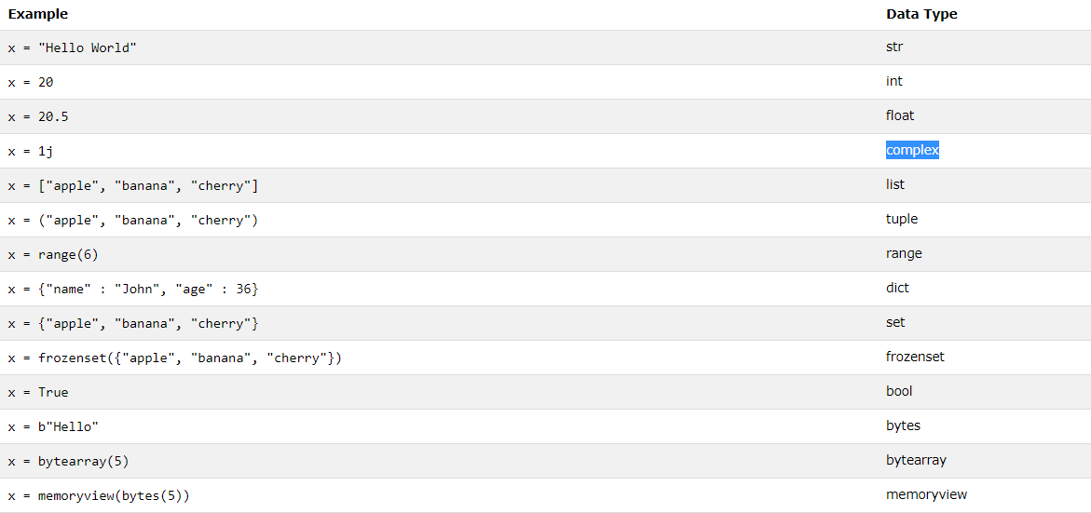
Python Data Types Cont.
In Python, the data type is set when you assign a value to a variable:

Slide 23

Random Number
Random Number
Python does not have a random() function to make a random number, but Python has a built-in module called random that can be used to make random numbers:
Example
Import the random module, and display a random number between 1 and 9:

Slide 24
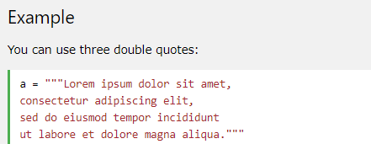
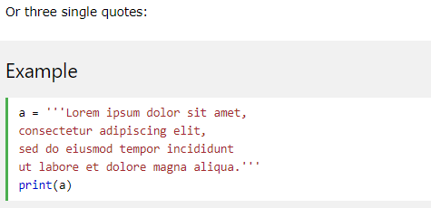
Multiline Strings
You can assign a multiline string to a variable by using three quotes:

Slide 25
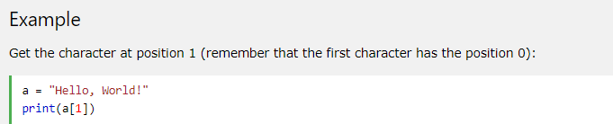

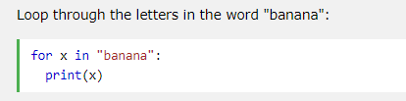
Strings are Arrays
Like many other popular programming languages, strings in Python are arrays of bytes representing unicode characters.
However, Python does not have a character data type, a single character is simply a string with a length of 1.
Square brackets can be used to access elements of the string.
Looping Through a String
Since strings are arrays, we can loop through the characters in a string, with a for loop.

Slide 26
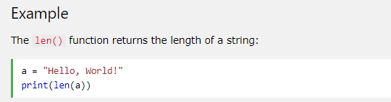

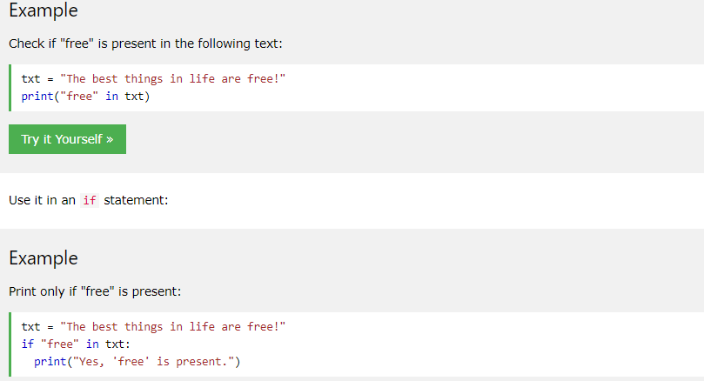

Strings are Arrays
String Length
To get the length of a string, use the len() function.
Check String
To check if a certain phrase or character is present in a string, we can use the keyword in.

Slide 27
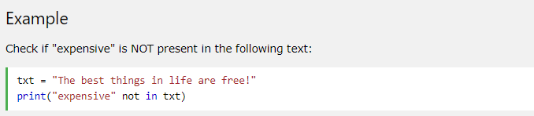
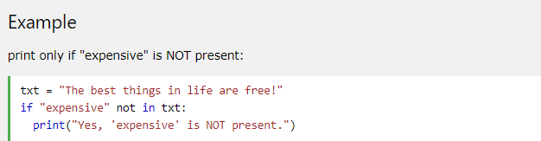
Strings are Arrays
Check if NOT
To check if a certain phrase or character is NOT present in a string, we can use the keyword not in.

Slide 28
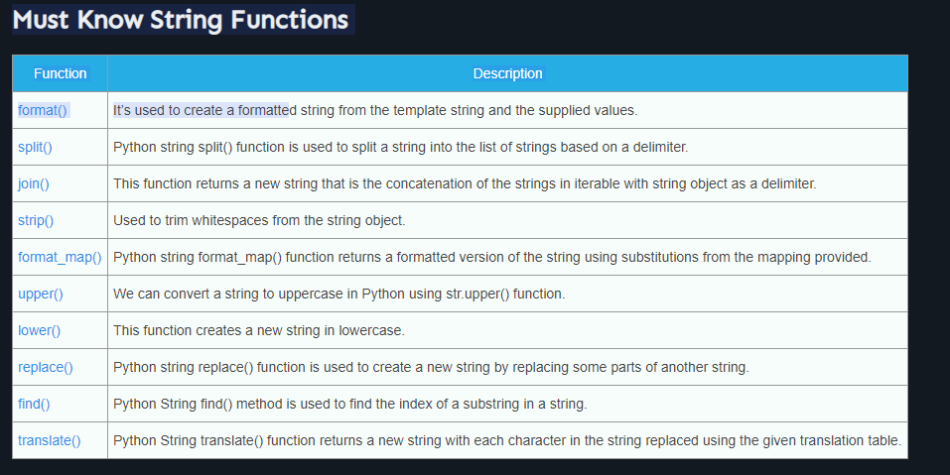
Strings

Slide 29
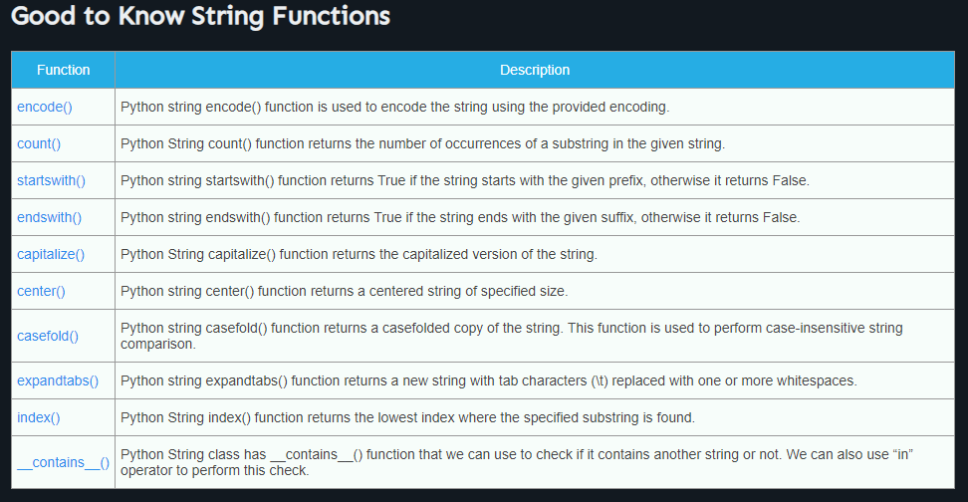
Strings

Slide 30
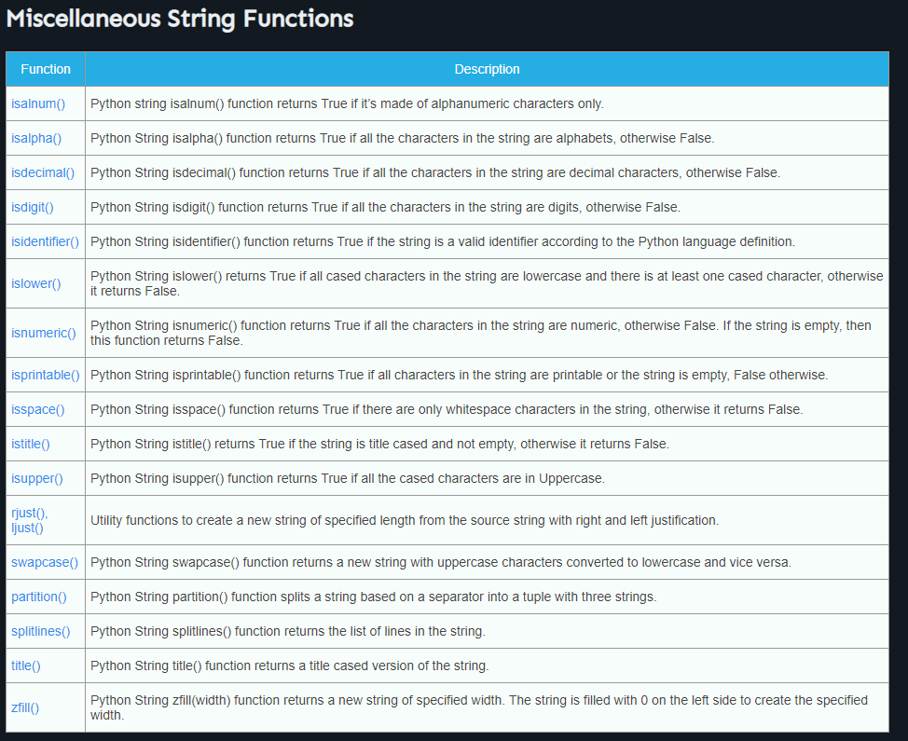
Strings

Slide 31
Strings

Slide 32
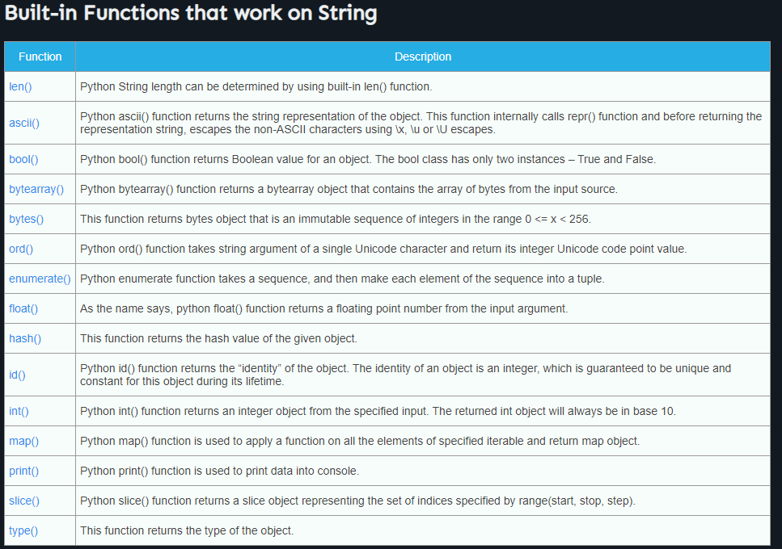
Strings

Slide 33
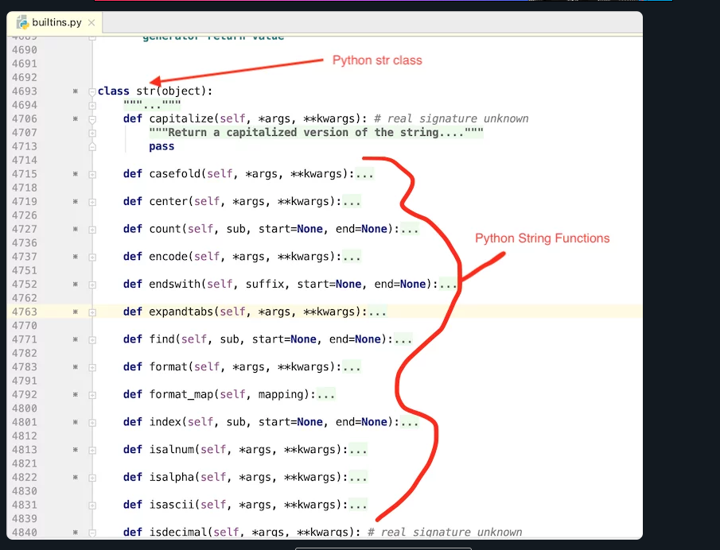
Do I Need to remember all of them ???

Slide 34
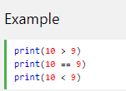

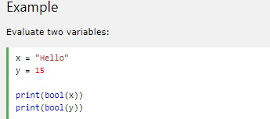

Python Booleans
Booleans represent one of two values: True or False.
Boolean Values
In programming you often need to know if an expression is True or False.
You can evaluate any expression in Python, and get one of two answers, True or False.
When you compare two values, the expression is evaluated and Python returns the Boolean answer:
Evaluate Values and Variables
The bool() function allows you to evaluate any value, and give you True or False in return,

Slide 35
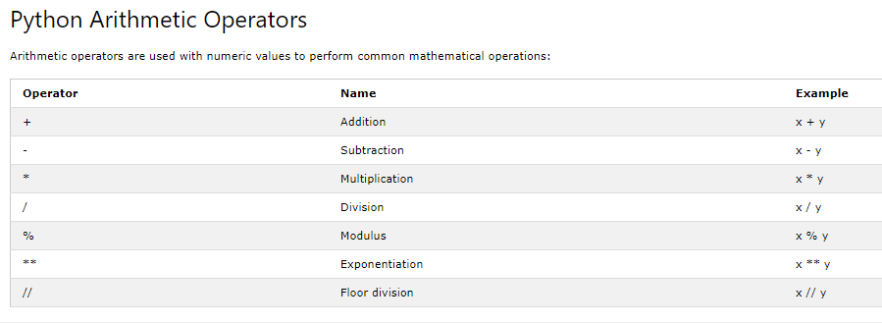
Python Operators
Python Operators
Operators are used to perform operations on variables and values.
In the example below, we use the + operator to add together two values:

Slide 36
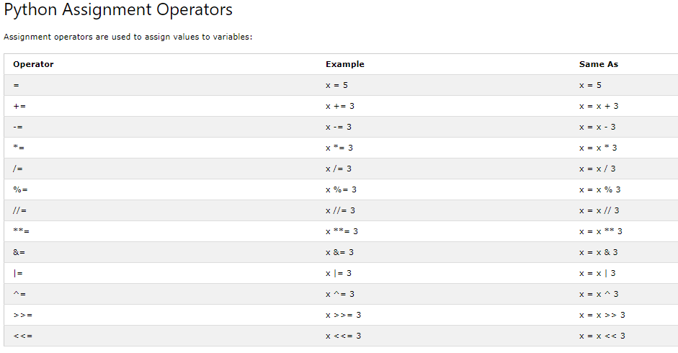
Python Operators

Slide 37
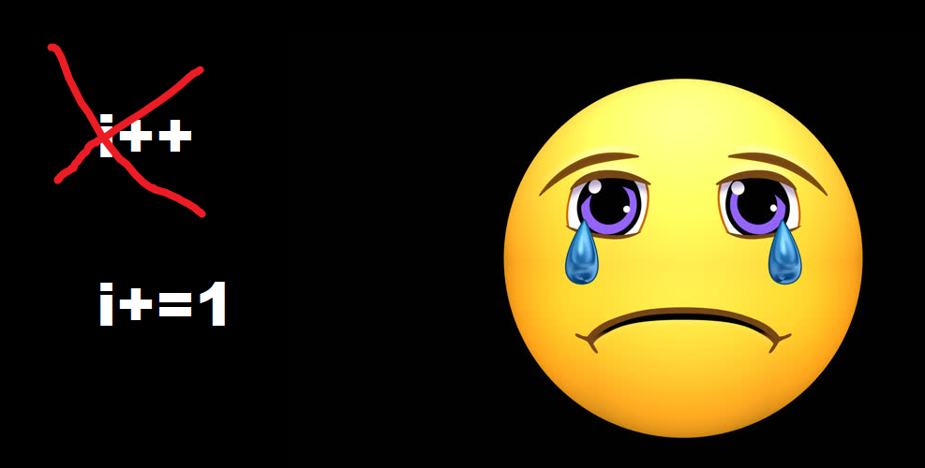
Python Operators

Slide 38
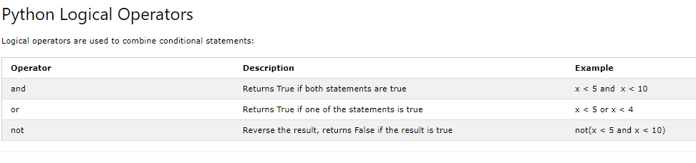
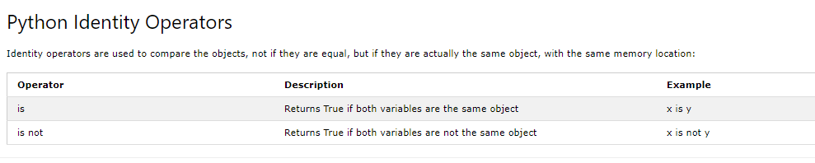
Python Operators

Slide 39


Python If ... Else
If statement:
Python relies on indentation (whitespace at the beginning of a line) to define scope in the code. Java programming language use curly-brackets for this purpose.

Slide 40




Python If ... Else
If statement:
Python relies on indentation (whitespace at the beginning of a line) to define scope in the code. Java programming language use curly-brackets for this purpose.

Slide 41




Python If ... Else
And
The and keyword is a logical operator, and is used to combine conditional statements:
Or
The or keyword is a logical operator, and is used to combine conditional statements:

Slide 42


Python If ... Else
Nested If
You can have if statements inside if statements, this is called nested if statements.
The pass Statement
if statements cannot be empty, but if you for some reason have an if statement with no content, put in the pass statement to avoid getting an error.

Slide 43


Short Hand If
If you have only one statement to execute, you can put it on the same line as the if statement.
Short Hand If ... Else
If you have only one statement to execute, one for if, and one for else, you can put it all on the same line:

Slide 44


Python While Loops
The while Loop
With the while loop we can execute a set of statements as long as a condition is true.
The while Loop
With the while loop we can execute a set of statements as long as a condition is true.

Slide 45


Python While Loops
The continue Statement
With the continue statement we can stop the current iteration, and continue with the next:
while-loop-else-clause, which is unique to Python. The else-block is only executed if the while-loop is exhausted.

Slide 46

Python Lists
List
Lists are used to store multiple items in a single variable.
Lists are one of 4 built-in data types in Python used to store collections of data, the other 3 are Tuple, Set, and Dictionary, all with different qualities and usage.
Lists are created using square brackets:
List items are ordered, changeable, and allow duplicate values.
List items are indexed, the first item has index [0], the second item has index [1] etc.
Ordered
When we say that lists are ordered, it means that the items have a defined order, and that order will not change.
If you add new items to a list, the new items will be placed at the end of the list.
Note: There are some list methods that will change the order, but in general: the order of the items will not change.
Changeable
The list is changeable, meaning that we can change, add, and remove items in a list after it has been created.
Allow Duplicates
Since lists are indexed, lists can have items with the same value.

Slide 47
Python Lists
List
Lists are used to store multiple items in a single variable.
Lists are one of 4 built-in data types in Python used to store collections of data, the other 3 are Tuple, Set, and Dictionary, all with different qualities and usage.
Lists are created using square brackets:
List items are ordered, changeable, and allow duplicate values.
List items are indexed, the first item has index [0], the second item has index [1] etc.\
Ordered
When we say that lists are ordered, it means that the items have a defined order, and that order will not change.
If you add new items to a list, the new items will be placed at the end of the list.
Note: There are some list methods that will change the order, but in general: the order of the items will not change.
Changeable
The list is changeable, meaning that we can change, add, and remove items in a list after it has been created.
Allow Duplicates
Since lists are indexed, lists can have items with the same value.

Slide 48



Python Lists
The list() Constructor
It is also possible to use the list() constructor when creating a new list.

Slide 49



Python - Access List Items
Access Items
List items are indexed and you can access them by referring to the index number:
Negative Indexing
Negative indexing means start from the end
-1 refers to the last item, -2 refers to the second last item etc.
Negative Indexing
Negative indexing means start from the end
-1 refers to the last item, -2 refers to the second last item etc.

Slide 50
Python - Access List Items
Access Items
List items are indexed and you can access them by referring to the index number:
Negative Indexing
Negative indexing means start from the end
-1 refers to the last item, -2 refers to the second last item etc.
Negative Indexing
Negative indexing means start from the end
-1 refers to the last item, -2 refers to the second last item etc.
Note: The search will start at index 2 (included) and end at index 5 (not included).

Slide 51



Python - Access List Items
Example
This example returns the items from the beginning to, but NOT included, "kiwi":
Check if Item Exists
To determine if a specified item is present in a list use the in keyword:

Slide 52


Modifying elements in a list
Example
This example returns the items from the beginning to, but NOT included, "kiwi":

Slide 53

Modifying elements in a list
Example
This example returns the items from the beginning to, but NOT included, "kiwi":

Slide 54



Removing elements from a list
The remove() method removes the specified item.
The remove() method removes the specified item.

Slide 55



Removing elements from a list
If you do not specify the index, the pop() method removes the last item.
Remove the first item
The clear() method empties the list.
The list still remains, but it has no content.

Slide 56




Join Two Lists
There are several ways to join, or concatenate, two or more lists in Python.
One of the easiest ways are by using the + operator.
Use the extend() method to add list2 at the end of list1:

Slide 57

List Methods
Python has a set of built-in methods that you can use on lists.

Slide 58
List Methods
Python has a set of built-in methods that you can use on lists.

Slide 59


Python Tuples
Tuples are used to store multiple items in a single variable.
A tuple is a collection which is ordered and unchangeable.
Tuples are written with round brackets.
Tuple items are ordered, unchangeable, and allow duplicate values.
Tuple items are indexed, the first item has index [0], the second item has index [1] etc.
Ordered
When we say that tuples are ordered, it means that the items have a defined order, and that order will not change.
Unchangeable
Tuples are unchangeable, meaning that we cannot change, add or remove items after the tuple has been created.
Allow Duplicates
Since tuple are indexed, tuples can have items with the same value:

Slide 60




Python Tuples
To determine how many items a tuple has, use the len() function:
Access Tuple Items
You can access tuple items by referring to the index number, inside square brackets:

Slide 61

Python Tuples
To determine how many items a tuple has, use the len() function:
Access Tuple Items
You can access tuple items by referring to the index number, inside square brackets:

Slide 62

Change Tuple Values
Once a tuple is created, you cannot change its values. Tuples are unchangeable, or immutable as it also is called.
Tuples are unchangeable, so you cannot remove items from it

Slide 63


Python - Unpack Tuples
Unpacking a Tuple
When we create a tuple, we normally assign values to it. This is called "packing" a tuple:
Unpacking a Tuple
When we create a tuple, we normally assign values to it. This is called "packing" a tuple:

Slide 64



Tuples
To join two or more tuples you can use the + operator
If you want to multiply the content of a tuple a given number of times, you can use the * operator:

Slide 65



Python Dictionaries
Dictionaries are used to store data values in key:value pairs.
A dictionary is a collection which is unordered, changeable and does not allow duplicates.
Dictionaries are written with curly brackets, and have keys and values:
Dictionary Items
Dictionary items are unordered, changeable, and does not allow duplicates.
Dictionary items are presented in key:value pairs, and can be referred to by using the key name.

Slide 66


Python Dictionaries
Unordered
When we say that dictionaries are unordered, it means that the items does not have a defined order, you cannot refer to an item by using an index.
Changeable
Dictionaries are changeable, meaning that we can change, add or remove items after the dictionary has been created.
Duplicates Not Allowed
Dictionaries cannot have two items with the same key:

Slide 67
Sources
https://www2.slideshare.net/LiliaSfaxi/software-engineering-chp4-design-patterns
https://www.journaldev.com/1377/java-singleton-design-pattern-best-practices-examples

