Slide 1
DATA ANALYST CASE STUDY
Client Churn Risk
& Revenue Forecasting
Managed IT Services • 200 enterprise clients • 10M transactions
CountryEdu × Abhishek & Company
Synthetic implementation — production data was not supplied
1

Slide 2
1. Business Objective
Four management questions become measurable analytical outputs.
• Identify clients likely to churn within the next 3 months.
• Find the strongest churn drivers.
• Forecast revenue for the next 12 months.
• Reduce churn by 5% relative to the 18% baseline.
• Prioritize retention by expected revenue loss.
CLIENTS
200
enterprise accounts
TRANSACTIONS
10 million
FINANCIAL MISSINGNESS
12%
2

Slide 3
2. Analytical Architecture
Transaction data becomes client-level risk and financial decisions.
• 10M transactions → client-month aggregation → health/trend features → churn model → revenue-at-risk ranking.
• Prediction unit = client-month, not transaction.
• Expected revenue loss = churn probability × annualized client revenue.
3

Slide 4
3. Executive KPI Snapshot
Synthetic results from the completed analytical pipeline.
BASELINE CHURN
TARGET CHURN
REVENUE AT RISK
FORECAST MAPE
18%
17.1%
79.3M
1.15%
BEST MODEL
ROC-AUC
PR-AUC
Logistic Regression
0.896
0.760
All numerical values are synthetic.
4

Slide 5
4. Data Quality & Feature Engineering
Customer health is built from financial, service and relationship signals.
• Financial: monthly revenue, revenue growth and payment delays.
• Support: ticket volume, incidents and escalations.
• Service quality: SLA compliance, security incidents and cloud usage.
• Customer health: CSAT and CSAT trend.
• Contract: months to renewal and service count.
• Missing financial values are retained with explicit flags.
MODELING UNIT
Client-month
PREDICTION HORIZON
3 months
FORECAST HORIZON
12 months
5

Slide 6
5. Churn Model Performance
Time-based holdout evaluation.
LOGISTIC ROC-AUC
LOGISTIC PR-AUC
XGBOOST ROC-AUC
XGBOOST PR-AUC
0.896
0.760
0.889
0.746
• PR-AUC is the primary model-selection metric because churn is imbalanced.
• The selected model produces a client-level probability and risk band.
• Revenue exposure is calculated after prediction for business prioritization.
6

Slide 7
6. Churn Drivers
Actionable customer-health signals.

Slide 8
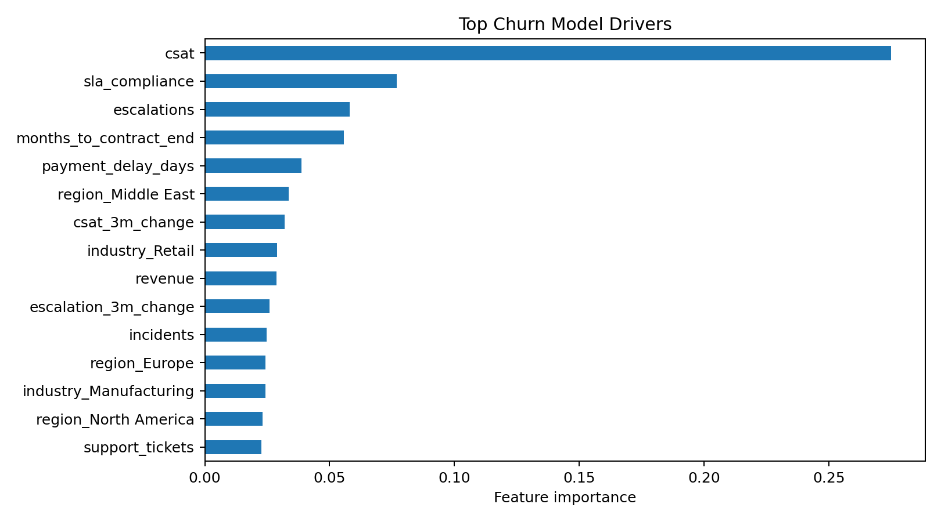
6. Churn Drivers
Actionable customer-health signals.
• Customer experience deterioration
• SLA degradation
• Support and escalation pressure
• Contract timing
• Revenue decline
7

Slide 9
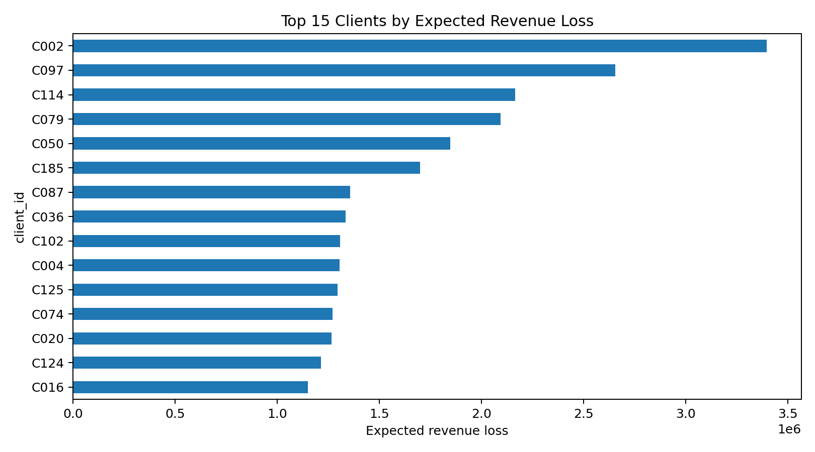
7. Client Risk Prioritization
Probability alone is not enough; revenue exposure determines priority.
TOP 20 REVENUE RISK
30.6M
PRIORITY METRIC
P(churn) × revenue
8

Slide 10
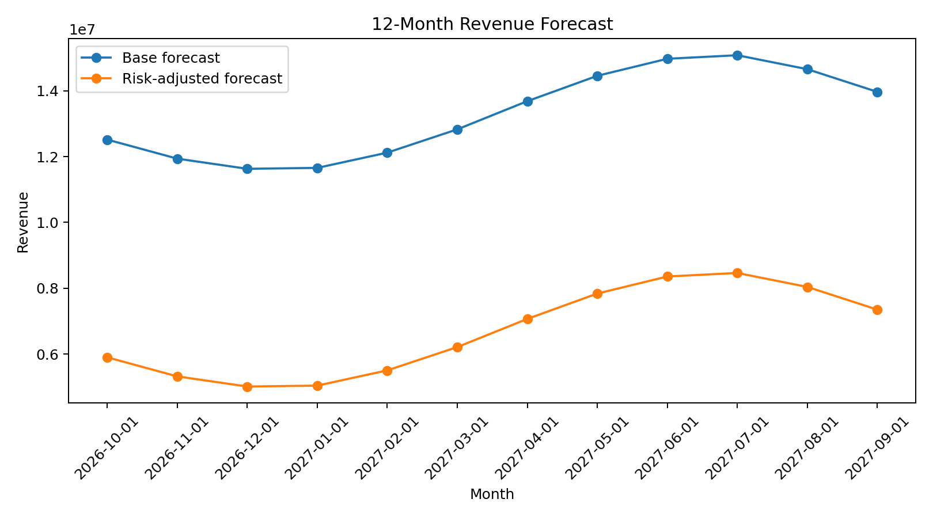
8. 12-Month Revenue Forecast
Base forecast and churn-adjusted planning scenario.
BASE FORECAST
159.5M
RISK-ADJUSTED
80.1M
BACKTEST MAPE
1.15%
9

Slide 11
9. Retention Strategy
Convert risk scores into account-management actions.
• Critical + high revenue risk → executive retention and renewal intervention.
• Critical risk → service recovery and account-manager review.
• High risk → health check plus SLA/CSAT improvement plan.
• Medium/Low risk → proactive monitoring.
• Measure retention conversion against the 17.1% target churn rate.
TARGET
18.0% → 17.1% churn
5% relative reduction
10

Slide 12
10. Power BI Management Dashboard
Single operating view for churn, revenue exposure and retention execution.
CHURN RATE
REVENUE AT RISK
12M FORECAST
18%
79.3M
159.5M
RISK-ADJUSTED
TARGET CHURN
MODEL PR-AUC
80.1M
17.1%
0.760
Dashboard pages
Executive Overview | Churn Risk | Churn Drivers | Revenue Forecast
11

Slide 13
11. Final Recommendation
Direct retention resources to clients with the greatest financial exposure.
• Predict three-month churn risk at client level.
• Rank clients by expected revenue loss, not probability alone.
• Use CSAT, SLA, support pressure and contract timing as intervention levers.
• Publish base and churn-adjusted revenue forecasts together.
• Measure retention outcomes against the 17.1% target churn rate.
Synthetic case study — production data can replace the synthetic layer.
12

