Slide 1

MOBILE SALES
DASHBOARD
Interaction Sales Analysis Using Microsoft Power BI
Tool: Microsoft Power BI
Technology: Power BI, DAX, Data Modeling
Presented By: Ashish Kumar

Slide 2
INTRODUCTION
  The dashboard converts raw sales data into meaningful KPIs and visual reports.
  Users can analyze sales based on time, mobile model, brand, payment method and city.
  DAX measures are used for calculations and time-based analysis.
  The Mobile Sales Dashboard is an interactive Business Intelligence (BI) project.
  It analyzes mobile sales transaction data from 01 January 2021 to 31 December 2024.

Slide 3
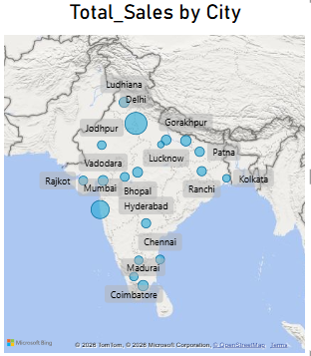
PROBLEM STATEMENT
  Raw sales data is difficult to analyze manually due to the large number of transaction records.
  Sales trends and performance are difficult to identify across different dates, cities, brands, and mobile models.
  An interactive dashboard is needed.

Slide 4
PROJECT OBJECTIVES
Analyze sales performance across different cities.
Compare current performance with the same period of the previous year.
Provide interactive filtering for better analysis..
Monitor overall Total Sales.
Track Total Quantity and Transactions.
Analyze Average Price.
Identify sales trends by Year, Quarter, Month and Day.

Slide 5
Important Fields
DATA PREPARATION
  Transaction ID
  Date
  City
  Mobile Model
  Brand
  Customer Age
  Customer Name
  Payment Method
  Price Per Unit
  Total Sales
  Total Quantity
  Average Price
  Checked data types and missing values.
  Prepared date fields for time-based analysis.
  Connected the sales data with a dedicated calendar table.

Slide 6
DAX MEASURES
Total Sales :
  Other Measures
SUMX(Mobile_Sales_Data,Mobile_Sales_Data[Units Sold]*Mobile_Sales_Data[Price Per Unit])
Total Quantity
Transactions
Average Price
Same Period Last Year
Month to Day:
MTD = TOTALMTD( [Total_Sales], Custom_Calendar[Date] )

Slide 7
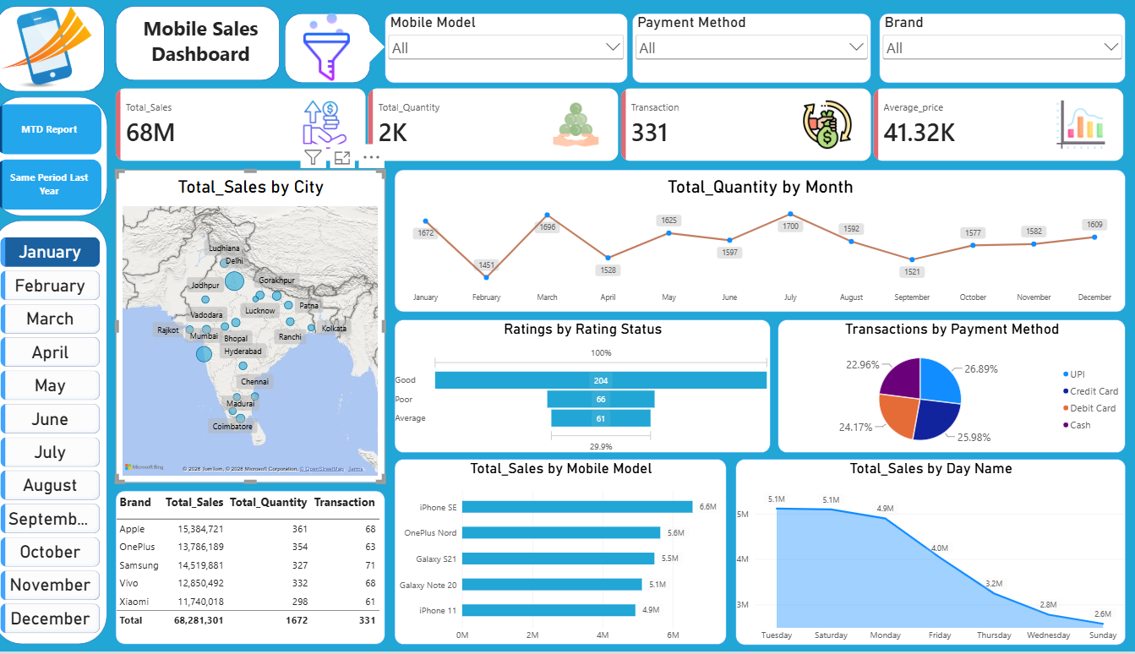
DASHBOARD COMPONENTS

Slide 8
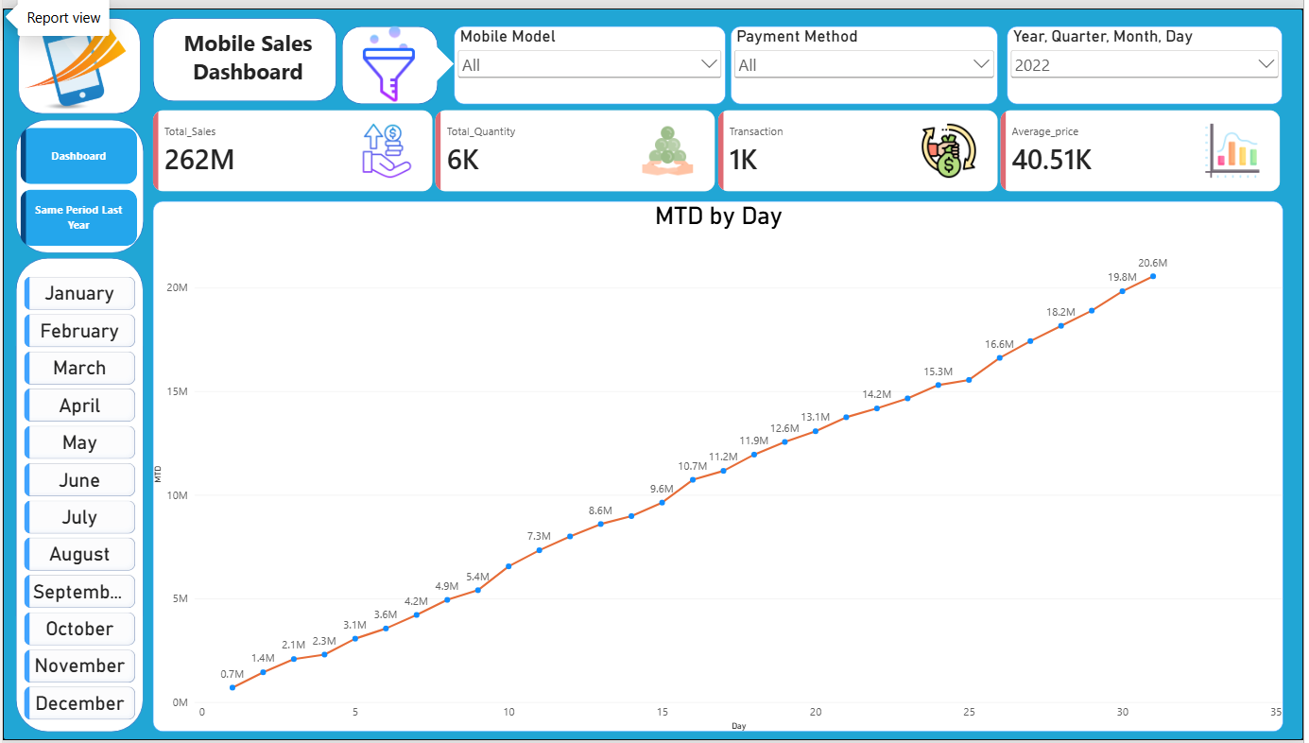
MTD ANALYSIS
Purpose:
Monitor sales progress during the month.
Understand daily cumulative performance.
Identify sales growth patterns.
Month-to-Date Analysis :
MTD measures the cumulative sales from the beginning of the selected month up to the current date.

Slide 9
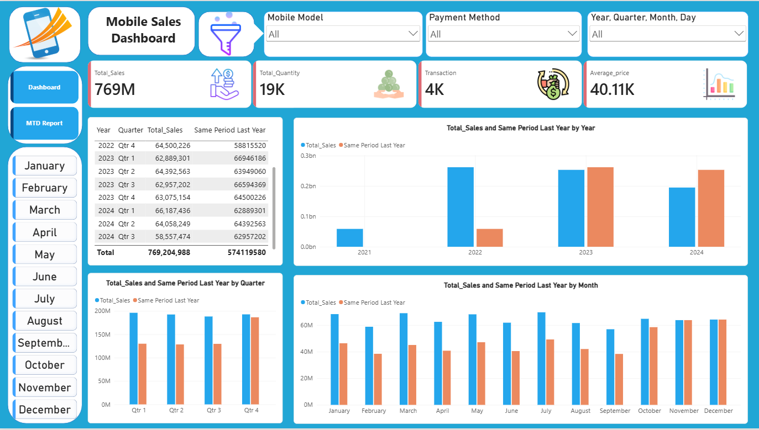
SAME PERIOD LAST YEAR
Benefits:
Compare current and previous-year performance.
Analyze changes in daily/monthly sales.
Understand year-over-year trends.
Support historical sales analysis.
The Same Period Last Year (SPLY) measure compares sales with the corresponding period from the previous year.

Slide 10
KEY INSIGHT
MTD provides a cumulative view of monthly performance.
Previous-year comparison provides historical context.
Interactive slicers allow users to analyze specific business segments.
Total sales can be monitored through KPI cards.
Daily and monthly sales patterns can be analyzed using time-based visuals.
City-wise sales distribution can be explored using the map.

Slide 11
CONCLUSION
  The Mobile Sales Dashboard transforms raw transaction data into an interactive BI solution.
  It provides a centralized view of important sales KPIs.
  DAX and a custom calendar table enable advanced time-based analysis.
Interactive filters make it easier to explore sales from different perspectives.
The dashboard can help users understand sales performance and historical trends.

Slide 12
THANK YOU

