Slide 1
An App for Making Institutes Digital
About The App
This is an E-Learning App which focuses to make all the Institutes(Schools, Colleges etc) Digital.
This is not only for 1 institute, but A single App where different Institutes can create there account and get themselves a digital platform for studies.
This is an App with combined functionality of 5 different Apps (Live Lecture, Live Test, Notes, Uploaded Videos and Dictionary).
This is created in such a way that all Institutes(Schools, Colleges, Universities) will be private and only accessible to Students and Teachers of that institute only. Students and Teachers get verified in the App by their departments with just a single click. They just need to tell their department admin their unique username of App.
If someone is interested in learning something or teaching, but is not enrolled in any institute, there is a Guest Section available for them where they can teach and learn something new every day.
This App is completed for the working demo and will be completed for Production soon.
After the completion of current development phases, I would try to improve the functionality of this App, add Attendance System and use Data Science for some more features.

Slide 2
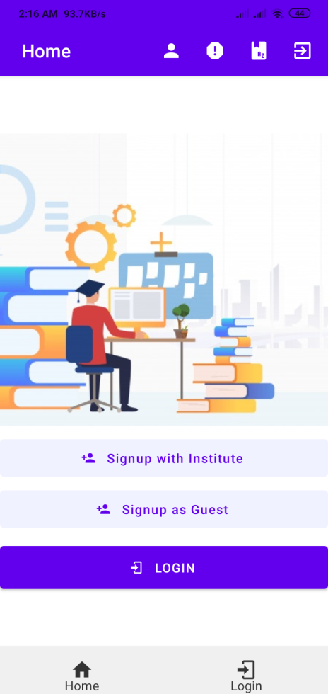
Technology Stack
React Native/Expo : For UI/UX (Used to make cross-platform Apps)
Node Js & Express : For Server Side and Rest APIs
MongoDb : For Database Storage
Agora/WebRTC : For Live Lecture features
Use Cases
This App can be used by every institute, every student, every teacher and every other person who has a Smartphone and wants to study or teach.
In this situation of Covid-19, this is a much useful and much needed App, so that no one’s learning suffers.
**GITHUB Repository for Source Code :
https://github.com/Ak-Bhatia/e-learning-portal
* Note: A demo apk can also be found in this github repo’s Readme file.

Slide 3
Development Phases & Working
This App’s development has been divided into 8 Phases/Stages:
Designing up of UI/UX
Setting up of Routes/Navigation System
Working on Database and Database Models
Building up of Basic Functionality such as Authentication of users, adding of Notes, Videos etc.
Building up of Advanced Features such as Live Lectures, Real-time Chat System, Live Tests, Adding Dictionary etc.
Adding more Security Features and Cleaning up of Code (The code may become messy and may have a lot of redundancy).
Making App ready for Production
Testing of Overall App
*Note: In each of these phases, testing of every phase is also needed.

Slide 4
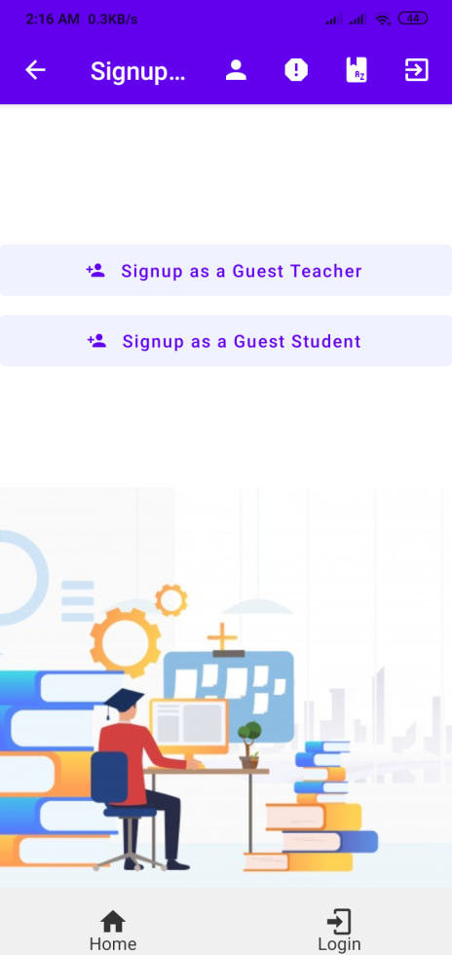
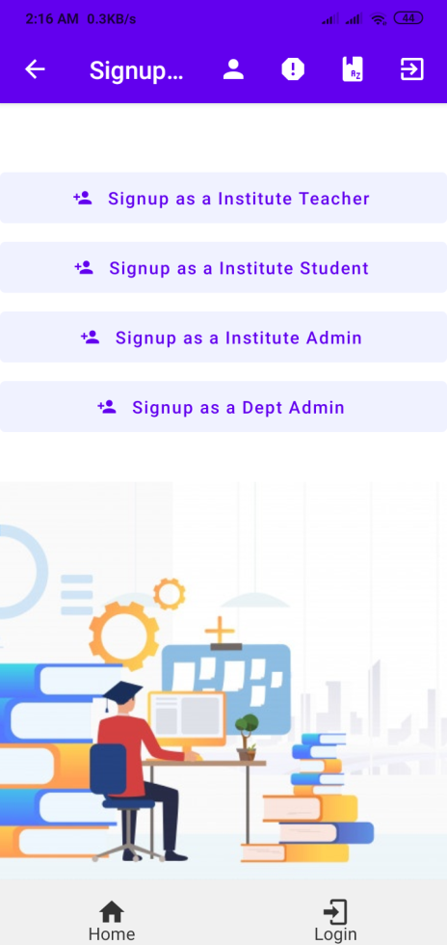
Designing of UI/UX
The UI/UX of App has been completed but it will still be improved a bit for production.
Description about each of the Screen is given in the section “Working of UI & Navigations” of this Pdf.

Slide 5
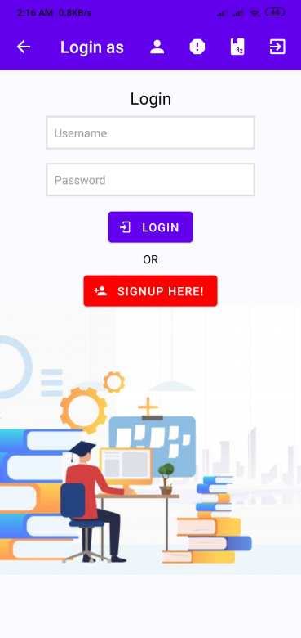
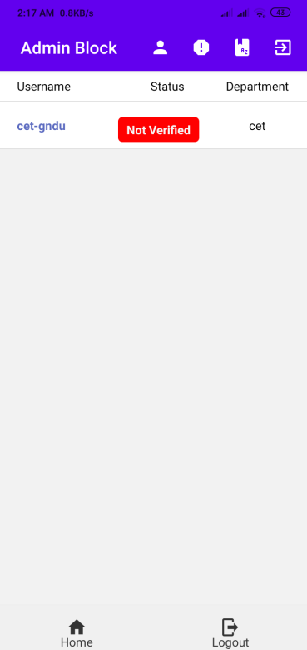
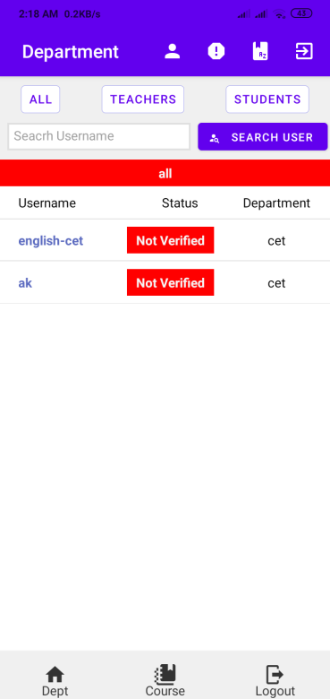
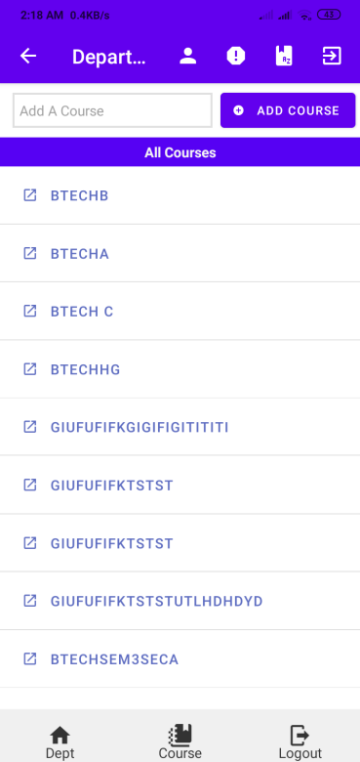
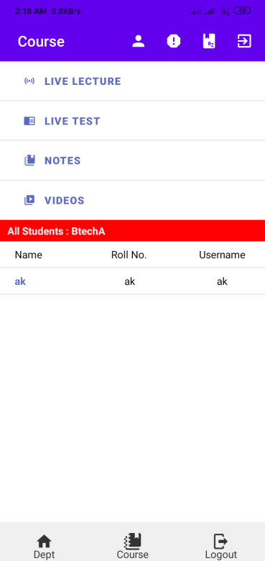
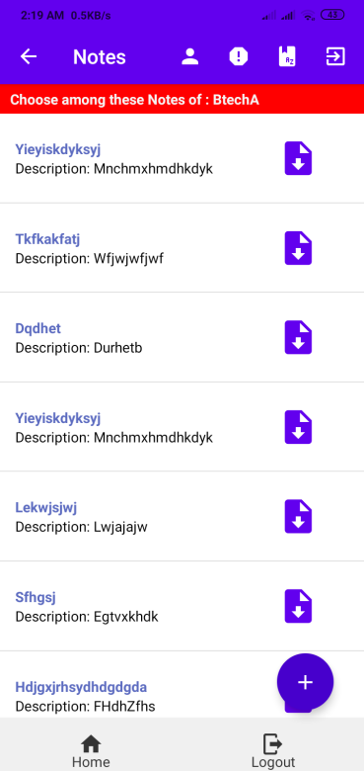
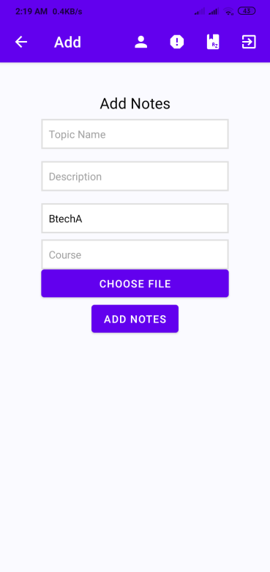
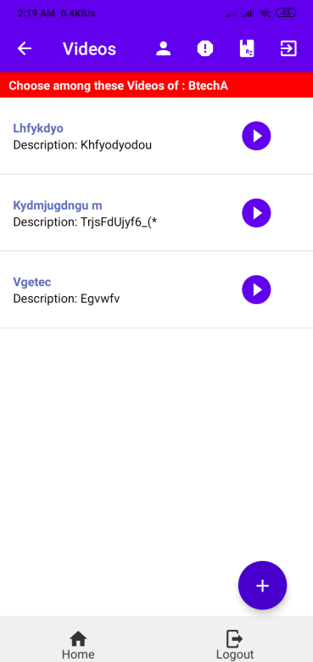
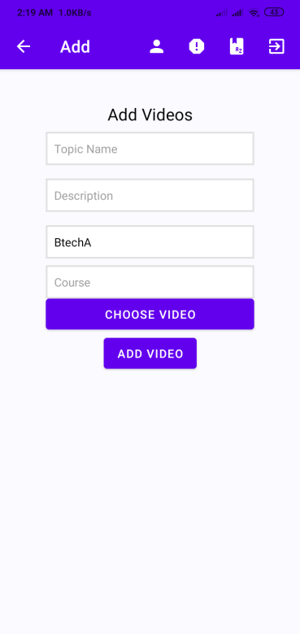

Slide 6
Setting up of Routes/Navigation System
All the Routes and Navigations between Screens has been developed.
These Navigations are developed in such a way that every Screen is accessible by every other Screen to make it easy for user to use this App.
Details about Navigations is given in Section “Working of UI and Navigations” of this Pdf.

Slide 7

Working of UI and Navigations
A Button to Switch user between institute and Guest
Overview of Basic Elements and Buttons
A Button to popup an inbuilt Dictionary driven by an API
All the Announcements from user’s Institute will appear here
A Button to take user to his/her profile Page
Name of the Respective Screen
A Button to get user to the respective Dashboards
A Button to get user to the Login Screen

Slide 8



This will be the Home Page of Application

Slide 9


Institute Signup Page
Guest Signup Page
For Teacher of School/College
For Students of School/College
For Administration Block of School/College
For Various Departments of School/College
For Teachers who are not part of any institute
For Students who are not part of any institute

Slide 10

Administration Block’s Dashboard
`
This will be the Usernames of Various Departments
Verification status of Various Departments will appear here. Admin Block will click on this button and verify the department
List of all the Departments in that School/College/University will appear here
Actual Name of Departments will appear here

Slide 11

Department’s Dashboard
Filter to get required result
Search bar to search for a username
This will be the Usernames of Various Students and Teachers
Verification status of Various Students and Teachers will appear here (Department can click on this button and verify the student/teacher).
List of all the Students and Teachers of that Department will appear here
Name of Department will appear here

Slide 12


Department’s Courses And Teacher’s Page
Live Class/Lecture for that Particular will Course
To Add a New Class/Batch/Course
Live Test of that Particular will Course
All the Classes/ Batches/ Courses will appear here
Notes of that Particular will Course
Videos for that Particular will Course
On Pressing any of the Class/ Course/ Batch, this page will appear
*Note: An institute Teacher and Guest Teacher page will be same in UI and functionality

Slide 13

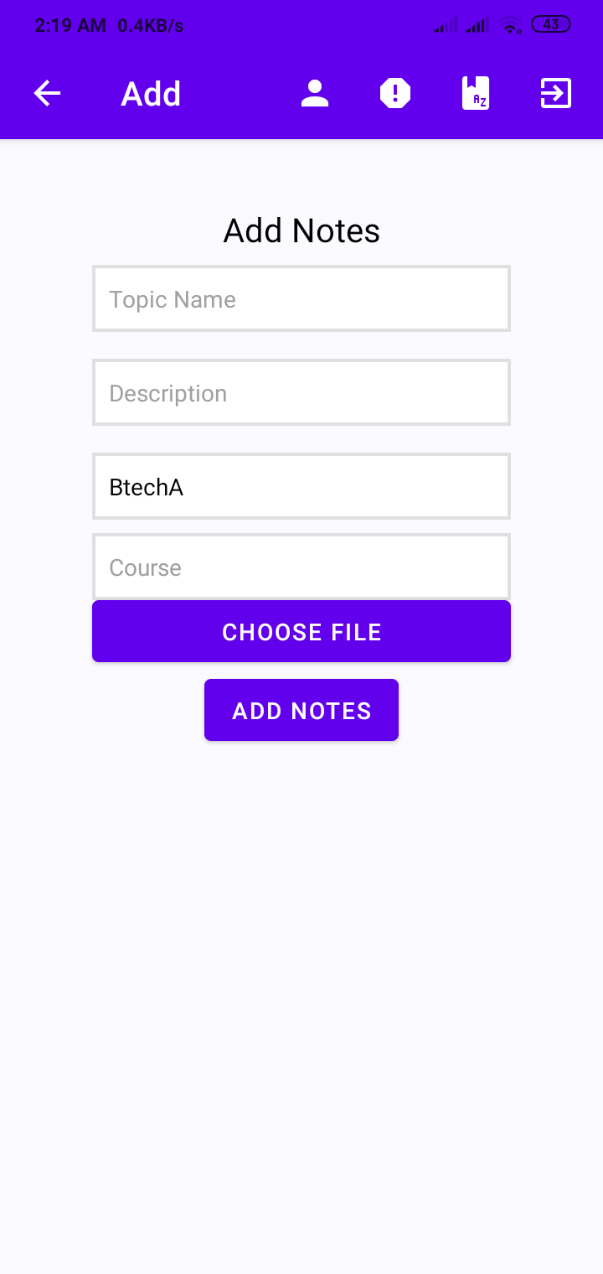
Notes Page
A Button to Download PDF Notes
Add Code or Topic Name of Notes
All the PDF Notes of a Class/ Batch/ Course will appear here
Add Description of Notes
To choose the PDF from Device
A button to Add New Notes
(This button will be visible to Teachers only)

Slide 14


Uploaded Videos Page
A Button to Play Video
Add Code or Topic Name of Videos
All the Videos of a Class/ Batch/ Course will appear here
Add Description of Videos
To choose the Video from Device
A button to Add New Videos
(This button will be visible to Teachers only)

Slide 15
Student’s Page
This page will be same as discussed in previous page, only difference will be that the student will not get any button to Add Notes or Videos
Neither a Student can Start a Live Lecture or Live Test, these buttons will only take him to any Live Lecture or Live Test.
*Note: An institute Student and Guest Student page will be same in UI and functionality

Slide 16
Working of Database and Database Models
This App is currently using MongoDb as its Database storage for faster access.
All the Database models (Notes, Uploading Videos, User Models) have been
developed.
Building up of Basic Functionality
Basic Functions such as authentication of users, Adding and retrieving Notes, Uploading and Retrieving Videos has been completed.

Slide 17
Building up of Advanced Features
Currently I am on this Phase/Stage of Developing this Application.
Building up of all these features (Live Video, Live Test, Dictionary) is in progress.
Adding more Security and Cleaning up the Code
Security is a main concern these days and after completing the previous stage, I will be getting on to adding more security to the App.
Also, right now, the Code can be seen very messy and unorganized and needed to be cleaned, which I am currently doing and will be doing till the end of this stage.

Slide 18
Testing and Making App Production-Ready
After completion of all the above mentioned Development Stages, the App will be tested for overall features and will be improved in case of any errors.
Deployment To PlayStore and Apple Store
After successful testing, this App will be deployed for Production.
Further Improvements
After all this, I will still try to add more features such as adding Attendance System.
Adding recommendations of Videos, Notes for Guest Sections based on their interests (with the use of Data Science)
Add tags to Videos & Notes

