Slide 1
Drowsy Driving Prevention
Michigan Traffic Safety Summit
March 14
Darrel Drobnich
Chief Program Officer – Policy, Education & Research
National Sleep Foundation
1522 K Street, NW, Suite 500
Washington, DC 20005
www.sleepfoundation.org

Slide 2
Overview
The Scope of the Problem
Drowsy Driving Characteristics
At-risk Groups
Legal and Legislative Aspects
Countermeasures and Prevention

Slide 3
How Big is the Problem of Drowsy Driving?
Notes:
Just how big is the problem of drowsy driving?

Slide 4
Drowsy Driving
National Statistics
National Highway Traffic Safety Administration estimates
100,000 police-report crashes annually
1,550 fatalities (4%)
71,000 injuries
$12.5 billion in monetary losses
1 million – 1/6 of all crashes are linked to inattention
(Knipling, 1996)

Slide 5
International Studies
England—About 20%; 30% on some roads
Australia—Between 15-20% of all crashes; 30% of single-vehicle crashes
New Zealand—13% of fatal crashes & 6% of injury crashes
Germany—35% of fatal motorway crashes
France—About 10%
Notes:
According to international data from Australia, England, Finland and other nations—all of which have more consistent crash-reporting procedures than the United States—drowsy driving represents at least 10% to 20% of all crashes.
These data show us that we have only begun to scratch the surface in determining the scope of the drowsy driving problem—which is why some have termed drowsy driving to be “the silent killer.”
References:
Horne JA, Reyner LA. Sleep-related vehicle accidents. Brit Med J. 1995;310:565-567.
New South Wales Road Safety Bureau. Problem Definition and Countermeasure Summary: Fatigue. 1993.
Philip P et al. Fatigue, alcohol, and serious road crashes in France: factorial study of national data. Brit Med J. Apr7, 2001;322(7290):829-30.
Hell W et al, Driver Inattention And Other Causative Factors In Fatal Highway Crashes. Proceedings of the 41st Annual Conference of the Association for the Advancement of Automotive Medicine, Orlando, USA, November, 10-11, 1997.
Land Transport Safety Authority, Fact sheet 24, Fatigue and Road Accidents, Land. Transport Safety Authority, PO Box 2840, Wellington, New Zealand, 1998

Slide 6
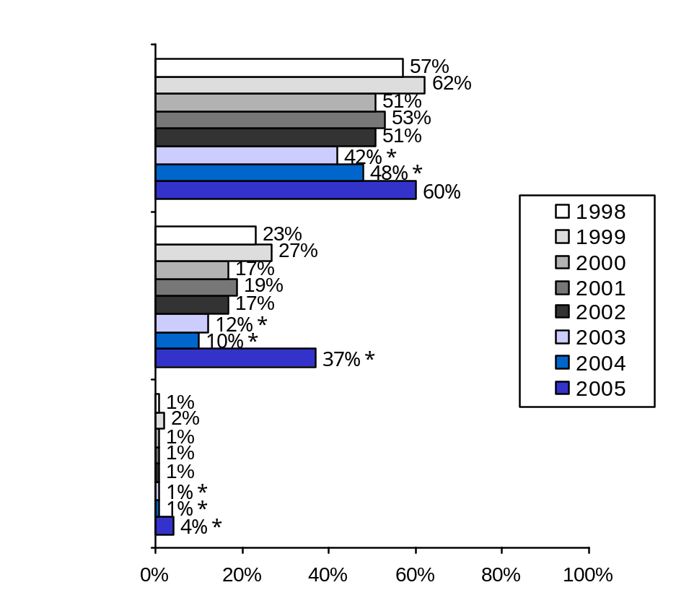
Drowsy Driving Experiences
Percent Reporting Their Experiences While Driving During the Past Year (% Yes)
Driven a vehicle
while feeling drowsy
Dozed off while at
the wheel of a vehicle
(at any time)
Had an accident
because they dozed off
or were too tired
2003* Parents who drive
2004* Adults 55-84
Notes:
According to NSF surveys, about one-half of adult drivers—or about 95 million people—say they have driven a vehicle while feeling drowsy in the previous year, and almost 1 in 5 or 32 million people, have actually fallen asleep at the wheel. One percent—approximately two million drivers—admit they have had an accident because they dozed off or were too tired to drive.
The problem of drowsy driving is likely to grow as baby boomers grow older and develop sleep disorders, as Americans work more hours and experience longer commutes between work and home.
References:
National Sleep Foundation. Sleep in America Poll: 1998. Washington, DC. 1998.
National Sleep Foundation. Sleep in America Poll: 1999. Washington, DC. 1999.
National Sleep Foundation. Sleep in America Poll: 2000. Washington, DC. 2000.
National Sleep Foundation. Sleep in America Poll: 2001. Washington, DC. 2001.
National Sleep Foundation. Sleep in America Poll: 2002. Washington, DC. 2002.

Slide 7
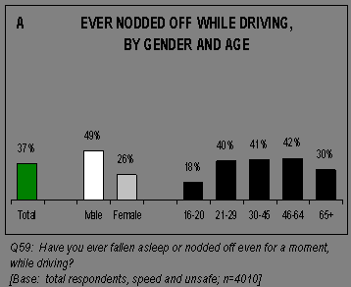
NHTSA National Survey of Distracted and
Drowsy Driving Attitudes and Behaviors
➔

Slide 8
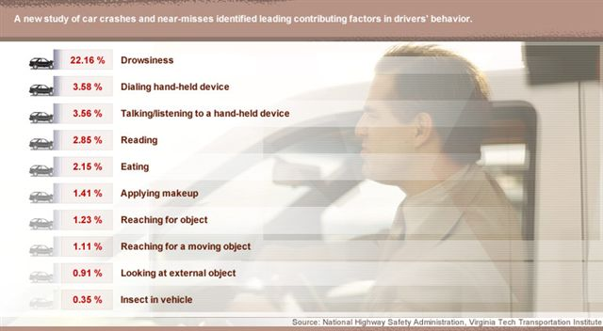
The 100-Car Naturalistic Driving Study
⬅
Cameras in 100 cars for 1 year. 241 drivers were involved in 82 crashes, 761 near crashes, and 8,295 critical incidents.
NHTSA, Virginia Tech Transportation Institute, 2006

Slide 9
What are the Characteristics of Drowsy Driving Crashes?
Notes:
I’d like to talk now about some of the common characteristics of sleep-related crashes.

Slide 10
Characteristics of Drowsy Driving Crashes
Most happen between midnight – 6:00 am & in the midafternoon (circadian dip)
The driver is alone and more likely to be male
A single vehicle drifts off the road and hits a stationary object
Most are rear-end or head-on collisions
Many involve serious injuries and/or fatalities
There is no evidence of braking or evasive maneuvers – NO SKID MARKS!!
(Pack, 1995, Knipling & Wang 1995)
Notes:
While there are subjective and objective tools that can quantify or detect sleepiness in other situations, there are no such tests currently available that can be used at a crash site. However, research has found that there are common characteristics that set sleep-related incidents apart from other crashes.
Night – Most drowsy driving crashes have been found to occur at night when the body’s need for sleep is the greatest. There is also a number of crashes that occur in the late afternoon, between 1pm and 4pm, when we experience what is usually called the “post-lunch dip.”
Drivers who drive alone or have no one to help them watch for the signs of fatigue are at higher risk. Studies also show that males have a much higher risk than females. We are not totally sure why. (Pack et. al., 1995; Horne and Reyner, 1995).
Sleep-related crashes tend to involve a single vehicle running off a high-speed road to the right or to the left. However, sleep drivers are also likely to be over represented in rear-end and head-on collisions (Knipling and Wang, 1994).
Sleep-related crashes look different from alcohol-related crashes in that the driver tends not to be able to brake or take evasive measures because they are completely “out” prior to impact.
Because the person is unable to slow down or take measures to evade another object, injuries and fatalities tend to be high.
Knowing the characteristics of sleep-related crashes can help in developing and targeting effective countermeasures. This knowledge also helps us to identify high risk groups, which I will discuss next.
Do you know someone who have been in a fall-asleep crash?

Slide 11
Why Do People Have Drowsy Driving Crashes? AAA FTS Study
Occupational Factors:
People with more than one job are 2x more likely to have a fall-asleep crash
Working the night shift increases the risk by 6x
Working more 60 hrs per week increased the risk by 40%
Notes:
Work and sleep factors are very closely linked to whether a person has a drowsy driving crash.

Slide 12
Why Do People Have Drowsy Driving Crashes? AAA FTS Study
Amount of Sleep:
One fourth of drivers in sleep-related crashes and 1/3 of drivers fatigue-related crashes got less than 6 hrs of sleep.
7 to 8 hrs = 1.2x higher risk
6 to 7 hrs = 1.8x higher risk
5 to 6 hrs = 3.3x higher risk

Slide 13
Are You At Risk?
Notes:
Since most Americans are not getting the proper sleep they need, just about anyone can be at risk at one time or another.

Slide 14
Special At-Risk Groups Include:
Shift workers
Commercial drivers
People with undiagnosed or untreated sleep disorders
Business travelers
The elderly
Young people
Notes:
Young people - Sleep-related crashes are most common in young people, who tend to stay up late, sleep too little, and drive at night. A study of fall-asleep auto crashes in North Carolina in 1990-1992 indicated that in 55 percent of the crashes, drivers were age 25 or younger and predominantly male. The peak age of occurrence of all crashes was age 20. (Pack et al. 1995), thus strengthening the argument for graduated licensing programs.
Shift workers – Working the night shift increases your risk for a crash by nearly 6 times. Rotating shift workers also need to be extra careful. An NSF poll showed that 80% of shift workers say that they have driven drowsy in the previous year, indicating the existence of a major public health problem.
Commercial drivers – Truck drivers are at increased risk for sleep-related crashes because of their greater exposure to high-risk driving times and situations. This is especially true for long distance drivers, who tend to work long hours, at irregular schedules, and drive along, at night. The U.S. Department of Transportation estimates that at least 15% of all heavy truck crashes involve fatigue.
People with undiagnosed or untreated disorders – Approximately 40 million Americans suffer from chronic sleep disorders and another 20 to 30 million suffer intermittent sleep-related problems. People with untreated sleep apnea, a sleep and breathing disorder, have been shown to have up to a 7 times increased risk of falling asleep at the wheel. It is important that if you are having trouble sleeping or experiencing excessive daytime sleepiness that you consult your physician.
Business travelers – People who many be experiencing jet lag or drive as part of their job need to be extra careful.
Elderly – While the elderly tend not to drive at night, there is some evidence that they might have problems with sleepiness during the late afternoon. They also have to be careful about the sedating medications they may be taking. There needs to be more research on the elderly to see how large a problem drowsy driving may be for them.

Slide 15
2006 Sleep in America Poll
51% of adolescents who drive report that they have driven drowsy in the past year
  16% of 11th graders and 20% of 12th graders drive drowsy once a week or more.

Slide 16
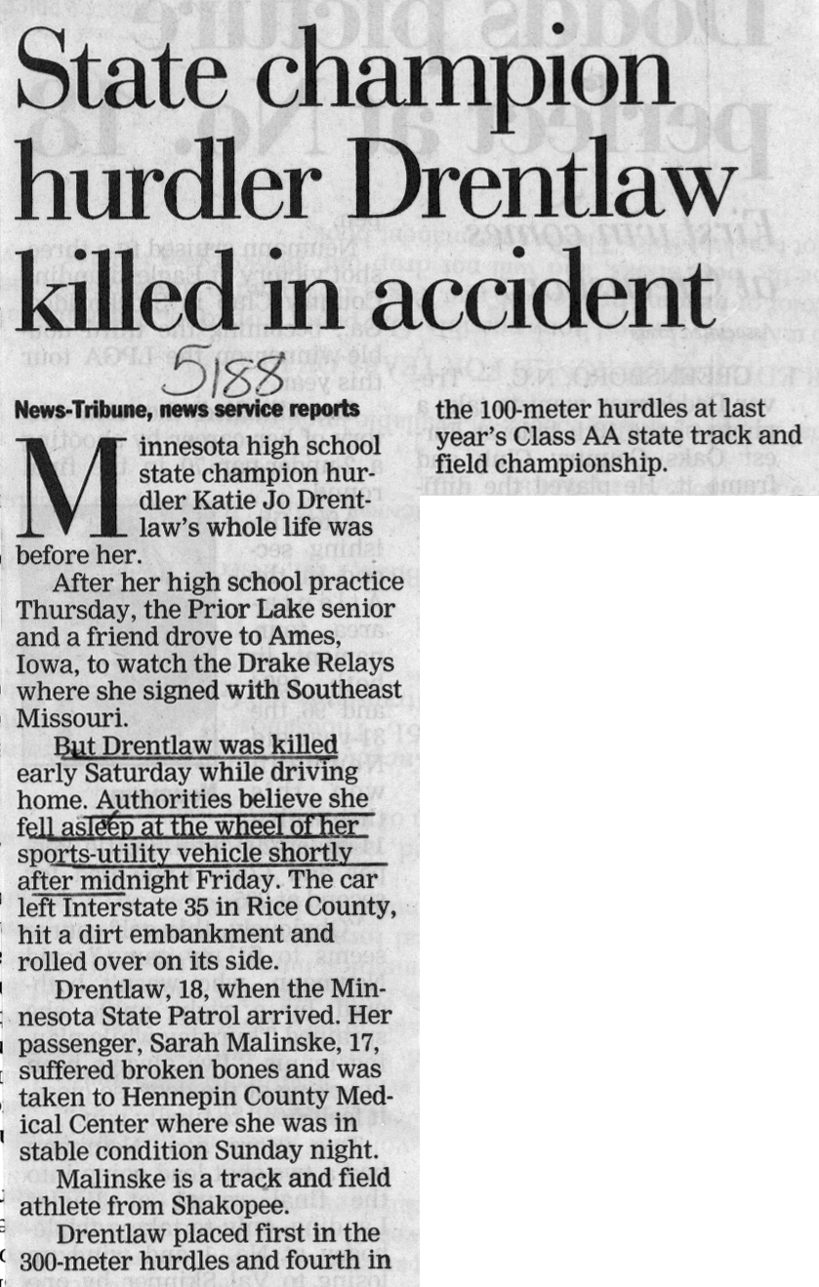

Slide 17

Cocaine – “The Legal Alternative”
Cocaine - Instant Rush. NO Crash!
Warning! You are about to experience the highest energy content of ANY energy drink on the market today! 350% greater than The Bull!
Cocaine is not just a re-hash of existing drinks: It is a completely unique new formula - it tastes like a fireball, a carbonated atomic fireball!
The question you have to ask yourself is: "Can I handle the rush?"
Active ingredients: Caffeine (280mg), B2, B3,B6, B12, CoEnzyme Q10, Guarana, Yerba Mate, Green Tea

Slide 18
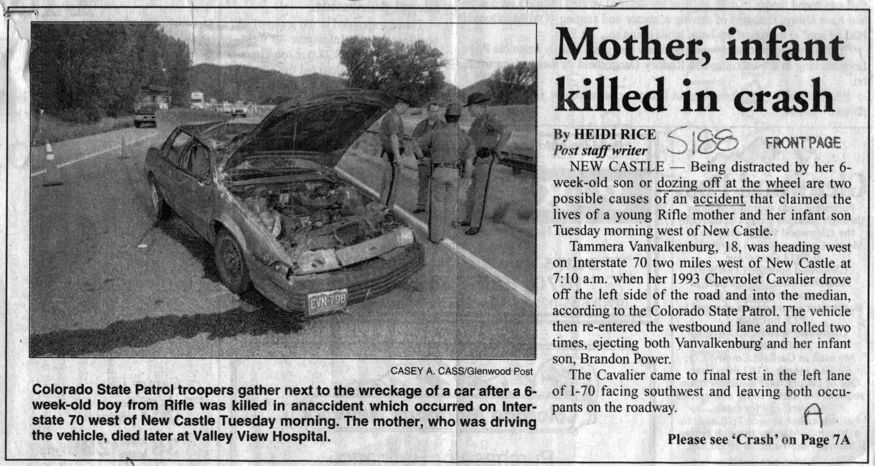

Slide 19
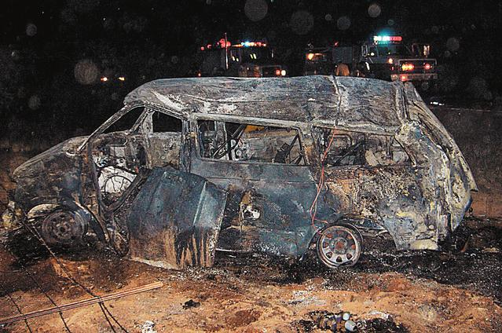
I-10 crash's 5 victims were from New Mexico
Two adults, 3 kids killed in family outing
7:30 pm
Rollover after the driver “fell asleep at the wheel”
Notes:
HEADLINE: Victims of I-10 rollover that killed 5 identified;
Several were in the same family from New Mexico. The group was bound for a convention in Tucson.
BYLINE: David L. Teibel, dteibel@tucsoncitizen.com
BODY:
By DAVID L. TEIBEL
Three of the five people killed in a rollover on Interstate 10 east of Willcox on Thursday night and the three who survived were members of the same New Mexico family, a state Department of Public Safety officer said last night.
The other two who died, also from New Mexico, were sisters from a different family, Officer Christopher Lentz said.
The eight, all from Chaparral, about 20 miles southeast of Las Cruces, were headed to a religious convention in Tucson, Lentz said, adding the van rolled after the driver fell asleep at the wheel.
Killed were Rey Romero, 48; his wife, Susana, 53; Myra Romero, 15; Priscilla Soladad, 18; and her sister Joyce Cisneros, 14, DPS officers said.
Injured were the van's driver, Jahaziel Romero, 18; Jennifer Romero, 14; and Angela Romero, 15.
DPS Officer Frank Torres earlier said the crash was in the westbound lanes of I-10 25 miles east of Willcox at about 7:30 p.m.
The three injured were airlifted to a hospital, Torres said.
LOAD-DATE: July 5, 2005

Slide 20
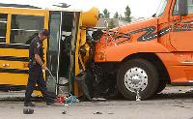
Who is Driving Your Children?
June 22, 2005: A school bus carrying 14 children collided head-on with a semi trailer in West Jordan, Utah, sending 13 kids and one adult to hospitals with minor injuries.
“The 22-year-old driver told police he may have dozed off.”
Source: The Salt Lake Tribune
Notes:
Article Last Updated: 6/23/2005 12:42 AM
School bus collides head-on with a semiBy Justin Hill
The Salt Lake Tribune
Salt Lake Tribune A school bus carrying 14 children collided head-on Wednesday afternoon with a semitrailer in West Jordan, sending 13 kids and one adult to hospitals with minor injuries.
"Everybody's pretty lucky," said West Jordan police Capt. Gary Cox as he stood on the sidewalk of Old Bingham Highway (9250 South), where just east of 4610 West the compact school bus had its engine compartment completely crushed by the semi. "I'm surprised the injuries weren't worse."
The bus was transporting three adult counselors and 14 children enrolled in a summer camp at West Ridge Academy, also known as Utah Boys Ranch, after a day of swimming.
Cox said some of the children were wearing seat belts. The Utah Boys Ranch had the seat belts installed as an added safety precaution, said Ken Allen, executive director.
The vehicle was westbound on the Old Bingham Highway about 3:15 p.m. when it drifted into the eastbound lane, Cox said. The driver of the truck tried to avoid the oncoming bus. The semi was just about stopped, but it is estimated that the bus was going around 35 mph, Cox said. On Wednesday, police were investigating why the bus went into oncoming traffic, though Cox said the 22-year-old driver told police he may have dozed off.
Everyone was released from the hospital Wednesday, and the summer camp is expected to resume today.
The driver, who has worked for the boys ranch for two years and is trained in driving buses, has been asked to take a leave of absence while the ranch and police complete their investigations.
Amanda Gunderson heard the crash from her home, the back of which faces the highway. She thought it was her kids' bus. Her heart sank.
"I was amazed that someone even survived that," she said.
Along the side of the road, children sat crying, she said.
Don Bagshaw, who drove by the accident shortly after leaving work at SME Steel, saw some children had blood on their shirts.
"The ones who were standing out there were white as a ghost," he said. "It was terrible."
---
Tribune reporters Ronnie Lynn, Lisa Rosetta and Jessica Ravitz contributed to this story.

Slide 21
Legal Aspects of Drowsy Driving

Slide 22
Do Officers Consider Drowsy Driving To Be a Problem?

Slide 23
AAA Foundation for
Traffic Safety Internet Survey
Nearly 90% of police officers reported they had stopped a driver who they believed was drunk, but turned out to be drowsy
89% agreed that drowsy driving is as dangerous as drunk driving
93% believed drowsy driving is a serious problem
93% agreed that drowsy driving is a serious problem for passenger car drivers

Slide 24
AAA Foundation for
Traffic Safety Internet Survey
97% agreed that drowsy driving is a serious problem for commercial drivers
95% agreed that drivers who cause a crash because they are fatigued should be charged with a driving violation
96% agreed that more education is needed to inform drivers about the dangers of drowsy driving

Slide 25
Maggie’s Law
1. N.J.S.2C:11-5 is amended to read as follows:
2C:11-5. Death by auto or vessel.
a. Criminal homicide constitutes vehicular homicide when it is caused by driving a vehicle or vessel recklessly.
For the purposes of this section, driving a vehicle or vessel while knowingly fatigued shall constitute recklessness. “Fatigued” as used in this section means having been without sleep for a period in excess of 24 consecutive hours

Slide 26
Maggie’s Law applied in Dennis Twp. road fatality
By TRUDI GILFILLIAN Staff Writer
CAPE MAY COURT HOUSE - A Cape May County vehicular-homicide case may have been the first to make use of Maggie's Law, named for a young Gloucester County woman who died when a tired driver struck her car.
Last week, Lower Township resident Scott Robb pleaded guilty to vehicular homicide after admitting he had gone 24 hours or more without sleep when his minivan swerved into another lane striking a minivan driven by Thomas Herring Jr. on Sept. 25, 2004. Herring, of Delaware, died.
Robb will be sentenced to five years in state prison.
Assistant Prosecutor Rob Johnson said he prosecuted Robb using Maggie's Law, which specifically defines being without sleep for 24 consecutive hours as recklessness in cases of vehicular homicide, a second-degree crime punishable by as many as 10 years in prison.
- PressofAtlanticcity.com

Slide 27
New State Legislation
Illinois – SB104 (adds “fatigue” to reckless driving in vehicular homicide statue)
Kentucky – HB 150 (adds “fatigue” to reckless driving in vehicular homicide statue)
Massachusetts – SB730 – Creates special commission for drowsy driving
  More comprehensive bill stalled

Slide 28
New State Legislation
New York
  A00970 – Screening for OSA in CMV drivers
  A01234 – Drowsy driving a misdemeanor; felony for vehicular homicide
  A02332 – Death from drowsy driving a misdemeanor
Tennessee
  SB0071 – Adds drowsy driving to vehicular homicide statute

Slide 29
1998 NSF Survey of States
Six states still did not have fatigue codes: Al, AR, DE, MA, MO, WI – Now 1 (MASS)
Most states had separate codes for both “fatigue” and “fell asleep”
Only two states (AL, MS) said that they would not charge a drowsy driver for causing a crash
Only Alabama said that they would not charge a drowsy driver for causing a fatality

Slide 30
Criminal Prosecutions
Detroit Red Wings – (Birmingham, MI)
  2 injured – 9 mos. For driving on suspended license plus 200 hrs comm. Ser.
Willie Starling (Allentown, PA)
  Wife killed – 1-5 years, $10,000 fine
Neal Semich – (Fairfax, VA)
  2 dead, 5 yrs with 2 yrs probation
Scott Robb – (NJ)
  One dead, 5 yrs

Slide 31
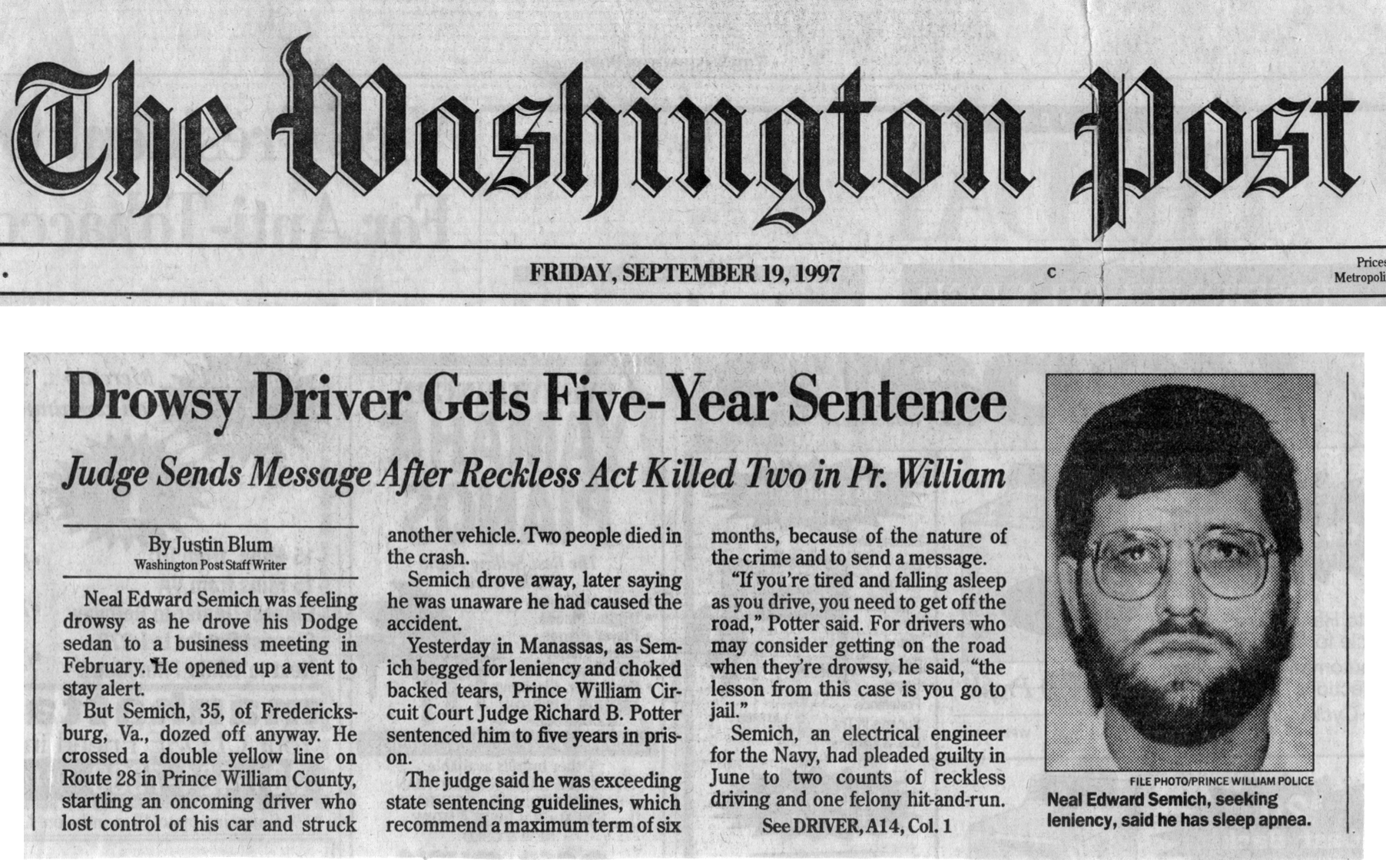

Slide 32
Civil Litigation
Hardy vs. General Motors - $150 million
  Human performance vs. mechanical defect
Dave Truitt - $750,000 – pipe fitter working 39 hour shift
Faverty vs. McDonald’s Rest of Oregon - $400,00 – Employee slept 7 hours over 48 (Ist against the employer in non-commercial setting)
Budd vs. Berlingieri - $1 million (Allstate)
  Retired police officer killed by drowsy driver

Slide 33
Holiday Inn liable for drowsy driver's crash
Holiday inn and one of its employee drivers must pay $5.8 million to the family of a woman who was killed when an employee, while in the course and scope of his employment, crossed the center line and hit the woman's car head-on, a Texas jury ruled on April 26. The driver, who was taking a hotel guest to the airport, couldn't remember what happened. The plaintiffs contended that the driver fell asleep at the wheel, a consequence of working a double shift. While the jury found negligence on both the driver and Holiday Inn, it assessed $2 million in punitive damages against the hotel. The plaintiffs had argued that
the hotel should have had a policy against driving during the second leg of a double shift.
Garza v. Posadas USA Inc., No. 2000CVE000509-D1 (Webb Co., Texas,Dist. Ct.).
National Law Journal – June 10, 2002

Slide 34
Countermeasures

Slide 35
Maximize Your Sleep
Minimize Your Risks
Notes:
I now would like to talk about how to recognize the signs of fatigue and what you can do you reduce your risk for drowsy driving or sleep-related crashes.

Slide 36
Recognize the
Warning Signs of Fatigue
Trouble focusing, keeping your eyes open or your head up
Daydreaming; wandering/disconnected thoughts
Yawning or rubbing your eyes repeatedly
Drifting from your lane, tailgating, & missing signs or exits
Feeling restless & irritable
Inattention
Rolling down the window or turning up the radio
  NHTSA focus groups, Jim Horne
Notes:
These are some of the signs that you should be self conscious while driving or before leaving for a trip. Sleep is very insidious and people are notoriously bad at estimating their own alertness, so you have to be very vigilant in looking for the slightest change in how you feel.
Trouble focusing, keeping your eyes open or your head up
Daydreaming; wandering/disconnected thoughts
Yawning or rubbing your eyes repeatedly
Drifting from your lane, tailgating, & missing signs or exits
Feeling restless & irritable

Slide 37
Before A Trip
Get a good night’s sleep, 7-9 hrs
Reduce sleep dept
Schedule breaks every 100 miles or 2 hours during long trips
Travel with a companion to help watch for the signs of fatigue
Avoid alcohol
Check medications (sedating)
Notes:
Here are some things that you should do before a long trip:
Get a good night’s sleep, preferably 8 hrs
Schedule breaks every 100 miles or 2 hours during long trips
Travel with a companion to help watch for the signs of fatigue
Avoid alcohol and sedating medications

Slide 38
Before A Trip
Take a nap or consume caffeine (200 mg) before leaving work if tired
Consult your physician or local sleep disorders center if you are experiencing frequent daytime sleepiness or having difficulty sleeping at night
Notes:
You need to also be careful on short trips between work and home as well.
Take a nap or drink caffeine before leaving work if tired
Consult your physician or local sleep disorders center if you are experiencing frequent daytime sleepiness or having difficulty sleeping at night

Slide 39
Countermeasures While Driving
Stop driving – Only 100% method!
Pull off the road at a safe place and take a short nap (15-45 mins.)
Consume caffeine (equivalent of 2 cups of coffee) (gum, mints, energy drinks)
Try both caffeine and a nap
Switch drivers
Don’t rely on “drowsy driving devices” or folk remedies (e.g., sunflower seeds, ice, shoe removal)
Notes:
“Old tricks” (e.g., turning up the radio, chewing ice) people use to “keep themselves awake” do not work for long. Just because your eyes are open does not mean that you are alert. Below are the only proven countermeasures to help prevent a drowsy driving and/or increase alertness for a sustained period of time:
Stop driving - A very simple solution. This is the only sure way to save yourself. Find a place to sleep for the night (e.g., motel, friend’s house)
Naps - Take 15 to 45 minute nap. More than 20 minutes can make you groggy for 15 minutes after or more after awakening.
Let a passenger drive – It’s good to share driving, especially on long trips.
Caffeine - Consume the equivalent of 2 cups of coffee. Caffeine is available in various manners (soft drinks, chewing gum, tablets) and amounts. Remember, caffeine takes about 30 minutes to enter the blood stream and will not greatly affect those who regularly consume it. Try taking caffeine and then a short nap to get the benefits of both.
Alerting Devices – At this time, there are no validated devices available to alert drowsy drivers. There are a lot of “snake-oil” products out there. Be very wary about these devices.
Continuous shoulder rumble strips – These are deep grooves placed on the side of a high-speed road, have been shown to be very effective in reducing off-the-road crashes. If you hit these, get off the road at a safe spot immediately – you may be tired.

Slide 40
Summary
Drowsy Driving is an underreported and unrecognized safety problem
It needs to be handled like other traffic safety problems through Education, Enforcement and Engineering
Like drunk driving, it is a public health issue that requires public health interventions that ensure that people with sleep problems are properly treated

Slide 41
Wake Up Michigan! Symposium
Thursday, September 20, 2007
Steelcase Town Hall, Grand Rapids

Slide 42
For More Information
www.sleepfoundation.org
www.drowsydriving.org
www.sleepforkids.org
Notes:
For more information about sleep tips, sleep disorders, and how to combat drowsy driving write to the National Sleep Foundation for free brochures and fact sheets or visit its website at the following address.

