Slide 1


Indian Postal Service Bill Calculation
Date - DD/MM/YYYY
Time - 16:00:00
Indian postal service welcome you!
Data Input
Bill Generation
Exit

Slide 2
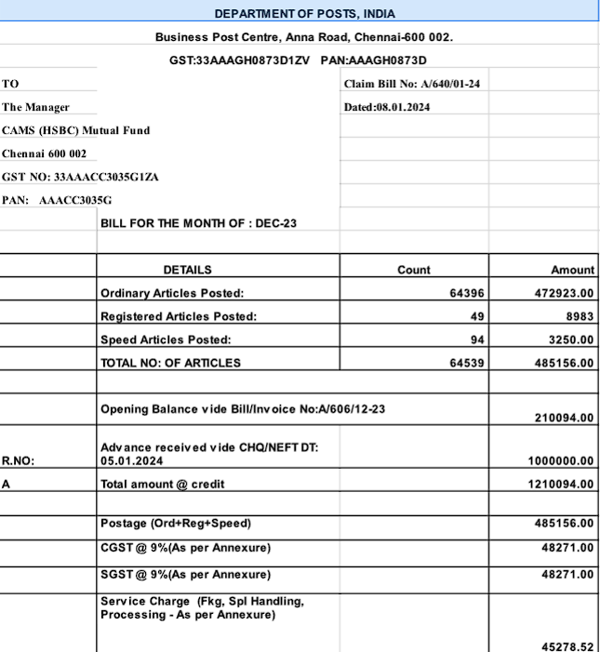
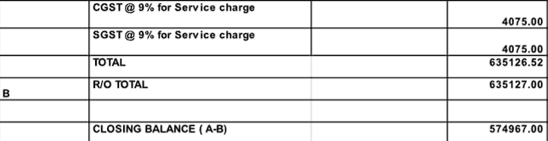
Date - DD/MM/YYYY
Time - 16:00:00
Print
Back
Exit

Slide 3
Indian Postal Service Bill Calculation
Date - DD/MM/YYYY
Time - 16:00:00
Company Advance
Attendance Manager
Back
Exit

Slide 4
Date - DD/MM/YYYY
Time - 16:00:00
Attendance Manager
Click the Employee name for attendance
Employee 1
Employee 2
Employee 3
Employee 4
Employee 5
Add Employee
Back
Exit

