Slide 1
MINI-PROJECT
LADERA

Slide 2
INTRODUCTION

Slide 3
—TRISH PARR
“If you think Math is hard, try Web Design.”

Slide 4
ABOUT THE PROJECT

Slide 5
WHAT IS QR DIAGNOSTICS?

Slide 6
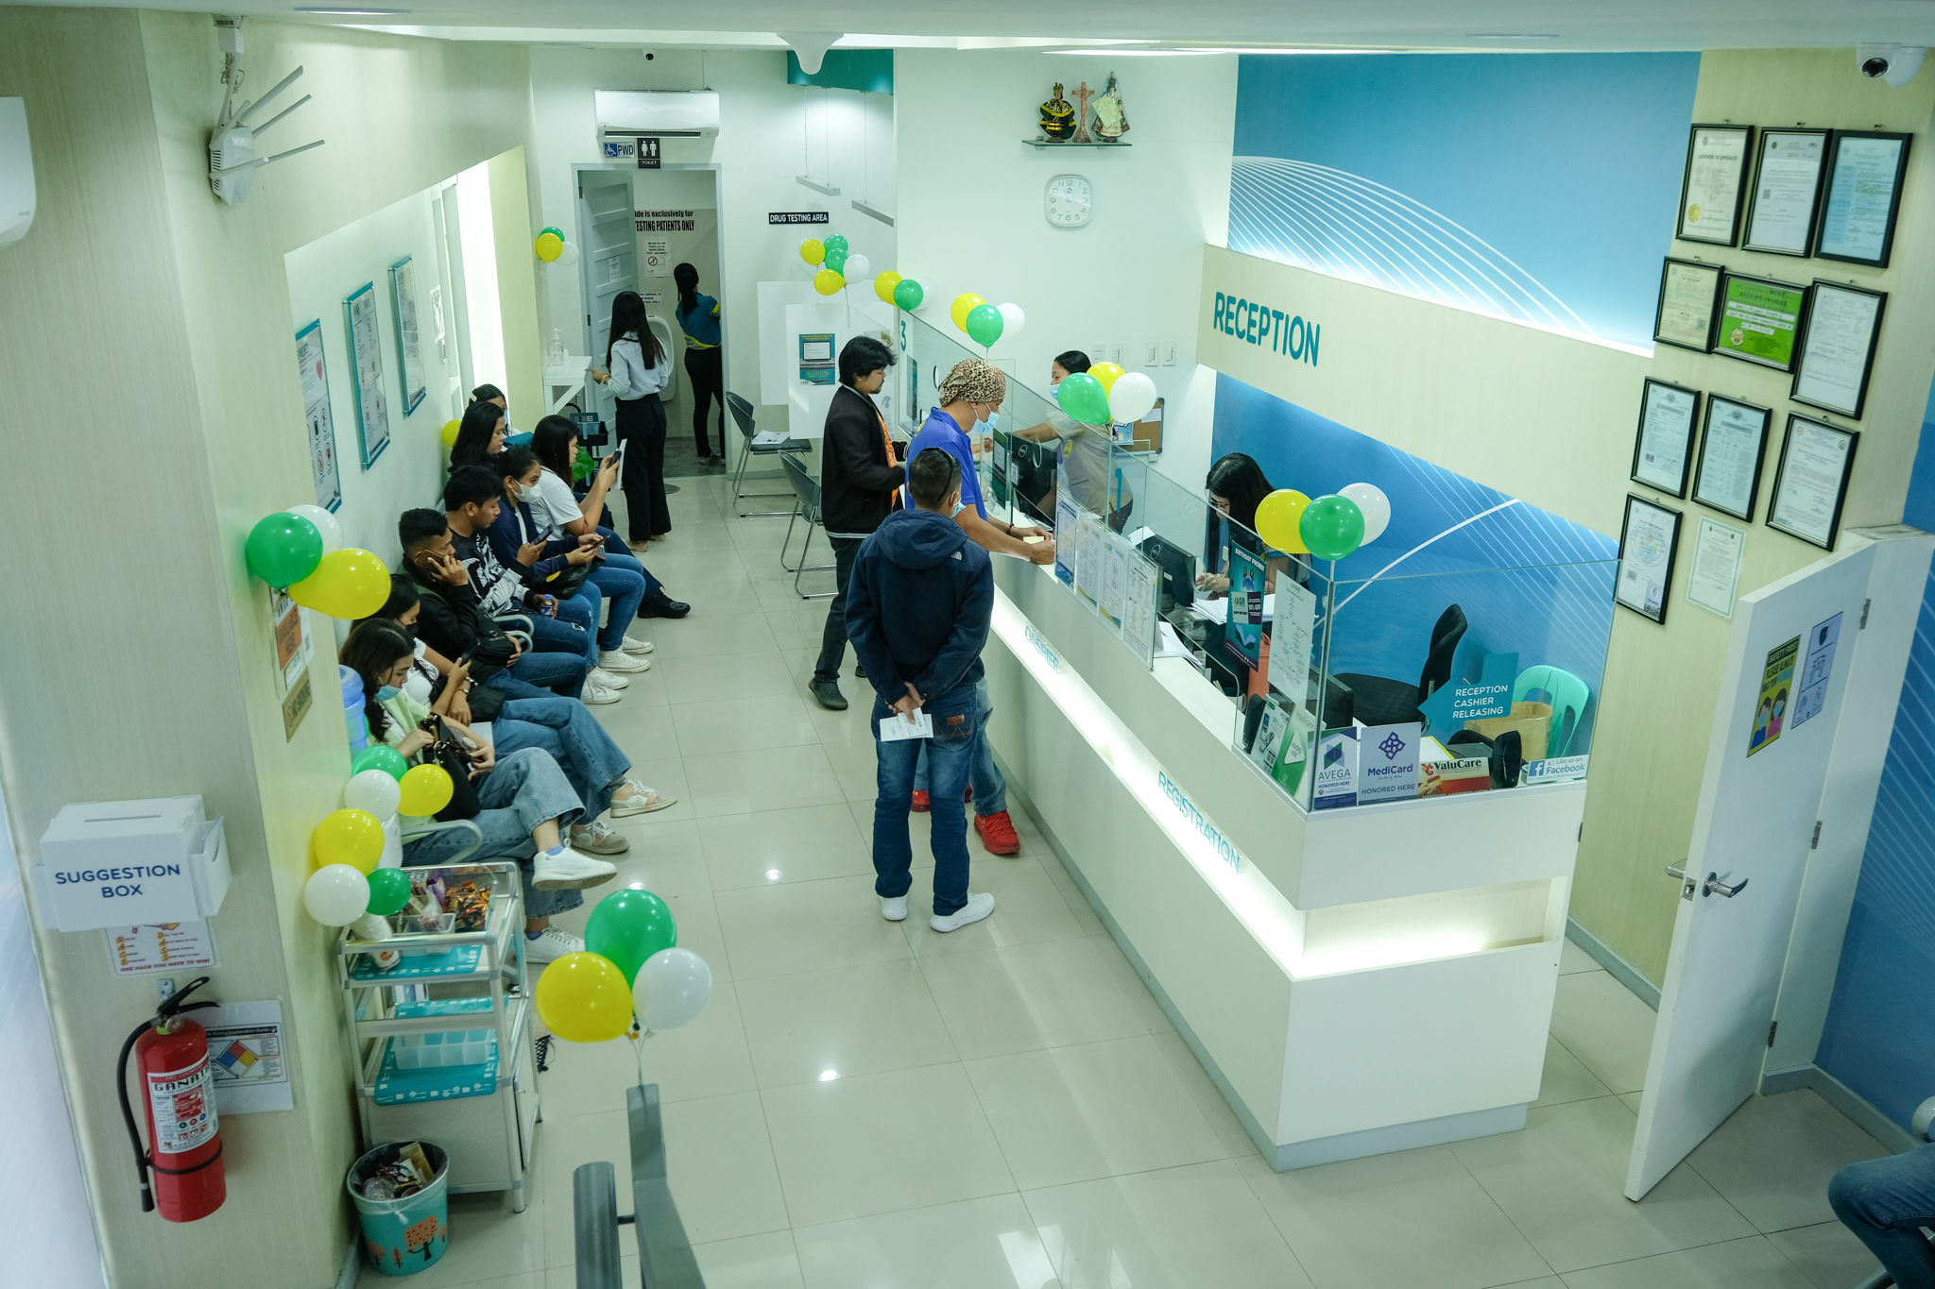
Quality and Reliance Diagnostic Center, located in Tacloban City, is a leading healthcare facility dedicated to providing top-notch diagnostic services to the local community and beyond. Founded with a strong commitment to excellence and reliability, their center has established itself as a trusted name in the field of medical diagnostics.

Slide 7
FEATURES
USER-FRIENDLY
RESPONSIVE

Slide 8
TECHNOLOGY AND LIBRARIES

Slide 9
TECHNOLOGIES
HTML
CSS
BOOTSTRAP FRAMEWORK
JAVASCRIPT

Slide 10
LIBRARIES
BOXICONS
AOS
FONTAWESOME

Slide 11
SNEAK PEEK
HEADER
TEXT
SLIDER
ICONS

Slide 12


WEB AND MOBILE PERSPECTIVE

Slide 13
LIVE DEMO

