Slide 1
MINI-PROJECT
LADERA

Slide 2
INTRODUCTION

Slide 3
—TRISH PARR
“If you think Math is hard, try Web Design.”

Slide 4
ABOUT THE PROJECT

Slide 5
WHAT IS QR DIAGNOSTICS?

Slide 6
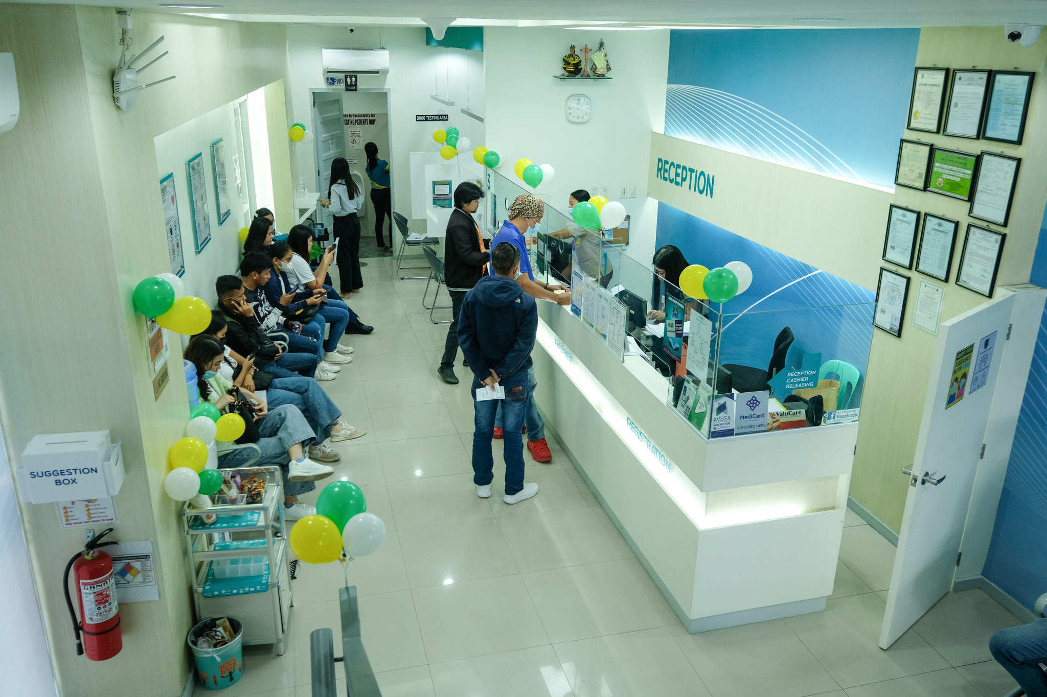
Quality and Reliance Diagnostic Center, located in Tacloban City, is a leading healthcare facility dedicated to providing top-notch diagnostic services to the local community and beyond. Founded with a strong commitment to excellence and reliability, their center has established itself as a trusted name in the field of medical diagnostics.

Slide 7
FEATURES
USER-FRIENDLY
RESPONSIVE

Slide 8
TECHNOLOGY AND LIBRARIES

Slide 9
TECHNOLOGIES
HTML
CSS
BOOTSTRAP FRAMEWORK
JAVASCRIPT

Slide 10
LIBRARIES
BOXICONS
AOS
FONTAWESOME
FLATPICKR

Slide 11
SNEAK PEEK
HEADER
TEXT
SLIDER
ICONS

Slide 12


WEB AND MOBILE PERSPECTIVE

Slide 13
LIVE DEMO

