Slide 1
MINI-PROJECT
LADERA

Slide 2
TABLE OF CONTENTS
01
04
About the Project
Sneak Peek
02
05
Major Requirements
Project Stages
03
06
Project Goals
Our Team
Here you could describe
the topic of the section
Here you could describe
the topic of the section
Here you could describe
the topic of the section
Here you could describe
the topic of the section
Here you could describe
the topic of the section
Here you could describe
the topic of the section

Slide 3
INTRODUCTION

Slide 4
—TRISH PARR
“If you think Math is hard, try Web Design.”

Slide 5
ABOUT THE PROJECT

Slide 6
WHAT IS QR DIAGNOSTICS?

Slide 7
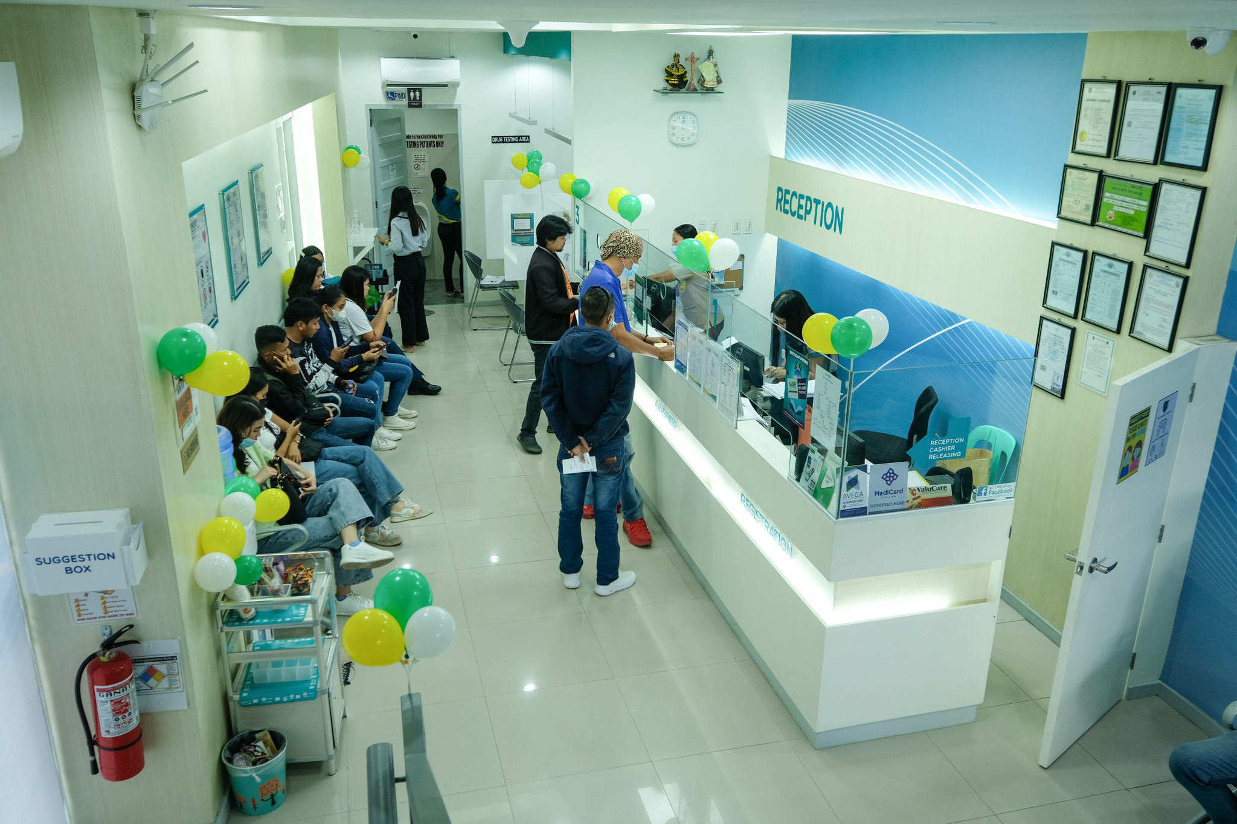
Quality and Reliance Diagnostic Center, located in Tacloban City, is a leading healthcare facility dedicated to providing top-notch diagnostic services to the local community and beyond. Founded with a strong commitment to excellence and reliability, our center has established itself as a trusted name in the field of medical diagnostics.

Slide 8
FEATURES
USER-FRIENDLY
RESPONSIVE

Slide 9
TECHNOLOGY AND LIBRARIES

Slide 10
TECHNOLOGIES
HTML
CSS
BOOTSTRAP FRAMEWORK
JAVASCRIPT

Slide 11
LIBRARIES
BOXICONS
AOS
FONTAWESOME

Slide 12
SNEAK PEEK
HEADER
TEXT
SLIDER
ICONS

Slide 13
WEB AND MOBILE PERSPECTIVE

Slide 14
LIVE DEMO

