Slide 1

GLOBAL EVENTS
project eiab replacement
- AKSHATHDAYAN SURESH, MARKETING CO-OP-

Slide 2





Criteria
Establishing criteria: what are our needs?
Vendors
Overview of different vendors and their service offerings
Agenda
Comparison
Evaluating each vendor against one another to look for the best possible choice
Recommendation
Presenting the best and right option to be undertaken by D2L
Questions
Feedback and gaining perspective on the next steps

Slide 3


Problem Statement
Current Event-in-a-Box vendor
Breakdowns in communication
Inaccurate inventory counts
Shipping logistics mistakes
High billings for project management services
No full breakdown of costs in invoice
Poor experience and User Interface

Slide 4

Inventory Management
Shipping Services
Store variety of items long-term
Reserve admin-use items
Ship to/from warehouse
Use multiple carriers (UPS, FedEx, UPS, DHL)
Return labels
Project Management
User Portal
Detailed monthly reports of: financials, budget code, purchaser, billed management fee and inventory
Flag damaged items
Notify for replacements
Low inventory alerts
Accessible order placement
Varied access levels
Admin view
Order and user tracking
Item tagging and categorization
Budget code input
User-friendly UI
Salesforce & Marketo integration
Criteria
Customer Support
Dedicated POC – CSM
Live chat support
Sustainability
Sustainable practices

Slide 5

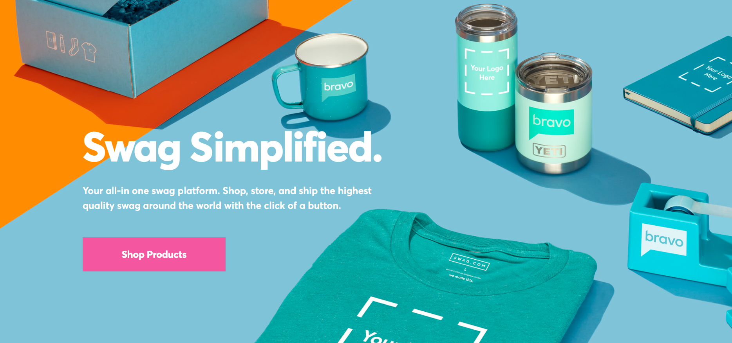

WHAT THEY OFFER
New York,
NY
Swag Bulk Ordering
Swag Distribution
Swag In A Box
Corporate Gifting
Company Stores
Swag Automation
Notes:
Based out of New York City
First Company I spoke to and introduced to Alyssa
Swag Bulk Ordering : Ability to order swag in bulk as they have multiple vendor sourcing
Swag Distribution : Send swag to one or multiple locations at once – 3 Warehouses, 2 in Pennsylvania and 1 in Ohio
Swag in a Box : Send people swag items in a box i.e. gifting
Corporate gifting: Ability to capture and follow up with potential leads to more secure pipeline and enhance engagement.
Custom Landing page creation post lead collection via email
Company Stores: Create a fully custom digital storefront to sell our branded goods using the Swag.com Shopify integration.
Swag Automation: Custom API that automates swag distribution - Never miss another birthday, lead follow-up or thank you gift again.

Slide 6

KEY TAKEAWAYS
Swag creation/ sourcing
Swag distribution
Gifting
“Online swag closet”- Inventory Management
Integration
No return labels/ sendbacks to warehouse
Do not hold third party items
Notes:
Swag creation/ sourcing
Swag distribution
Gift giveaway landing page creation is possible
They have a "my inventory swag closet" to sort items, give priority, check stock, and people access management - can distribute to one/ multiple addresses.
Platform used – Zapier – Salesforce integration possible (order trigger only)
Domestic and International Shipping available – USPS, UPS, Fed-x, DHL
POC: CS Rep and Account Manager
Unfortunately, they do not do returns i.e., send backs to warehouse, return labels and hold D2L inventory – banners, tablecloths, supplies, etc.
Eco-friendly products

Slide 7
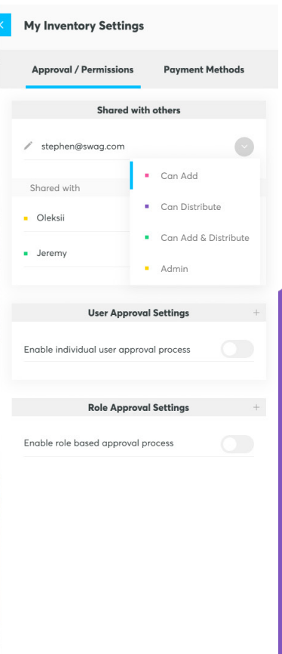
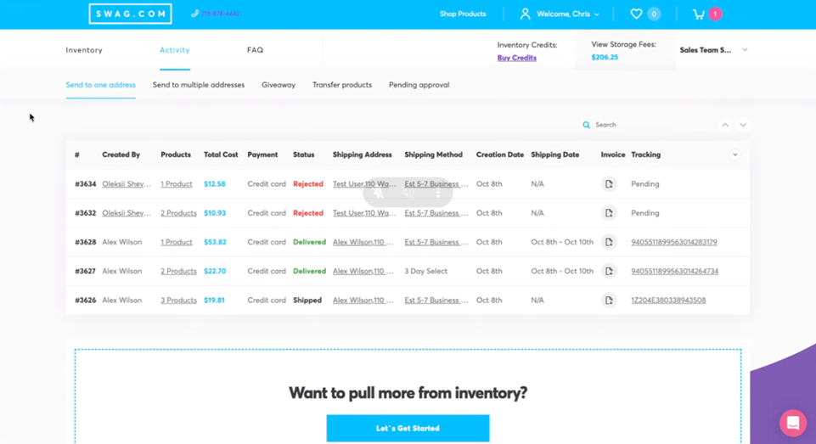
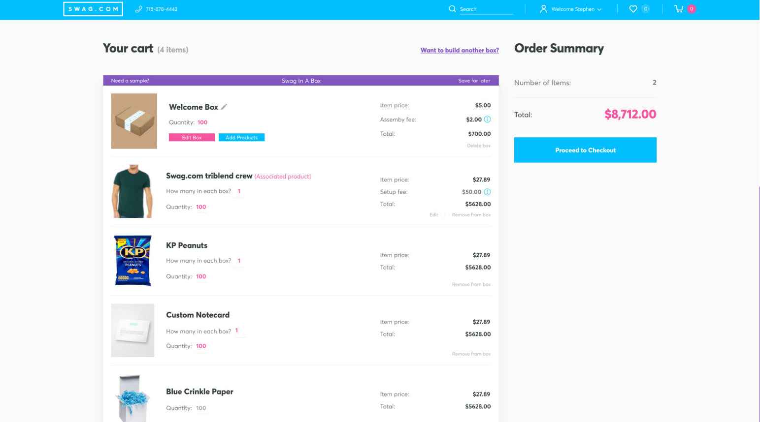

Slide 8


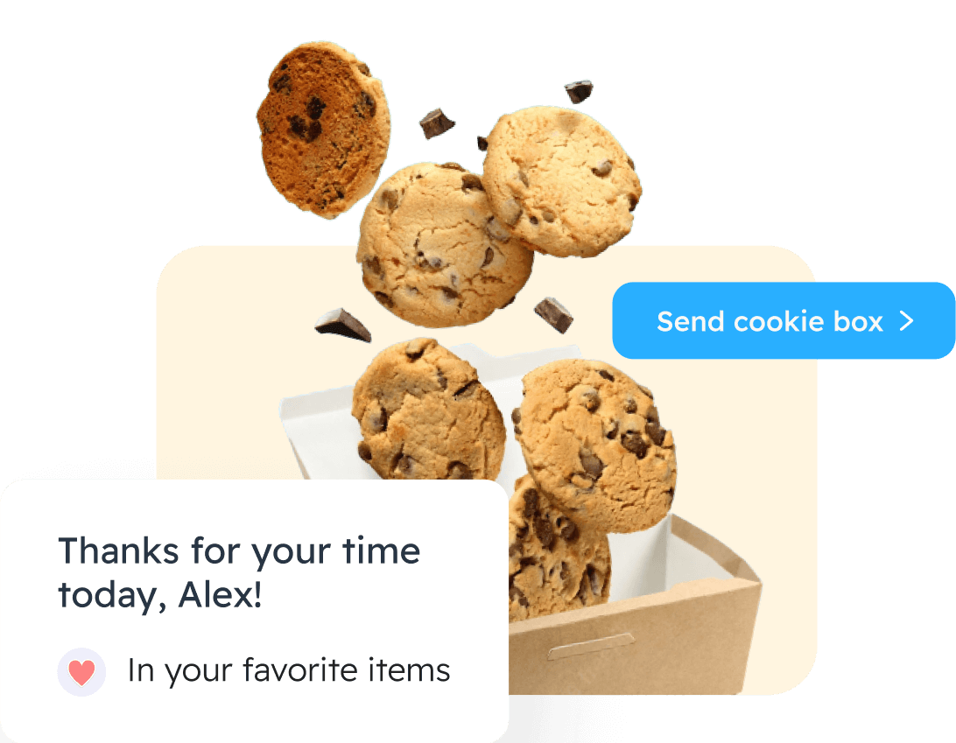
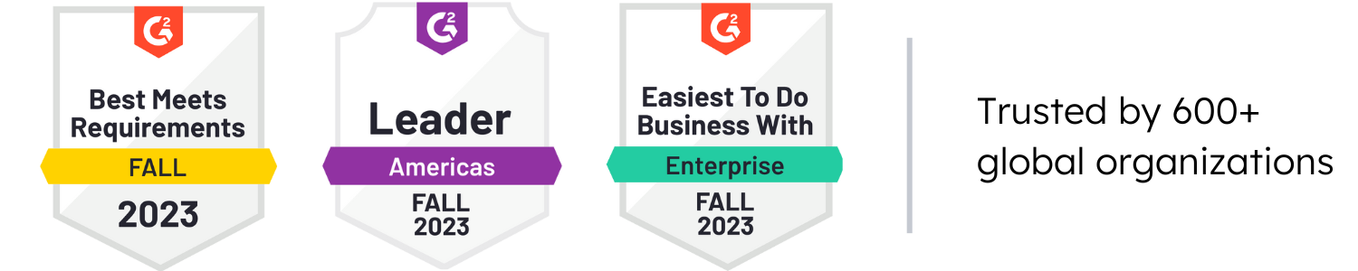
San Luis Obispo,
CA
WHAT THEY OFFER
Postal Engage
Postal Brand
Postal ABM
Paper Plane
“Guaranteed ROI on your spend”
Notes:
Based in California
Postal engage: Ability to scale, execute, and track offline campaigns to grow our business. With Postal’s global online gifting platform, we can start sending the perfect item faster and easier.
Postal Brand: Swag storefront with our swag items to be purchased by customers/ people within org – ecommerce store - custom employee purchases – Giftcards
Postal ABM: Account Based Marketing - Build, execute, and manage targeted, data-driven campaigns – essentially tracking the lead’s journey and sending them down the funnel – Reporting & ROI
Paper plane: is a creative services agency focused on offline marketing design including direct mail, promotional materials, branded swag, and custom kits. – network of distributors, mock-ups, quick items, samples, drop shipping, warehousing. NO MARKUPS

Slide 9
Key Takeaways
More focus on gifting
Sending – Direct, Multiple, Email Customer Giftings, Magiclink, Bulk-Send
Warehousing
Buyout program
Inventory Management
Integration
Virtual Events
No notifications for damaged items/ replacements YET
No Budget code payment method, balance based
Complex pricing structure
Notes:
Had about 3-4 calls with them - very responsive and engaging
More focus on gifting
Different sending options – Send one or multiple items directly, Email giftings to capture leads, magiclink (on-site QR code gifting, lead gathering, able to book meeting – book meetings, bulk send for events, returns and warehousing – international shipping - UPS, USPS
Warehousing available in US, Canada, Europe, Australia, and UK, Delivery duty paid – shipping times – 3-5 days domestic, 8-24 international
Buy Out Program if not happy with STAR service – will take effect immediately if pursued with no cost
Inventory management - Live inventory counts, monthly reports, access management, swag categorization - Inventory Segmentation – Team Access, Budget Allocation
Integrations – Marketo, Salesforce, slack
Ability to host virtual events – landing page, registration and swag sends
POC – CSM, Project manager, warehouse associate
Low Inventory count alerts but no notifications for damaged items/ replacements YET
No Budget code payment method, balance based
Complex pricing structure – Platform fee + Warehousing (Skus etc)
1% Pledge equity, product, time, profit
, CA Certified green,

Slide 10
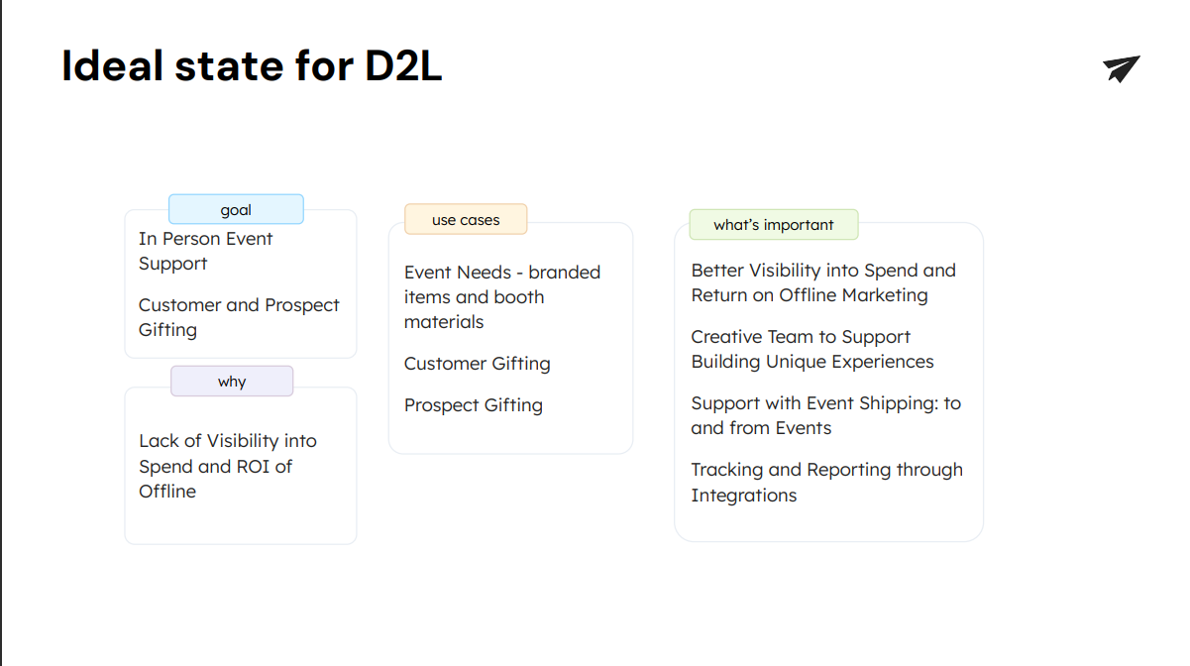

Slide 11
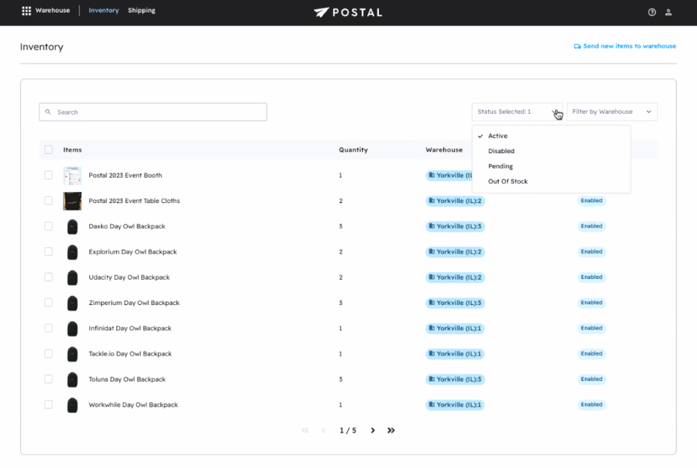
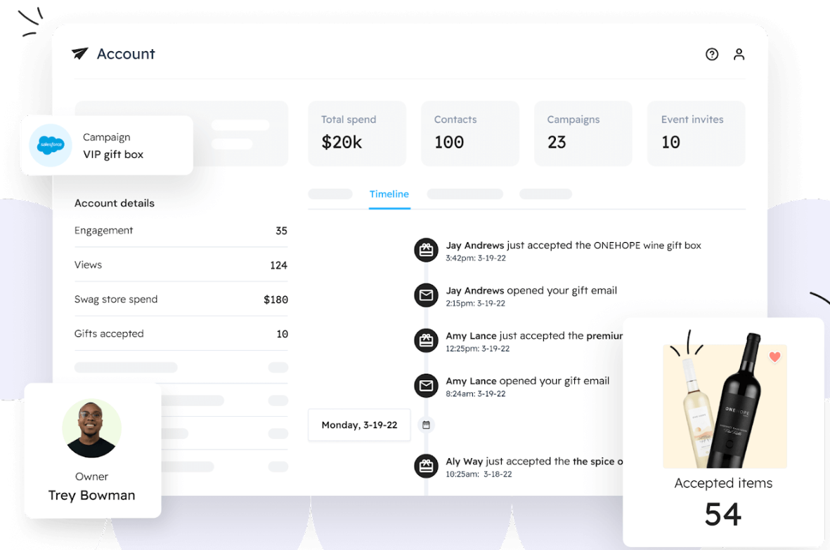
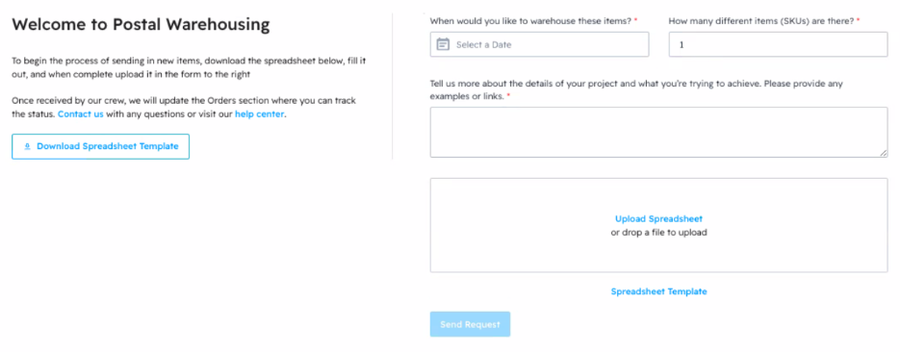

Slide 12

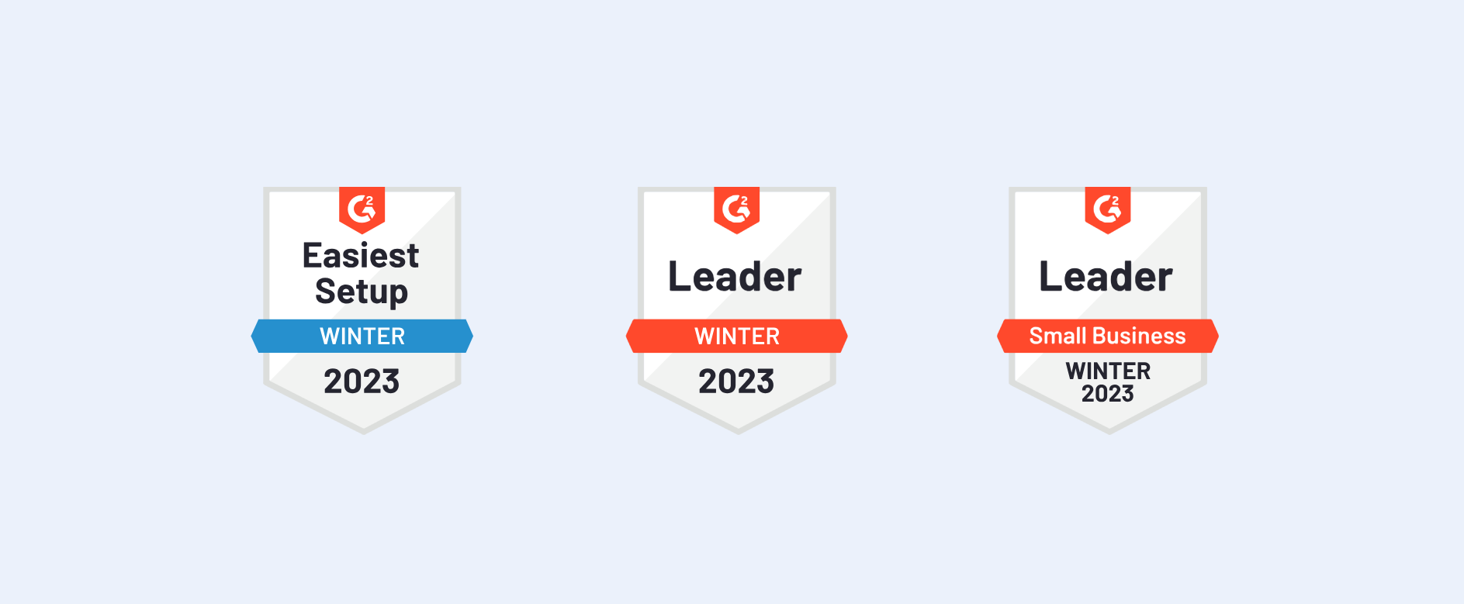
Piscataway,
NJ
What They Offer
Free platform
Design
Storage
Assemble
Ship
Swag Storefront
“The Swag Platform For The Modern Workplace
Create, Automate & Distribute Swag Globally”
Notes:
Their platform is free – charge on subscription basis if you want access to more within the platform
Design: helps design the swag for or can collaborate. Just send them brand guide and logos and they take care of the rest
Storage We offer simple storage fees and a Dashboard to manage it all!
Assemble: They assemble everything , special packing requests
International Shipping – 3 warehouses
Swag Storefront

Slide 13

Key Takeaways
3rd Party Item warehousing
Budget allocation ahead of time, before transaction
No access management
Not much information shared on sales call/ post call email
Notes:
Sustainability: Ecofriendly packaging and products

Slide 14
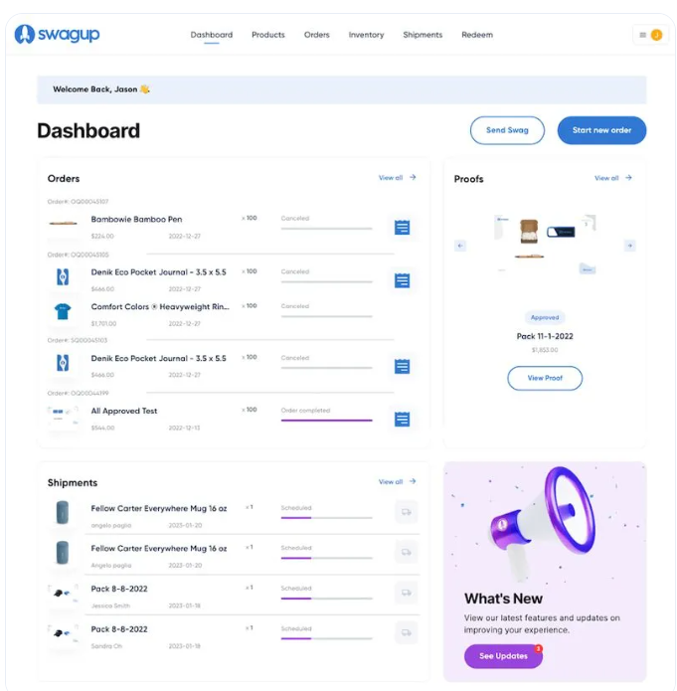

Slide 15





Seattle,
WA
What they offer
Consulting & creative services
Warehousing & Fulfillment
Swag Stores & Portals
“Make, manage, warehouse and send amazing swag, all from a single platform”
Notes:
Ability to source swag, get designs made and buy swag items
Warehousing our products and bought products and shipping fulfillment
Swag storefront, to sell our swag

Slide 16

KEY TAKEAWAYS
Free warehousing, premium service
Single inventory management system
In-house print shop + vendor sourcing
Full cost transparency
Forum & training
Poor and outdated UI
Notes:
Free warehousing with premium service – 3 point accuracy counts, Swag Closet – Virtual Warehouse – RETURN LABELS AND SENDBACKS, Kotis Customer Service for front end and back-end support, Quality Assurance for damaged swag, Flagging of swag for low inventory and damages for replacement
2 Facilities in Ohio/ Utah - (UPS, FedEx, USPS, DHL, LTL), 2 day ship – fastest method
All their stores and portals are tied together with a single inventory management system that feeds the listings on each portal. You choose access levels, products displayed and pricing for each portal
Salesforce Integration
Redeem Page – for events, unique swag/ link
Full cost transparency
Access management for all departments
POC – Account Manager, Program manager and CSM Exec
seems very cost effective however UI does not seem categorized and user friendly.
Eco-packaging, biodegradable materials – tape, mailers,

Slide 17
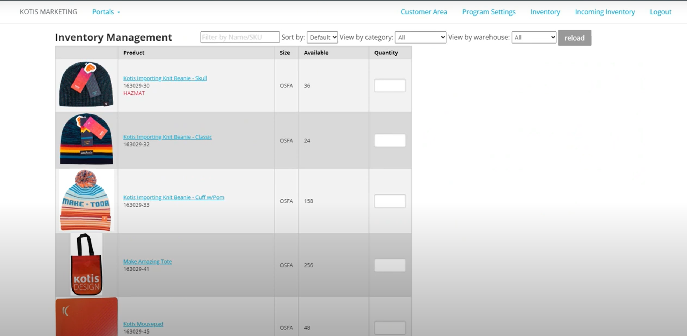
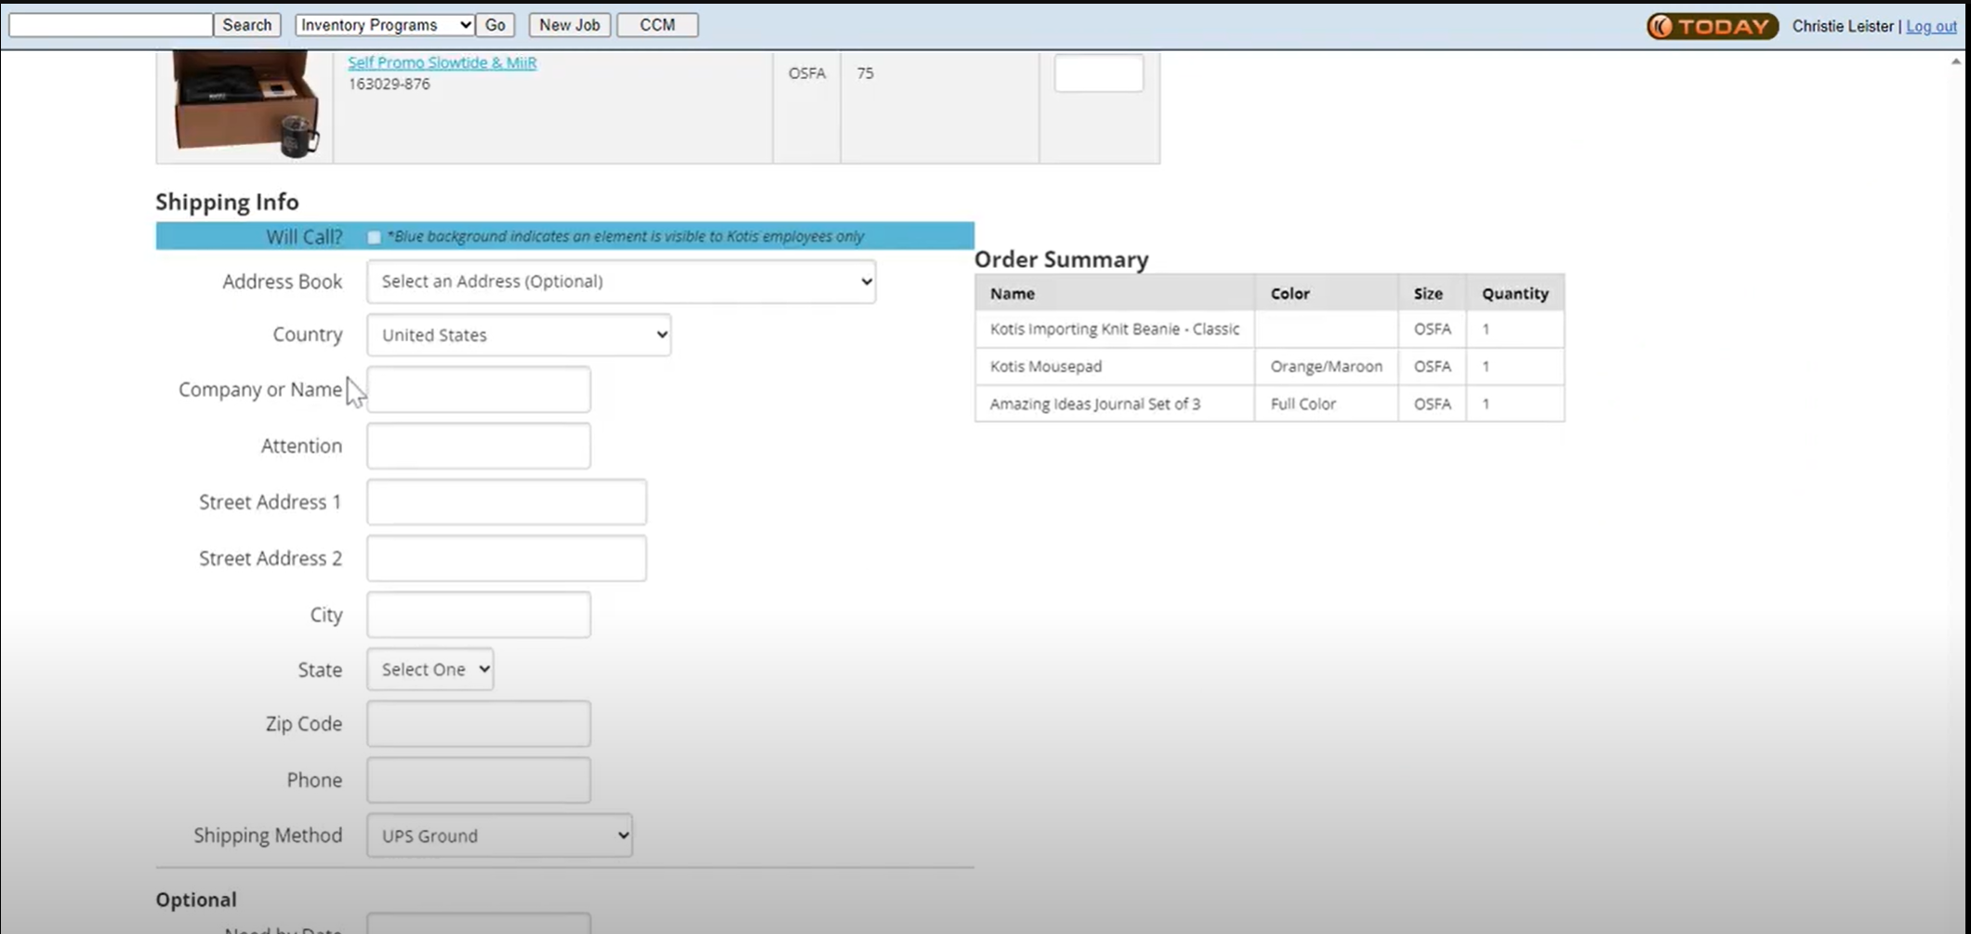

Slide 18

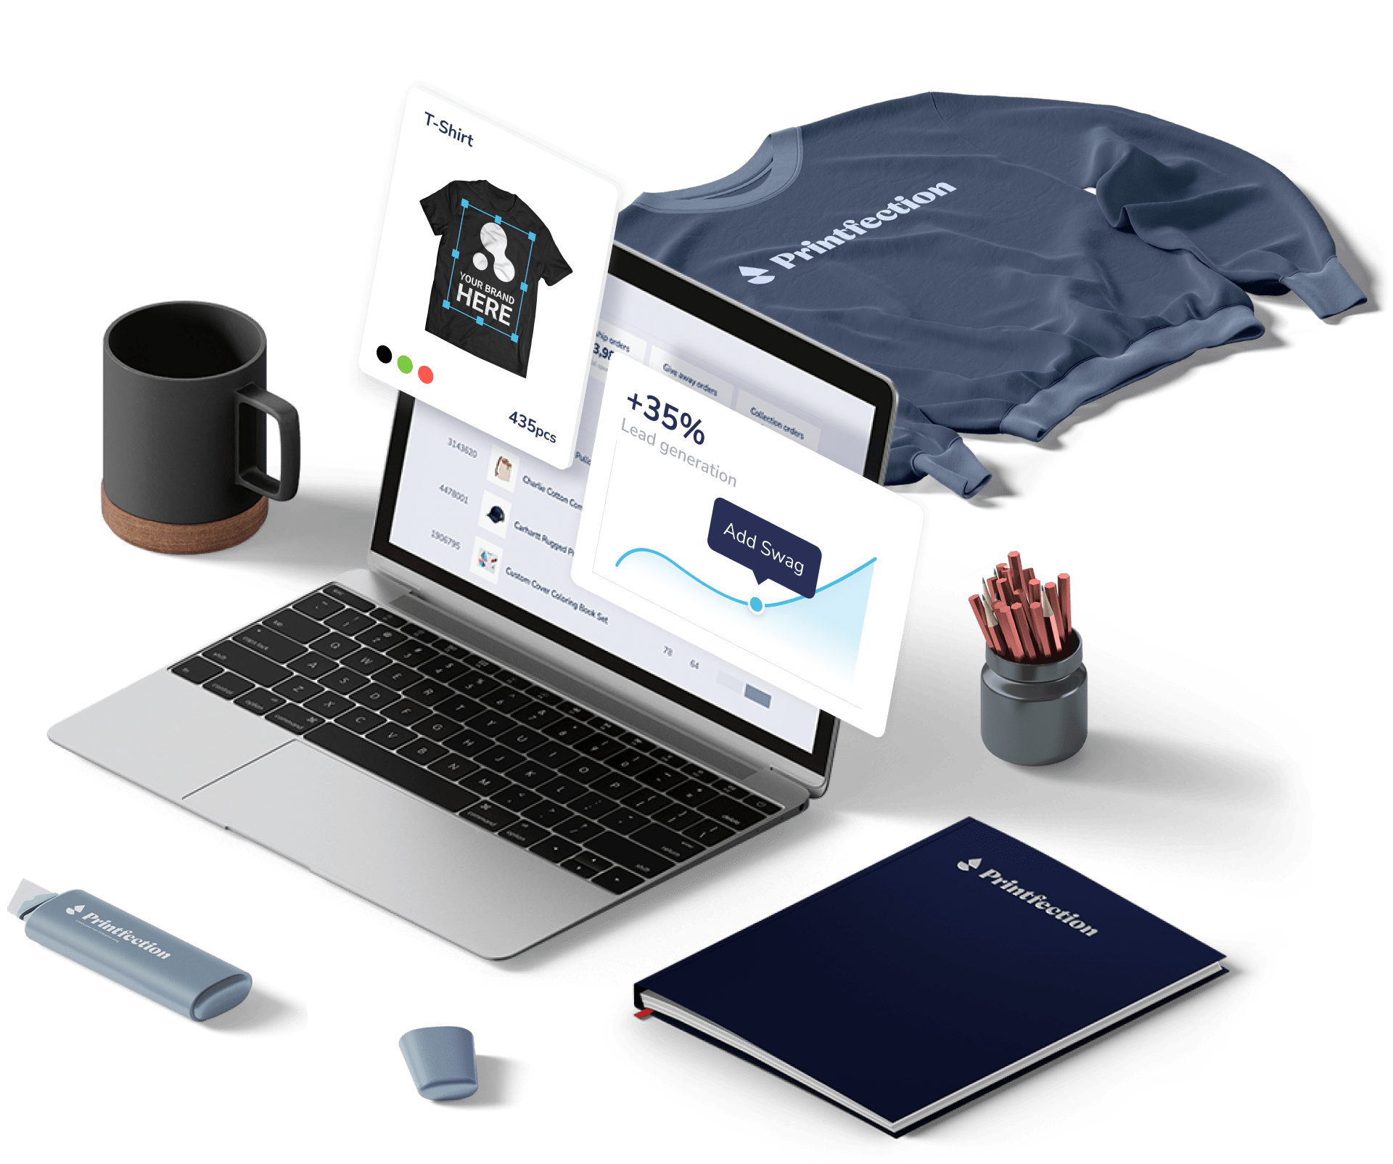
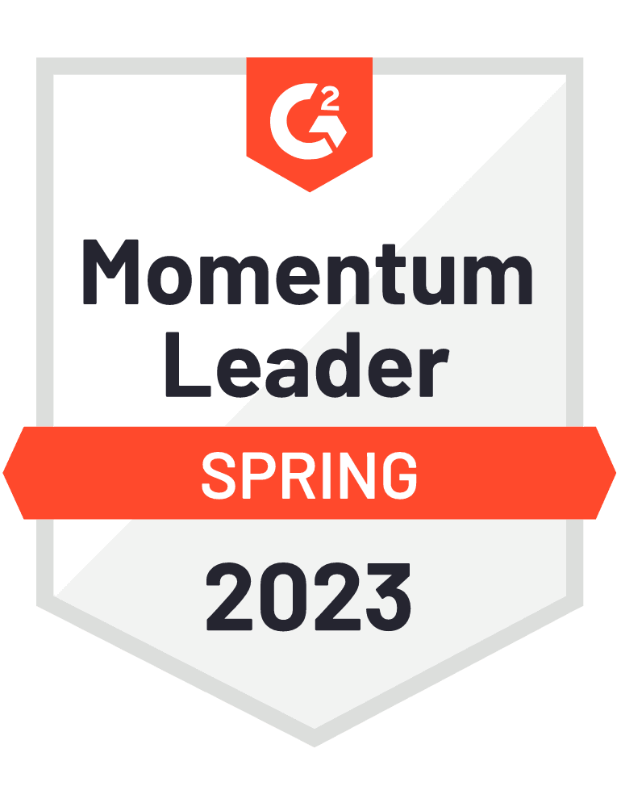
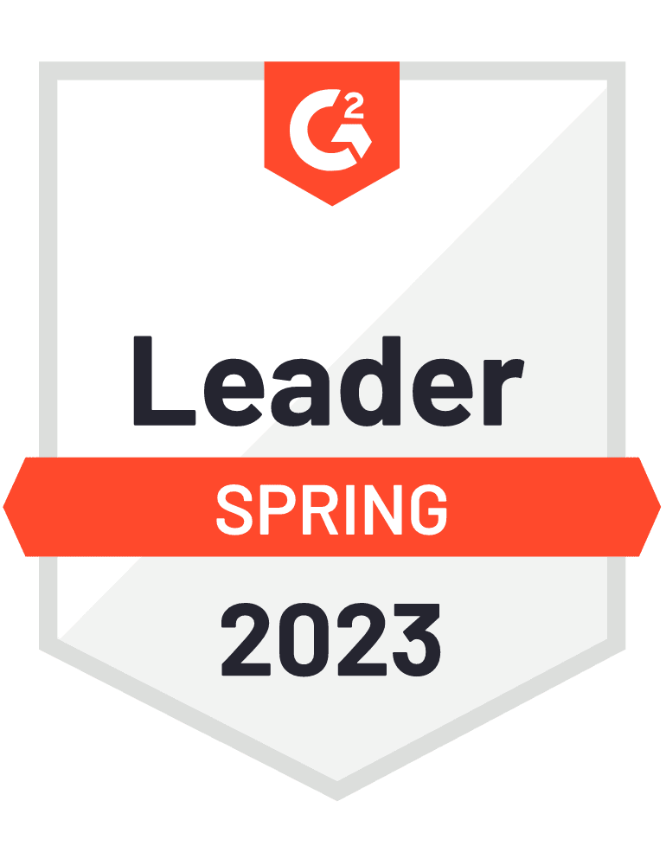
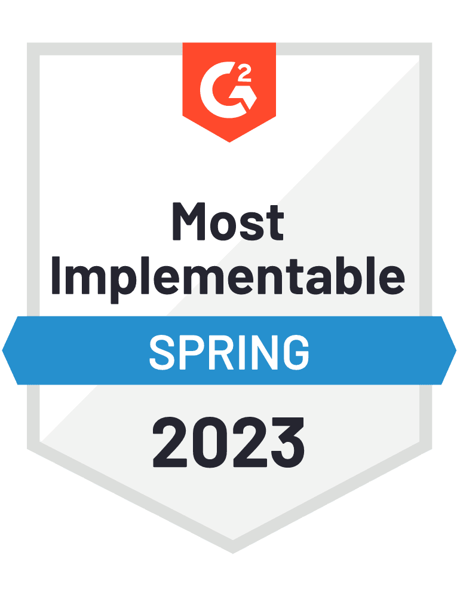
Denver,
CO
What They Offer
Drop Shipping & Events
Printing
Giveaways
Kitting
Swag stores
Warehousing
“Say goodbye to swag logistics headaches and experience a fully featured swag management platform.”
Notes:
Dropshipping and events: Shipping services with vetted vendors
On demand printing – Ability to print merch/ source different merch for our needs
Giveaways and kitting: Gifting – customers, potential leads, custom made swag kits – across all departments – trade shows, leads, new employee (onboarding), landing page services
Swag storefront – integrate shopify to sell our company merch
Warehousing: Own warehouse 1 warehouses, full control in Colorado, ships with UPS

Slide 19

KEY TAKEAWAYS
Full scale inventory management
On demand printing and swag sourcing
Shipping fulfillment
Reporting
Integrations
Willing to negotiate pricing based on our needs
Notes:
Trade show experience
Full scale inventory management support with access management, sophisticated back end and cost breakdowns – Account manager, merchandise specialist and CSM, accept 3rd party items, archive items, inventory alerts
Printing on demand for events – free samples, sourcing different vendors for best price/ products, mockups, etc.
Shipping fulfillment – international shipping – they take care of taxes, customs fees, forms, use UPS, event packing, exact date delivery – organized and sorted according to size, labelled etc
Reporting – Budget setting, budget codes, campaign summary and spend, full reports on orders, campaigns, item usage, accounting – full visibility
Integrations – Salesforce, marketo, budget code integration
Sent the most information – full pdf, video, resources
Ecofriendly packaging, charity givebacks, recycled items, one tree

Slide 20
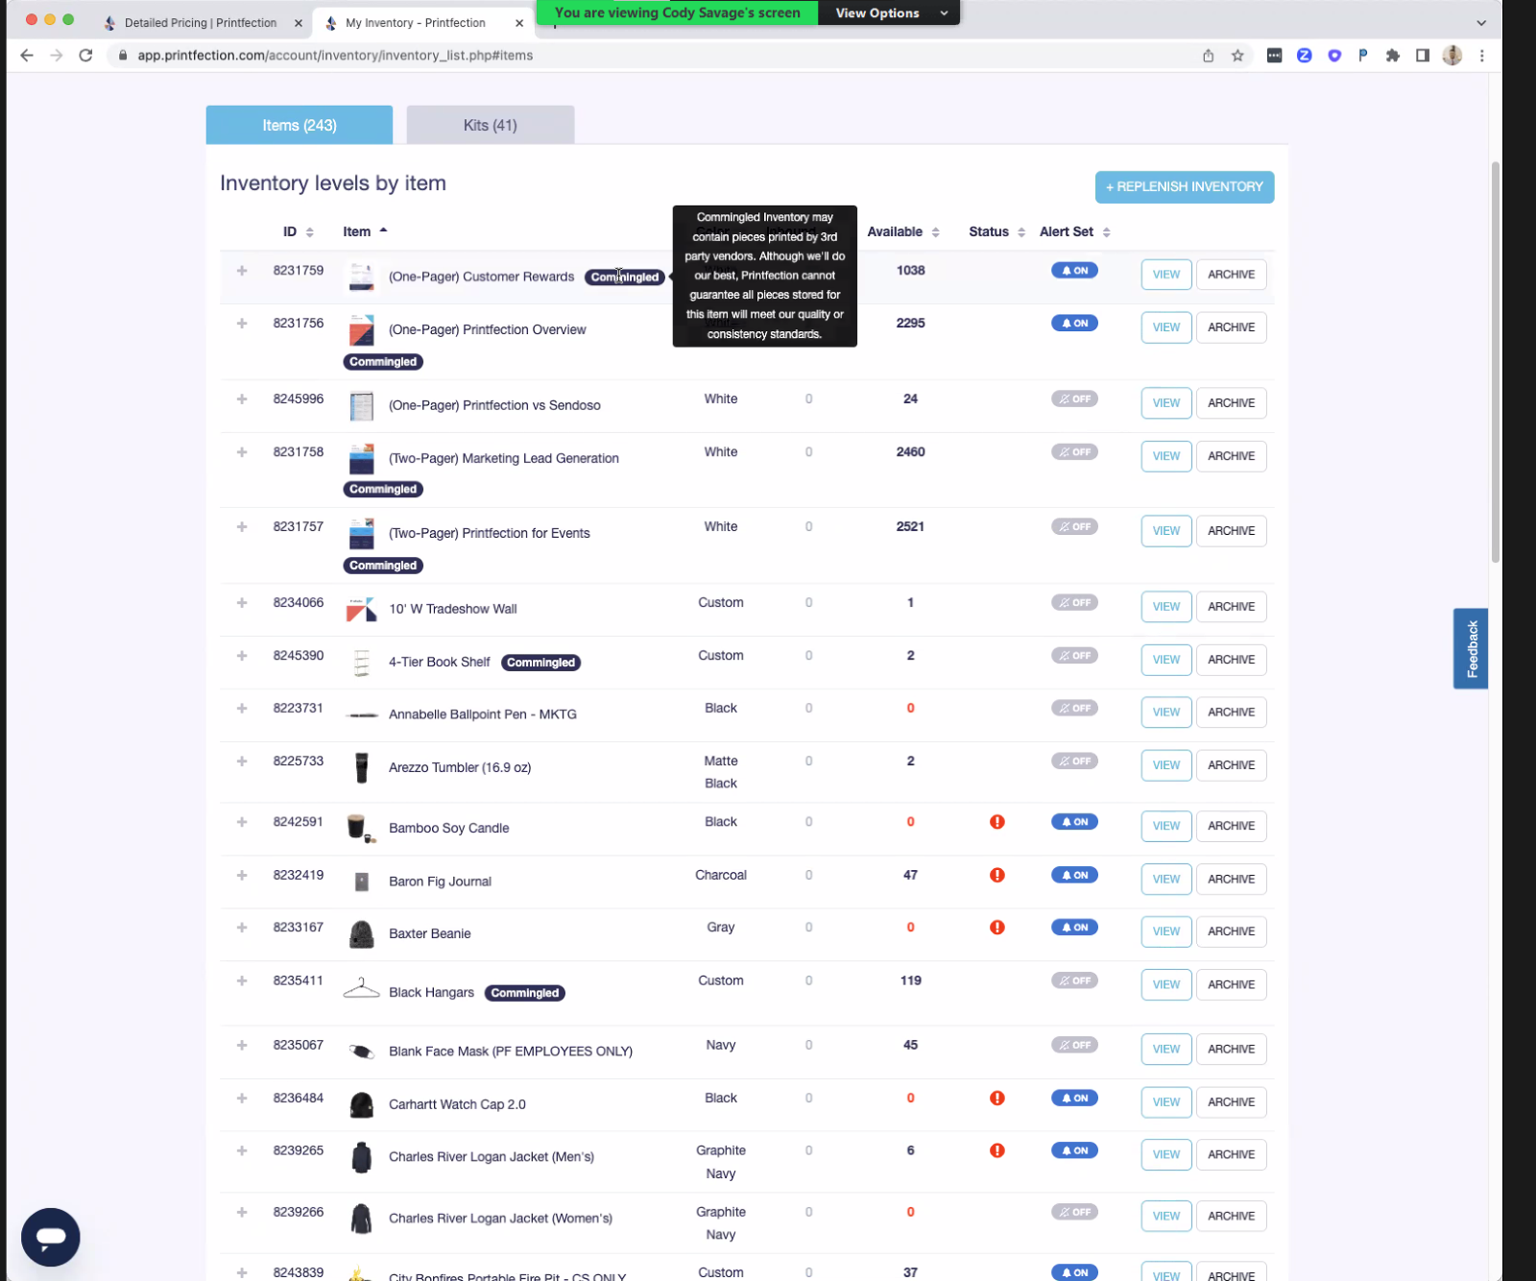
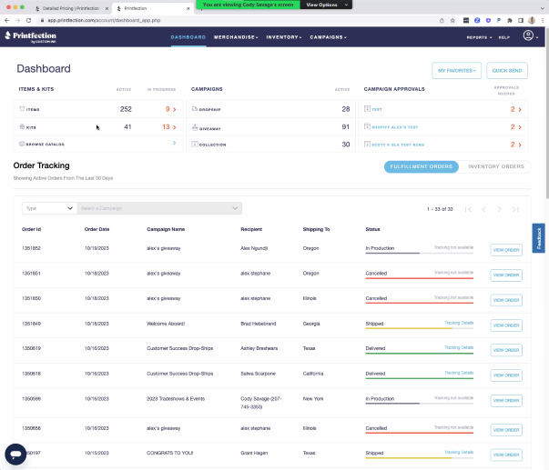
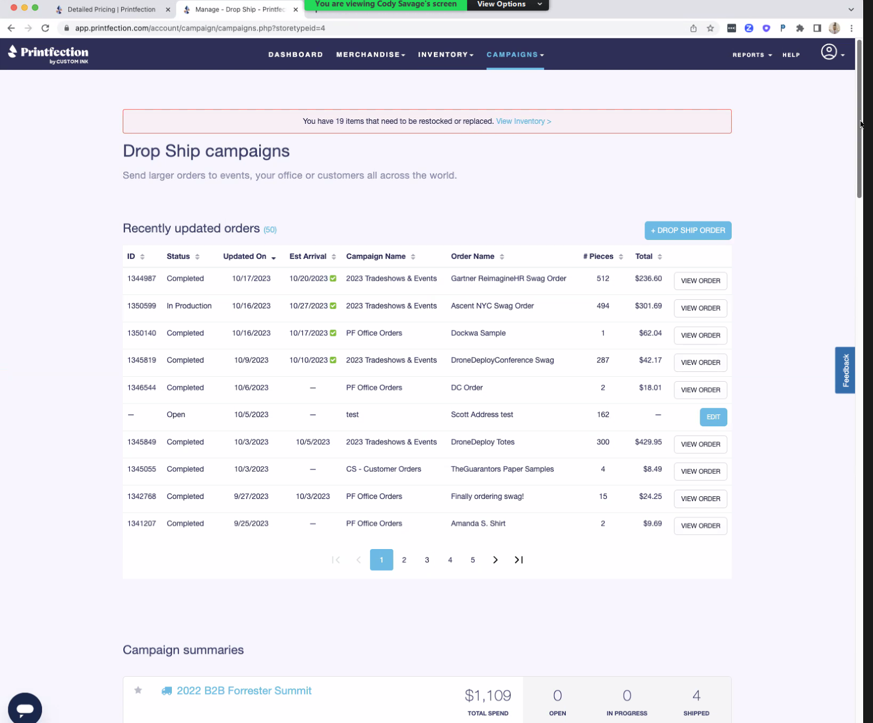

Slide 21


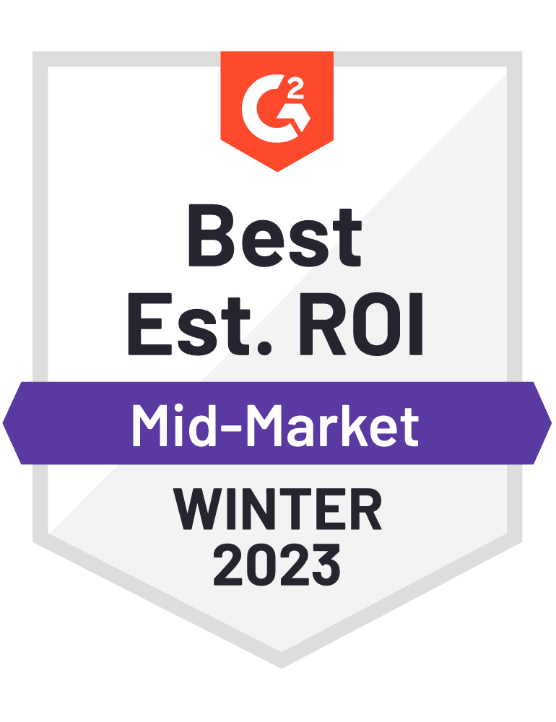
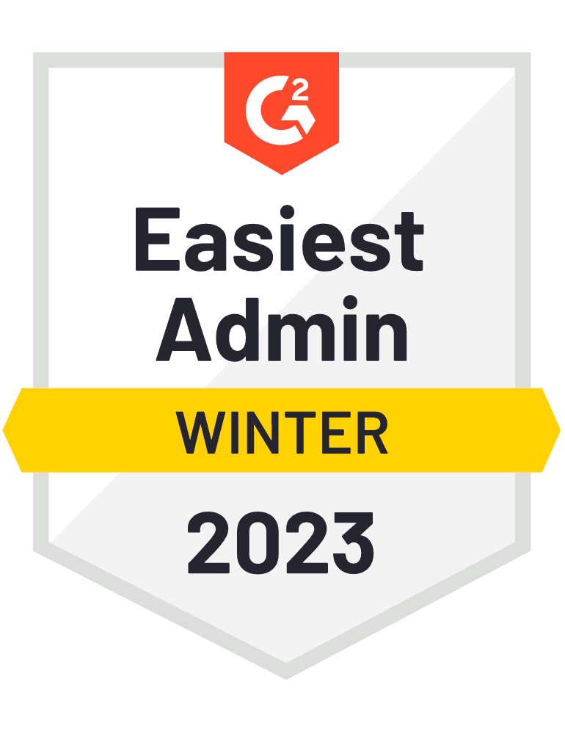
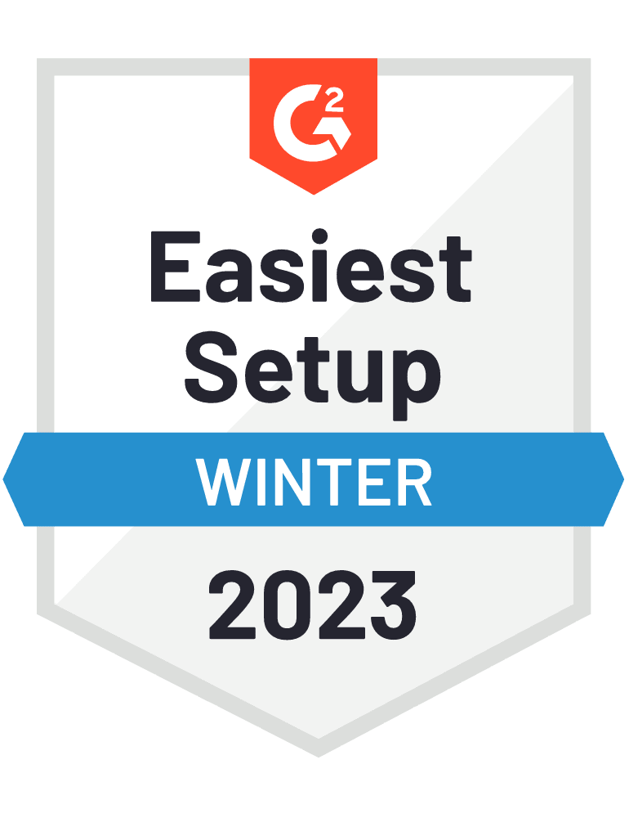
New York,
NY
What they offer
Inventory management
Gifting & Bundles
Storage and shipping
Merchandise Builder
ABX/ABM
“ROI, guaranteed.
Use data-driven gifting to grow your pipeline, close more deals, and create an exceptional customer experience with the world's first Allbound Engagement Platform.”
Notes:
Full scale inventory management: Access management,
Gifting and Bundles: Event bundles, customer bundles, landing page, egifts
Storage and shipping: Store your swag with us and ship from a dedicated global network of 5 global warehouses, US, Canada, 2 in Uk, 1 in australia - Bulk Send
Merchandise builder: 5000 vendor network
ABX/ ABM: Account based marketing/ experience -. ABM strategies are most often used to locate, engage and grow high-level or key accounts – full visibility into tracking leads and sending them down the funnel

Slide 22

Key Takeaways
More focus on gifting and bundles
Logistics support
Inventory management
Integrations
Competitor analysis
Cost effectiveness
Credit/ Wallet based
Notes:
Focus: Spoke more about gifting, bundles, landing pages, ties into ABM/ABX marketing
Premium logistics support: full scale reporting, CSM, Account manager, ABX team, trainings, taking on tasks, handling shipping and shipping back
Inventory management continued: Automatic stock update, alerts, live chat, access management
Integrations: Salesforce, marketo, okta
Stood out: Spoke about competition and how they are better – better customer service
Cost effectiveness: Wallets but, annual sign up fee, warehousing included, no margins on sourced items, metrics oriented
Backend is not as sophisticated
minimize shipping emissions, work with sustainable vendors, limit waste - Featured partner: Rewards.Earth

Slide 23
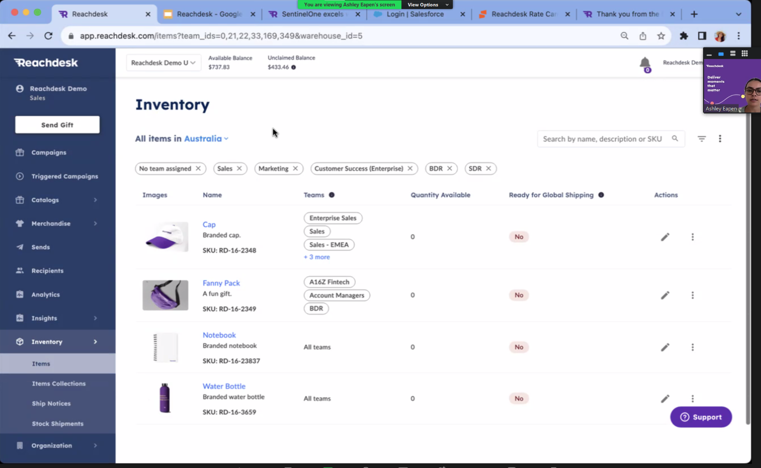
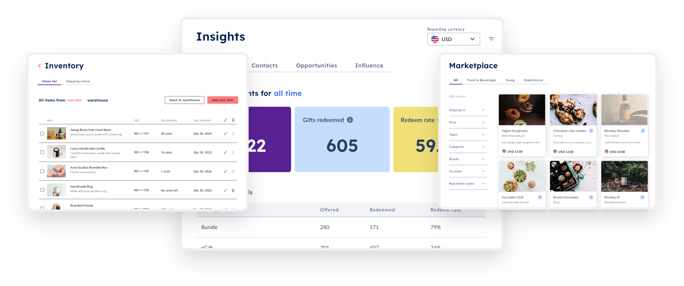

Slide 24



Inventory Management
Project Management
Shipping Services
User Portal
Customer Support
Sustainability
Notes:
Swag.com : No return labels/ sendbacks to warehouse
Do not hold third party items
Use Zapier – only salesforce trigger, no marketo
Postal: No notifications for damaged items/ replacements YET
No Budget code payment method, balance based – open to change this kinda
Complex pricing structure
Swagup : No access management
Not much information shared on sales call/ post call email
Not a lot of services offered backend – as free platform
Kotis Design: Poor and outdated UI
Printfection:
Reachdesk: Credit/ Wallet Based – Open to negotiate

Slide 25


Slide 26
My Recommendation
Notes:
Backend
Best fit
Other companies are good, postal and reachdesk but they focus more on gifting experiences
In our case we need a sophisticated backend portal to make EIAB requests specifically for tradeshows and events, everything else is an addon bonus
They have the right integrations, right reporting and full transparent cost breakdowns for our services. They also do invoice budget code based payments as we were already used to it, other companies require credit/balance upfront
Kotis design was also a great choice, however their user portal lacked options and things we can do within
This I feel is the best possible choice for us across the 3 companies that came on top.
Moreover they also provided me with the best resources such as training video,
Drawbacks and limitations: Only me on the sales calls more than criteria – they were clearly trying to upsell me, first time doing this, cost structure of STAR, how much we can save with alternative
That being said, I still think we can negotiate certain term with other companies if they can fit our requirements better – we can schedule further calls and go from there
If we are considering international shipping as well, then reach desk would be a better option

Slide 27




Slide 28
Questions? Comments?
Your thoughts?

Slide 29
THANK YOU!

