Slide 1

Notes:
Reach for the top

Slide 2
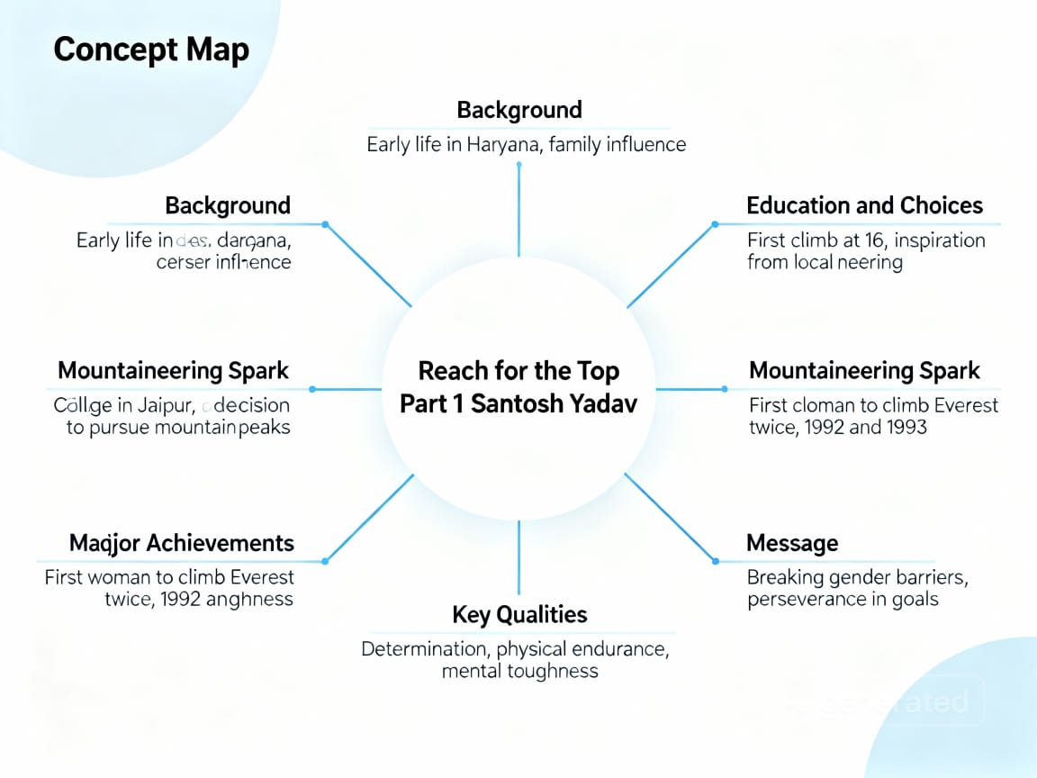

Slide 3
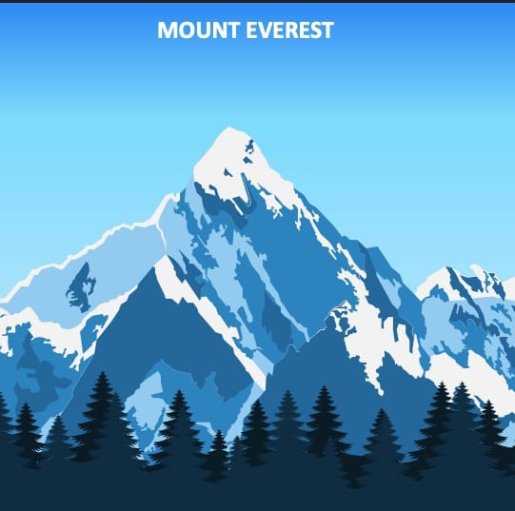
Word Web
Determined: Firm in purpose
Courageous: Willing to face danger
Compassionate: Showing concern and kindness for others
Trailblazer: Someone who leads the way for
Others
5.Environmentalist: A person who cares about protecting nature
Notes:
Word Web

Slide 4
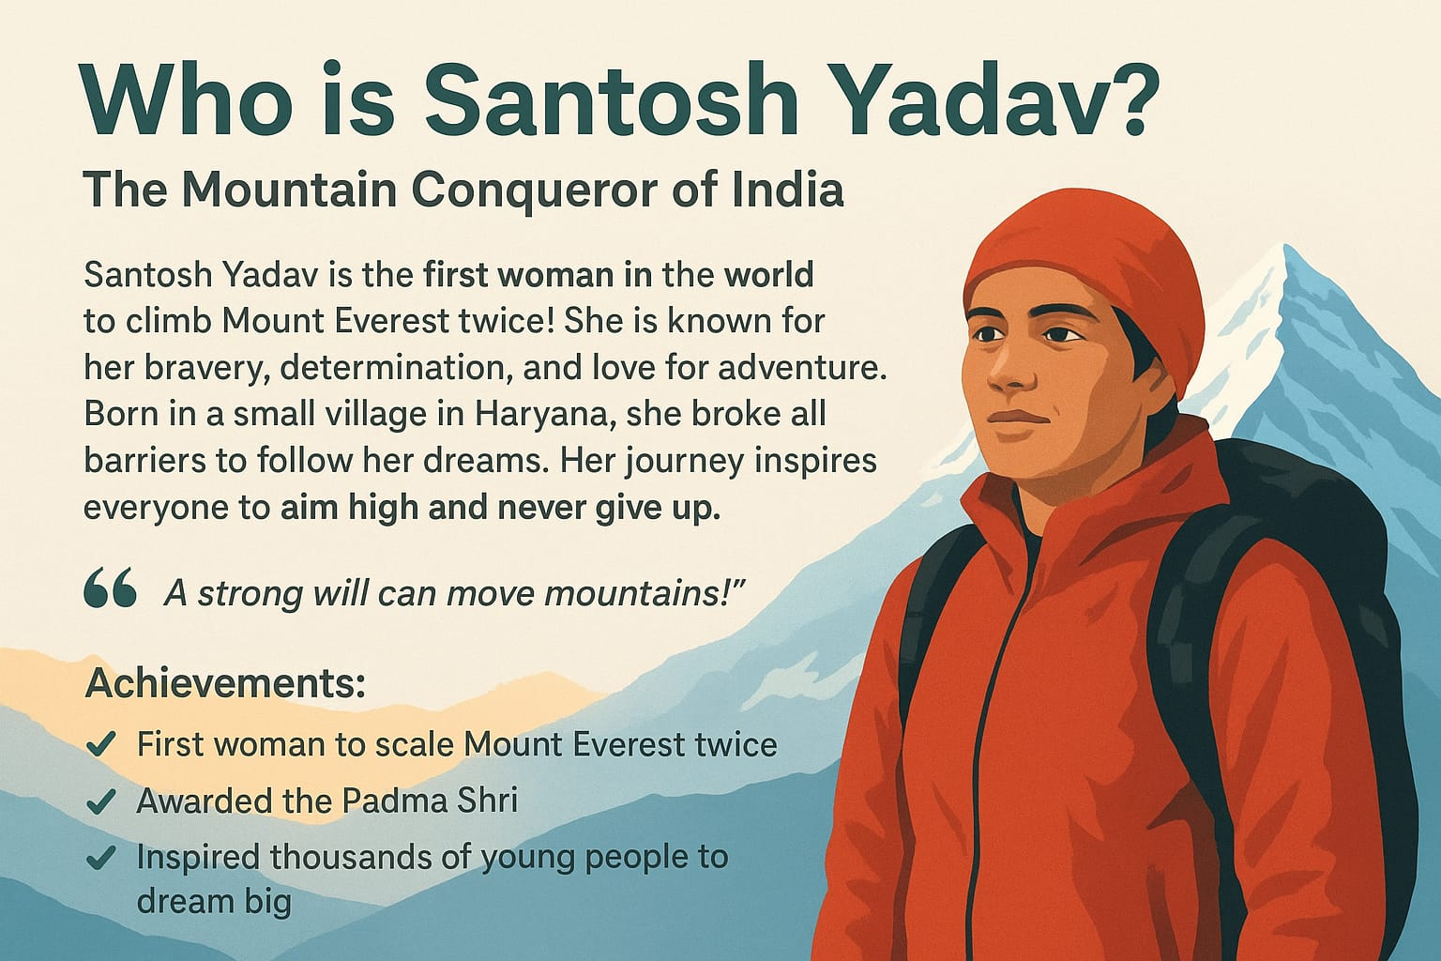

Slide 5
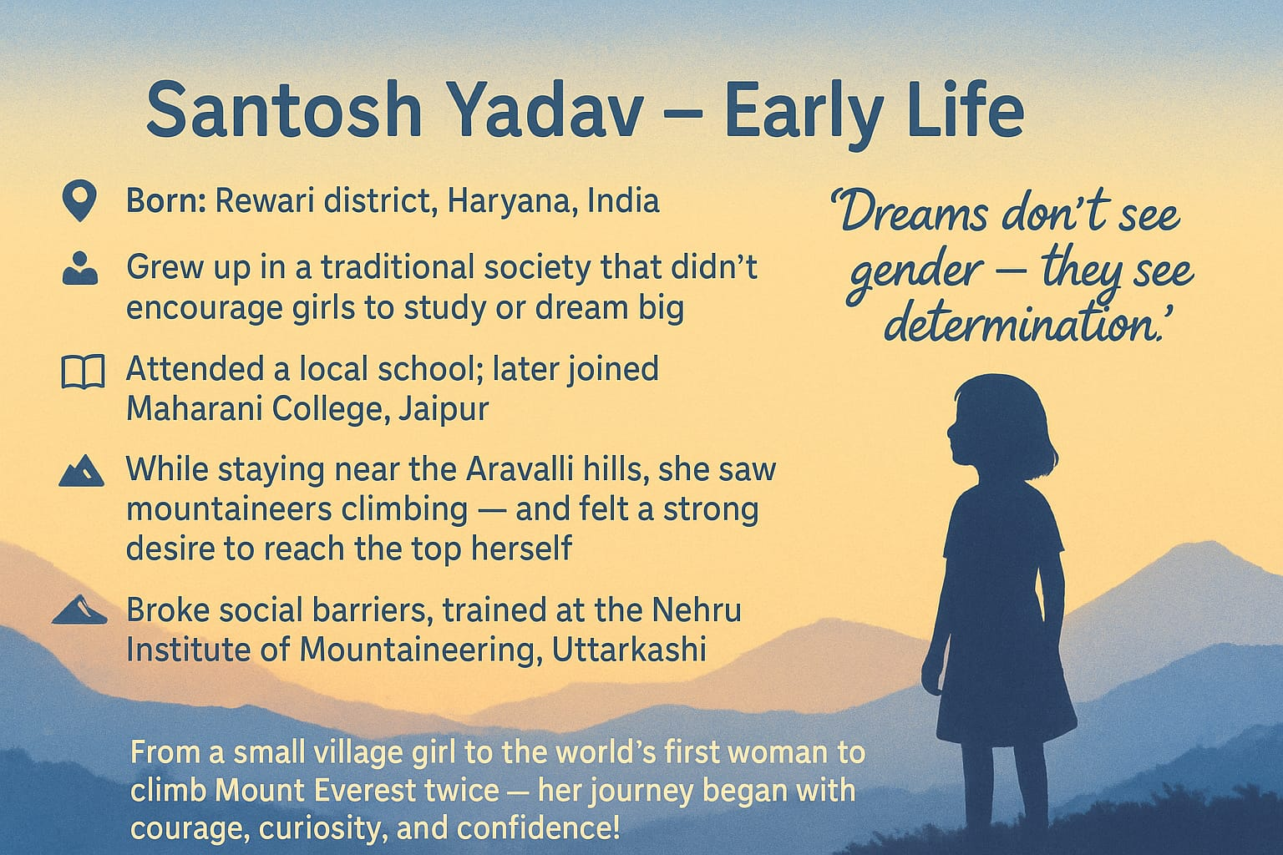

Slide 6
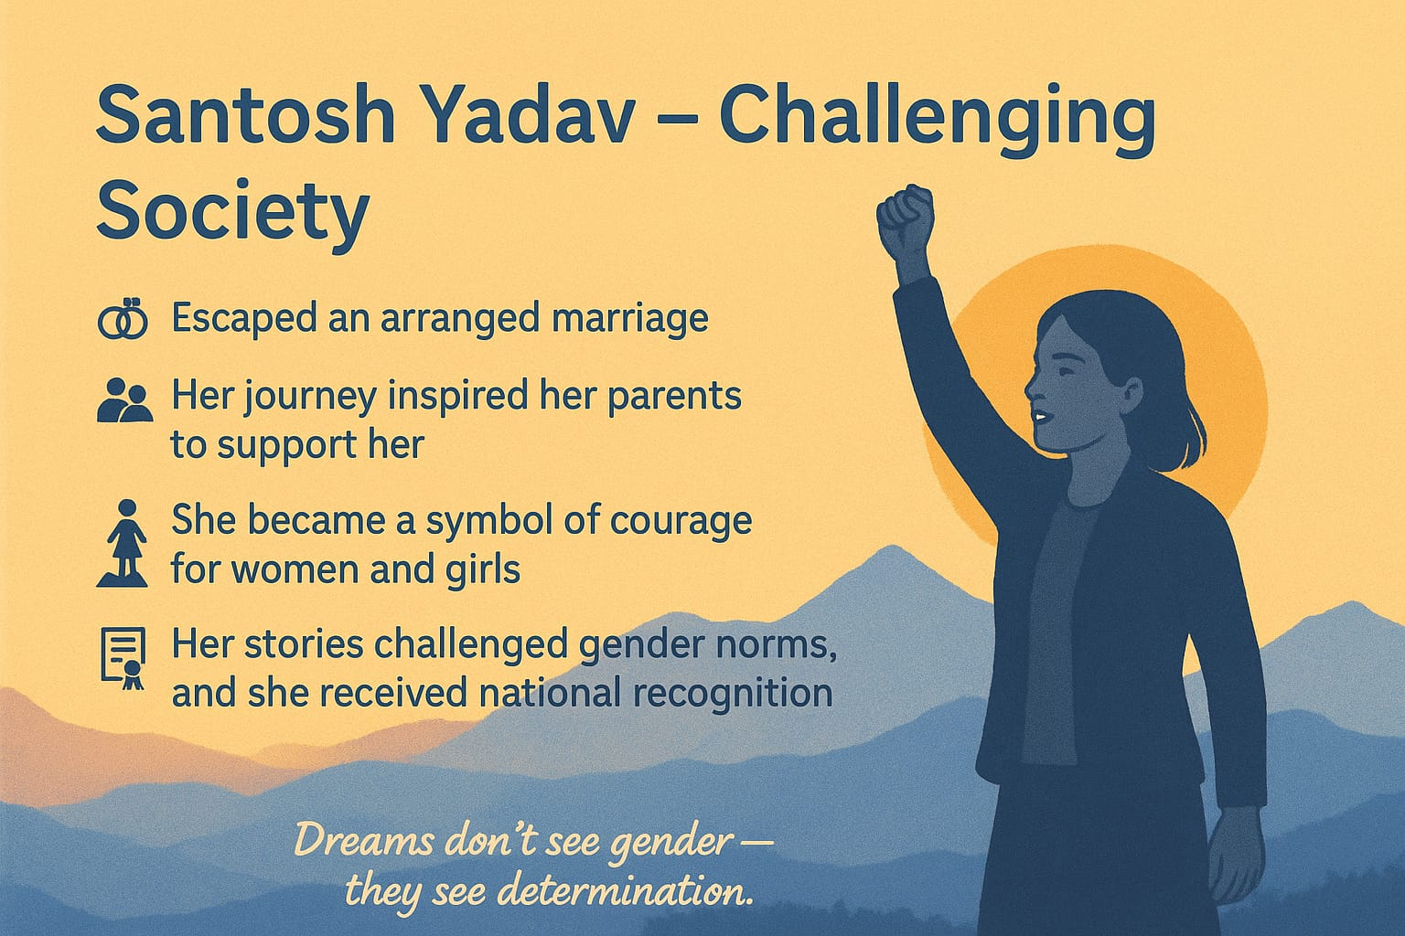

Slide 7
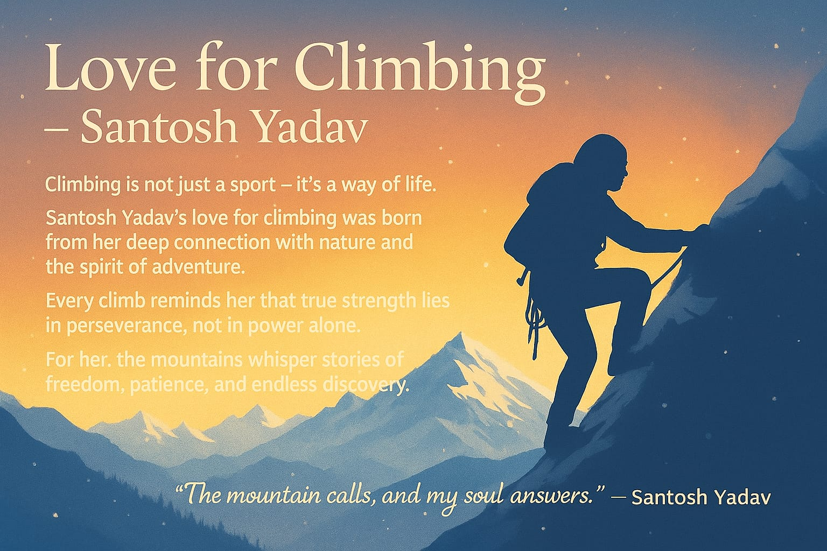

Slide 8
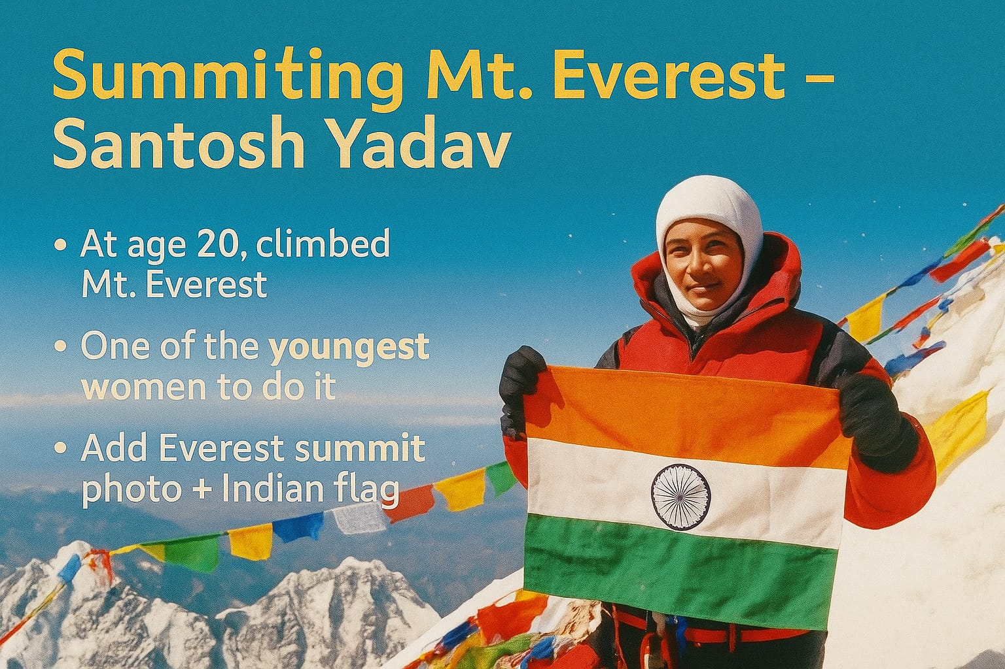
At the age 20, climbed Mt. Everest
One of the youngest women to do it
World record

Slide 9
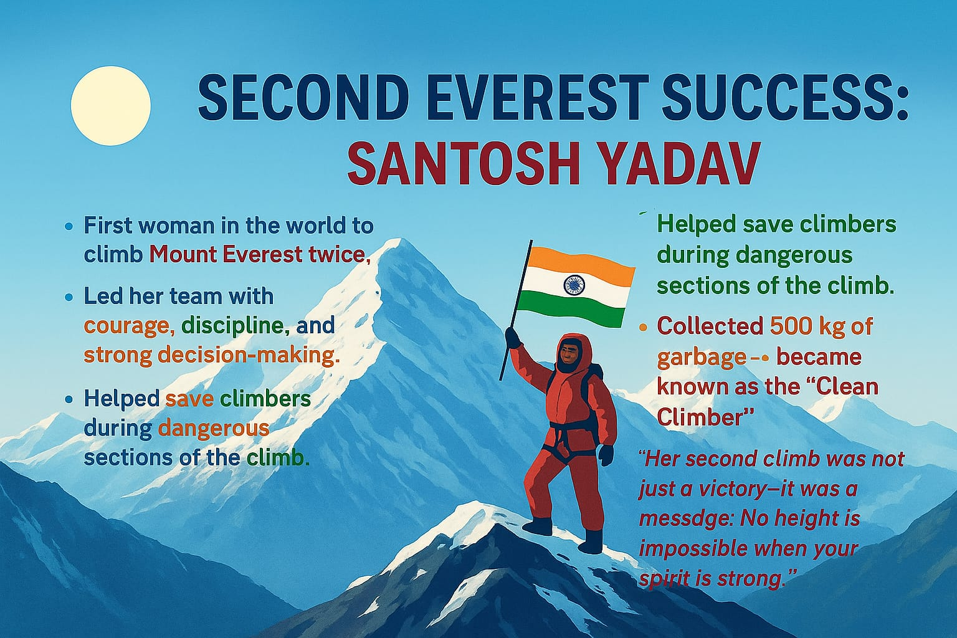

Slide 10
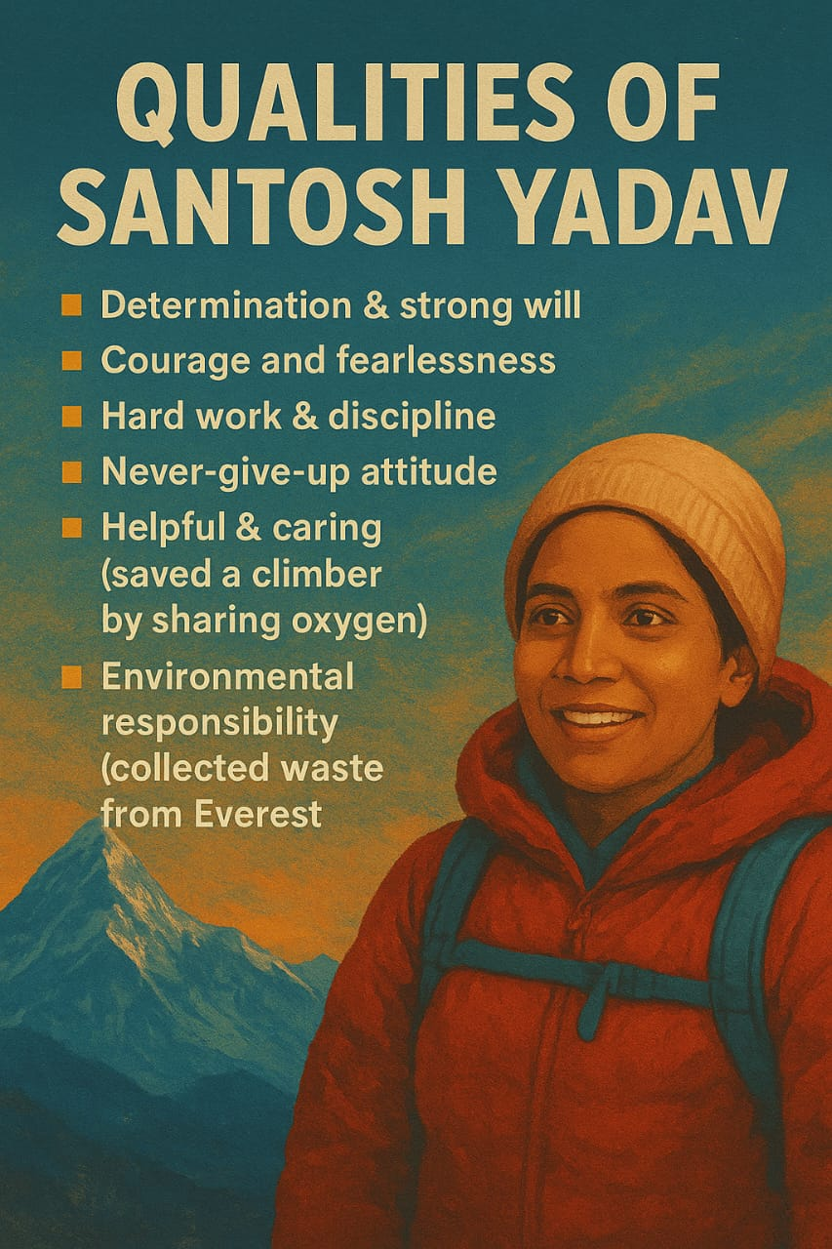

Slide 11

Message or moral of the lesson is
“Never let society decide your limits”
“ Hard work + courage = Success ”
Notes:
“ Hard work + courage = Success ”

Slide 12


