Slide 1
7
Library Portal
Final educational project: seven laboratory works in one Spring Boot application
Kuat Bektursyn
Group IT1-2409IS · RWPSF 3305 — Web Application Development with Spring Framework
IITU, Almaty, 2026
github.com/AkAyu44/library-portal
Notes:
Good afternoon. I am presenting the final educational project for the course Web Application Development with Spring Framework. It is one application, a library catalogue, which combines the topics and the individual variants of all seven laboratory works.

Slide 2
The idea: seven labs as seven layers
7
32
7
1
laboratory works
in one application
integration tests —
one per experiment
individual variants
implemented
shared BookService
for every layer
Technology stack
Domain
Java 25, Spring Boot 4.1.1 (Spring Framework 7), Maven 3.9
Spring MVC + Thymeleaf, Hibernate Validator
Spring AOP (AspectJ annotations), Spring Boot Actuator
Spring HATEOAS, springdoc-openapi 3 + Swagger UI
Book catalogue: list, details, add, delete
REST API /api/books (DTOs, HAL links, Swagger UI) and HTML pages /books
Two interface languages — EN and RU
Library Portal · RWPSF 3305 · Kuat Bektursyn
2
Notes:
All the labs were done in one repository, spring-lab-01, but each one on its own branch and as a separate demonstration. In the final project they become layers of one library catalogue: REST and MVC are the entry point, IoC assembles the application, configuration supplies the parameters, AOP adds cross-cutting behaviour, forms are the user interface and lab 7 turns the API into a documented contract. Everything works on one BookService, and every experiment from the reports is reproduced by an automated test.

Slide 3
Architecture: where each lab lives
6
1·5·7
5·6
DispatcherServlet
@RestController + DTOs
@Controller + Thymeleaf
LocaleChangeInterceptor · ?lang=ru
BookMapper · HATEOAS · OpenAPI
BookPageController · /books
6·7
4
@ControllerAdvice
CGLIB proxy of BookService
HTML 404 · ProblemDetail 404/409
Audit(1) → Logging(2) → Timing(3) → CallTracing
5
2·3
3
BookRepository
NotificationService
CitationCache
in-memory, ConcurrentHashMap
@Primary EmailNotifier ← app.mail
app.cache.ttl / max-entries
Library Portal · RWPSF 3305 · Kuat Bektursyn
3
Notes:
A request enters the DispatcherServlet. The LocaleChangeInterceptor from lab 6 selects the language. The REST controllers from labs 1, 3, 5 and 7 return JSON — lab 7 adds request and response DTOs, a mapper and HATEOAS links — the page controller returns a Thymeleaf view name. Errors are split between two ControllerAdvice classes. Below is the CGLIB proxy of BookService, through which the four aspects from lab 4 pass. The service itself uses the repository, the notifications from lab 2 and the citation cache, whose parameters come from the configuration of lab 3.

Slide 4
Spring Boot and the first REST controller
Lab 1 · V7
Project: Spring Initializr, parent POM 4.1.1, Java 25, Maven Wrapper
Starters: webmvc (Tomcat and Jackson come transitively), DevTools
HelloController: @RestController, @GetMapping, @RequestParam, @Value
Endpoints: /api/hello, /api/info
Variant 7: /api/wordcount — words, characters, longest word
web/HelloController.java
@GetMapping("/wordcount")
public WordCount wordCount(
@RequestParam(defaultValue = "") String text) {
String trimmed = text.trim();
if (trimmed.isEmpty())
return new WordCount(0, 0, "");
String[] words = trimmed.split("\\s+");
...
Input text | wordCount | characterCount | longestWord
Hello World | 2 | 11 | Hello
Spring Boot is very interesting | 5 | 31 | interesting
(parameter omitted) | 0 | 0 | ""
Library Portal · RWPSF 3305 · Kuat Bektursyn
4
Notes:
Lab 1 set up the environment and the first project. From it the final project keeps the parent POM, the webmvc starter, DevTools, the Maven Wrapper and HelloController. Individual variant 7 is the wordcount endpoint: it counts words and characters and finds the longest word. If the parameter is missing, defaultValue is an empty string, so the answer is zeros instead of a 400 error.

Slide 5
IoC container: beans, injection, scopes
Lab 2 · V8
1
2
3
99
Variant 8 · HtmlNotifier
input: Hello <world>
output: <p>Hello &lt;world&gt;</p>
Angle brackets are escaped instead of being interpreted as HTML
console
email
html
noop
@Order(1)
@Primary
V8 · escape
@Fallback
List<Notifier> is ordered by @Order: console → email → html → noop
@Primary / @Qualifier / List / Map — 4 ways to pick a bean
@Bean reportDateFormatter — a JDK class without @Component
LifecycleDemo: constructor → @PostConstruct → @PreDestroy
Ticket (prototype): a new instance only through ObjectProvider
How it is used in the project
BookService.create() sends «New book in the catalogue» through the @Primary EmailNotifier, which reads app.mail.* from lab 3
Library Portal · RWPSF 3305 · Kuat Bektursyn
5
Notes:
Lab 2 is about the IoC container. There is a Notifier interface with four implementations. Email is marked Primary, noop is Fallback, and Order defines the order in the list. NotificationService receives them in every possible way: through Primary, Qualifier, List and Map. Variant 8 is HtmlNotifier, which escapes angle brackets. In the final project this is not just a demo: when a book is added, the service sends a notification through the Primary bean. There is also a @Bean for DateTimeFormatter, the bean lifecycle and a prototype Ticket bean obtained through ObjectProvider.

Slide 6
Configuration: YAML, profiles, properties
Lab 3 · V7
/api/config field | no profile | dev | prod
serverPort | 8080 | 8081 | 8080
mailRetryCount | 3 | 1 | 5
mailEnabled | true | false | true
cacheTtl (V7) | PT1M | PT30S | PT1M
cacheMaxEntries (V7) | 100 | 50 | 100
banner | no profile | DEVELOPMENT | PRODUCTION
config/AppProperties.java
@ConfigurationProperties("app")
@Validated
public record AppProperties(
@NotBlank String owner,
@Valid Mail mail,
@Valid Cache cache) {
record Cache(
@DefaultValue("1m") Duration ttl,
@Min(10) @Max(10000)
int maxEntries) {}
}
Property source precedence (strongest → weakest)
Actuator: /actuator/env/app.mail.retry-count shows the value and its source
Check: retry-count=99 → APPLICATION FAILED TO START
--arg
-D JVM
ENV
profile.yml
app.yml
Library Portal · RWPSF 3305 · Kuat Bektursyn
6
Notes:
Lab 3 is about external configuration. application.yml holds the shared values, dev and prod override them. AppProperties is a record with ConfigurationProperties and Validated: with retry-count set to 99 the application does not start. EnvironmentBanner shows that for any combination of profiles exactly one bean exists. Variant 7 is app.cache. In the report it was only printed in JSON; here CitationCache really caches citations by ttl and max-entries. Precedence: a command-line argument beats a JVM system property, which beats an environment variable, which beats the files.

Slide 7
Spring AOP: cross-cutting concerns
Lab 4 · V8
AuditAspect @Order(1) · @Around(@annotation)
Real log · deleteBulk(viaProxy=true)
LoggingAspect @Order(2) · @Before / @AfterReturning / @AfterThrowing
[AUDIT] start BOOK_DELETE [3]
[LOG] -> BookService.delete(..) args=[3]
[TRACE] -> BookService.delete(..)
[TRACE] -> CitationCache.evict(..)
[TRACE] <- CitationCache.evict(..)
[TRACE] <- BookService.delete(..)
[TIME] BookService.delete(..) - 1 ms
[AUDIT] BOOK_DELETE success
[TIME] SLOW: BookService.statistics() - 301 ms
TimingAspect @Order(3) · @Around + proceed()
BookService.delete(id)
CGLIB proxy:
BookService$$SpringCGLIB$$1
deleteBulk(ids, viaProxy) | BOOK_DELETE records
false → this.delete() | 0 (proxy bypassed)
true → self.delete() | 2 (through the proxy)
V8 Call Tracing: @Before increases and @After decreases the ThreadLocal depth — the indent shows the nesting
Library Portal · RWPSF 3305 · Kuat Bektursyn
7
Notes:
Lab 4 is AOP. Pointcuts is a library of named pointcuts: public methods of the service package. The aspects are ordered: audit is the outermost, then logging, then timing. Auditing applies only to methods carrying the Audited annotation. The service is a CGLIB proxy, which /api/system/proxy shows. Self-invocation: if deleteBulk calls this.delete, there is no audit; through self there is one record per id. Variant 8 is call tracing: a citation call, which calls CitationCache.get inside, produces a real nested indentation.

Slide 8
Spring MVC: routing and status codes
Lab 5 · V6
200
201
204
404
GET /api/books
POST /api/books
DELETE /api/books/2
DELETE again
list, ?author, ?limit
+ Location
deleted
already gone
400
405
415
406
GET /api/books/abc
DELETE /api/books
POST text/plain
Accept: xml
abc → long fails
wrong method
body media type
response media type
@RestController writes to the response body, @Controller returns a view name
Post/Redirect/Get + flash: no duplicate after F5
static/index.html and css/app.css — served without a controller
Variant 6 · citation
@GetMapping(value = "/{id}/citation",
produces = "text/plain")
→ Joshua Bloch (2018). Effective Java.
Library Portal · RWPSF 3305 · Kuat Bektursyn
8
Notes:
Lab 5 was done by my partner Gibrat Bekbaev; in the final project it became the base of the catalogue. A Book domain record, an in-memory repository, a service, a REST controller with five operations and a page controller with Thymeleaf. The key experiment is the status codes: each of 400, 404, 405, 415 and 406 points to the part of the mapping that did not match. Variant 6 is a citation as text/plain; with Accept application/json the answer is 406.

Slide 9
Forms, validation and error handling
Lab 6 · V7
1
2
3
4
5
6
Browser
WebDataBinder
@Valid
MessageSource
BindingResult
Thymeleaf
POST /books
title=
→ BookForm
typeMismatch
Hibernate
Validator
{book.title.
required} · ru/en
errors, no
exception
th:errors
th:errorclass
Variant 7 · publication date
BookForm is separate from the Book record — no id, no mass assignment
@NoDigits — a custom constraint; null is valid
messages(_ru).properties + ?lang=ru via SessionLocaleResolver
/books/999 → HTML 404 page (PageExceptionHandler)
/api/books/999 → application/problem+json (ApiExceptionHandler)
@PastOrPresent
@DateTimeFormat(style = "S-",
fallbackPatterns = "yyyy-MM-dd")
Locale | Input | In the catalogue
en | 5/9/06 | 9 May 2006
ru | 09.05.2006 | 9 мая 2006
Library Portal · RWPSF 3305 · Kuat Bektursyn
9
Notes:
Lab 6 is about forms. BookForm is a separate mutable class without an id, which protects from mass assignment. The path of an error message: the binder fills the form, Valid runs Hibernate Validator, the key in braces is resolved through the MessageSource for the current locale, the error goes into BindingResult, the controller returns the form and th:errors prints the text. There is a custom NoDigits constraint and two ControllerAdvice classes for pages and the API. Variant 7 is the publication date, whose format depends on the language. In the final project the same constraints also validate the JSON of the REST API.

Slide 10
REST API: DTOs, status codes and errors
Lab 7 · V7
BookRequest
BookMapper
Book record
BookMapper
BookResponse
JSON in · no id, no createdAt
toDomain()
service · repository · createdAt
toResponse()
JSON out · id + createdAt
Request | Success | Errors
GET /api/books | 200 · array | —
GET /api/books/{id} | 200 · HAL | 404
POST /api/books | 201 + Location | 400 · 409
PUT /api/books/{id} | 200 | 400 · 404 · 409
DELETE /api/books/{id} | 204 | 404, also the 2nd time
409 · application/problem+json
{
"type": ".../errors/duplicate-title",
"title": "Duplicate title",
"status": 409,
"detail": "A book «Effective Java» by
Joshua Bloch is already ...",
"instance": "/api/books",
"bookTitle": "Effective Java"
}
One advice: ApiExceptionHandler extends ResponseEntityExceptionHandler — the base class builds the 400 for an invalid body, we add 404 and 409; controllers have no try/catch
409, not 400: the request is valid but conflicts with the current state of the catalogue
Library Portal · RWPSF 3305 · Kuat Bektursyn
10
Notes:
Lab 7 turns the lab 5 controller into an API another team could use. What crosses the boundary is a DTO: BookRequest carries only what a client may send — no id and no createdAt — and BookResponse carries what the contract promises. BookMapper is the single place that knows both shapes and the Book record, so the controller has no conversion code. Every outcome has a deliberate status: 201 with a Location header for a creation, 204 for a deletion, 404 for a missing book — also on a repeated DELETE, because nothing changes on the server and the client learns there was nothing to delete — and 409 for a duplicate, because the body is valid but conflicts with the catalogue. All errors are RFC 9457 problem details from one advice.

Slide 11
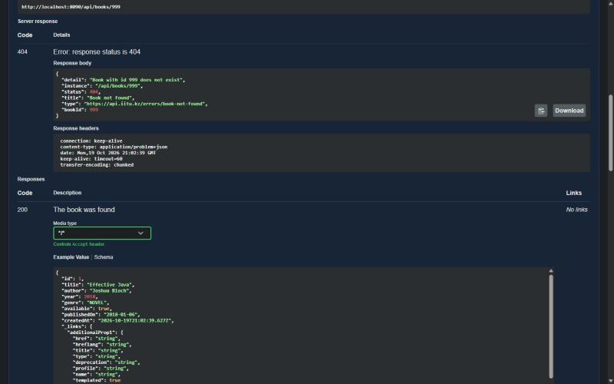
OpenAPI, Swagger UI and HATEOAS
Lab 7 · V7
Generated: paths, methods, parameters, DTO schemas
maxLength: 120 of title ← @Size(max = 120)
Annotated: @Tag, @Operation, @ApiResponses, @Parameter
Closed in prod: springdoc.*.enabled = false
Variant 7 · HATEOAS · application/hal+json
{ "id": 1, "title": "Effective Java", ...
"_links": {
"self": {"href": ".../books/1"},
"books": {"href": ".../books"},
"citation": {"href": ".../books/1/citation"}
} }
EntityModel.of(book, linkTo(...).withSelfRel(),
... withRel("books"), ... withRel("citation"))
Swagger UI · Try it out · GET /api/books/999 → 404, application/problem+json
Library Portal · RWPSF 3305 · Kuat Bektursyn
11
Notes:
springdoc-openapi 3.1.1, the line for Spring Boot 4, generates the OpenAPI document at /v3/api-docs and serves Swagger UI at /swagger-ui.html. Without a single annotation it already knows the paths, the methods, the parameters and the DTO schemas — even maxLength 120 of the title, taken from @Size. The annotations @Tag, @Operation, @ApiResponses and @Parameter add what the code cannot say: summaries, the meaning of each status code, examples. Here Swagger UI executes GET /api/books/999 and shows the 404 problem detail. Under the prod profile the document and the page are switched off. My variant 7 is HATEOAS: GET of one book returns an EntityModel in HAL format with links to itself, to the collection and to its citation.

Slide 12
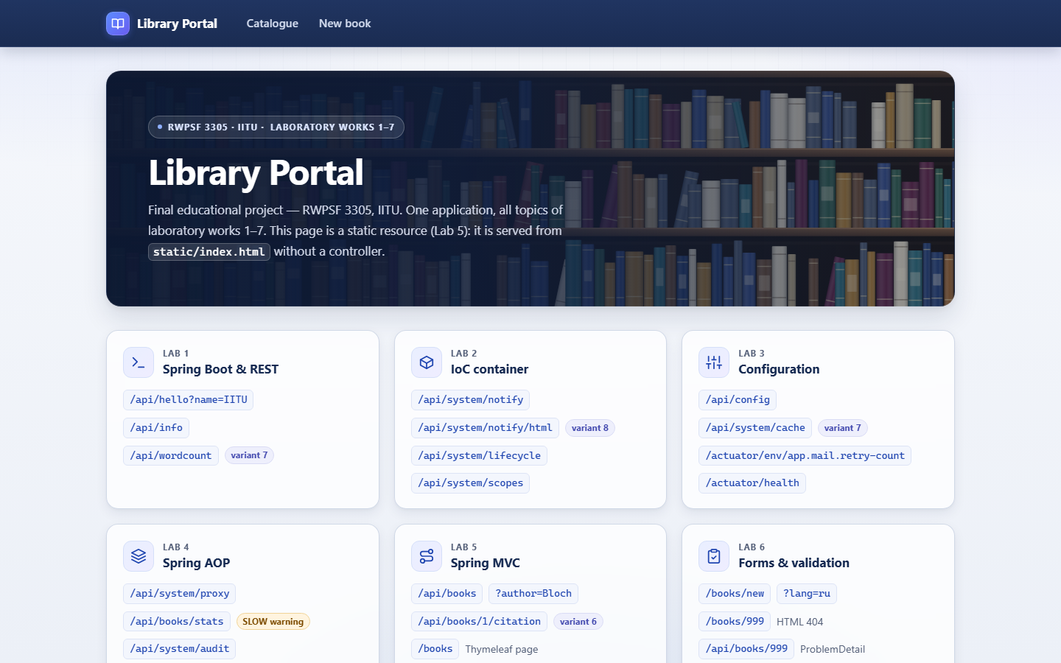
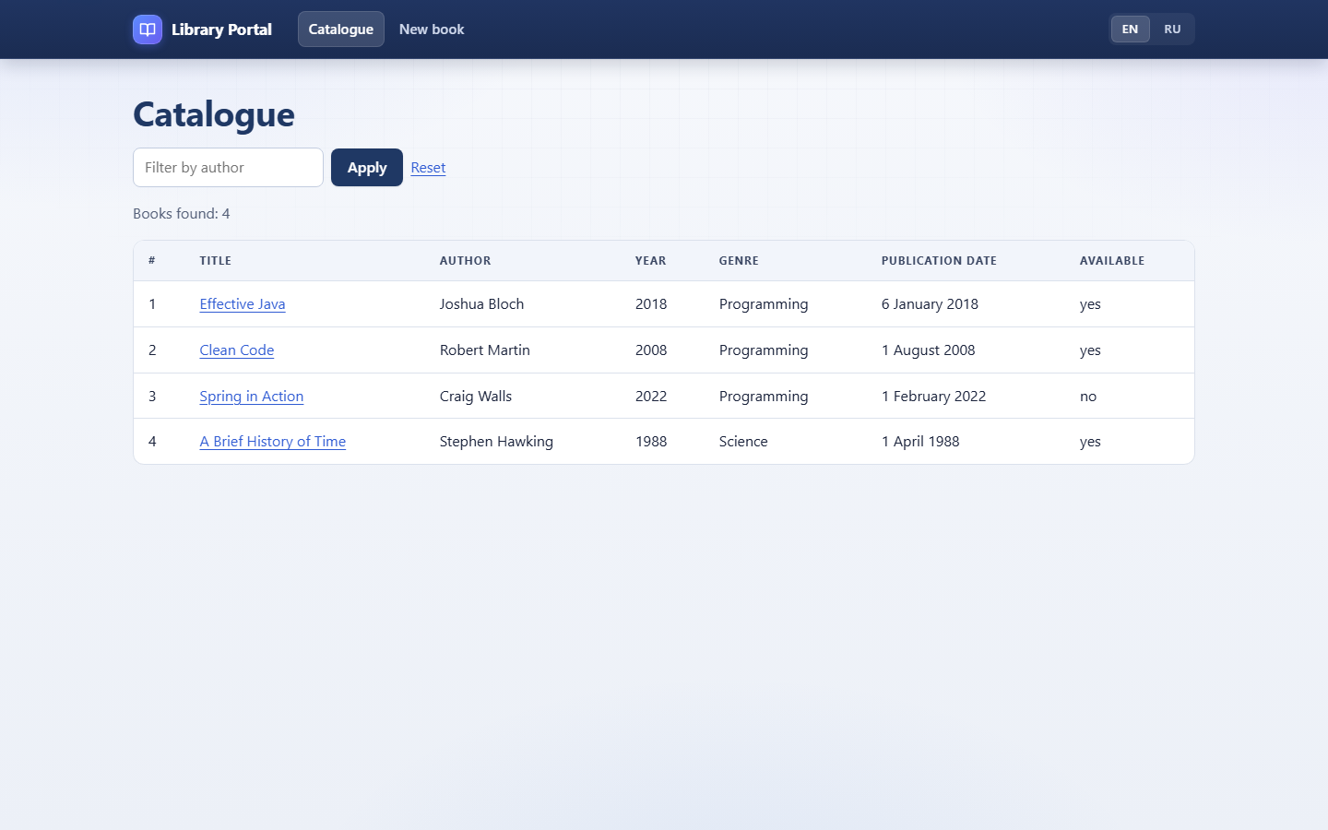
The application: web interface
Start page — one card per laboratory work (static/index.html, Lab 5)
Catalogue — Thymeleaf page with a filter by author (Labs 5–6)
Shown live in the demonstration: start page → catalogue → book details → form → Swagger UI
Library Portal · RWPSF 3305 · Kuat Bektursyn
12
Notes:
These are screenshots of the running application. On the left, the start page: a card for every laboratory work with links to its endpoints; the page itself is a static resource from lab 5, served without a controller. On the right, the catalogue — a Thymeleaf page from labs 5 and 6 with a filter by author; every title opens the book's details. The interface is responsive and switches between English and Russian.

Slide 13
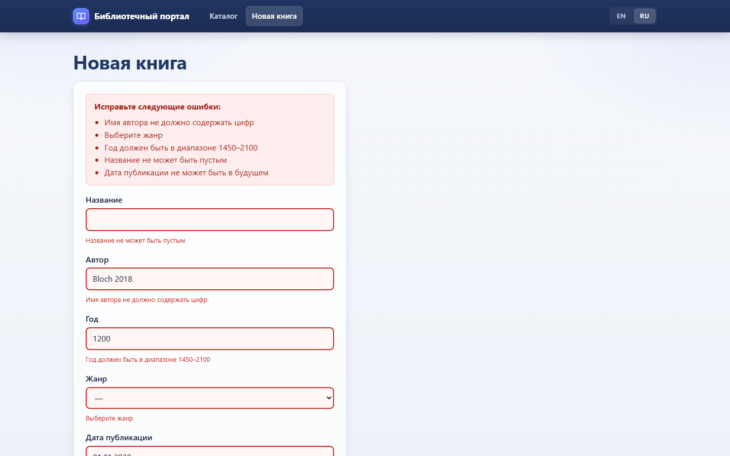
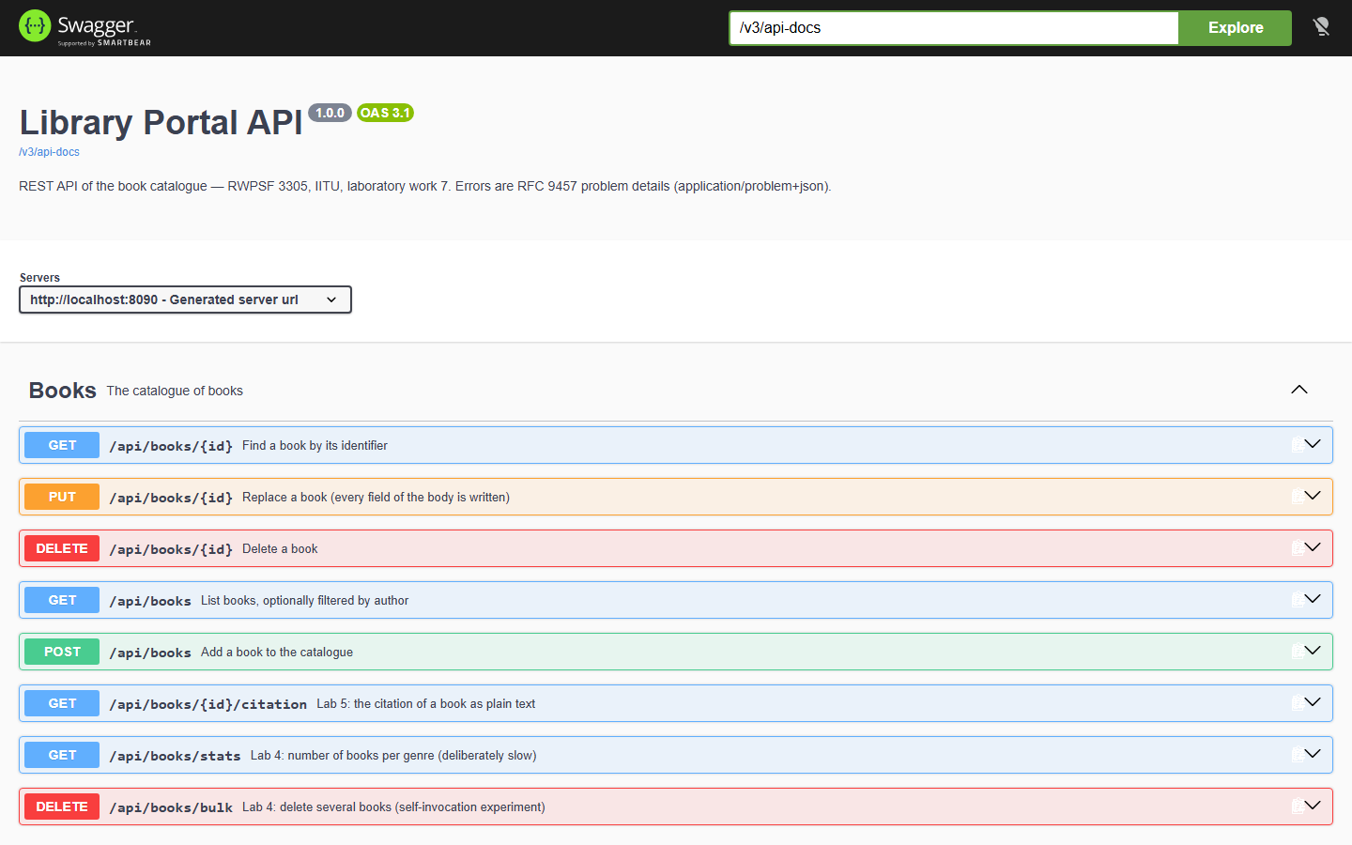
The application: validation and API docs
Form in Russian: all validation errors at once (Lab 6, variant 7 date)
Swagger UI: every operation of /api/books documented (Lab 7)
Generated, not hand-written: paths, methods and DTO schemas come from the code; annotations add summaries
Library Portal · RWPSF 3305 · Kuat Bektursyn
13
Notes:
On the left, the new-book form in Russian after an invalid submission: every error is listed at once and each field is marked — an empty title, an author with digits rejected by my own NoDigits constraint, a year out of range, no genre, and a publication date in the future, which is my lab 6 variant 7. On the right, Swagger UI generated by springdoc from the code: every operation of /api/books with its summary. Requests can be executed from this page directly, which is how I show lab 7 live.

Slide 14
Not side by side, but together: how labs connect
2 → 5
3 → 2
3 → 5
New book notifications
Mail depends on the profile
Citation cache from app.cache
BookService.create() calls the @Primary EmailNotifier
dev: mail disabled · prod: retry-count = 5
1 min / 100 entries, under dev — 30 s / 50
4 → all
6 ↔ 7
4 + 6
Every operation is wrapped
Shared rules: API and form
Client error is 400
Audit · Log · Time · Trace on the whole service layer
Lab 6 constraints validate the JSON; the 409 rule shows as a form error
delete(0): @AfterThrowing, audit failure, ProblemDetail
Library Portal · RWPSF 3305 · Kuat Bektursyn
14
Notes:
The main difference between the final project and a set of labs is the connections. Configuration controls notifications and the cache. Aspects wrap every catalogue operation. Validation from lab 6 also protects the REST API, and the IllegalArgumentException from lab 4 now becomes 400 instead of 500.

Slide 15
Every experiment is an automated test
32 / 32
./mvnw test → BUILD SUCCESS
200 / 201 / 204 / 400 / 404 / 405 / 406 / 415
form errors in EN and RU, flash + redirect
CGLIB proxy and self-invocation: 0 vs 2 records
dev profile: port 8081, ttl PT30S
201 + Location, 404/409 problem details, HAL, OpenAPI
Library Portal · RWPSF 3305 · Kuat Bektursyn
15
Notes:
So that the defence does not depend on screenshots, every experiment from the reports is written as a MockMvc integration test. There are 32 of them, 14 for lab 7 alone: they check status codes, validation errors, Russian messages, the proxy, self-invocation and the dev profile. One command, mvnw test, and everything is green.

Slide 16
Demonstration script
1
./mvnw test
32 tests are green
2
./mvnw spring-boot:run → /
start page: links for every lab
3
/books/new?lang=ru → «Сохранить»
all validation errors in Russian
4
Valid form → F5
redirect + flash, no duplicate; [AUDIT] and EMAIL in the log
5
DELETE /api/books/bulk?ids=1,2&viaProxy=false|true
/api/system/audit: 0 and 2 records
6
books.http: POST → POST again → DELETE ×2
201 + Location, 409, 204, 404
7
/swagger-ui.html → GET /api/books/999
404 problem detail inside Swagger UI
8
/books/999 and /api/books/1
HTML 404 page vs HAL with _links
9
-Dspring-boot.run.profiles=dev → /api/config
port 8081, PT30S, DEVELOPMENT
Library Portal · RWPSF 3305 · Kuat Bektursyn
16
Notes:
The demonstration takes about five minutes. First the tests, then the start page with a card for each lab, the Russian form with errors, adding a book correctly and the aspect log in the console, the self-invocation experiment, the lab 7 requests from books.http and Swagger UI, two different 404 responses and a restart with the dev profile.

Slide 17
Key defence questions
Why constructor injection?
Why 201 and a Location header?
final fields, the object is always complete, easy to test
a new resource was created; Location names its URI
Profile file or --argument?
When 409 and not 400?
the command-line argument: a profile is just a PropertySource
the request is valid but conflicts with the current state
Why is self-invocation not advised?
What do 405 / 415 / 406 mean?
this.method() skips the proxy → use a self reference
wrong method / body media type / response media type
Why a separate BookForm?
BindingResult not right after the form?
protects from mass assignment, keeps the user input
an exception and 400 instead of the form with errors
Library Portal · RWPSF 3305 · Kuat Bektursyn
17
Notes:
These are the most frequent questions across all labs. The full list with answers is in docs/DEFENSE.md.

Slide 18
Summary
1
2
3
One application
Seven variants
32 tests
a library catalogue instead of seven separate demos
V7 · V8 · V7 · V8 · V6 · V7 · V7 — implemented and connected
every experiment from the reports is reproduced
Thank you for your attention! Questions are welcome.
github.com/AkAyu44/library-portal
Notes:
To sum up: seven laboratory works are combined into one working application where each topic is a layer of the system, the individual variants are implemented and connected to each other, and the experiments are verified by tests. Thank you for your attention, I am ready to answer your questions.

