Slide 1
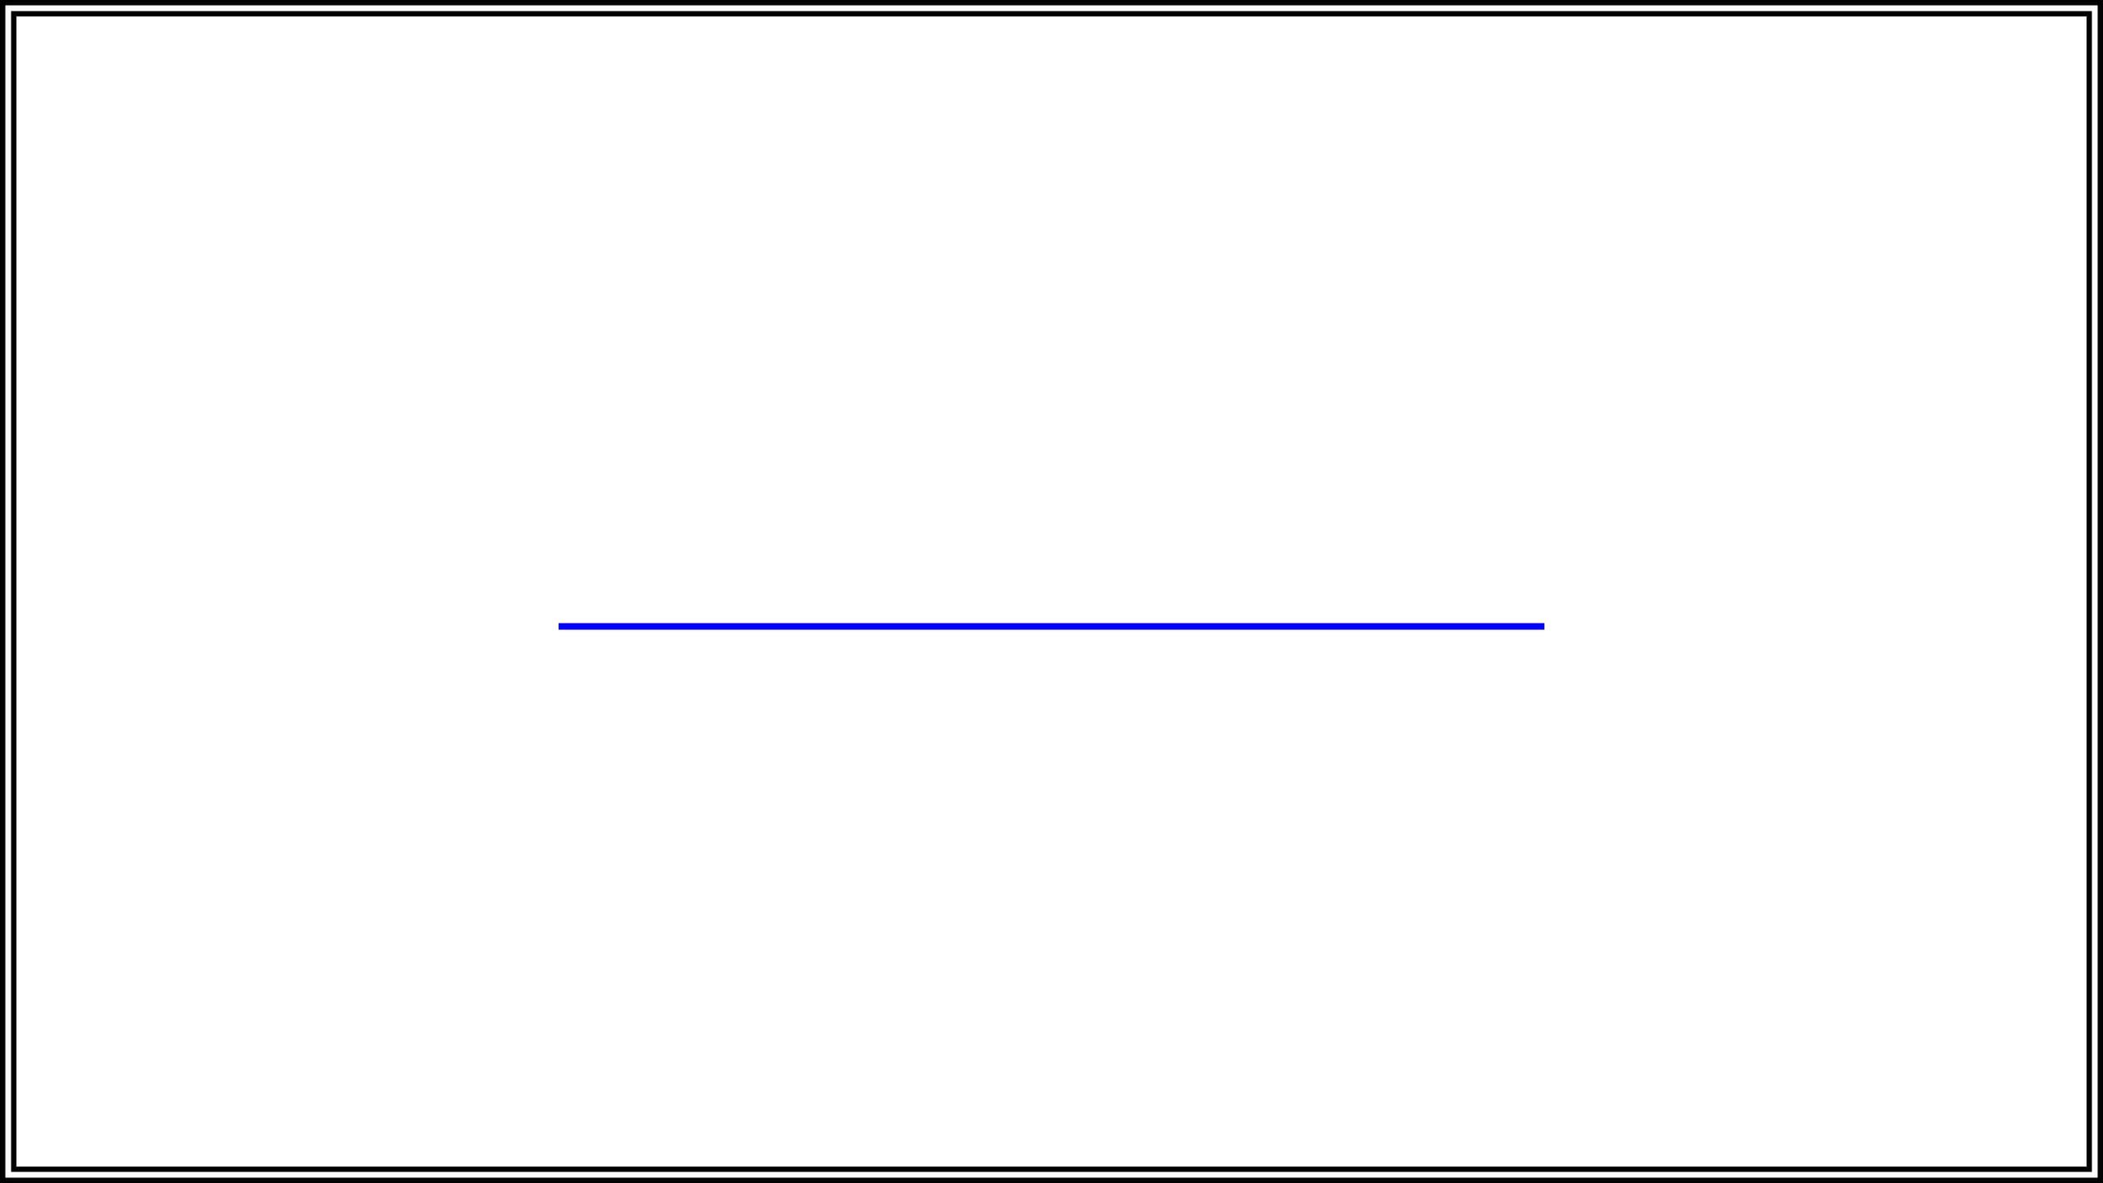
YouTube Prototype Project Documentation & Overview
A Comprehensive Technical Analysis and Roadmap
Presented by: Alexander Kwesi Sagoe

Slide 2

About the Presenter
I am Alexander Kwesi Sagoe, a dedicated professional committed to technical excellence and innovation in information technology.
Current Role: National Service Personnel
Department: College of Science IT Office
Focus: System administration, technical support, and prototype development.

Slide 3
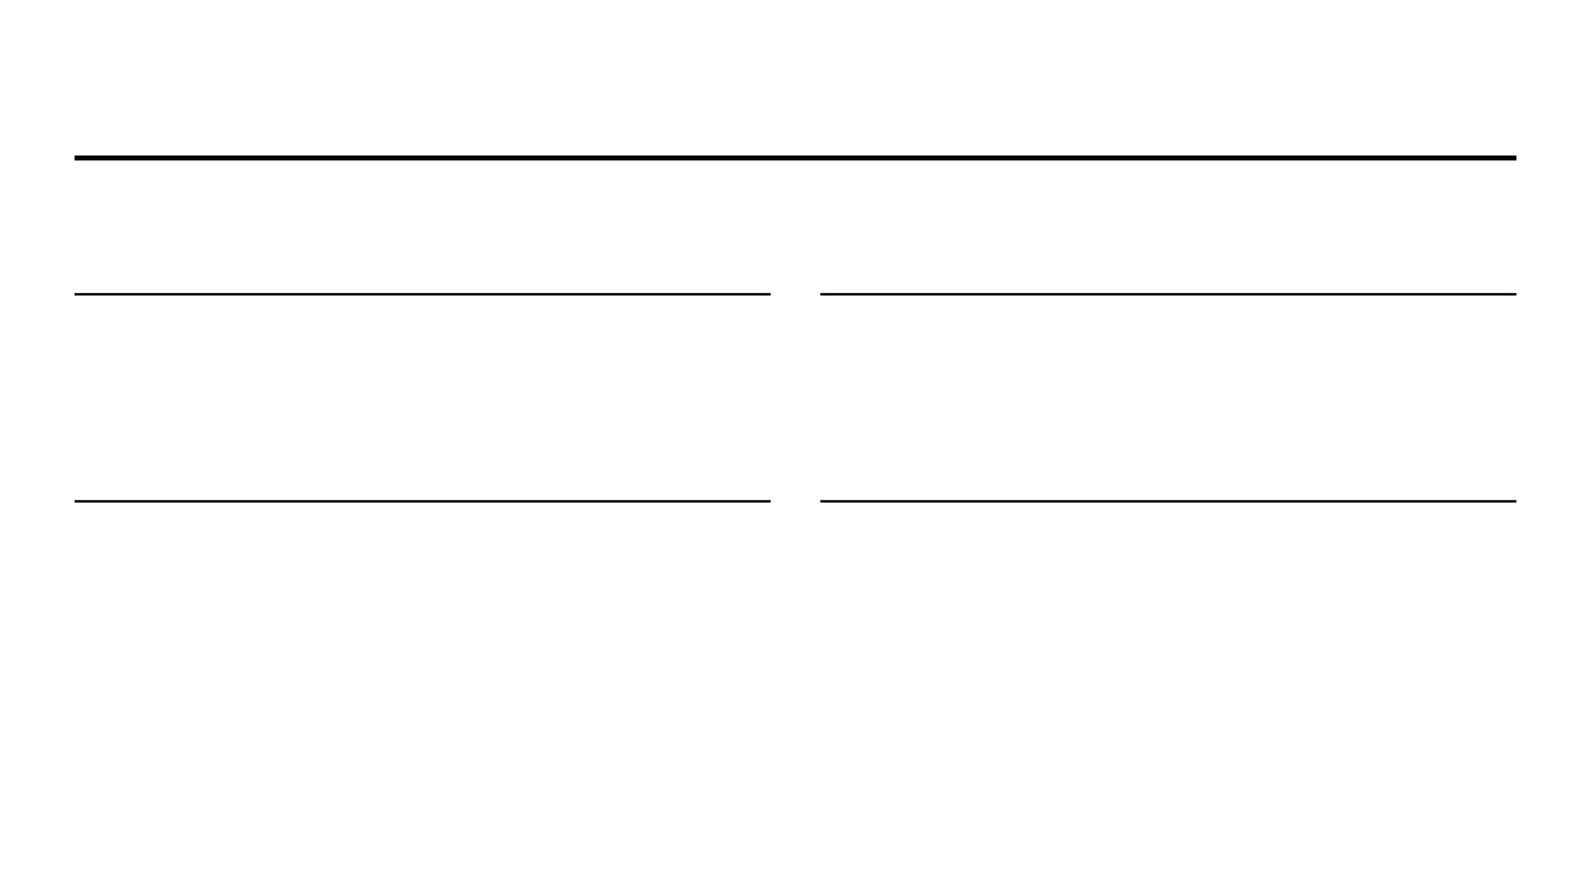
Original YouTube Platform
"To give everyone a voice and show them the world."
GLOBAL DISTRIBUTION
CONTENT DISCOVERY
Enabling users to upload and share video content with a worldwide audience instantly.
A sophisticated ecosystem for viewing, rating, and discovering diverse media content.
USER INTERACTION
MEDIA MANAGEMENT
Fostering community through comments, likes, and channel subscriptions.
Comprehensive tools for creators to organize content into playlists and channels.

Slide 4
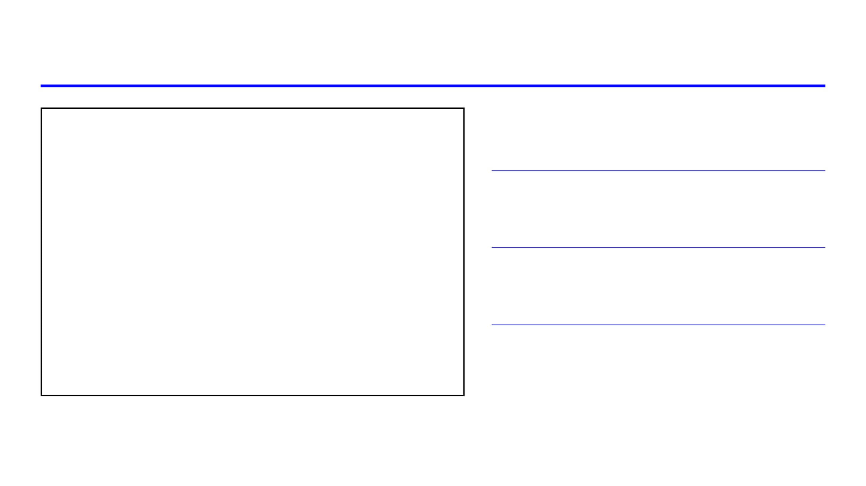
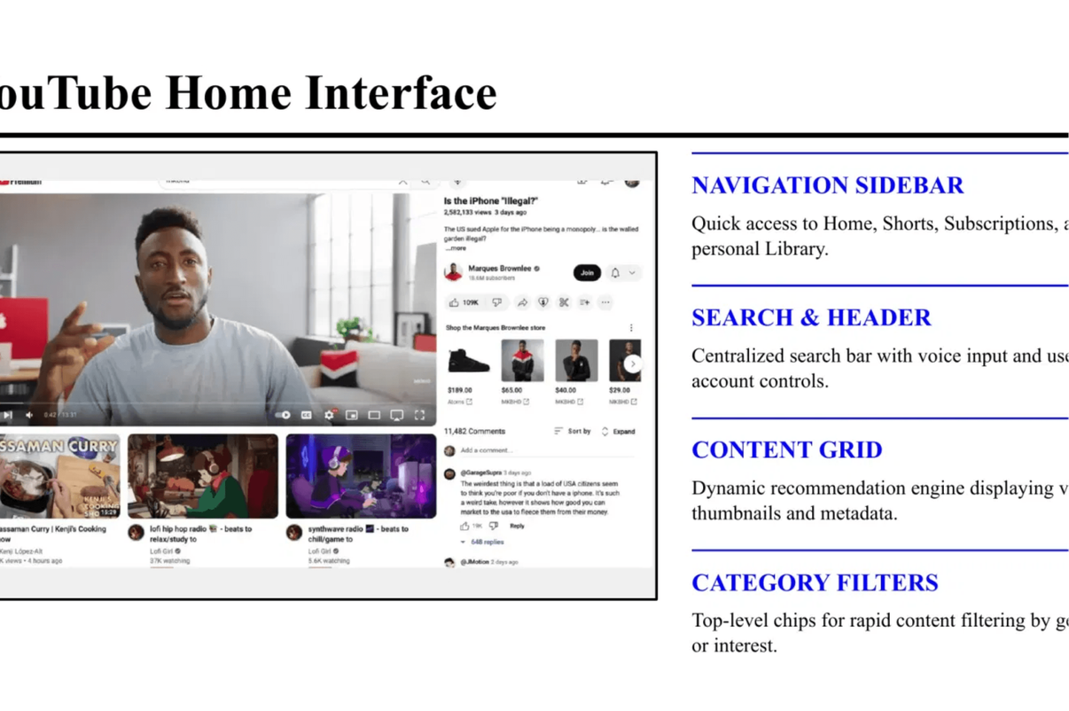
YouTube Home Interface
NAVIGATION SIDEBAR
Quick access to Home, Shorts, Subscriptions, and personal Library.
SEARCH & HEADER
Centralized search bar with voice input and user account controls.
CONTENT GRID
Dynamic recommendation engine displaying video thumbnails and metadata.
CATEGORY FILTERS
Top-level chips for rapid content filtering by genre or interest.

Slide 5
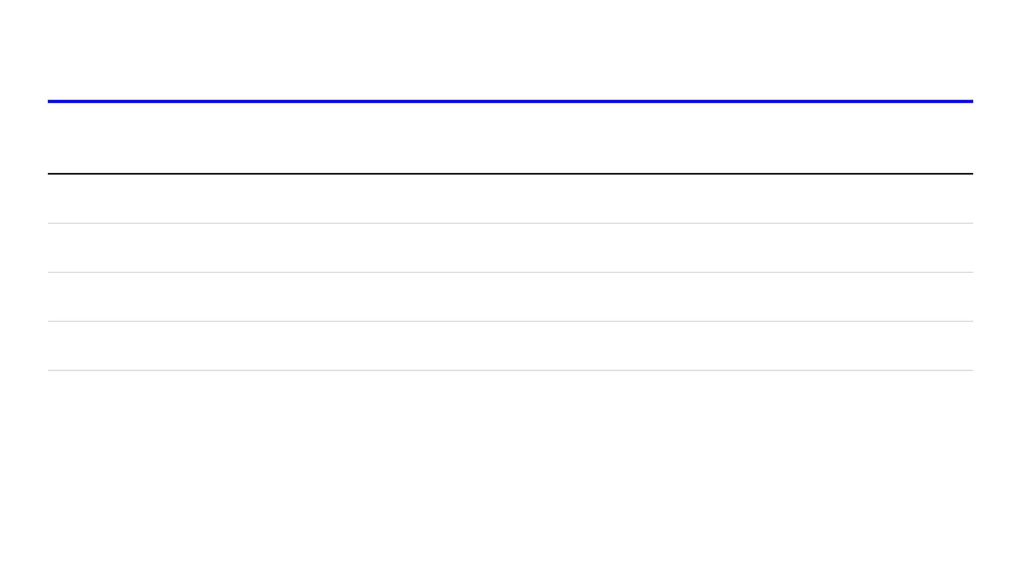
Project Timeline & Milestones
DATE / PERIOD
MILESTONE
DESCRIPTION & DELIVERABLES
April 23, 2026
Project Commencement
Initial project assignment and requirement gathering.
April 29, 2026
Documentation Deadline
Submission of comprehensive project documentation and schema design.
May 1 - May 24
Weekly Progress
Weekly updates and progress reporting on prototype development.
May 31, 2026
Final Completion
Final project wrap-up and submission of the functional prototype.
* Progress reports are required every week following the documentation submission to ensure timely completion by May 31st.

Slide 6
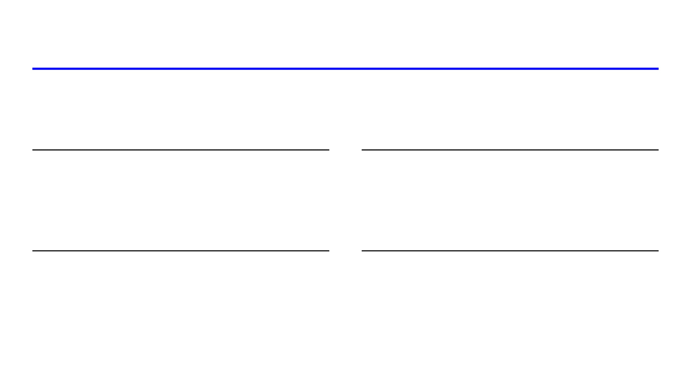
Prototype Introduction
Developing a functional prototype to demonstrate core modern video platform features, including user accounts, video uploads, and content discovery.
FUNCTIONAL PROTOTYPE
TECHNICAL FOUNDATION
Demonstrating essential features of a modern video-sharing platform.
Understanding the complexities of building scalable media-sharing applications.
USER INTERACTION
SCALABLE DESIGN
Fostering engagement through features like comments, likes, and subscriptions.
Establishing a robust architecture for future platform enhancements and growth.

Slide 7
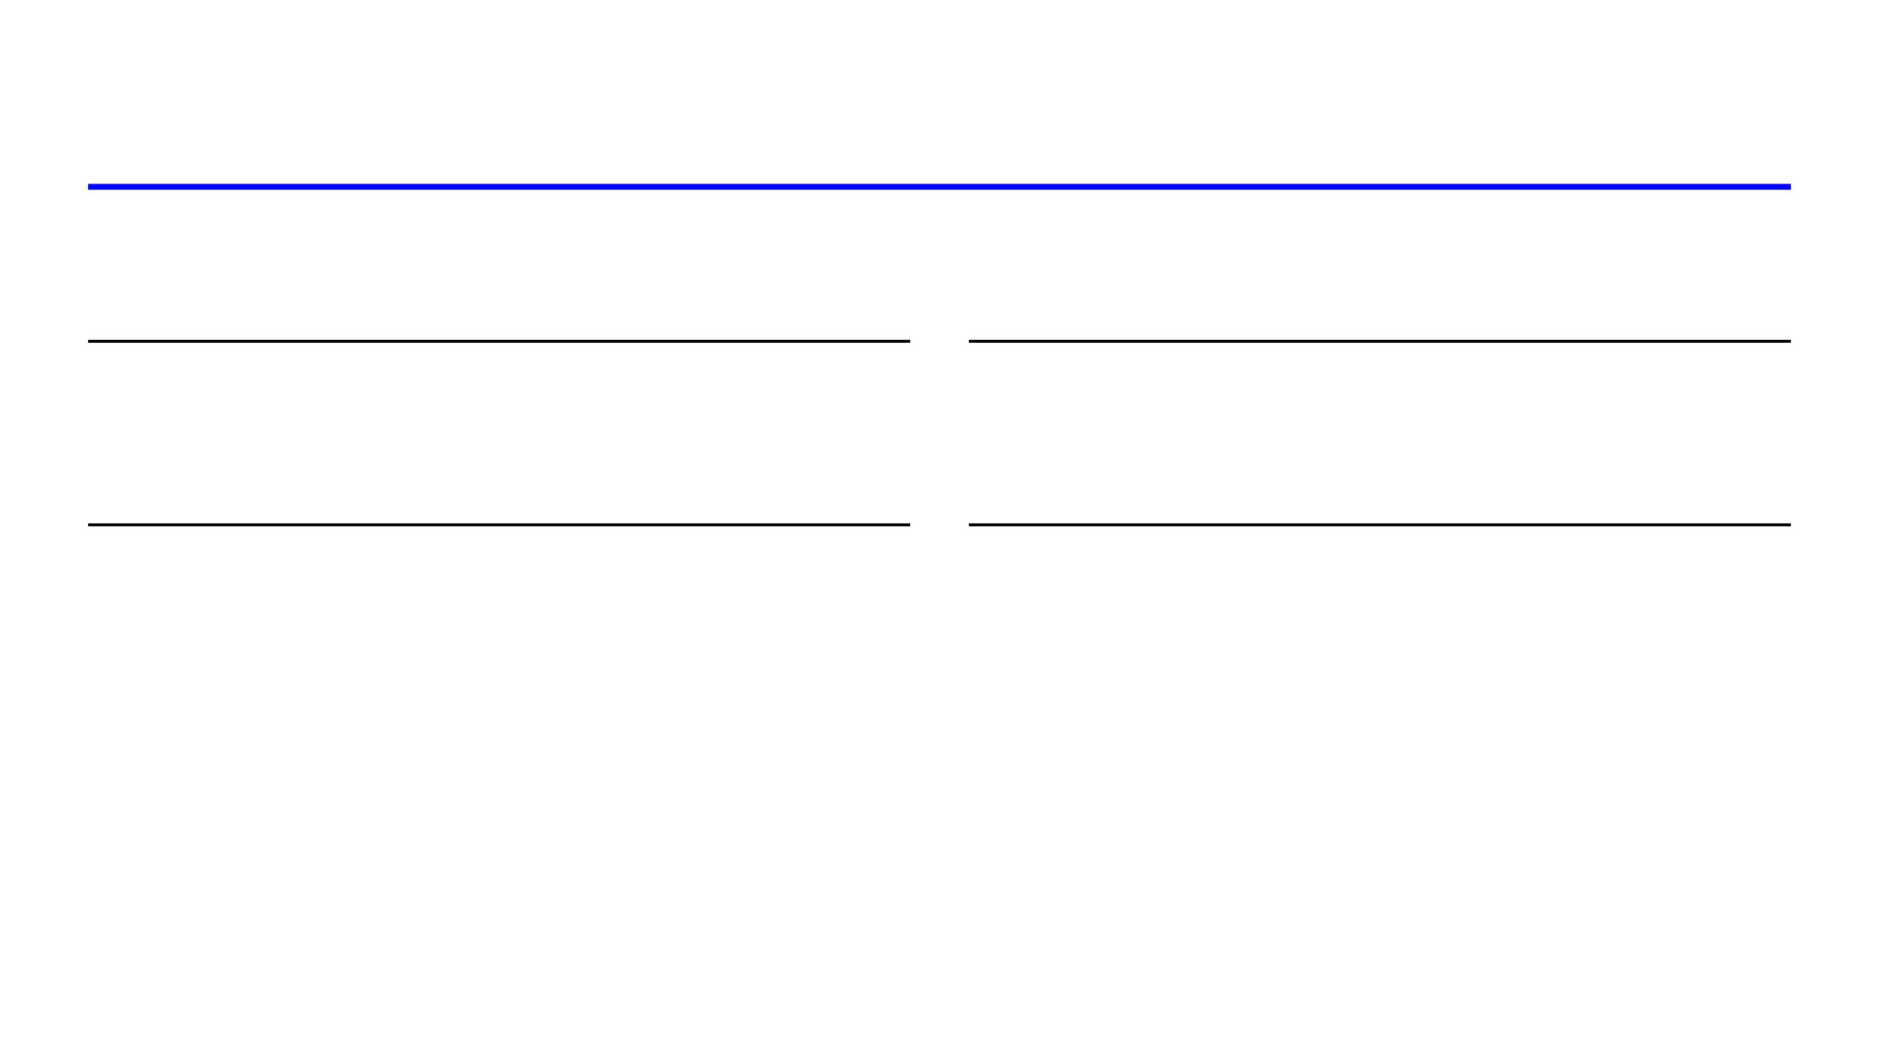
Prototype App Purpose
"Demonstrate core modern video platform features as a foundation for scalable media sharing."
CREATOR EMPOWERMENT
USER ENGAGEMENT
Easy upload and global distribution tools for creators.
Interactive features to increase community participation.
CONTENT DISCOVERY
TECHNICAL INSIGHT
Efficient search and categories for effortless browsing.
Learnings on high-performance media architecture and design.

Slide 8
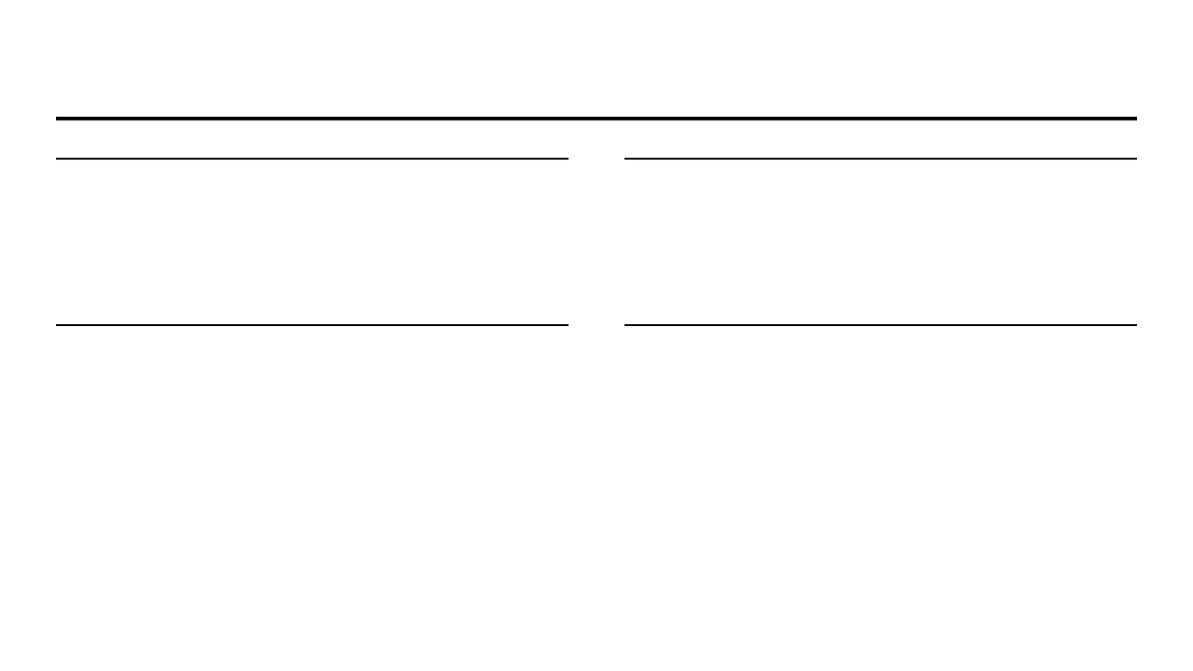
Core Features
ACCOUNTS & CHANNELS
VIDEO MANAGEMENT
Identity Management: Secure registration, login, and profile customization. Every user receives a dedicated channel for content.
Lifecycle Tracking: Metadata handling (titles, tags) and real-time status updates for processing, ready, or failed states.
ENGAGEMENT
DISCOVERY
Social Interaction: Subscriptions for channel updates, like/dislike feedback, and threaded commenting systems.
Content Access: Keyword-based search engine and categorical organization for efficient media browsing.

Slide 9
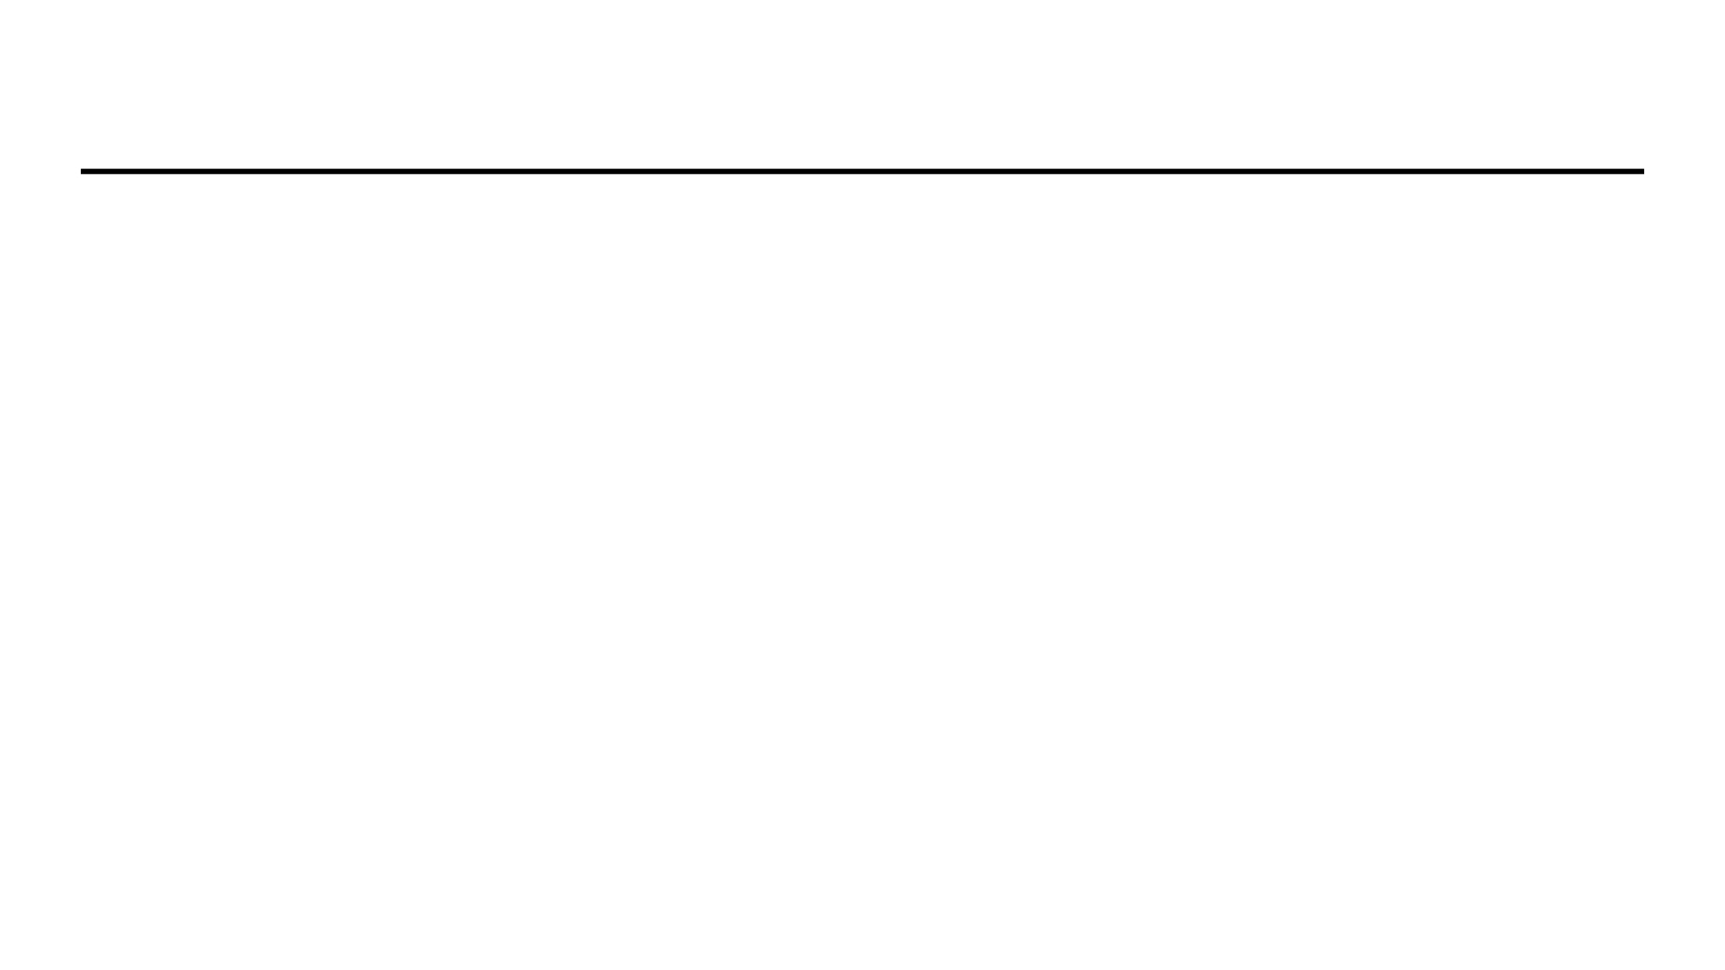
Tech Stack
BACKEND
Python & FastAPI
High-performance asynchronous framework for efficient API and metadata handling.
DATABASE
PostgreSQL
Reliable relational database for managing complex entity relationships and data integrity.
STORAGE
AWS S3
Scalable object storage solution for high-volume video and thumbnail data.
FRONTEND
React & Tailwind CSS
Modern component-based architecture for building a responsive and dynamic user interface.

Slide 10
Database Schema Overview
A PostgreSQL design prioritizing data integrity, scalability, and efficient querying for core platform functionalities.
RELATIONAL INTEGRITY
Strict enforcement of Primary and Foreign Key constraints to ensure consistent data across all tables.
SCALABLE ARCHITECTURE
Optimized schema design to handle complex relationships between users, videos, and social interactions.
CORE ENTITIES: USERS | VIDEOS | COMMENTS | REACTIONS | SUBSCRIPTIONS | CATEGORIES

Slide 11
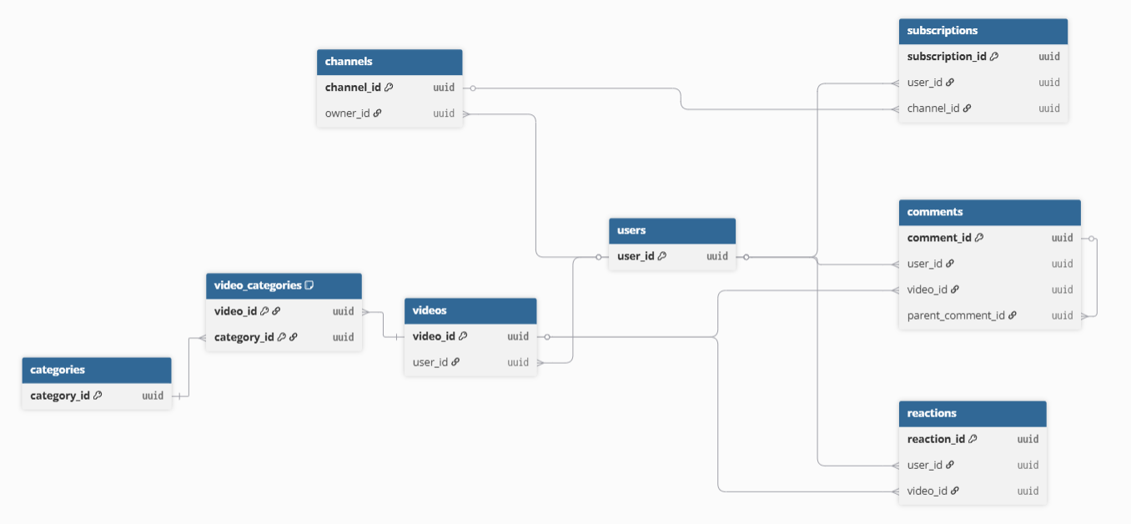
Entity-Relationship Diagram
The following diagram illustrates the relational structure of the YouTube prototype database, highlighting primary keys (PK), foreign keys (FK), and the cardinality of relationships between entities.

Slide 12
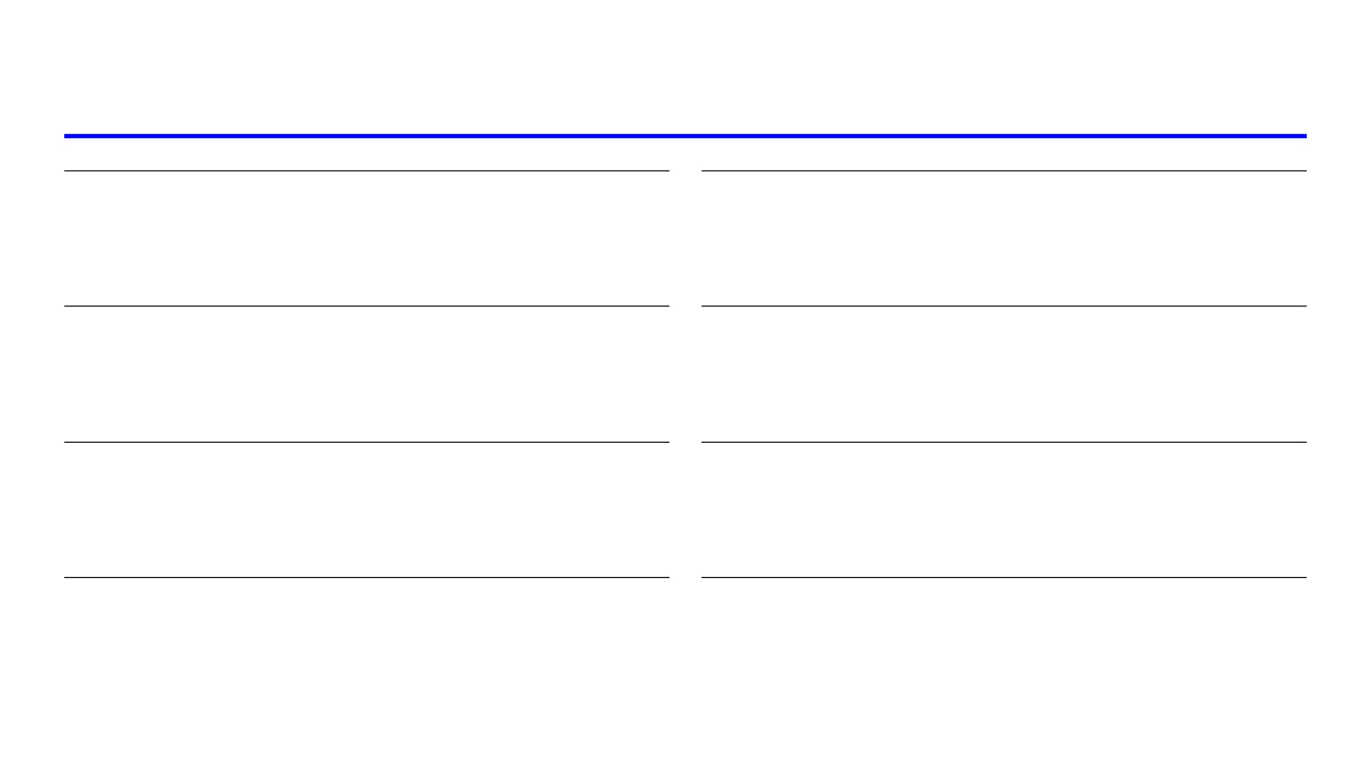
Relationship Summary
USERS TO VIDEOS
USERS TO COMMENTS
One-to-Many:
A user can upload multiple videos. The
user_id
in VIDEOS links
One-to-Many:
A user can post multiple comments. The
user_id
in COMMENTS
each video to its uploader.
identifies the author.
USERS TO REACTIONS
USERS TO SUBSCRIPTIONS
One-to-Many:
Users give multiple reactions;
user_id
in REACTIONS associates
One-to-Many:
Users subscribe to many channels;
subscriber_id
and
feedback with the user.
channel_id
manage these links.
VIDEOS TO CATEGORIES
VIDEOS TO COMMENTS
One-to-Many:
Videos map to multiple categories via the
VIDEO_CATEGORIES
One-to-Many:
A video can have many comments;
video_id
in COMMENTS links
junction table.
them to the video.
VIDEOS TO REACTIONS
COMMENTS TO COMMENTS
One-to-Many:
Videos receive many reactions;
video_id
in REACTIONS connects
Self-Referencing:
Comments can have replies;
parent_comment_id
references
feedback to the video.
another
comment_id
.

Slide 13
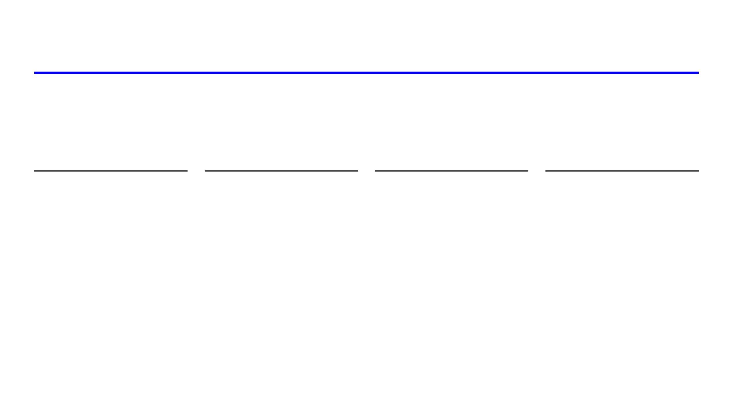
Conclusion
The YouTube prototype documentation establishes a scalable and robust technical foundation for modern video-sharing applications.
SCALABILITY
INTEGRITY
FUTURE POTENTIAL
READINESS
The architecture is designed to handle growing volumes of media data and user interactions seamlessly.
A structured relational database approach ensures consistent data across all platform entities.
The modular design allows for the integration of advanced features like AI-driven content recommendations.
This documentation serves as a clear and actionable roadmap for the development of a functional prototype.

